Slide 1
Tribal Capacity
GAP Statewide Monthly Webinar
June 17, 2026

Slide 2
Agenda
Welcome
ANTHC Updates
  Fred Dahl, Project Manager II, ANTHC Tribal Capacity program
EPA Updates
  Tia Allen, EPA Tribal Coordinator/Project Officer
Budget revisions/Change request forms
  What you will need
  Change Request Forms
  Budget revisions
  SF424A update
Open Discussion / Questions
Next GAP Statewide Call:
  August 19, 2026,

Slide 3
ANTHC UPDATES
Fred Dahl
Project Manager II
Tribal Capacity Program
fbdahl@anthc.org

Slide 4

Upcoming Trainings

Slide 5
EPA Updates
Tia Allen
Tribal Coordinator, Tribal Consultation Specialist
Tribal Trust and Assistance Division, U.S. Environmental Protection Agency

Slide 6
What you will need
Budget revisions/Change requests
Copy of the current approved budget
A copy of your EPA Compass report
Copy of current EPA GAP agreement
Copy of most recently submitted SF424a
Blank SF424a form

Slide 7
Important note
Less than 10% of total award does not require a formal amendment
Greater than 10% of total award amount requires a formal amendment

Slide 8
Change Request Form
To complete this form, you will need the following:
Approval from Tribe to make the change request
EPA approved final budget
EPA Compass report
List of prices and/or quotes for any purchases being requested
Notes:
Pull up the blank copy of the form

Slide 9
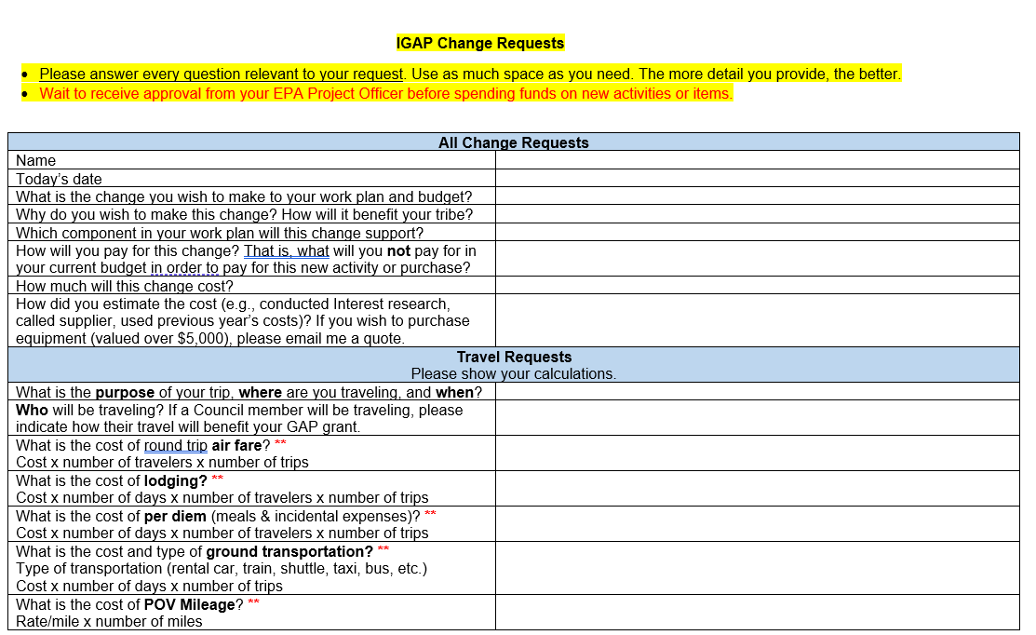
Change Request Form
Notes:
This is the Change Request form. This is the easiest way I have found to request changes to workplan and/or budget

Slide 10
Change Request Form Scenario 1
Permission from Tribal Administrator and/or Council for the change
Review costs for updated travel
GSA per diem rates
Notes:
Pull up approved budget-show how the TLES needs to be reallocated, pull up completed change request from and show how it is completed, navigate to the per diem website

Slide 11
Revised budget Scenario 1
Permission from Tribal Administrator and/or Council for the change
Change request approval from your EPA project officer
Notes:
Pull up approved budget-show how to revise it for the Tribes records

Slide 12

Questions

Slide 13
Change Request Form Scenario 2
Permission from Tribal Administrator and/or Council for the change
Review costs for new equipment
Gather quotes
Notes:
Pull up approved budget- explain the Tribe did not have a GAP employee for the first four months

Slide 14
Revised budget Scenario 2
Permission from Tribal Administrator and/or Council for the change
Change request approval from your EPA project officer
Notes:
Pull up approved budget-show how to revise it for the Tribes records

Slide 15
Questions

Slide 16
SF 424A
BUDGET INFORMATION - Non-Construction Programs
Will need your EPA Approved Final budget
Copy of the current EPA GAP grant agreement

Slide 17
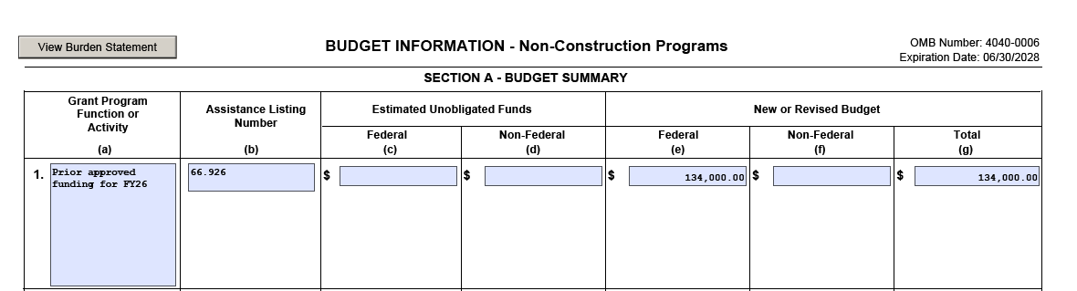
SF424A Budget Information
Non-construction Programs (Page 1) for first year applicants
Line1
Line 1A: First year applicants will put “Prior approved funding for FY2026”
Line 1B: Enter 66.926 for the Catalog of Federal Domestic Assistance Number
Line 1C & D: leave blank
Line 1E: Enter the approved budget total

Slide 18
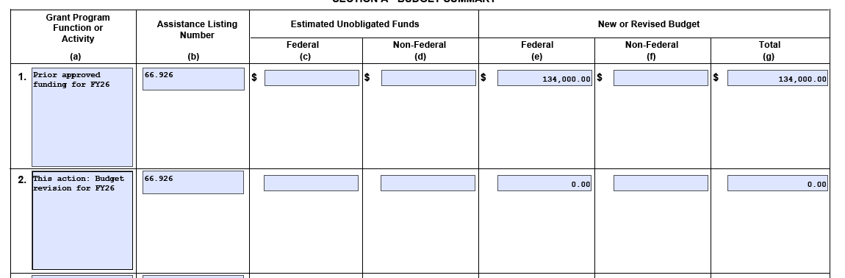
SF424A Budget Information
Non-construction Programs (Page 1) for first year applicants
Line 2
Line 2A: First year applicants will put “This action: Budget revisions for FY2026”
Line 2B: Enter 66.926 for the Catalog of Federal Domestic Assistance Number
Line 2 C & D: leave blank
Line 2E: Enter “$0”
  The EPA is not changing the award amount

Slide 19
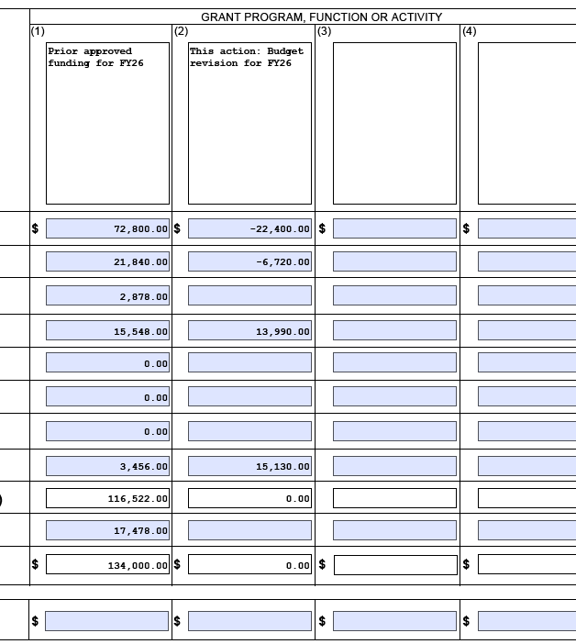
SF424A Budget Information
Non-construction Programs (Page 1A) for 1st year applicants
Row 1:
You will need the budget categories from the most current EPA GAP agreement. Page 2
Row 2:
Complete this by using the Approved Change Request and approved revised budget
Notes:
For this form in row 2, you will use the minus symbal to show where you are removing the funds.

Slide 20
Questions

Slide 21
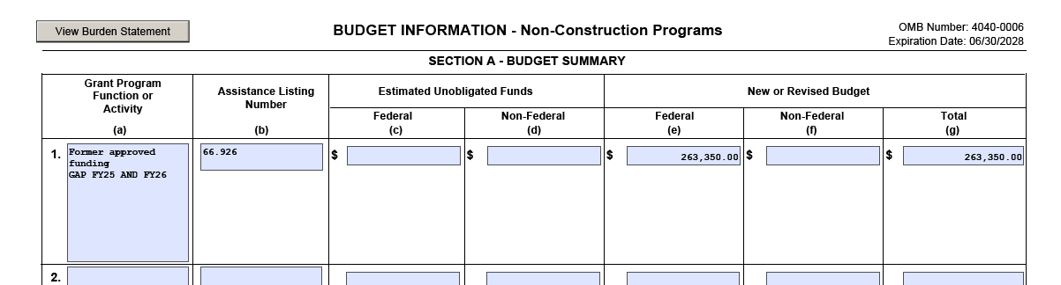
SF424A Budget Information
Non-construction Programs (Page 1) for 2nd – 4th year applicants
Line1
Line 1A: Enter “ Former approved funding” and the fiscal years
Line 1B: Enter 66.926 for the Catalog of Federal Domestic Assistance Number
Line 1C & D: leave blank
Line 1E: Enter the approved budget total from the most current GAP agreement on Page 2.

Slide 22
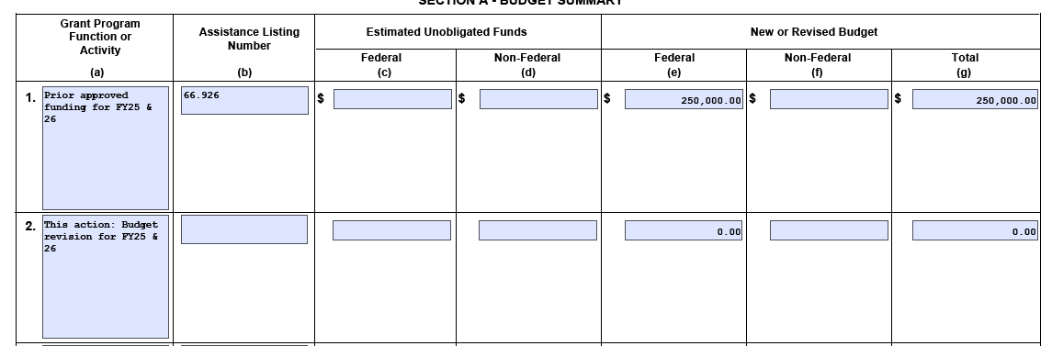
SF424A Budget Information
Non-construction Programs (Page 1) for 2nd – 4th year applicants
Line1
Line 2A: Enter “This action: Budget revision for” and the fiscal years
Line 2B: Enter 66.926 for the Catalog of Federal Domestic Assistance Number
Line 2C & D: leave blank
Line 2E: Enter “$0”
  The EPA is not changing the award amount

Slide 23
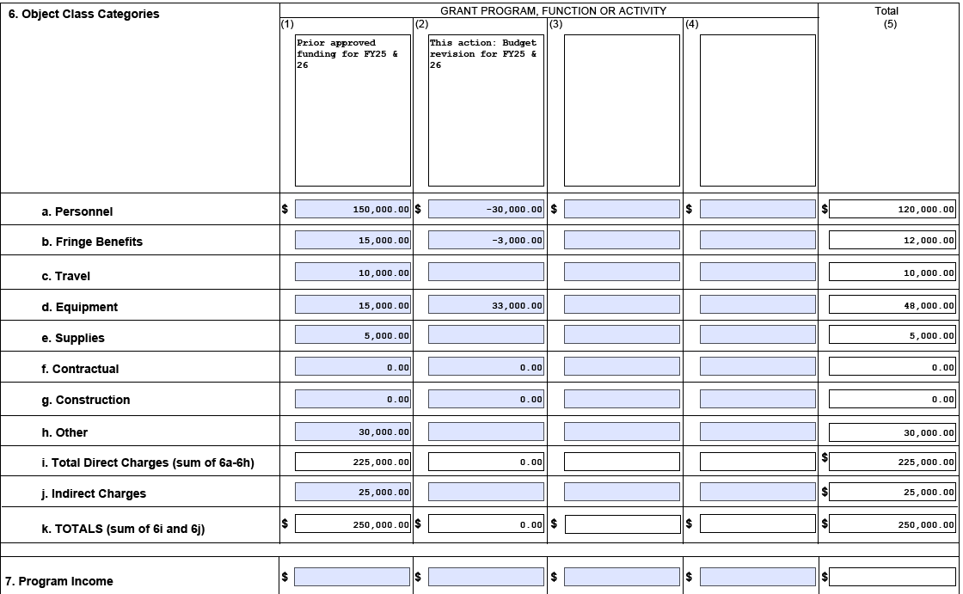
SF424A Budget Information
Non-construction Programs (Page 1A) for 2nd – 4th year applicants
Row 1:
You will need the budget categories from the most current EPA GAP agreement. Page 2
Row 2:
Complete this by using the Approved Change Request and approved revised budget
Notes:
For this form in row 2, you will use the minus symbal to show where you are removing the funds.

Slide 24
Trivia Time
Notes:
When is a change request required? Anytime a change in work or budget is needed
Who do you submit your change request form too? EPA project Officer
What is the EPA Compass report?
True or false, a budget revision of over 10% of the total award amount, does not require a formal amendment? False True or false, the SF424A form is only for formal amendments? Answer True
True or false, you submit the Change request prior to getting permission from your Tribes leadership? False

Slide 25
Open Discussion/Questions

Slide 26

Tribal Capacity Team

Slide 27
How can ANTHC better support our Tribal Partners?
You can contact the Tribal Capacity program with suggestions at: tribalcapacitytraining@anthc.org

