Slide 1
Cyber Awareness Training for Employees
Updated: January 2025

Slide 2
Disclaimer:
Sterling Seacrest Pritchard’s cyber guidance is offered for educational and informational purposes only. This information is not legal advice, does not replace independent professional judgment, does not constitute an endorsement of any kind, should not be deemed authoritative, and does not establish a standard of care in a clinical or information technology setting, or in courts of law. Before utilizing this information, you are encouraged to consult with your independent/corporate counsel at your own expense. We do not make any guarantees, express or implied, that following this guidance will prevent a cyber-attack and/or related complaint, claim, or suit from occurring, or mitigate the outcome(s) associated with any of them.
Any information provided by Sterling Seacrest Pritchard (“SSP”) in this presentation is the property of SSP. If you download, record, and/or otherwise utilize the information in this presentation, you agree not to display, distribute, license, publish, reproduce, duplicate, copy, create derivative works from, modify, sell, resell, transfer, or upload for any commercial purposes, all or any portion of these materials for any purpose, unless explicitly authorized by SSP.

Slide 3
Purpose
75% of Cyber Attacks are caused by some type of Phishing
The easiest way for bad actors to get into a system is through phishing. This training will help employees understand the risks and how they can help stop bad actors from gaining access.
Cyber Attacks are a growing concern for all types and sizes of Healthcare Practices
It takes all employees of a practice to be aware and help their physicians keep the risk low.
Medical Records Risk
Risks for medical practices go beyond losing financial and proprietary data, it can also impact medical records. If medical records are impacted, then the practice can be subject to OIG Review, Fines and Penalties as well as costs to notify every patient.
Special Note: Pediatric records are more valuable for bad actors because it could be years before it is noticed their info was used.

Slide 4
Definitions
Phishing: Fake email.
A technique for attempting to acquire sensitive data, such as bank account numbers, through a fraudulent solicitation in email or on a web site, in which the perpetrator masquerades as a legitimate business or reputable person
Spear Phishing: Same as phishing, except with a specific target.
A type of phishing campaign that targets a specific person or group and often will include information known to be of interest to the target, such as current events or financial documents.
Whaling: Phishing targeting high value targets.
A whale phishing or whaling attack is a spear phishing attack that is aimed exclusively at a high-level executive or official. The attacker typically impersonates a peer within the target’s organization, or an equal or higher-level colleague or associate from another organization.

Slide 5
Definitions
Smishing: combination of “SMS” and “phishing;” social engineering texts.
Smishing is a social engineering attack that uses fake mobile text messages to trick people into downloading malware, sharing sensitive information or sending money to cybercriminals.
Vishing: Voice phishing; scam social engineering phone calls.
Short for “voice phishing,” refers to fraudulent phone calls or voice messages designed to trick victims into providing sensitive information, like login credentials, credit card numbers, or bank details.
Angler Phishing: Uses fake social media accounts.
Angler phishing involves using social media to trick people into giving up sensitive information or downloading malware.
Artificial Intelligence: The above on steroids.
An AI phishing attack leverages artificial intelligence to make the phishing emails more convincing and personalized. A bad actor could use AI algorithms to analyze vast amounts of data on a target segment, such as social media profiles, online behavior, and publicly available information which allows them to create personalized campaigns.

Slide 6
Definition Citations
(https://csrc.nist.gov/glossary/term/phishing )
(https://www.dni.gov/files/NCSC/documents/campaign/Counterintelligence_Tips_Spearphishing.pdf )
(https://www.ibm.com/topics/whale-phishing#:~:text=A%20whale%20phishing%20or%20whaling,or%20associate%20from%20another%20organization. )
(https://www.ibm.com/topics/smishing )
(https://www.cisco.com/site/us/en/learn/topics/security/what-is-vishing.html )
(https://it.nc.gov/resources/online-safety-privacy/tips-guidance/phishing/common-phishing-attacks )
(https://www.mailgun.com/blog/email/ai-phishing/#:~:text=scammers%20and%20phishers.-,What%20is%20an%20AI%2Dpowered%20phishing%20attack%3F,emails%20more%20convincing%20and%20personalized. )

Slide 7
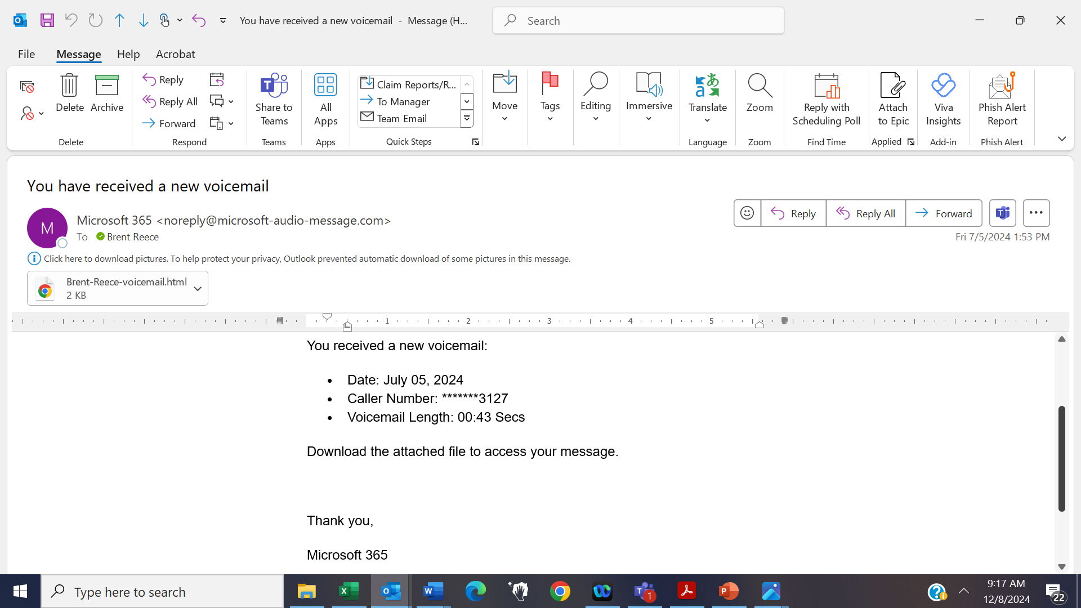

Phishing (example)
Asking you to click on a link is a clue this is fraudulent.

Slide 8
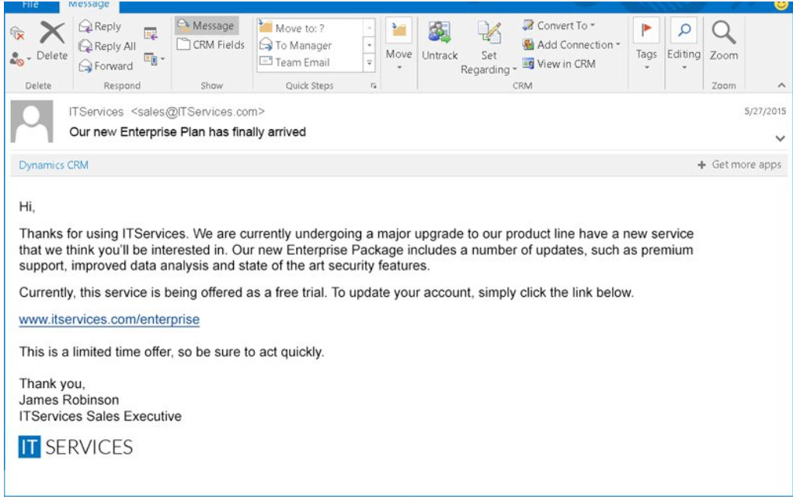

Spear Phishing (example)
Asking you to click on a link is your clue this is fraudulent.

Slide 9



Whaling (example)
Note the three “Ls” in the last name and the “s” at the end of “Co”.
Be aware when immediate action is required.

Slide 10
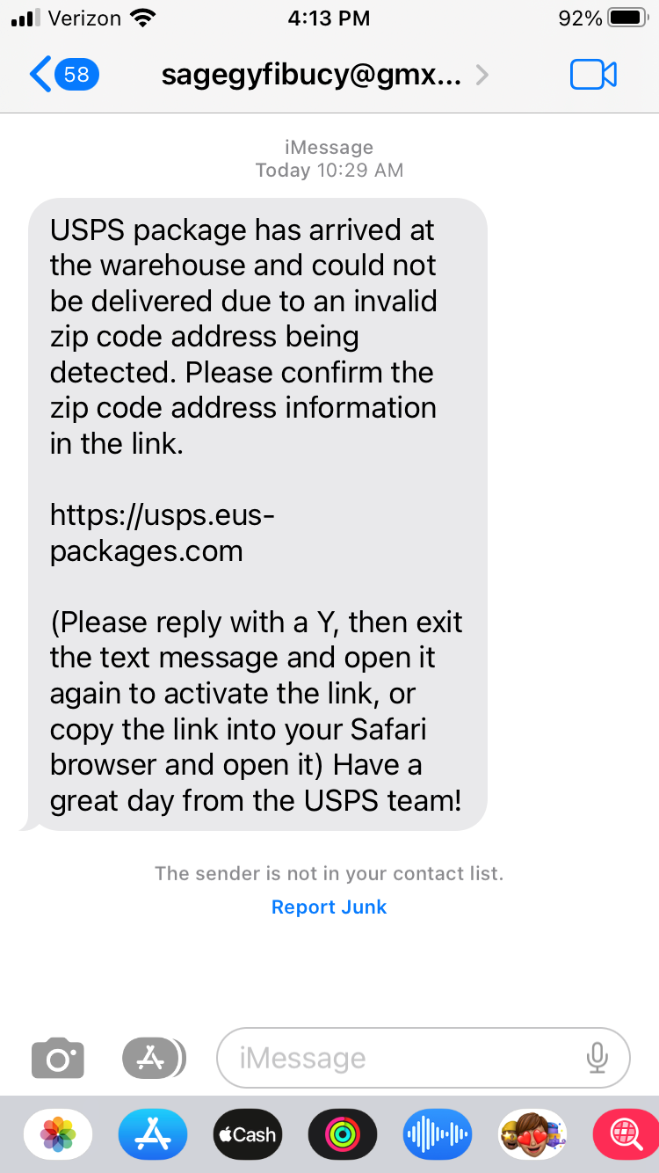

Smishing (example)
Always look closely at the sender; fraudulent texts are usually from an address unrelated to the company referenced in the text message.
The link in the text message is your clue this is fraudulent.

Slide 11



Vishing (example)
If it’s too good to be true, it probably is.
Immediate action required is your clue this is fraudulent.
Asking you to provide personal information over the phone and to send money are additional clues this is fraudulent.

Slide 12

Angler Vishing (example)
Once the target engages (i.e., is lured in by the reward), the cyber criminal attempt to get personal information from the victim.

Slide 13
Artificial Intelligence used with Vishing (example)

Slide 14
Steps to Take
1. If you receive a suspicious email, text, etc – alert your supervisor/manager or IT Company.
2. Never click on a link unless you are sure you know who sent it.
3. If you suspect a breach has happened – contact your Practice Administrator or Physician ASAP.

