Slide 1
Reducing Liability Risks: Best Practices for Termination of Care and Use of Chaperones
Brent Reece
Director of Risk Management and Claim Advocacy
Sterling Seacrest Pritchard
Becky Lowman
Senior Risk Consultant
Curi Insurance

Slide 2
Agenda
Best Practice for the Use of Chaperones
Best Practice for the Termination of Care
Questions and Answers

Slide 3
Best Practice for the Use of Chaperones

Slide 4
Rule 360-3-.02 Unprofessional Conduct Defined
(12) Conducting a physical examination of the breast and/or genitalia without a chaperone present, unless the patient or the patient's parent or guardian specifically requests that a chaperone not be present for this portion of the clinical encounter which shall be documented in the patient's medical record. Physicians at their discretion may refuse to conduct an examination of the breast and/or genitalia without a chaperone present. [NOTE: Previous rule only addressed such exams of the opposite sex]

Slide 5
Georgia CMB Guidelines on Chaperones
May 5, 2016 – “…the Board recommends that physicians aim to respect the patient’s dignity and to make a positive effort to secure a comfortable and considerate atmosphere for the patient; such actions include the provision of appropriate gowns, private facilities for undressing, sensitive use of draping, and clear explanations on various components of the physical examination. The physician should have a policy that patients are free to make a request for a chaperone. This policy should be communicated to patients, either by means of a well-displayed notice or preferably through a conversation initiated by the intake nurse or the physician. The request by a patient to have a chaperone should be honored. It is recommended that an authorized health professional should serve as a chaperone whenever possible. In their practices, physicians should establish clear expectations about respecting patient privacy and confidentiality to which chaperones must adhere. If a chaperone is to be provided, a separate opportunity for private conversation between the patient and the physician should be allowed.”

Slide 6
Frequently Asked Questions

Slide 7
Q: If a child refuses a chaperone, can we still complete the exam?
A: If the patient is 18 years of age or older, they can refuse a chaperone. If under 18, the parent holds the right of refusal but, ideally, you would like to honor the patient’s wishes too, especially if they are in their teens for example. If a chaperone is refused, document in the patient’s record who, specifically, refused a chaperone. If you are examining the genitalia, however, the “default” approach is to have a chaperone present unless/until the parent/patient requests that a chaperone not be present.

Slide 8
Q: Can the provider decline to perform an exam if the patient/parent refuses a chaperone?
A: The AAP supports the provider’s right to decline an exam when the patient/parent declines to have a chaperone present. The AMA Code of Ethics emphasizes honoring a patient’s request for a chaperone but also underscores the importance of minimizing risk and maintaining a professional environment—principles that support declining an exam if the provider feels it’s unsafe to proceed without one. If the provider believes conducting the exam without a chaperone exposes either party to risk, they can refuse to proceed and instead delay the exam, use an alternative clinician, or revisit with a chaperone present later.

Slide 9
Q: If a parent is already in the room, do we still need to offer a chaperone when doing an exam of the genitalia?
A: Yes. A parent cannot substitute for a chaperone. Remember, the chaperone is there to protect you too.
**From a liability standpoint, an undocumented chaperone offer = no chaperone offer.

Slide 10
Q: Do we need to document who the chaperone is or that one is (or is not) present?
A: Yes. For example, “Kathy Smith, MA chaperoned the examination of the patient” or “Kathy Smith, MA was present as a chaperone during my examination of the patient.”

Slide 11
Q: What are the qualifications for a chaperone?
A: According to the Board: “It is recommended that an authorized health professional should serve as a chaperone whenever possible.”

Slide 12
Q: At what patient age do we need a chaperone?
A: The GCMB rules do not specify a specific patient age when a chaperone should be present, thus arguably suggesting that one is required regardless of age.
According to an AAP Statement: “For infants and younger children, routine observation and palpation in the anogenital area will generally not require a chaperone; however, more invasive procedures may prompt consideration of the use of a chaperone, as should more than routine observation of sensitive areas in older children and adolescents. The adolescent patient may prefer a parent or caregiver to be present during a sensitive examination or procedure, and these requests can be respected in most circumstances, as they can provide comfort to an anxious child or adolescent. In addition to the family member’s presence, especially for patients who have started puberty, clinicians may consider including a chaperone who is a member of the health care team.” Vol. 155, Issue 6, June 2025

Slide 13
Barriers to Implementation

Slide 14
Staffing*
Limit chaperone to the actual time required for the sensitive parts of the examination rather than entire visit.
Designate a single staff member at the start of each clinic session to serve as chaperone when needed.
When no other options exist, the use of a specifically trained, nonmedical staff member or a family member, if specifically requested by the patient, as a chaperone may be acceptable, even though it may not be ideal. Document thoroughly as to who served as the chaperone and why.
*AAP Guidelines on Chaperones

Slide 15
Incident/Claims

Slide 16
Claims involving the absence of a chaperone during a minor’s examination rarely begin as traditional malpractice cases. They most often originate as:
Allegations of Inappropriate Touch or Sexual Misconduct. Alleged genital, rectal, or breast exam performed without a staff chaperone present. Parent later reports the encounter as “unnecessary,” “unexpected,” or “not explained.”Claims often arise months or years later, frequently after a custody dispute or unrelated adverse event.
Medical Board Complaints (Not Lawsuits Initially). Parents file complaints with the Georgia Composite Medical Board (GCMB).The allegation is framed as “unprofessional conduct”, not negligence.
Vicarious Liability Exposure for the Practice. Even when the provider is the sole target, practices are often named based on (i) failure to enforce chaperone policy, (ii) inadequate staff training regarding chaperones, and (iii) lack of signage or disclosure regarding chaperone availability.

Slide 17
Noteworthy Exclusions in Curi Policy:
(q) Any Claim or Legal Action where an allegation of Sexual Misconduct* is made against any
individual listed under Coverage A of the Declaration Page. Notwithstanding this exclusion,
the Company shall have such rights and duties to defend and investigate as are otherwise
applicable to Coverage A.
(r) Any Claim or Legal Action where an allegation of Sexual Misconduct is made against the
Medical Practice listed under Coverage B of the Declarations Page. However, this
exclusion shall apply to damages only to the extent that the Medical Practice, other than the
individual Insured under Coverage A whose conduct is addressed by Exclusion item (q),
knew or should have known about an Insured’s Sexual Misconduct and failed to
appropriately investigate or act to prevent damages from any such misconduct.
Notwithstanding this exclusion, the Company shall have such rights and duties to defend and
investigate as are otherwise applicable to Coverage B.
*“Sexual Misconduct” means any physical, emotional or mental assault, harassment, or contact of any sexual nature. Curi Policy

Slide 18
(y) Any willful, fraudulent, malicious (including malicious prosecution or abuse of process) or
intentional acts or omissions, including, but not limited to, battery. However, this exclusion
shall not preclude coverage for acts of gross negligence, or a similar higher statutory
standard of proof required to establish the legal responsibility of an Insured when rendering
Professional Services.

Slide 19
Georgia incident (no chaperone):
Male pediatrician performed an annual well-visit on 10 year-old male patient with only the mom present in the room. During the visit, the physician performed an examination of the patient’s genitalia without first explaining to the patient (or mom) what he was about to do, and without a chaperone present. When the physician left the exam room and a nurse came back in, the patient was crying and the mom was in shock. The mom threatened to file a Board Complaint (which could result in action against the physician’s license because he admittedly did not have a chaperone present during the examination of genitalia).

Slide 20
Georgia incident (with chaperone):
38 YOF underwent hemorrhoid procedure by insured with female medical assistant present. A month after the exam, the patient contacted the practice and said that the physician inappropriately touched her vaginal area. She also contacted the police and an investigation was started. The practice completed an internal investigation and, based upon the MA’s recollection of the examination, was able to conclude that no inappropriate conduct occurred, and they notified the patient accordingly. The police also dropped its investigation after discovering that the MA was present and would testify that nothing inappropriate occurred.
Key takeaway - MA’s presence prevented the dangerous “he said/she said” scenario and neutralized any potential civil and/or criminal charges.

Slide 21
New York lawsuit: F.J.O. v Free-Nozil, NY Sup. Ct. (12/23/2025):
This case involved infant pediatric care with multiple providers at a pediatric practice. While not a sexual misconduct case, expert testimony and discovery raised practice‑policy issues, including whether examinations were appropriately witnessed or supervised. The court denied summary judgment on core malpractice claims, allowing the case to proceed, emphasizing disputed standards of care and documentation practices, which included examination setting and safeguards for vulnerable pediatric patients.
Key takeaway - The decision illustrates how lack of chaperone or failure to document supervision can prevent early dismissal and increase defense costs—even where there is no allegation of sexual abuse.

Slide 22
Termination of the Patient-Provider Relationship and Avoiding Patient Abandonment

Slide 23
Why This Topic Matters
High risk for patient abandonment claims
Creates vulnerability during transitions of care
Duty of care does not end immediately
Errors are procedural, not clinical
Termination letters become key legal exhibits
Increased exposure if patient suffers harm during transition
High regulatory and board scrutiny
Triggers allegations of retaliation or discrimination

Slide 24
Definition of Medical Abandonment
Unilateral termination of a physician‑patient relationship
Without reasonable notice
While the patient still requires care
Without an opportunity to secure alternative care

Slide 25
What are the Risks?
Allegation of Patient Abandonment
Medical Board Complaint
Civil Liability
Civil Rights Violation-Discrimination
Contractual Violations
Notes:
Patient Abandonment
Defined in Georgia as unilateral termination of care without reasonable notice or a suitable replacement, leaving the patient without necessary medical services.
The Georgia Composite Medical Board generally considers 30 days’ notice to be reasonable, but this may vary depending on the patient’s condition
Terminating care during a medical crisis, pregnancy (especially second trimester or later), or acute behavioral health episode increases the risk of abandonment claims.
Medical Board Complaints
Improper termination can lead to disciplinary action by the Georgia Composite Medical Board, including:
Fines
License suspension or revocation
Mandatory ethics or patient care training
Civil Liability
Patients may file lawsuits for damages such as
Medical costs
Pain and suffering
Punitive damages (in egregious cases)
Civil Rights Violation
Terminating care based on race, gender, disability, religion, or other protected categories can lead to civil rights violations.
.
Contractual Violations
Managed care contracts (e.g., Medicaid, HMOs) may have specific termination procedures. Violating these can result in contract breaches or loss of payer relationships.
.
.

Slide 26
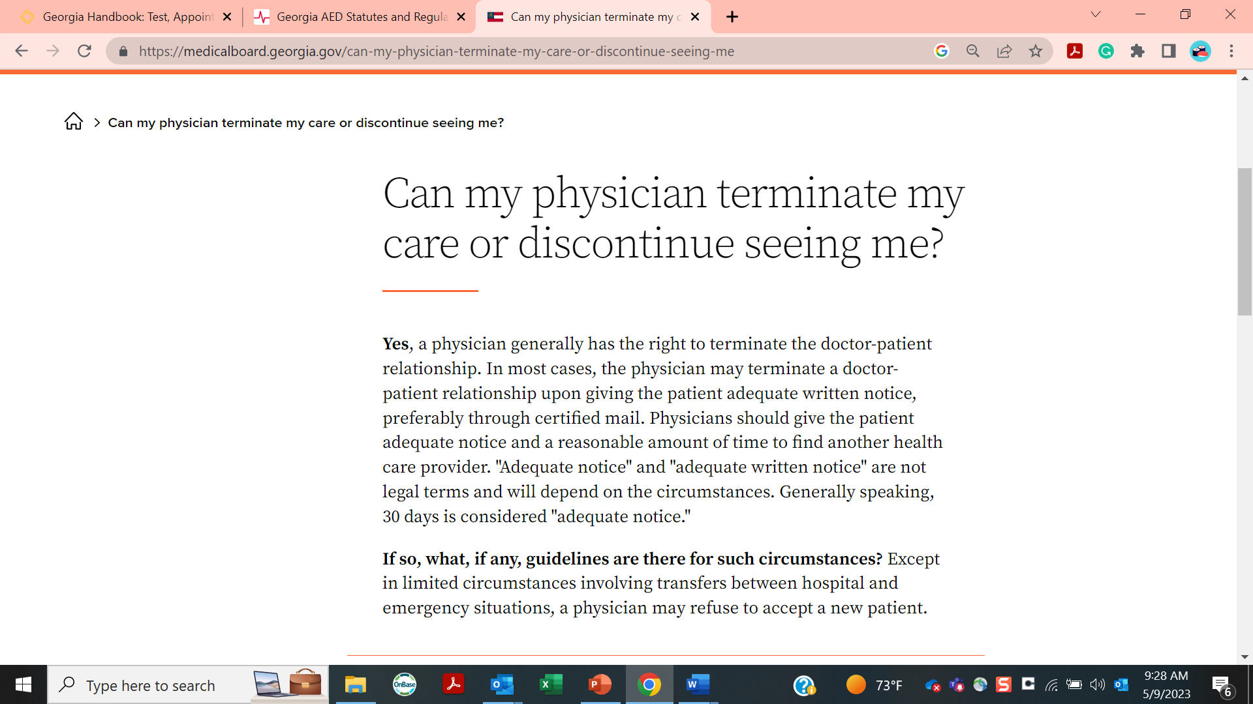
GCMB Guidance
https://medicalboard.georgia.gov/can-my-physician-terminate-my-care-or-discontinue-seeing-me

Slide 27
Elements of the GCMB Guidance
Physicians have the right to terminate the relationship.
The patient should be given adequate notice.
Preferably by certified mail
Must provide a reasonable time to find another healthcare provider.
“Adequate notice” and “adequate written notice” depend upon circumstances.
Thirty days is “generally” considered adequate.

Slide 28
When is Termination of Care Appropriate?
Repeated non‑compliance with treatment plans
Missed appointments that affect care
Abusive, threatening, or unsafe behavior by parent or caregiver
Persistent non‑payment (after reasonable attempts to resolve)

Slide 29
When is Termination of Care Not Appropriate?
Discriminatory factors (race, disability, family status, etc.)
Retaliation for complaints or special health needs

Slide 30
High Risk Situations
Termination requires extra caution when patients are:
Infants
Medically fragile or dependent upon medical devices (i.e. Trach, tube feeding)
Under active treatment (e.g., asthma, epilepsy, ADHD medication management)
In foster care or custody disputes

Slide 31
Case Example 1: No Shows for an Infant
Risk Issue: Medical vulnerability + missed care
Best Practice:
Multiple documented outreach attempts
Termination letter with extended notice
Referral resources (public clinics, Medicaid pediatricians)
A 6‑month‑old with poor weight gain has missed four appointments.
⚠️ High abandonment risk if terminated abruptly.

Slide 32
Case Example 2: Hostile Parent Behavior
Risk Issue: Staff safety vs. continuity of care
Best Practice:
Document incidents
Issue written termination
Continue emergency care for 30 days
A parent repeatedly yells at staff and threatens lawsuits.
Termination is appropriate. Must be well documented

Slide 33
Case Example 3: Foster Care Placement
Risk Issue: Complex custody + vulnerable child
Best Practice:
Coordinate with DFCS/caseworker
Delay termination if possible
Document agency communication
A foster child frequently changes guardians and misses visits
⚠️ High abandonment risk if terminated abruptly.

Slide 34
Case Example 4: Vaccine Declination
Risk Issue: Patient safety, exposure risk to other pediatric patients, policy noncompliance
Best Practice:
Noncompliance is ongoing and documented
Vaccine policy is written, applied consistently, and communicated clearly
Termination is based on care standards and patient safety, not personal beliefs
Proper notice and transition steps reduce abandonment risk
An established patient’s parent refuses to comply with vaccine schedule
High risk, but defensible when handled appropriately.

Slide 35
Suggested Elements of a Termination of Care Policy
  Purpose of the Policy
  Acceptable Reasons for Termination of Care
  Prohibited Reasons for Termination of Care
  Procedure for Termination of Care
  Risk Mitigation and Safety
Notes:
Purpose of the Policy
Define the goal: to ensure safe, respectful, and legally compliant termination of the patient-provider relationship.
Emphasize continuity of care and avoidance of patient abandonment.
Acceptable Reasons for Termination
Include clear, non-discriminatory reasons such as:
Repeated non-compliance with treatment plans
Abusive or threatening behavior toward staff or other patients
Failure to pay for services
Communication breakdowns
Geographic relocation or changes in provider scope
Patient request or cessation of medical need
Prohibited Reasons for Termination
Explicitly state that termination must not be based on:
Race, gender, religion, sexual orientation, disability, or HIV status
Limited English proficiency (especially if federally funded)
Pregnancy (especially third trimester)
Lack of alternative providers in the area
Procedure for Termination
Outline a step-by-step process:
Review and document the case thoroughly
Consult leadership or legal counsel if needed
Send a written termination letter via certified mail with return receipt
Include:
Effective date (typically 30 days from notice)
Emergency care availability during transition
Offer to transfer medical records
Referral resources (e.g., local medical society or hospital referral service)
Risk Mitigation and Safety
For abusive behavior, include immediate safety protocols:
Notify office manager
Document incident and witness statements
Call 911 if safety is threatened
Flag terminated patients in scheduling systems to prevent reappointments

Slide 36
Key Takeaways
  Termination is allowed in Georgia—but process matters
  30 days’ written notice is the minimum, not the goal.
  Providers should always be consulted prior to termination of care.
  Pediatric abandonment claims often hinge on process failures, not intent.
  When in doubt: slow down, document more, and extend notice.

Slide 37
Physicians have an ethical obligation to support continuity of care—even when ending a physician‑patient relationship.

Slide 38
Claim CME Credit
https://earnc.me/4q7lp1

Slide 39

Thank You!
Becky Summey‑Lowman, MBA, RDN, CPHRM, CHPS
​Becky.lowman@curi.com
Senior Risk Consultant
Curi Insurance
o:919‑501‑7652
www.curi.com

