Slide 1






Slide 2
The Problem:
Cape development patterns have resulted in...
Unacceptable Water Quality
90% of estuaries
> 33% of ponds
Economic Challenges
High cost of living
Expensive housing
Labor shortages
Fragmented Natural Landscapes
Undermined water supply and quality
Threats to species diversity
Increased Vulnerability
Increased flooding
Heightened risk from storm intensity

Slide 3
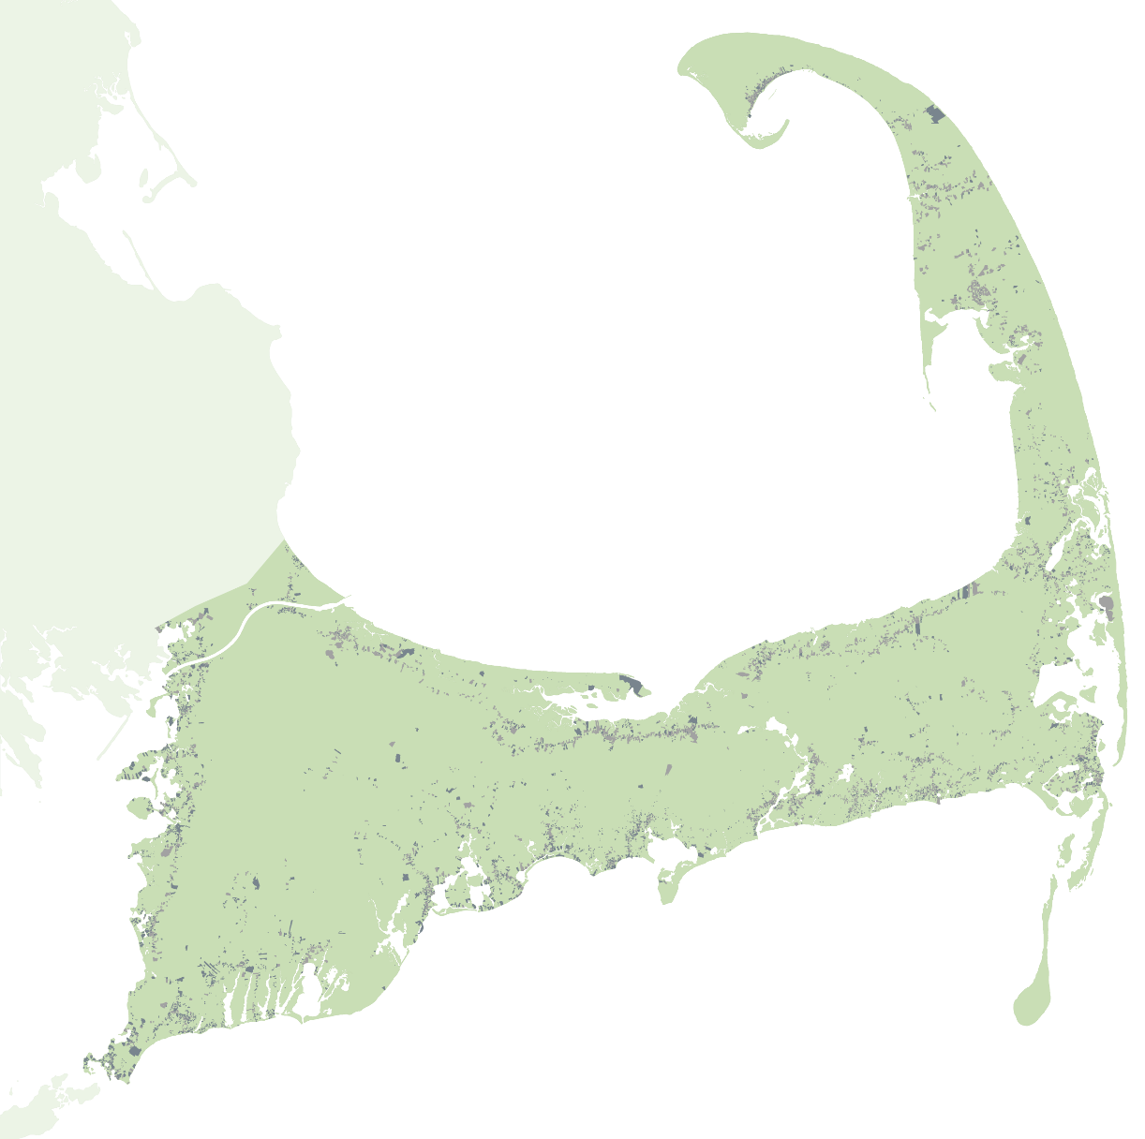
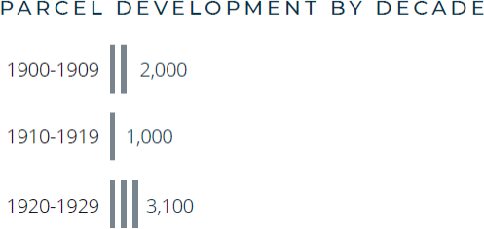
P r e 1 9 0 0
1900 - 1929
Source: Cape Cod Commission analysis and town assessing data for impervious surface and homes size statistics, Cape Cod Commission Parcel Data Set (2025) which uses individual town assessing data for development by decade

Slide 4
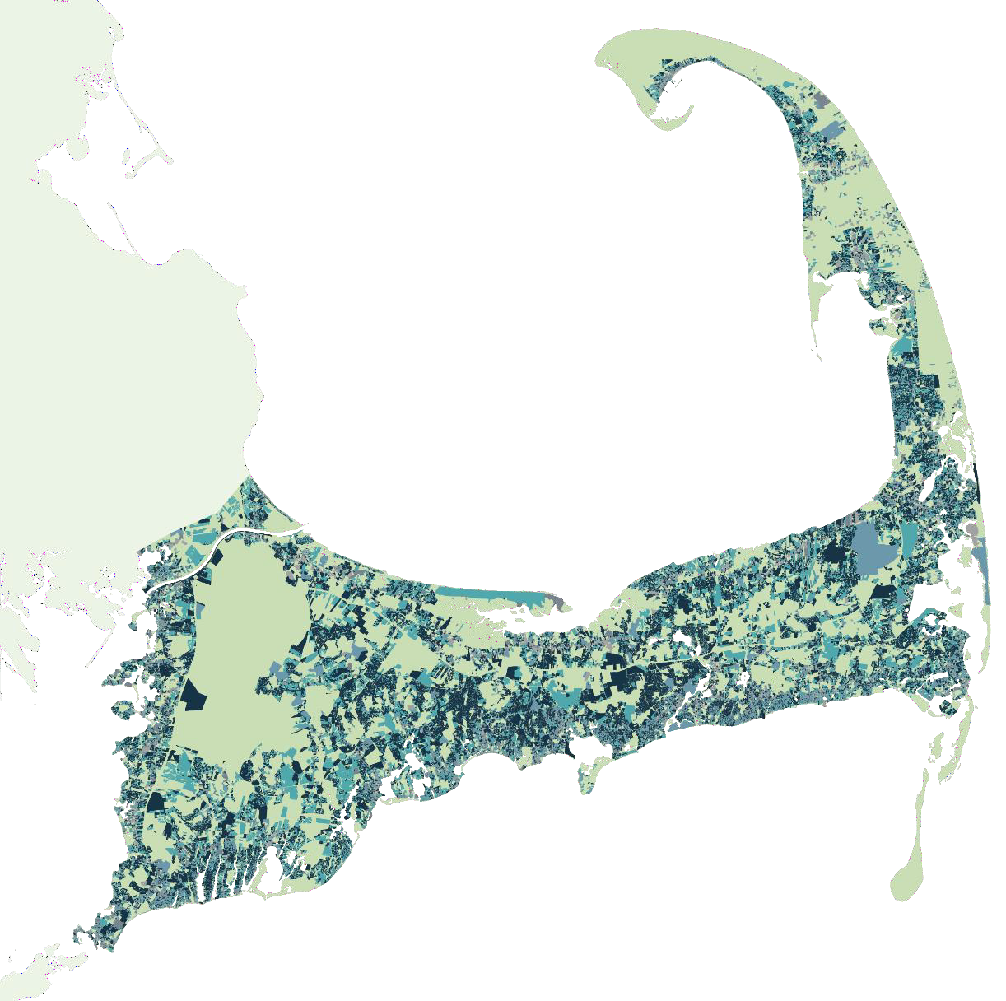
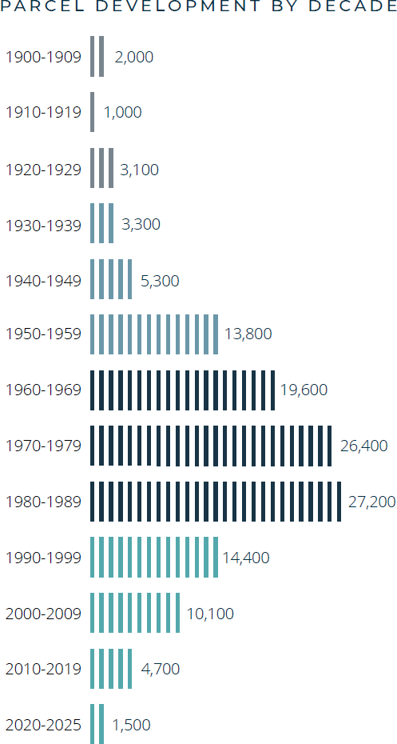
1990 - 2025
Source: Cape Cod Commission analysis and town assessing data for impervious surface and homes size statistics, Cape Cod Commission Parcel Data Set (2025) which uses individual town assessing data for development by decade

Slide 5
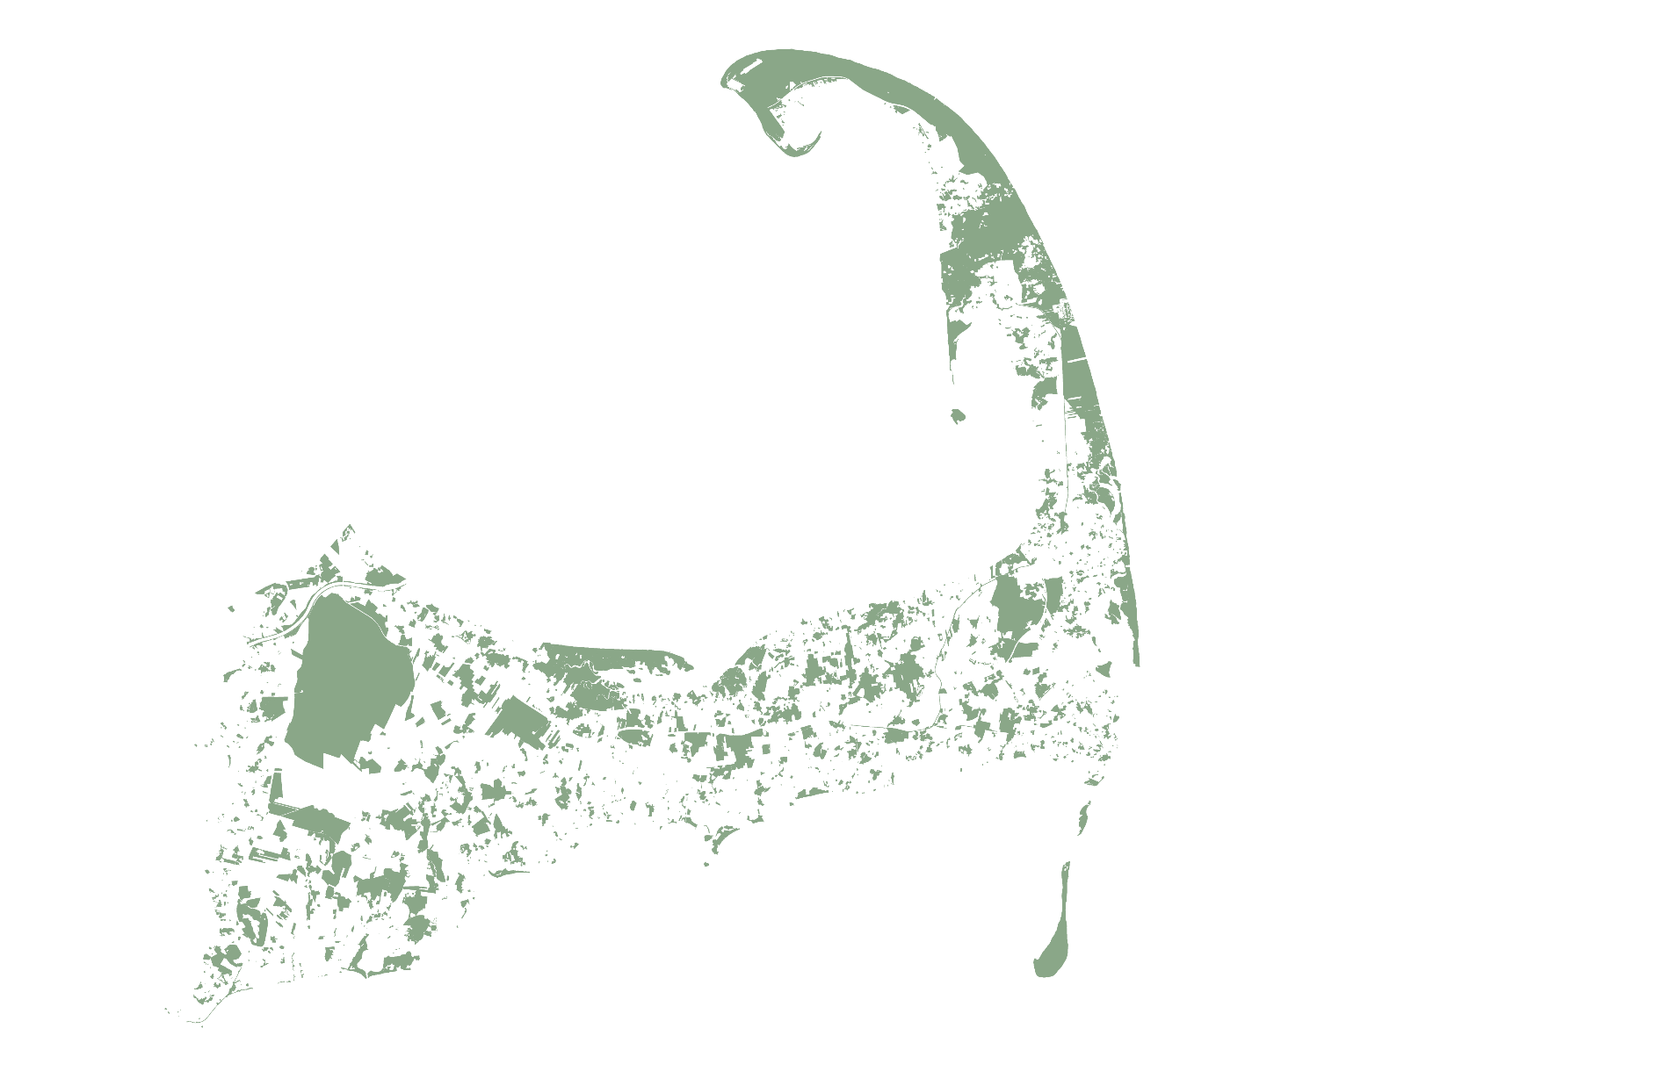

80%
of what's left is
priority natural resource
land
86%
of the Cape is already developed or protected
14%
undeveloped
and unprotected
Today
Source: MassGIS (2025) and Cape Cod Commission Parcel Data Set (2025) which uses individual town assessing data for development by decade; APCC's Hanging in the Balance report

Slide 6
DEFINITION: Priority Natural Resource Lands
Drinking Water
Zone II Wellhead Protection Areas
Potential Public Water Supply
Areas
Waterbodies and Wetlands
Wetlands and 100-ft. Wetland
Buffers
Vernal Pools and 350-ft. Vernal Pool Buffers
Habitat
NHESP Priority and Estimated
Rare Species Habitats
BioMap Core Habitats
BioMap Critical Natural Landscapes
BioMap Local Components
Coastal and Inland Flood-prone Areas
FEMA A Zone and V Zone

Slide 7
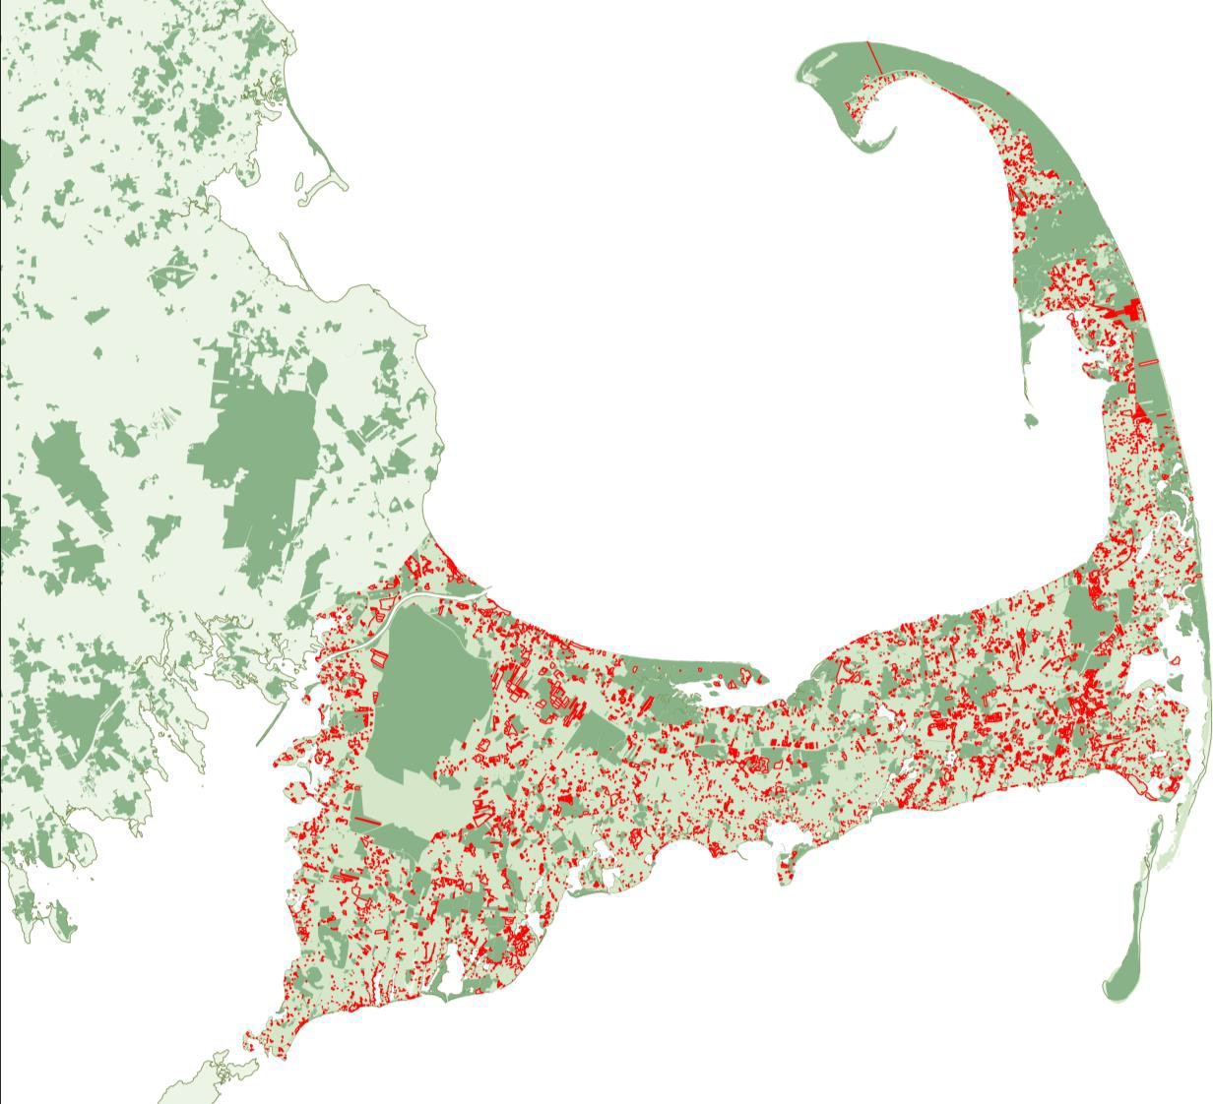
THREATS/ OPPORTUNITIES EVERYWHERE
Unprotected, Undeveloped Priority Natural Resource Lands
Source:: Undeveloped and underdeveloped parcel analysis based on town assessors’ data provided to MassGIS. Priority natural resource data based on MassGIS data layers. Base map: Cape Cod Commission.

Slide 8

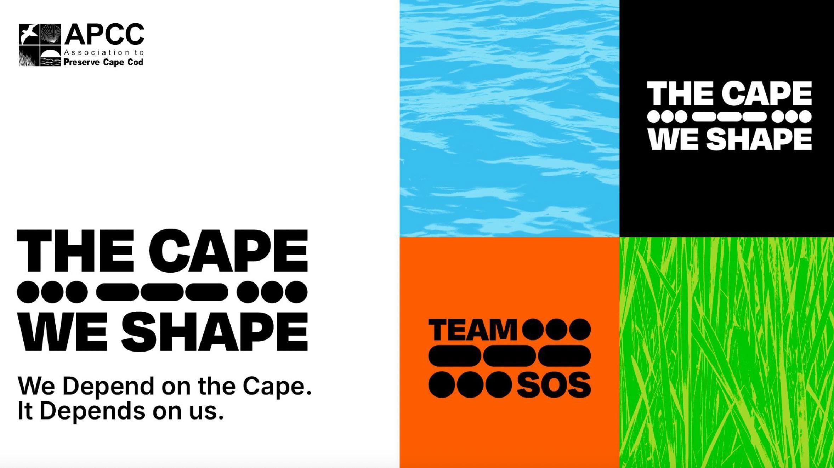


Slide 9


CAMPAIGN: Phases
Phase One:
Awareness + Education
Phase Two:
Engagement + Capacity Building
Phase Three: Sustained Action
Use a disruptive entry point to show that landp reservation is
personal, urgent, and needed now. Invite people to support permanent land protection by joining Team SOS.
Engage Team SOS and equip them with tools to spread the word, and help expand our base of supporters
for permanent land
protection.
Mobilize Team SOS to champion permanent land protection, drive
bottom-up efforts, and organize visible, public support for permanent land protection within their communities.
WE ARE HERE

Slide 10
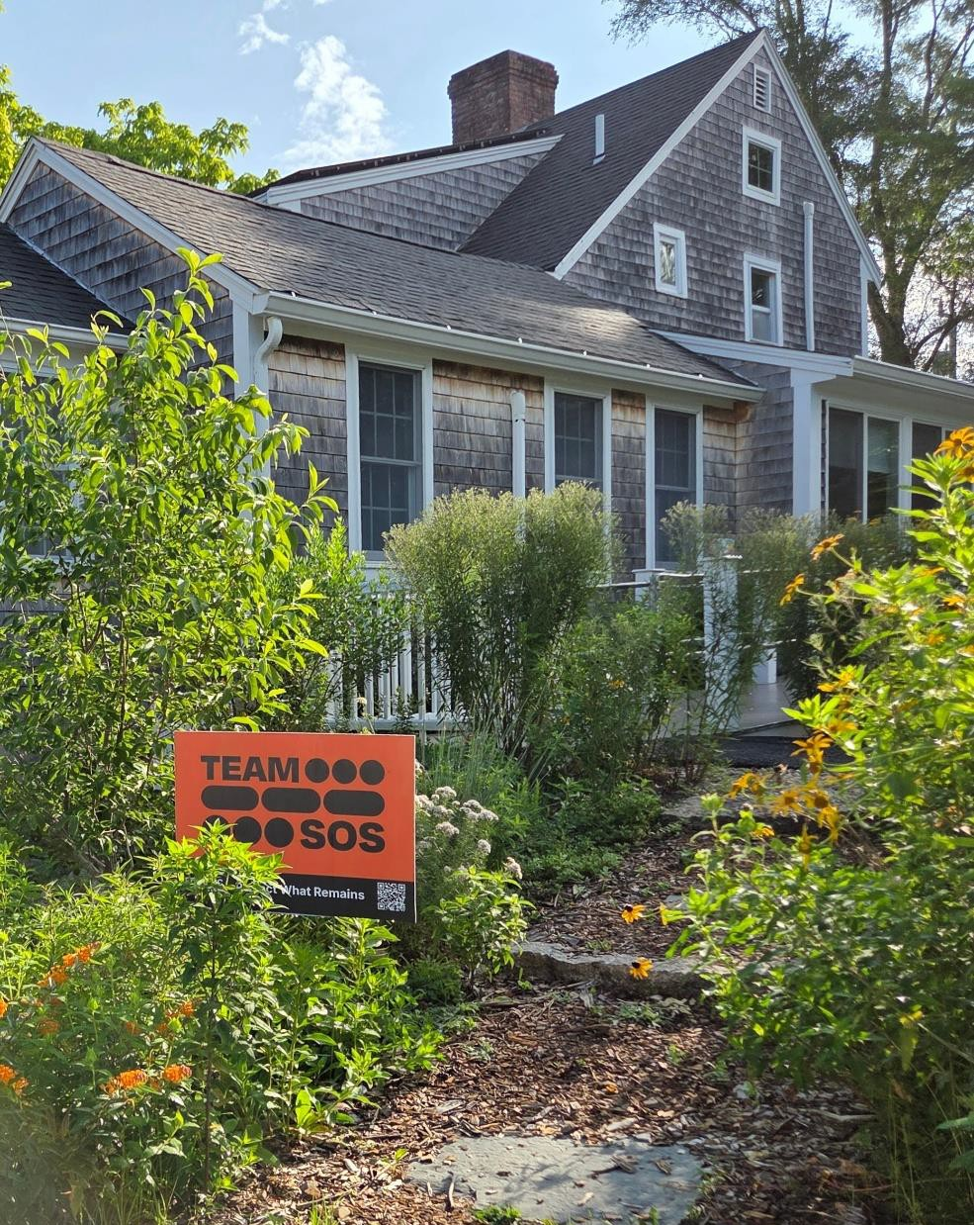

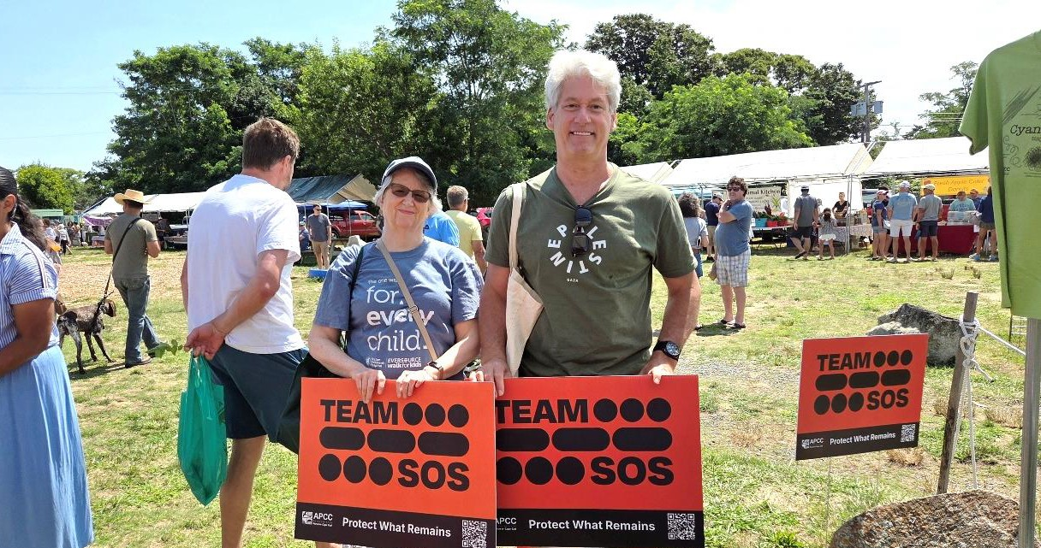
MORE INFO
thecapeweshape.org
TeamSOS@apcc.org
Facebook and Instagram

