Slide 1
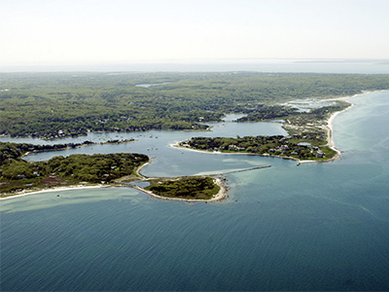

West Falmouth Village Association
Annual Meeting
July 30, 2026

Slide 2
Agenda
President’s Welcome & 2025/26 Review - Jim Gray
Recognition of Milt Williamson – Paul Sellers
Financial Report & Membership Statistics – Susan Challenger
2026/27 Goals & Objectives – Tammy Gilbert
Board Nominations & Elections – Susan Challenger
Vote to become a 501(c)(3) organization and to approve the amended Bylaws– Susan Challenger
Questions/Comments?
Guest Speaker – Christy Johnson, Association to Preserve Cape Cod

Slide 3
2025-2026 Review
0 West Falmouth Hwy land protected from development (Article 97)
Old Dock Road/West Falmouth Hwy crosswalk progress
Nashawena Safety improvements
Improved signage at Old Dock Road/Bike Path parking lot
Vegetation trimmed along Route 28A
Tree lighting, Earth Day cleanup and fall tennis lessons

Slide 4
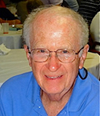
Recognizing Milt Williamson!

Slide 5
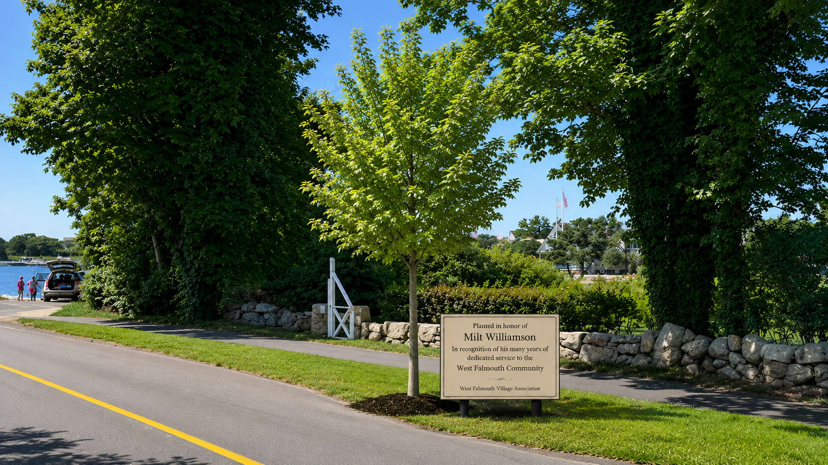

Slide 6
Financial Review: P&L Year over Year
 | Jan-Dec 2025 | Jan-Dec 2024 | Change
Income
Membership Dues | $1608 | $3427 | -$1819
Donations | $200 |  | $200
Total Income | $1808 | $3427 | -$1619
Expenses
Operations (Website, Constant Contact, etc.) | $1710 | $1661 | $49
Community Outreach | $1258 | $875 | $383
Total Expense | $2968 | $2536 | $432
Net Income | -$1160 | $891 | -$2051
Check Account Balance – Dec 31 | $6624 | $8035 | -$1412

Slide 7
Financial Review: YTD June 2026
 | Jan-Jun 2026
Income
Membership Dues | $2757
Donations | $905
Total Income | $3662
Expenses
Operations (website, Constant Contact, etc) | $1282
Community Outreach | $300
Total Expense | $1582
Net Income | $2080
Checking Account Balance as of June 30th | $8704

Slide 8
Paid Membership Overview
 | 2025 | 2026 YTD
Annual Membership Renewals | 18 | 62
New Lifetime Members | 3 | 5
Total Lifetime Members | 70 | 75

Slide 9
2026-2027 Goals & Objectives
Organizational
  Obtain 501(c)(3) designation
  Consistent & timely communication
    Website redesign
    Newsletter
    Social media presence
  Expand community outreach/events
    Swift Park Tennis Program
    Annual Tree Lighting
    Sponsor other events, cleanups, public forums

Slide 10
2026-2027 Goals & Objectives
Public Safety
  Advocate for Fire Station Improvements
    Building improvements/CPC application
    Continue to advocate for 24/7/365 coverage
  Road Safety and Walkability
    Work with Traffic Advisory Committee, Bicycle Safety Committee, Department of Public Works to improve road safety on West Falmouth town roads
    Old Dock Road/West Falmouth Hwy crosswalk – continue to work with Town and State Officials
    Sidewalks & Crosswalks - survey residents, compile data & advocate, communicate with membership

Slide 11
2026-2027 Goals & Objectives
Environmental/Community Preservation
Monitor Developments & Communicate with Membership
  Permeable Reactive Barrier Project on Nashawena
  Ocean Outfall
  Culvert Replacement at Oyster Pond
  0 West Falmouth Hwy – support petitioner’s article
  Watershed Management Financial Fairness Task Force

Slide 12
New Board Members
Motion from the Board to elect the following new WFVA Board members:
Ben Carroll
Mary Gray
Doug Shearer

Slide 13
2026/2027 Officers
  Motion from the Board to elect the following WFVA officers:
  President – Tammy Gilbert
  Treasurer – Mary Gray
  Secretary – Susan Challenger

Slide 14
2026/2027 WFVA Board of Directors
  Tammy Gilbert, President
  Mary Gray, Treasurer
  Susan Challenger, Secretary
  Mary Bunker-Ryther
  Ben Carroll
  Alden Cook
  Ollie Egleston
  Jim Gray
  Paul Sellers
  Dan Shearer
  Doug Shearer
  Dave Sugar
  Todd Taylor

Slide 15
Vote
Motion from the Board to become a 501(c)(3) organization and to approve the amended Bylaws
  501(c)(3) Amendments
    Aligned our purpose statement with that of a 501(c)(3) organization
    Included reporting requirements to the role of Treasurer
    Included a conflict-of-interest policy to align with IRS recommendations
  Additional Change
    Changed the minimum number of Board members from 12 to 9

Slide 16

Questions / Comments

Slide 17

Welcome Christy Johnson

