Slide 1
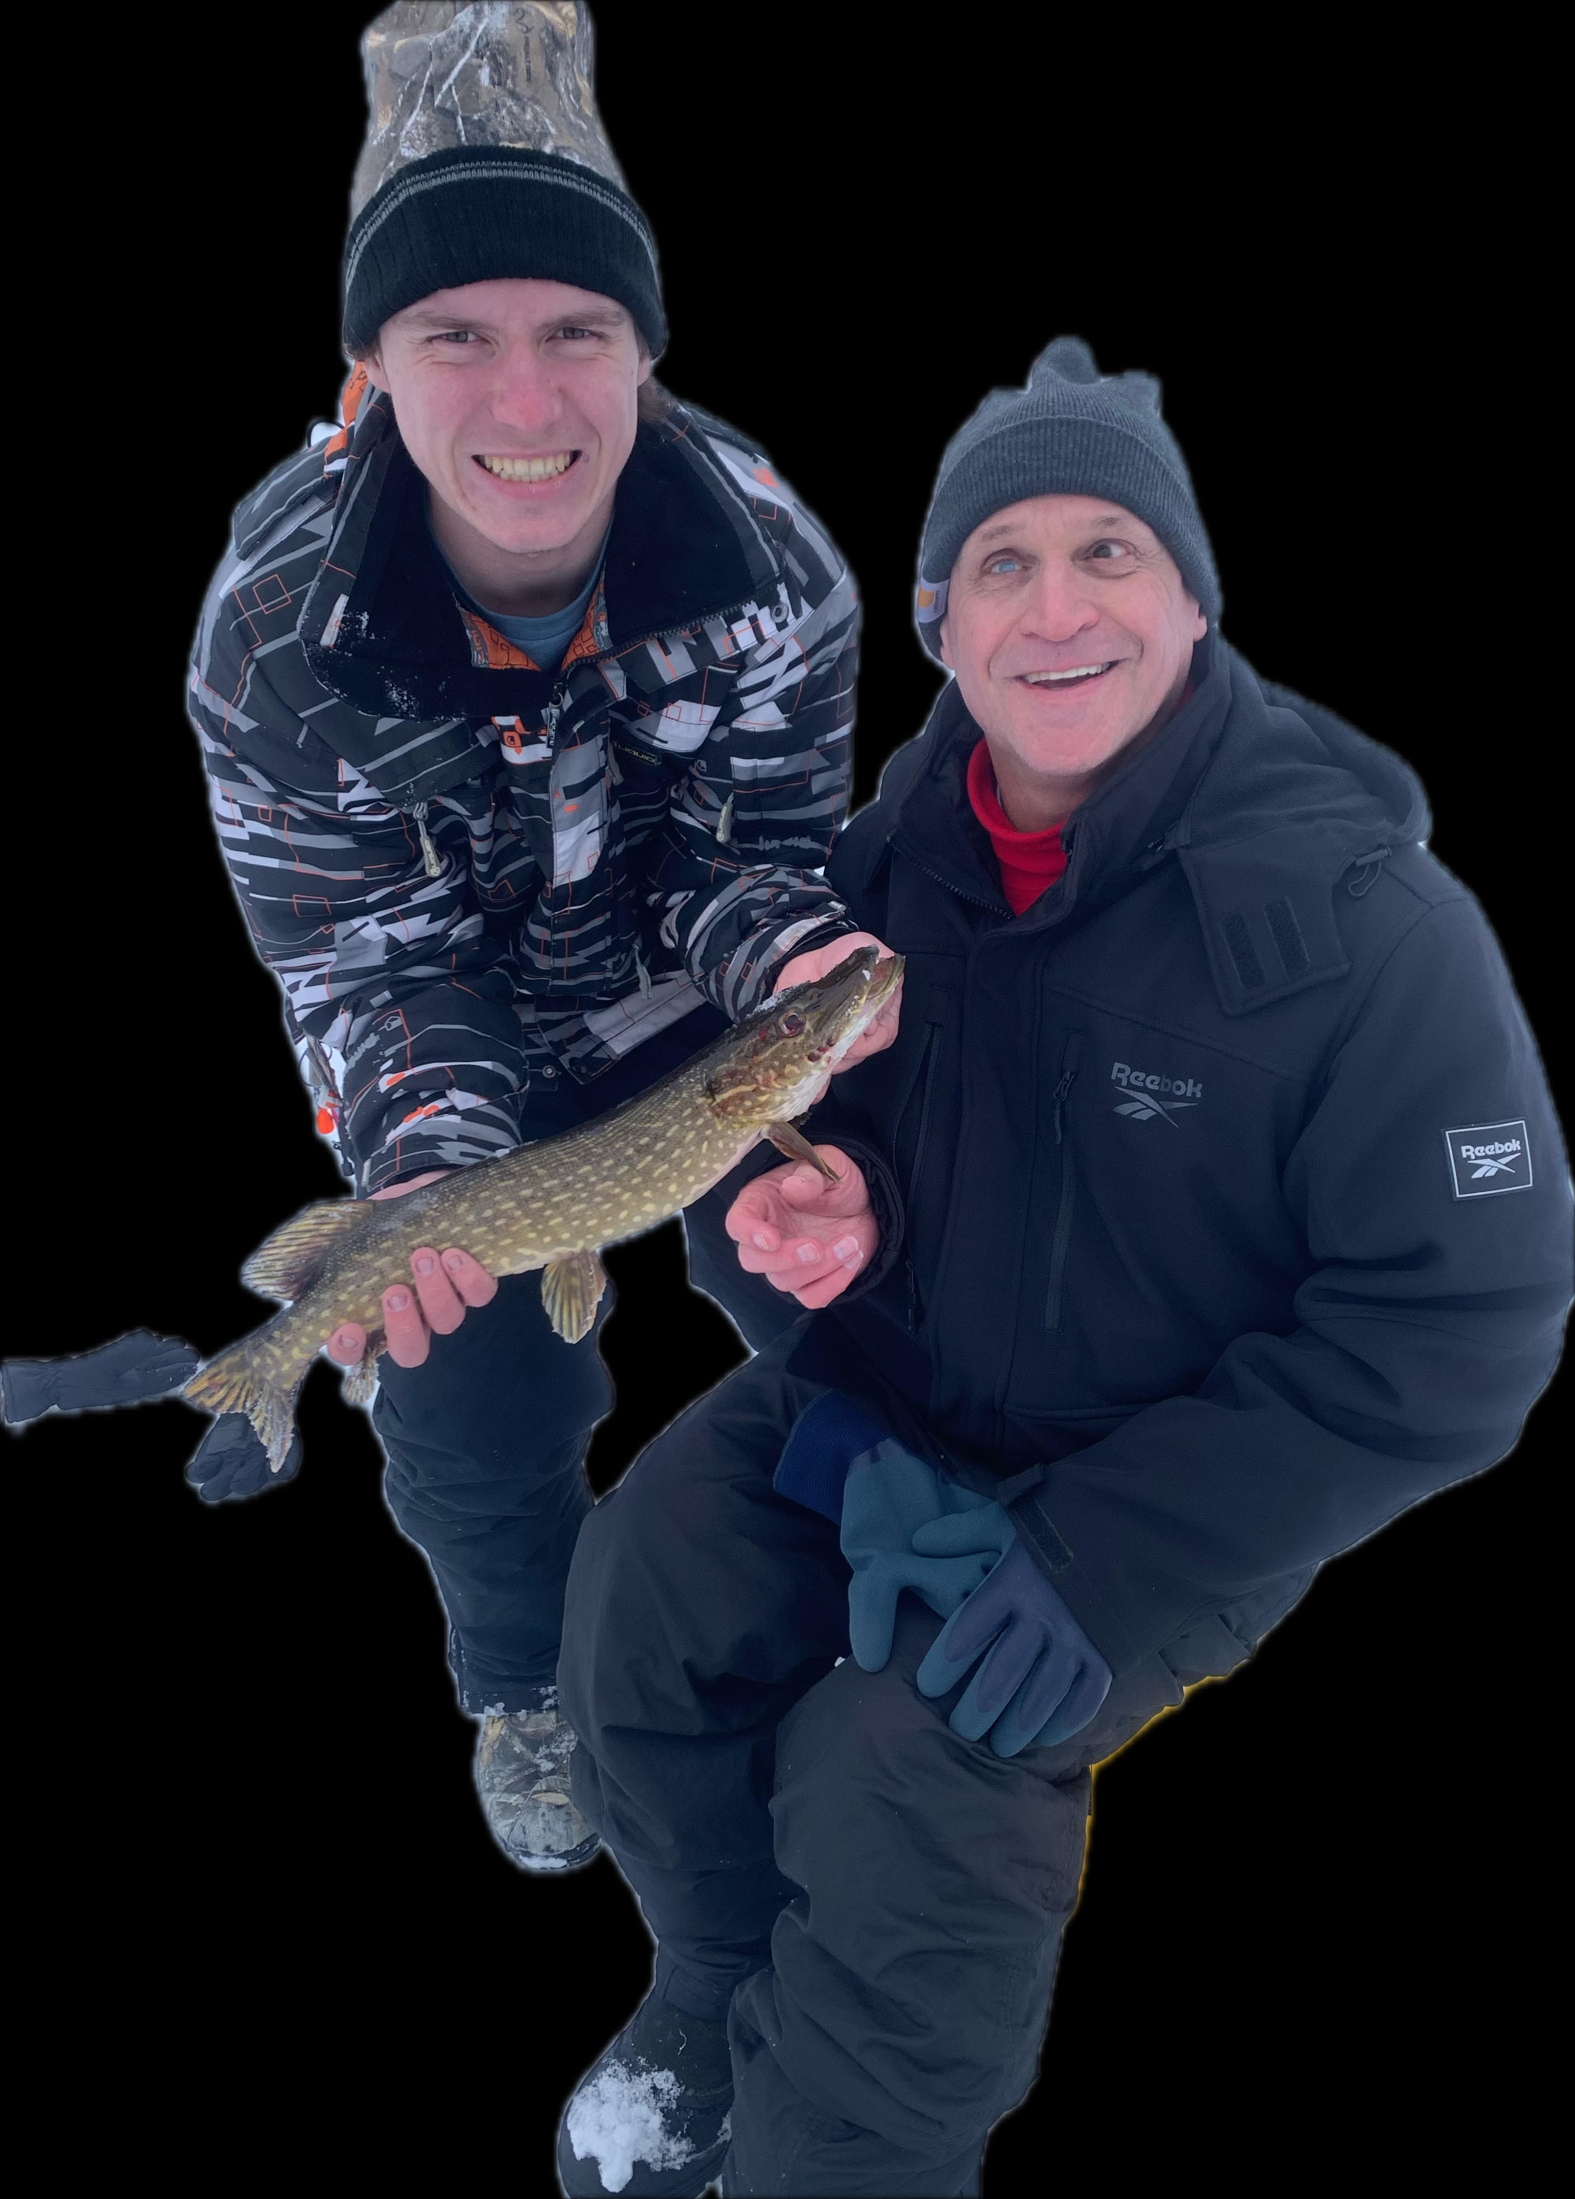

Winter Camp Fun
Blind people have great fun
at Winter Camp
Scott at Winter Blind Camp with guide ice fishing.
Graphic credit: Paul Middleton
Saturday @ 5 p.m.
on STR stations,
STR apps, or STR.fm

Slide 2

Private Wounds
hurt-to-healing story
Broken Heart.
Graphic credit: Kelly Sikkema via Unsplash
Next Friday @ 1 p.m. & Saturday @ 5 p.m.
on STR stations,
STR apps, or STR.fm

Slide 3
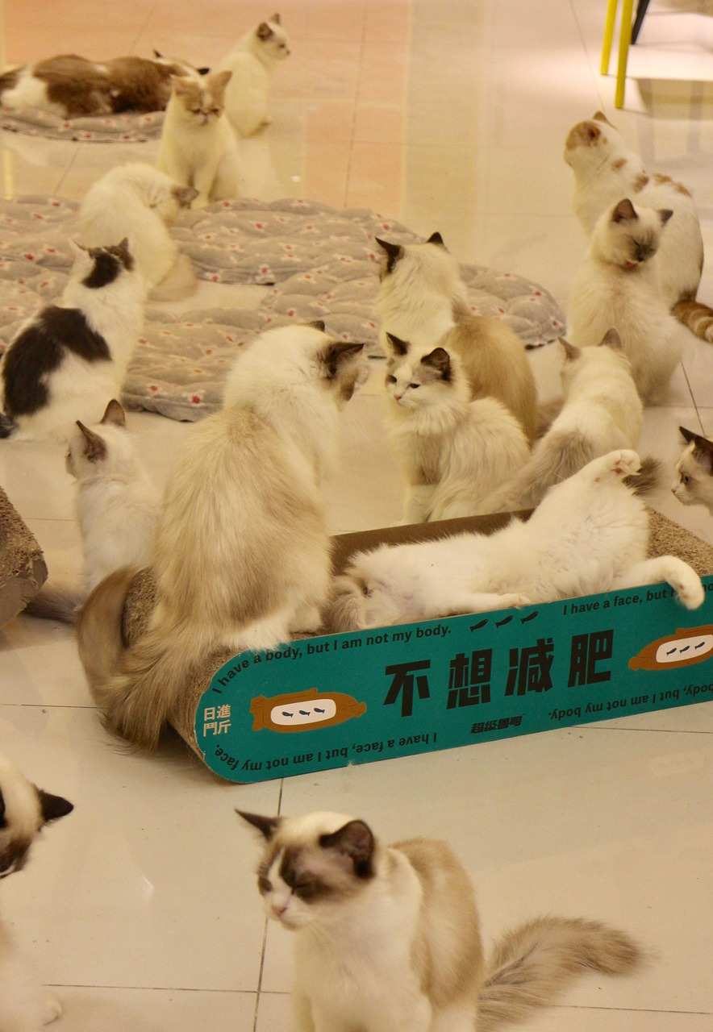
Selecting a Pet!
Tips on
Selecting a Pet
Cats.
Graphic credit: Pixabay
Sun. @ 5:00 P.M. Mon. @ 10:00 A.m. Wed. @ 12:00 a.m.
on STR stations,
STR apps, or STR.fm

Slide 4
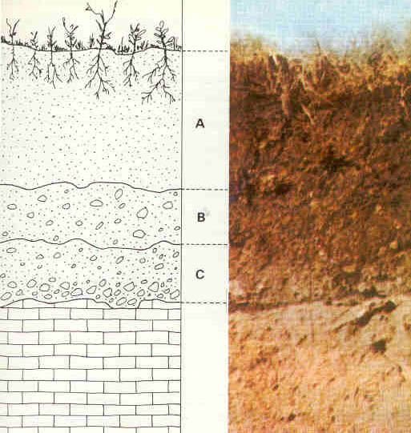
Soil- the Foundation
the most important part of your garden
Sun. 3:30 a.m.
Mon. @ 4 p.m. Wed. @ 9 p.m. Thu. @ 1 p.m.
Soil profile pedology by Vasily Dokuchaev
Graphic credit: Wikipedia
on STR stations,
STR apps, or STR.fm

Slide 5
Christian Radio
104.7 fm /1540 am
STR phone apps, &
STR.fm

Slide 6
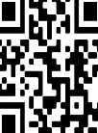
Point, click, and give!
﻿Give to Strong Tower Radio via the STR.fm giving page, with your smartphone, or mailing a check to:
P.O. Box 567, Cadillac, MI 49601

Slide 7
Strong Tower Radio
Area STR Stations
STR phone apps, &
STR.fm

