Slide 1


Garden Guy
Mums
Pumpkins
And more!
Photo credit: Strong Tower Radio
Sunday @ 5 pm, Monday @ 10 am, & Wednesday at 12 am
on STR stations,
STR apps, or STR.fm

Slide 2
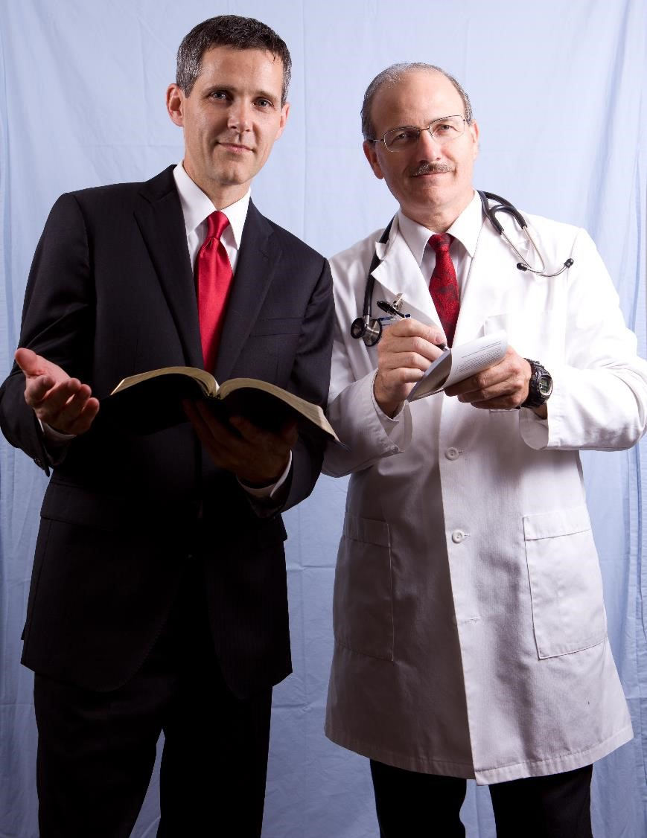
Integrated Primary Care
Medicine
Lifestyle
Therapies
Doctor-Pastor team
Photo credit: John Torquato MD
Sunday @ 3:30 am, Monday @ 4 pm, Wednesday @ 9 pm, and Thursday @ 1 pm
on STR stations,
STR apps, or STR.fm

Slide 3
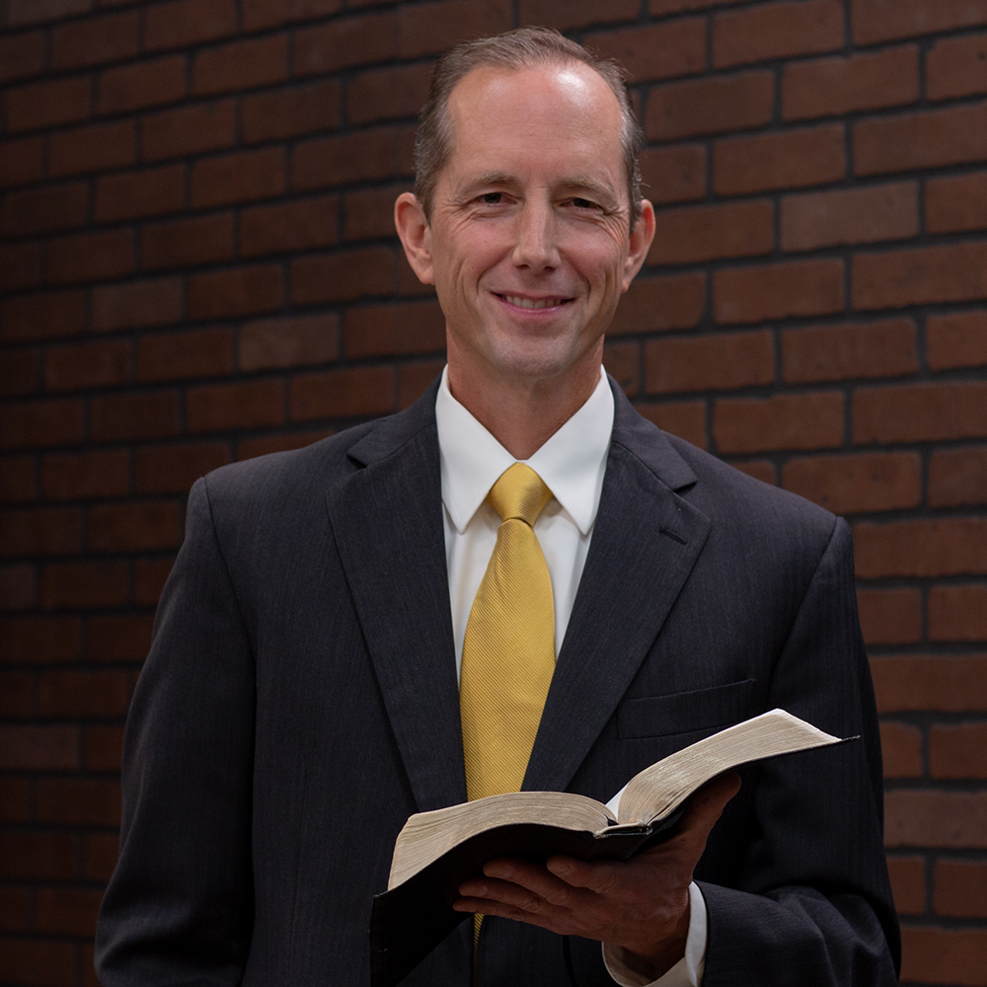
﻿UP Camp Meeting
Tim Rumsey’s
2026 Sermons
Tim Rumsey
Photo credit: Tim Rumsey
Fridays @ 1 pm & Sabbath @ 5 pm
on STR stations,
STR apps, or STR.fm

Slide 4
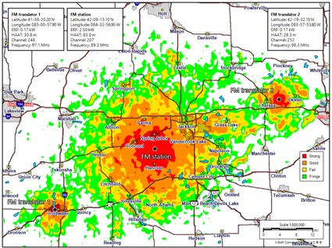
Strong Tower Radio
﻿New Stations
Spring Arbor
Battle Creek
Coldwater
Galesburg
Kalamazoo
Lansing
Chelsea
Strong Tower Radio's Spring Arbor station and translators
Photo credit: Strong Tower Radio
on STR stations,
STR apps, or STR.fm

Slide 5
Christian Radio
104.7 fm /1540 am
STR phone apps, &
STR.fm

Slide 6
Strong Tower Radio
91.9 FM & 97.3 FM
STR Android or ISO apps, &
STR.fm

Slide 7
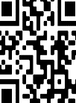
Point, click, and give!
﻿Give to Strong Tower Radio via the STR.fm giving page, with your smartphone, or mailing a check to:
P.O. Box 567, Cadillac, MI 49601

Slide 8
Strong Tower Radio
Area STR Stations
STR phone apps, &
STR.fm

