Slide 1

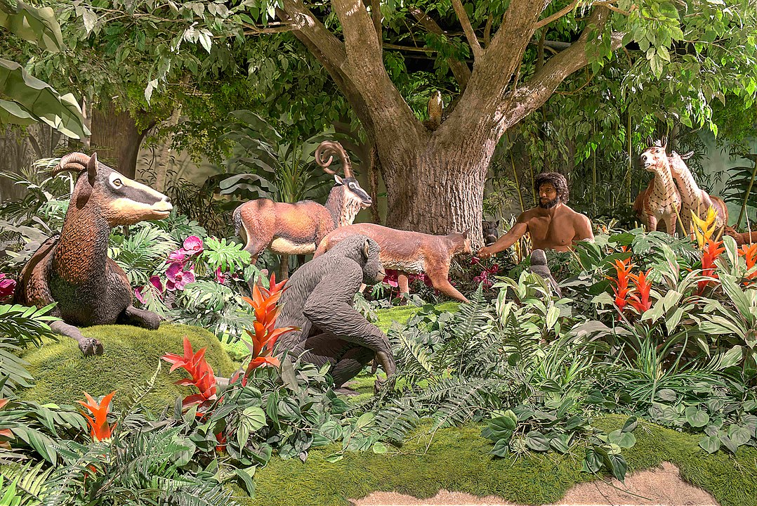
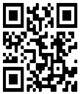
STR Announcements
STR Announcements
STR Announcements
Adam naming animals depicted at the Creation Museum.
Graphic Credit: D. S. Dugan
Creation Animal Care
"Creation Animal Care" debuts with a veterinarian host on location. Join us this Sunday at 5 p.m., Monday at 10 a.m., and Wednesday at midnight﻿.
AMEN Clinic Round II
The AMEN Free Clinic's second season begins at a small southeast Michigan church. Learn more this Sunday at 3:30 a.m., Monday at 4 p.m., Wednesday at
9 p.m., and Thursday at 1 p.m.
Physician-Pastor Team
The physician/pastor partnership is the most effective evangelistic team! Learn more next Friday (2/28) at 1 p.m. and Saturday (3/1) at 5 p.m.
Point, click, and give!
﻿Give to Strong Tower Radio via the STR.fm giving page, with your smartphone, or mailing a check to
P.O. Box 567, Cadillac, MI 49601
Adam naming animals depicted at the Creation Museum.
Graphic Credit: D. S. Dugan
Creation Animal Care
"Creation Animal Care" debuts with a veterinarian host on location. Join us this Sunday at 5 p.m., Monday at 10 a.m., and Wednesday at midnight﻿.
AMEN Clinic Round II
The AMEN Free Clinic's second season begins at a small southeast Michigan church. Learn more this Sunday at 3:30 a.m., Monday at 4 p.m., Wednesday at
9 p.m., and Thursday at 1 p.m.
Physician-Pastor Team
The physician/pastor partnership is the most effective evangelistic team! Learn more next Friday (2/28) at 1 p.m. and Saturday (3/1) at 5 p.m.
Point, click, and give!
﻿Give to Strong Tower Radio via the STR.fm giving page, with your smartphone, or mailing a check to
P.O. Box 567, Cadillac, MI 49601
Adam naming animals depicted at the Creation Museum.
Graphic Credit: D. S. Dugan
Creation Animal Care
"Creation Animal Care" debuts with a veterinarian host on location. Join us this Sunday at 5 p.m., Monday at 10 a.m., and Wednesday at midnight﻿.
AMEN Clinic Round II
The AMEN Free Clinic's second season begins at a small southeast Michigan church. Learn more this Sunday at 3:30 a.m., Monday at 4 p.m., Wednesday at
9 p.m., and Thursday at 1 p.m.
Physician-Pastor Team
The physician/pastor partnership is the most effective evangelistic team! Learn more next Friday (2/28) at 1 p.m. and Saturday (3/1) at 5 p.m.
Point, click, and give!
﻿Give to Strong Tower Radio via the STR.fm giving page, with your smartphone, or mailing a check to
P.O. Box 567, Cadillac, MI 49601
On-air, via Apple & Android apps, & STR.fm
On-air, via Apple & Android apps, & STR.fm
On-air, via Apple & Android apps, & STR.fm

