Slide 1

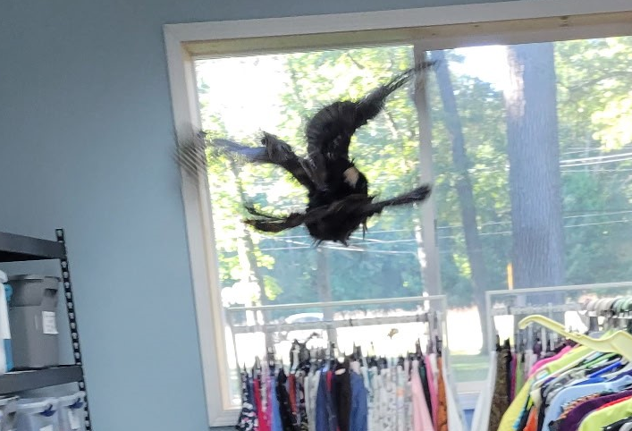
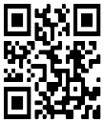
STR Announcements
STR Announcements
STR Announcements
Turkey flight inside the Muskegon Adventist Community Center.
Photo credit: Brent Link
The ACS Turkey Visit
A live turkey spent the night at the Muskegon Adventist Community Service Center. Hear about this and more this Sunday at 3:30 a.m., Monday at 4 p.m., and Wednesday at 9 p.m., and only on Strong Tower Radio stations, STR apps, or STR.fm.
New Pet Care
Dr. Edyie Hanna shares how to care for a new pet. Learn about the wonderful but life-changing responsibilities this Sunday at 5 p.m., Monday at 10 a.m., and Wednesday at midnight only on STR stations, STR apps, or STR.fm.
Passion Week Programs
Strong Tower Radio airs Passion Week programs from Palm Sunday to Easter only on STR stations, STR apps, or STR.fm. Invite a friend, family, or co-worker to tune in.
Point, click, and give!
﻿Give to Strong Tower Radio via the STR.fm giving page with your smartphone, or mail a check to
P.O. Box 567, Cadillac, MI 49601
Turkey flight inside the Muskegon Adventist Community Center.
Photo credit: Brent Link
The ACS Turkey Visit
A live turkey spent the night at the Muskegon Adventist Community Service Center. Hear about this and more this Sunday at 3:30 a.m., Monday at 4 p.m., and Wednesday at 9 p.m., and only on Strong Tower Radio stations, STR apps, or STR.fm.
New Pet Care
Dr. Edyie Hanna shares how to care for a new pet. Learn about the wonderful but life-changing responsibilities this Sunday at 5 p.m., Monday at 10 a.m., and Wednesday at midnight only on STR stations, STR apps, or STR.fm.
Passion Week Programs
Strong Tower Radio airs Passion Week programs from Palm Sunday to Easter only on STR stations, STR apps, or STR.fm. Invite a friend, family, or co-worker to tune in.
Point, click, and give!
﻿Give to Strong Tower Radio via the STR.fm giving page with your smartphone, or mail a check to
P.O. Box 567, Cadillac, MI 49601
Turkey flight inside the Muskegon Adventist Community Center.
Photo credit: Brent Link
The ACS Turkey Visit
A live turkey spent the night at the Muskegon Adventist Community Service Center. Hear about this and more this Sunday at 3:30 a.m., Monday at 4 p.m., and Wednesday at 9 p.m., and only on Strong Tower Radio stations, STR apps, or STR.fm.
New Pet Care
Dr. Edyie Hanna shares how to care for a new pet. Learn about the wonderful but life-changing responsibilities this Sunday at 5 p.m., Monday at 10 a.m., and Wednesday at midnight only on STR stations, STR apps, or STR.fm.
Passion Week Programs
Strong Tower Radio airs Passion Week programs from Palm Sunday to Easter only on STR stations, STR apps, or STR.fm. Invite a friend, family, or co-worker to tune in.
Point, click, and give!
﻿Give to Strong Tower Radio via the STR.fm giving page with your smartphone, or mail a check to
P.O. Box 567, Cadillac, MI 49601
On-air, via Apple & Android apps, & STR.fm
On-air, via Apple & Android apps, & STR.fm
On-air, via Apple & Android apps, & STR.fm

