Slide 1


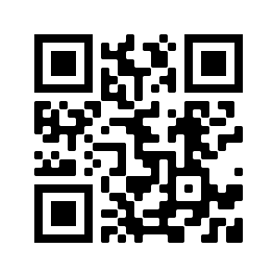
STR Announcements
STR Announcements
STR Announcements
September Adventist Heritage Tour
Photo Credit: Anderson Tours
.
Adventist Heritage Tour
Get the details of the September Adventist Heritage and American History Tour this Sun. at 3:30 a.m., Mon. at 4 p.m., Wed. at 9 p.m., and Thurs. at 1 p.m.
Farm Stew Kids
This week we talk to Farm Stew about their kids' mission-engagement ministry this Sun. at 5:20 p.m., Mon. at 10:20 a.m., and Wed. at 12:20 a.m.
SS Marie Variety Hour
Hear the latest Strong Tower Radio (STR) SS Marie Variety Hour today at 5 p.m.
Point, click, and give!
﻿Give to Strong Tower Radio via the STR.fm giving page, with your smartphone, or mailing a check to
P.O. Box 567, Cadillac, MI 49601
September Adventist Heritage Tour
Photo Credit: Anderson Tours
.
Adventist Heritage Tour
Get the details of the September Adventist Heritage and American History Tour this Sun. at 3:30 a.m., Mon. at 4 p.m., Wed. at 9 p.m., and Thurs. at 1 p.m.
Farm Stew Kids
This week we talk to Farm Stew about their kids' mission-engagement ministry this Sun. at 5:20 p.m., Mon. at 10:20 a.m., and Wed. at 12:20 a.m.
SS Marie Variety Hour
Hear the latest Strong Tower Radio (STR) SS Marie Variety Hour today at 5 p.m.
Point, click, and give!
﻿Give to Strong Tower Radio via the STR.fm giving page, with your smartphone, or mailing a check to
P.O. Box 567, Cadillac, MI 49601
September Adventist Heritage Tour
Photo Credit: Anderson Tours
.
Adventist Heritage Tour
Get the details of the September Adventist Heritage and American History Tour this Sun. at 3:30 a.m., Mon. at 4 p.m., Wed. at 9 p.m., and Thurs. at 1 p.m.
Farm Stew Kids
This week we talk to Farm Stew about their kids' mission-engagement ministry this Sun. at 5:20 p.m., Mon. at 10:20 a.m., and Wed. at 12:20 a.m.
SS Marie Variety Hour
Hear the latest Strong Tower Radio (STR) SS Marie Variety Hour today at 5 p.m.
Point, click, and give!
﻿Give to Strong Tower Radio via the STR.fm giving page, with your smartphone, or mailing a check to
P.O. Box 567, Cadillac, MI 49601
On-air, via Apple & Android apps, & STR.fm
On-air, via Apple & Android apps, & STR.fm
On-air, via Apple & Android apps, & STR.fm

