Slide 1


Adventist Heritage Tour
September Adventist Heritage
and American History Tour
Sun. 3:30 a.m.
Mon. @ 4 p.m. Wed. @ 9 p.m. Thu. @ 1 p.m.
on STR stations,
STR apps, or STR.fm

Slide 2

Farm Stew Kids
Hear this
Interview
Sun. @ 5 P.M. Mon. @ 10:00 A.m. Wed. @ 12:00 a.m.
on STR stations,
STR apps, or STR.fm

Slide 3
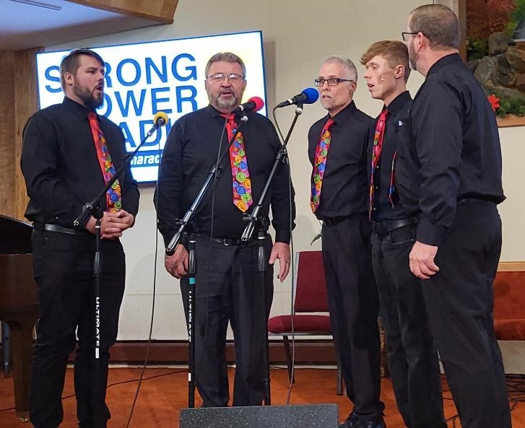
SS Marie Variety Hour
Hear the Premier
Today at 5:00 p.m.
on STR stations,
STR apps, or STR.fm

Slide 4
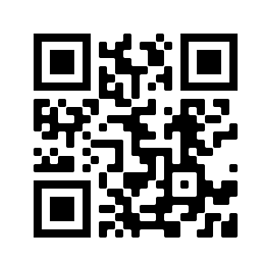
Point, click, and give!
﻿Give to Strong Tower Radio via the STR.fm giving page, with your smartphone, or mailing a check to:
P.O. Box 567, Cadillac, MI 49601

Slide 5
Christian Radio
104.7 fm /1540 am
STR phone apps, &
STR.fm

Slide 6
Strong Tower Radio
Area STR Stations
STR phone apps, &
STR.fm

