Slide 1


June Garden Guy
Blueberry and Garden Tips
STR June Garden Guy (not Gary Heilig)
Photo credit- Tom Mejeur - Google AI
Sunday @ 5 pm, Monday @ 10 am, & Wednesday at 12 am
on STR stations,
STR apps, or STR.fm

Slide 2
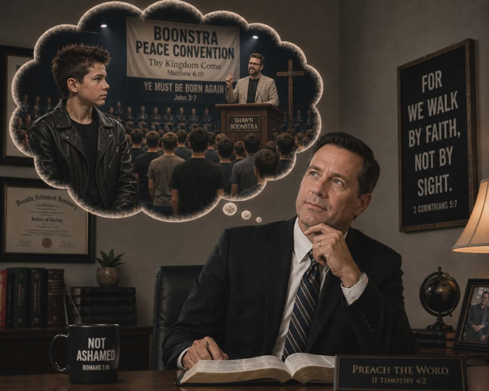
The Rest of the Story!
the story of a young rebellious youth attending Pastor Boonstra's meetings
Pastors Shawn Boonstra and Nick Wanovic
Photo credit: Jessica Taylor
Sunday @ 3:30 am, Monday @ 4 pm, Wednesday @ 9 pm, and Thursday @ 1 pm
on STR stations,
STR apps, or STR.fm

Slide 3
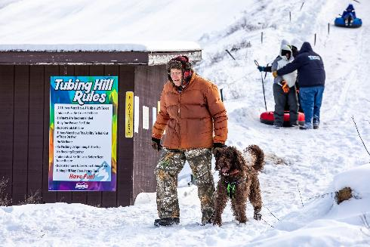
New Blind Camp Devotions
Fred Calkins Tubing at Hanson Hills during Winter Blind Camp 2026
Photo credit: Shawna Campbell
Fridays @ 1 pm & Saturdays @ 5 pm
on STR stations,
STR apps, or STR.fm

Slide 4
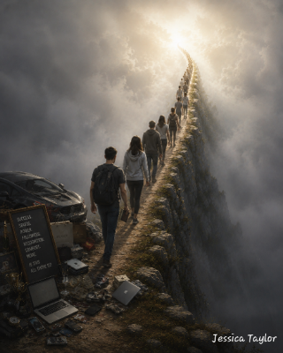
New Blind Camp Devotions
Northview Adventist School presents:
The Narrow Way to Heaven
Fridays @ 1 pm & Saturdays @ 5 pm
The Narrow Way in the modern context
Photo credit: Jessica Taylor
on STR stations,
STR apps, or STR.fm

Slide 5

Camp Meeting
3ABN 2026 Summer Camp Meeting logo
Photo credit- 3ABN website
Today 3-5, and 7-9 pm
on STR stations,
STR apps, or STR.fm

Slide 6
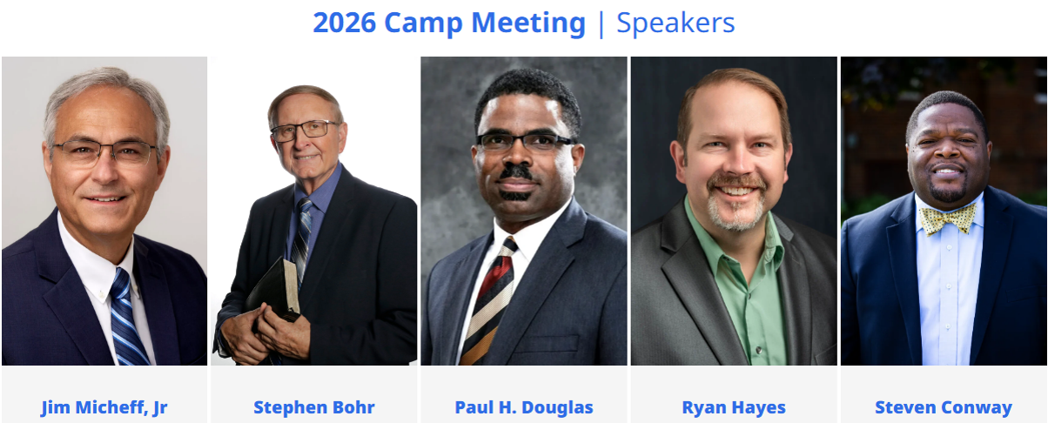
Camp Meeting
Photo credit- Michigan Conference of Seventh-day Adventists
June 12–20, weeknights 9 pm and Sabbaths from 9 am
on STR stations,
STR apps, or STR.fm

Slide 7
Christian Radio
104.7 fm /1540 am
STR phone apps, &
STR.fm

Slide 8
Strong Tower Radio
91.9 FM & 97.3 FM
STR Android or ISO apps, &
STR.fm

Slide 9
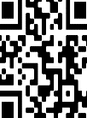
Point, click, and give!
﻿Give to Strong Tower Radio via the STR.fm giving page, with your smartphone, or mailing a check to:
P.O. Box 567, Cadillac, MI 49601

Slide 10
Strong Tower Radio
Area STR Stations
STR phone apps, &
STR.fm

