Slide 1

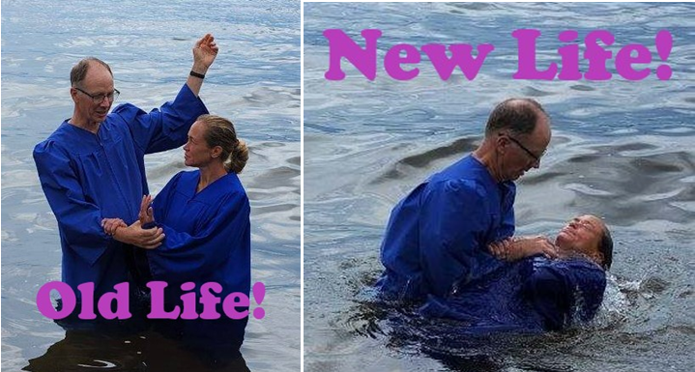
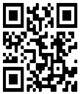
STR Announcements
STR Announcements
STR Announcements
Baptism Joey Retsema
Photo source: Pastor Bob Benson
Joey's STR Testimony 2
Joey completes her Strong Tower Radio testimony this Sunday at 3:30 am, Monday at 4 pm, Wednesday at 9 pm, and Thursday at 1 pm.
.
Order Your Seeds!
Enjoy the Garden Guy's Chinese Vegetable Quiz and seed ordering prompts this Sunday at 5 pm, Monday at 10 am, and Wednesday at midnight.
Camp Devotions Resume
Blind camp devotions resume this Friday at 1:00 pm and Sunday at 5 pm.
Point, click, and give!
﻿Give to Strong Tower Radio via the STR.fm giving page with your smartphone, or mail a check to
P.O. Box 567, Cadillac, MI 49601
Baptism Joey Retsema
Photo source: Pastor Bob Benson
Joey's STR Testimony 2
Joey completes her Strong Tower Radio testimony this Sunday at 3:30 am, Monday at 4 pm, Wednesday at 9 pm, and Thursday at 1 pm.
.
Order Your Seeds!
Enjoy the Garden Guy's Chinese Vegetable Quiz and seed ordering prompts this Sunday at 5 pm, Monday at 10 am, and Wednesday at midnight.
Camp Devotions Resume
Blind camp devotions resume this Friday at 1:00 pm and Sunday at 5 pm.
Point, click, and give!
﻿Give to Strong Tower Radio via the STR.fm giving page with your smartphone, or mail a check to
P.O. Box 567, Cadillac, MI 49601
Baptism Joey Retsema
Photo source: Pastor Bob Benson
Joey's STR Testimony 2
Joey completes her Strong Tower Radio testimony this Sunday at 3:30 am, Monday at 4 pm, Wednesday at 9 pm, and Thursday at 1 pm.
.
Order Your Seeds!
Enjoy the Garden Guy's Chinese Vegetable Quiz and seed ordering prompts this Sunday at 5 pm, Monday at 10 am, and Wednesday at midnight.
Camp Devotions Resume
Blind camp devotions resume this Friday at 1:00 pm and Sunday at 5 pm.
Point, click, and give!
﻿Give to Strong Tower Radio via the STR.fm giving page with your smartphone, or mail a check to
P.O. Box 567, Cadillac, MI 49601
Only on-air, via Apple & Android apps, &
STR.fm on your computer!
Only on-air, via Apple & Android apps, &
STR.fm on your computer!
Only on-air, via Apple & Android apps, &
STR.fm on your computer!

