Slide 1
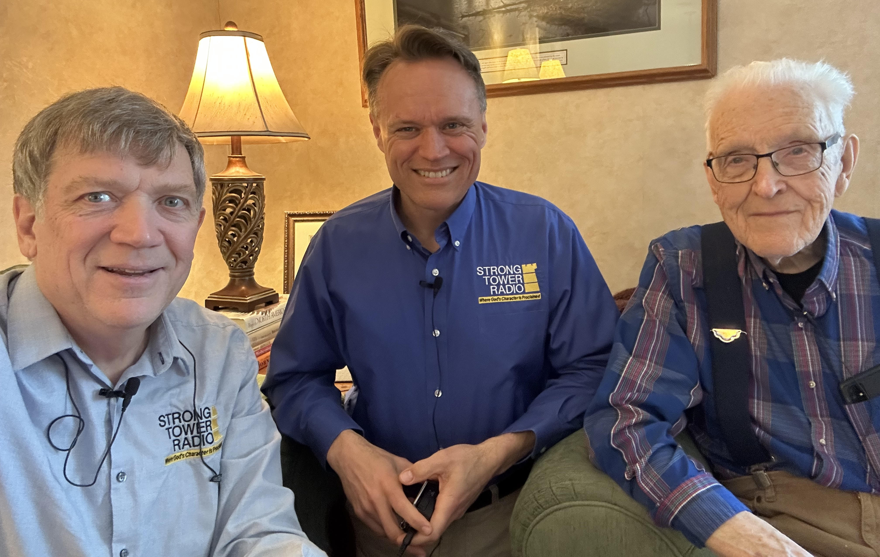

at 100 years old
Listen to an interview of
Dr. Arthur Weaver's life story
Sun. 3:30 a.m.
Mon. @ 4 p.m. Wed. @ 9 p.m. Thu. @ 1 p.m.
on STR stations,
STR apps, or STR.fm

Slide 2

Child Abuse Awareness
Child Abuse Awareness
month Program
Sun. @ 5 P.M. Mon. @ 10:00 A.m. Wed. @ 12:00 a.m.
on STR stations,
STR apps, or STR.fm

Slide 3
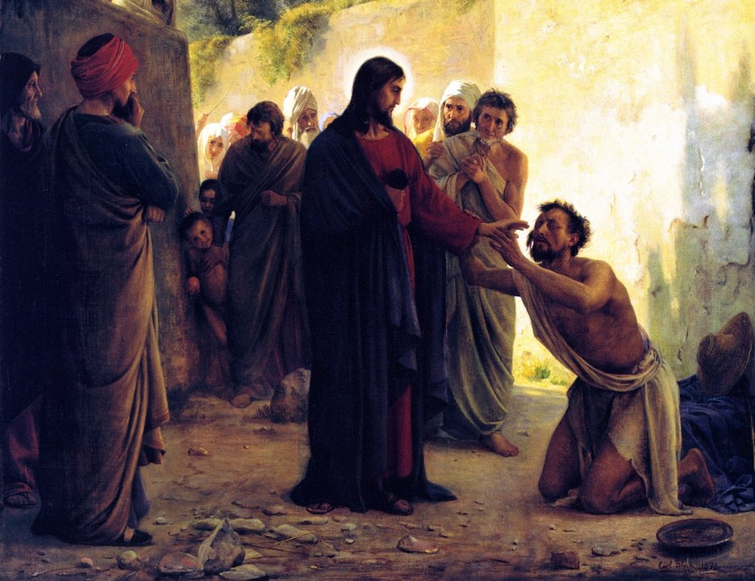
Jesus, Healing, the Gospel, & Me!
Series Continues
Friday @ 1 P.M. Sab. @ 5:00 p.m.
on STR stations,
STR apps, or STR.fm

Slide 4
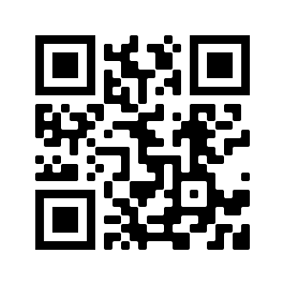
Point, click, and give!
﻿Give to Strong Tower Radio via the STR.fm giving page, with your smartphone, or mailing a check to:
P.O. Box 567, Cadillac, MI 49601

Slide 5
Christian Radio
104.7 fm /1540 am
STR phone apps, &
STR.fm

Slide 6
Strong Tower Radio
Area STR Stations
STR phone apps, &
STR.fm

Slide 7
Resurrection Theology
How Christ’s resurrection debunks
Immorality of the soul
Sun @ 3:30 a.m. / Mon. @ 4 p.m. / Wed. @ 9 p.m. / Thurs. @ 1 p.m.
on STR stations,
STR apps, or STR.fm

