Slide 1
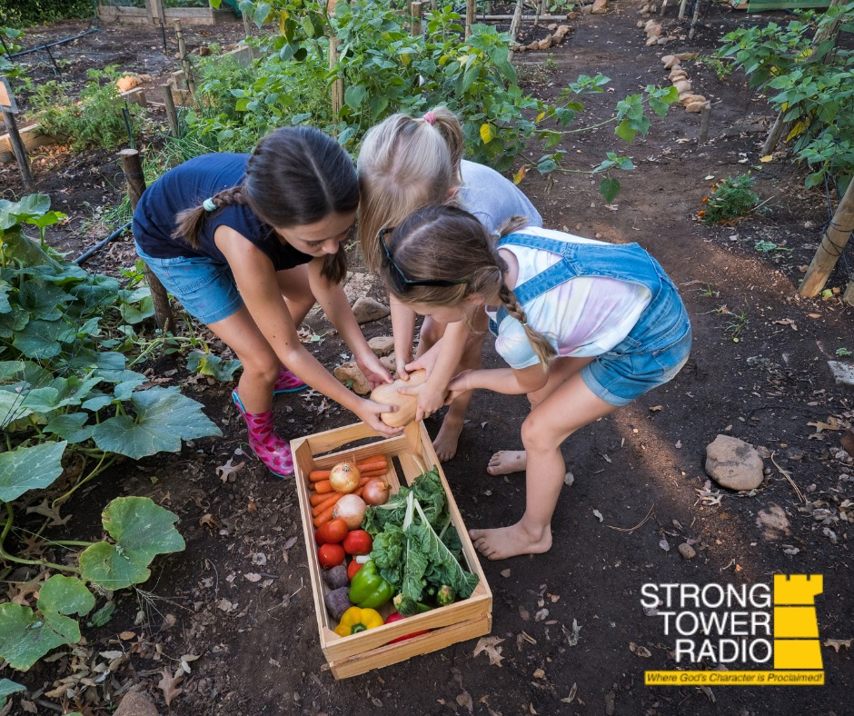

May Gardening
More
to
learn
Gardening
Photo credit: Jennifer Brooks
Sunday @ 5 pm, Monday @ 10 am, & Wednesday at 12 am
on STR stations,
STR apps, or STR.fm

Slide 2
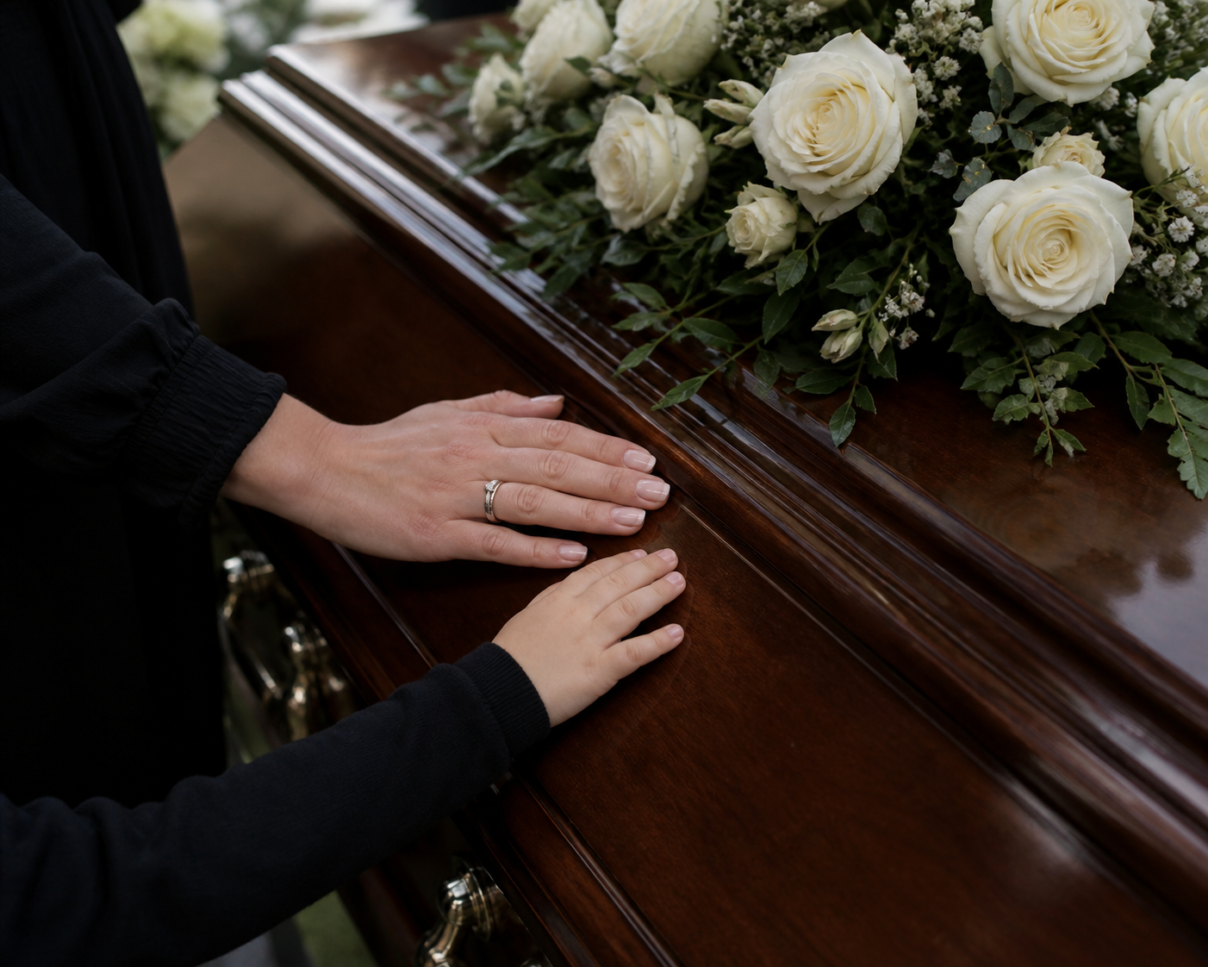
Grief Recovery
Pastor Steve
And
Tammy Conway
Grief
Photo credit: Jessica Taylor
Sunday @ 3:30 am, Monday @ 4 pm, Wednesday @ 9 pm, and Thursday @ 1 pm
on STR stations,
STR apps, or STR.fm

Slide 3

Galatians with Gallimore
Pastor Jay Gallimore
Photo Credit: Jennifer Brooks
Fridays @ 1 pm & Saturdays @ 5 pm
on STR stations,
STR apps, or STR.fm

Slide 4
Christian Radio
104.7 fm /1540 am
STR phone apps, &
STR.fm

Slide 5
Strong Tower Radio
91.9 FM & 97.3 FM
STR Android or ISO apps, &
STR.fm

Slide 6

Point, click, and give!
﻿Give to Strong Tower Radio via the STR.fm giving page, with your smartphone, or mailing a check to:
P.O. Box 567, Cadillac, MI 49601

Slide 7
Strong Tower Radio
Area STR Stations
STR phone apps, &
STR.fm

