Slide 1
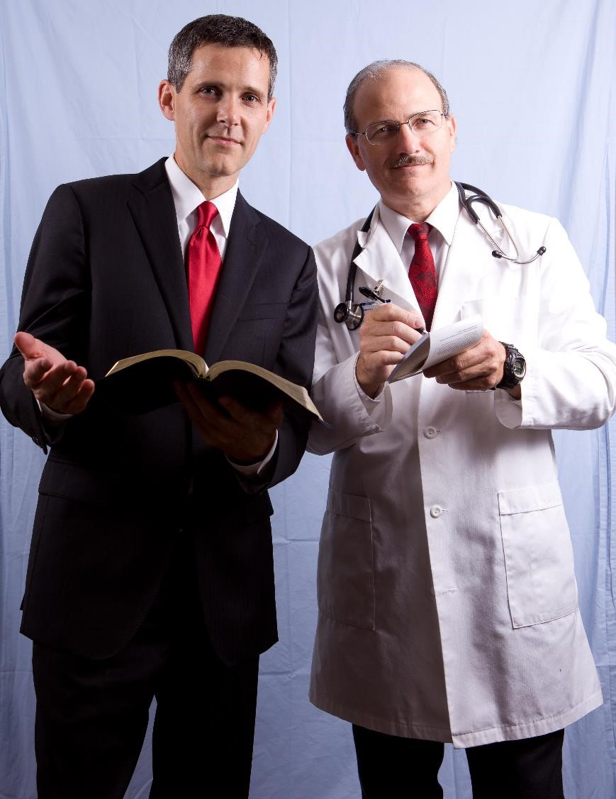

Physician-Pastor Team
is the most effective
evangelistic team
Pastor Physician team
Graphic credit: Wayne Kablanow
Next Friday @ 1 p.m. & Saturday @ 5 p.m.
on STR stations,
STR apps, or STR.fm

Slide 2
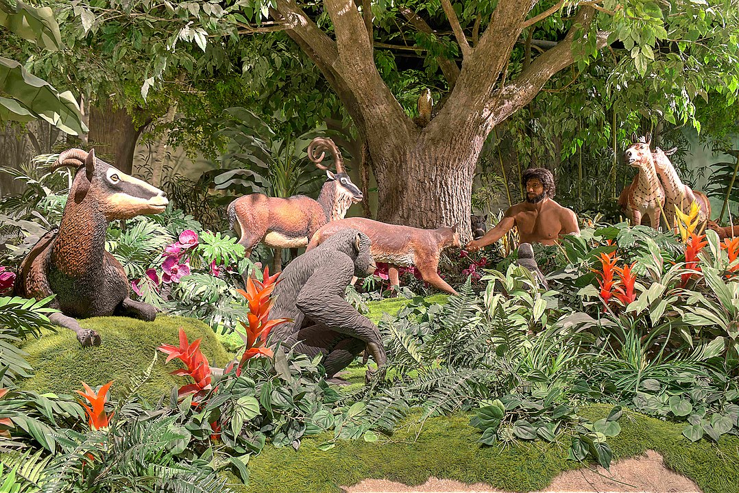
Creation Animal Care
debuts with a
veterinarian host
Adam naming animals depicted at the Creation Museum.
Graphic Credit: D. S. Dugan
Sun. @ 5:00 P.M. Mon. @ 10:00 A.m. Wed. @ 12:00 a.m.
on STR stations,
STR apps, or STR.fm

Slide 3
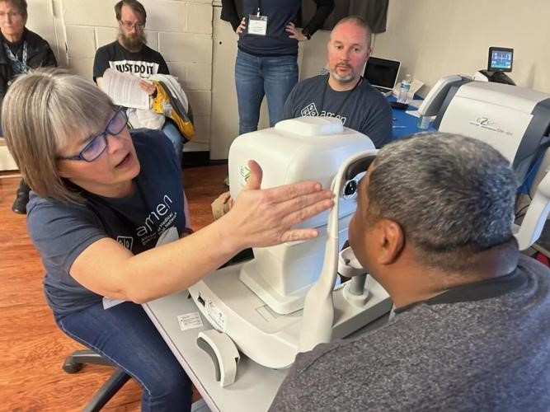
AMEN Clinic Round II
Info on its
second season
Sun. 3:30 a.m.
Mon. @ 4 p.m. Wed. @ 9 p.m. Thu. @ 1 p.m.
Cadillac AMEN Free Clinic optical scan April 15, 2024.
Graphic credit: Tom Mejeur
on STR stations,
STR apps, or STR.fm

Slide 4
Christian Radio
104.7 fm /1540 am
STR phone apps, &
STR.fm

Slide 5

Point, click, and give!
﻿Give to Strong Tower Radio via the STR.fm giving page, with your smartphone, or mailing a check to:
P.O. Box 567, Cadillac, MI 49601

Slide 6
Strong Tower Radio
Area STR Stations
STR phone apps, &
STR.fm

