Slide 1

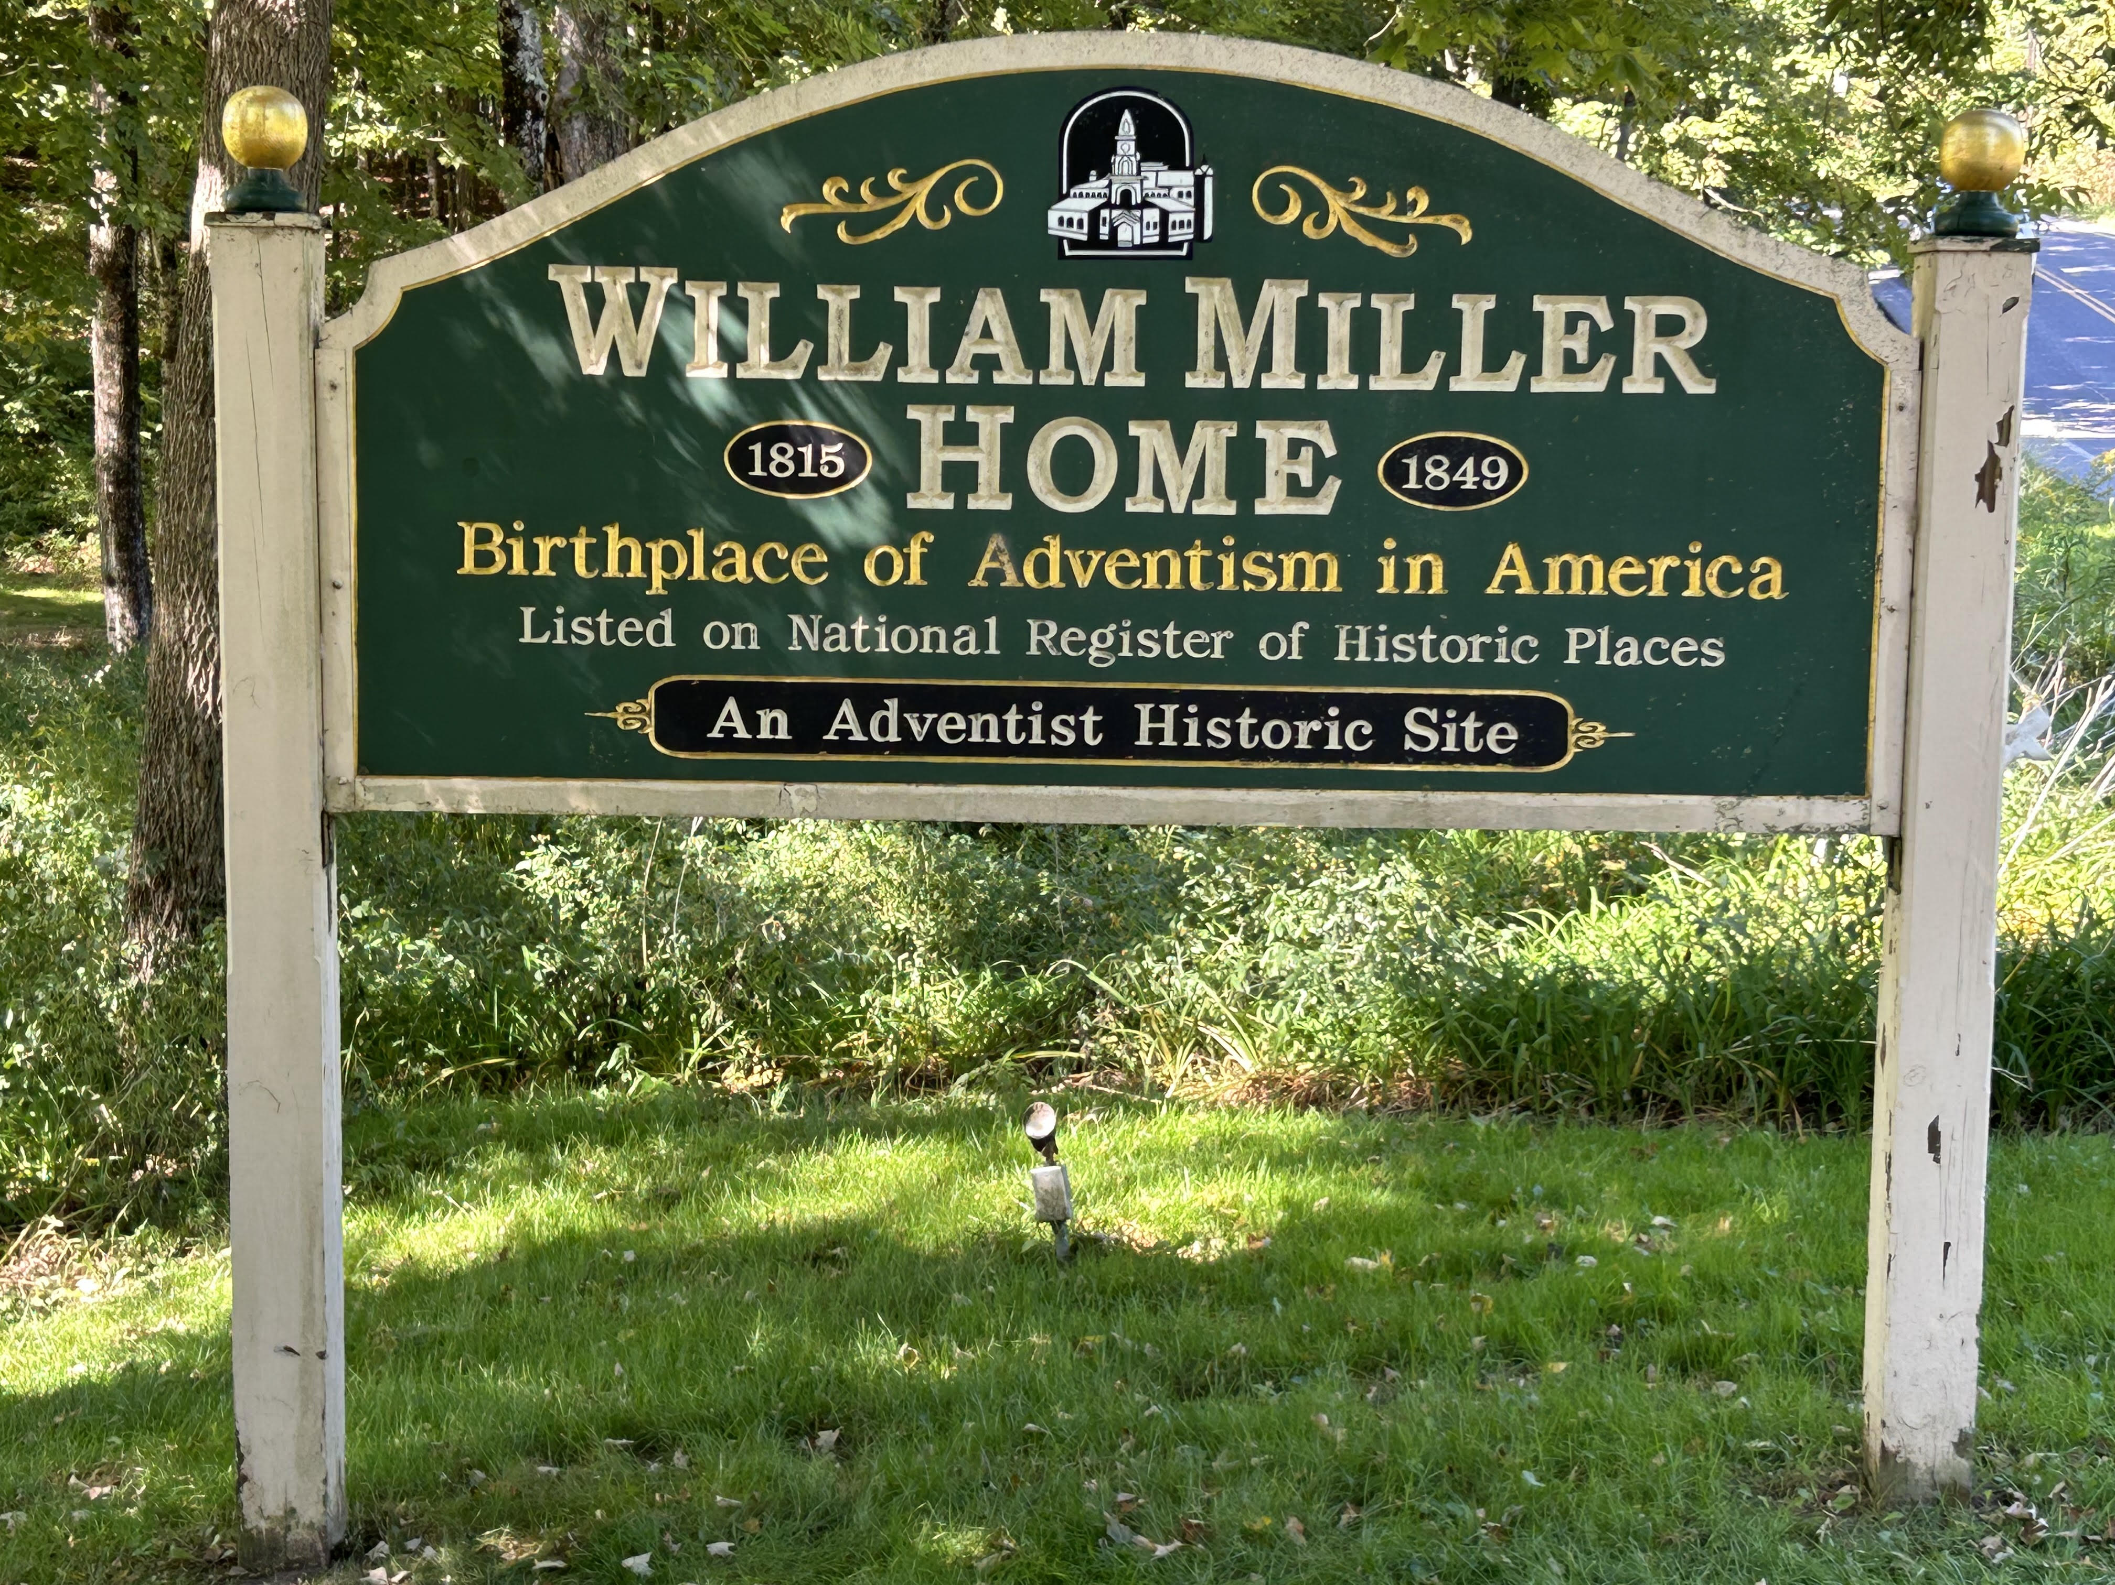
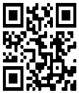
STR Announcements
STR Announcements
STR Announcements
Pioneer William Miller's home sign
Photo credit: Tom Mejeur
Joseph Bates & William Miller
New England Adventist Pioneer Tour features Joseph Bates and William Miller, narrated by Dr. Brian Strayer, on Friday at 1 pm, and again on Saturday at 5 pm.
Sabbath School Prep
Prepare for your adult Sabbath School lesson each Friday from 9-11 pm and Saturdays from 9-11 am.
"Why Love Never Ends"
STR Relationship CPR host explains his "Why Love Never Ends" lead article this Sunday at 5 pm, Monday at 10 am, and Wednesday at 12 am only on STR.
Healing Pre-school Families
STR visited Healing Roots, a program that helps struggling families thrive. Airing on Sunday at 3:30 am, Monday at 4 pm, Wednesday at 9 pm, and Thursday at 1 pm, only on STR stations, or STR.fm.
Point, click, and give!
﻿Give to Strong Tower Radio via the STR.fm giving page with your smartphone, or mail a check to
P.O. Box 567, Cadillac, MI 49601
Pioneer William Miller's home sign
Photo credit: Tom Mejeur
Joseph Bates & William Miller
New England Adventist Pioneer Tour features Joseph Bates and William Miller, narrated by Dr. Brian Strayer, on Friday at 1 pm, and again on Saturday at 5 pm.
Sabbath School Prep
Prepare for your adult Sabbath School lesson each Friday from 9-11 pm and Saturdays from 9-11 am.
"Why Love Never Ends"
STR Relationship CPR host explains his "Why Love Never Ends" lead article this Sunday at 5 pm, Monday at 10 am, and Wednesday at 12 am only on STR.
Healing Pre-school Families
STR visited Healing Roots, a program that helps struggling families thrive. Airing on Sunday at 3:30 am, Monday at 4 pm, Wednesday at 9 pm, and Thursday at 1 pm, only on STR stations, or STR.fm.
Point, click, and give!
﻿Give to Strong Tower Radio via the STR.fm giving page with your smartphone, or mail a check to
P.O. Box 567, Cadillac, MI 49601
Pioneer William Miller's home sign
Photo credit: Tom Mejeur
Joseph Bates & William Miller
New England Adventist Pioneer Tour features Joseph Bates and William Miller, narrated by Dr. Brian Strayer, on Friday at 1 pm, and again on Saturday at 5 pm.
Sabbath School Prep
Prepare for your adult Sabbath School lesson each Friday from 9-11 pm and Saturdays from 9-11 am.
"Why Love Never Ends"
STR Relationship CPR host explains his "Why Love Never Ends" lead article this Sunday at 5 pm, Monday at 10 am, and Wednesday at 12 am only on STR.
Healing Pre-school Families
STR visited Healing Roots, a program that helps struggling families thrive. Airing on Sunday at 3:30 am, Monday at 4 pm, Wednesday at 9 pm, and Thursday at 1 pm, only on STR stations, or STR.fm.
Point, click, and give!
﻿Give to Strong Tower Radio via the STR.fm giving page with your smartphone, or mail a check to
P.O. Box 567, Cadillac, MI 49601
On-air, via Apple & Android apps, & STR.fm
On-air, via Apple & Android apps, & STR.fm
On-air, via Apple & Android apps, & STR.fm

