Slide 1


Who Am I?
The Michigan Conference educational supervisor addresses the youth identity crisis in our society
Sun. 3:30 a.m.
Mon. @ 4 p.m. Wed. @ 9 p.m. Thu. @ 1 p.m.
on STR stations,
STR apps, or STR.fm

Slide 2

Faith and Science
discussion with the Geoscience Research Institute's director
Sun. @ 5 P.M. Mon. @ 10:00 A.m. Wed. @ 12:00 a.m.
on STR stations,
STR apps, or STR.fm

Slide 3
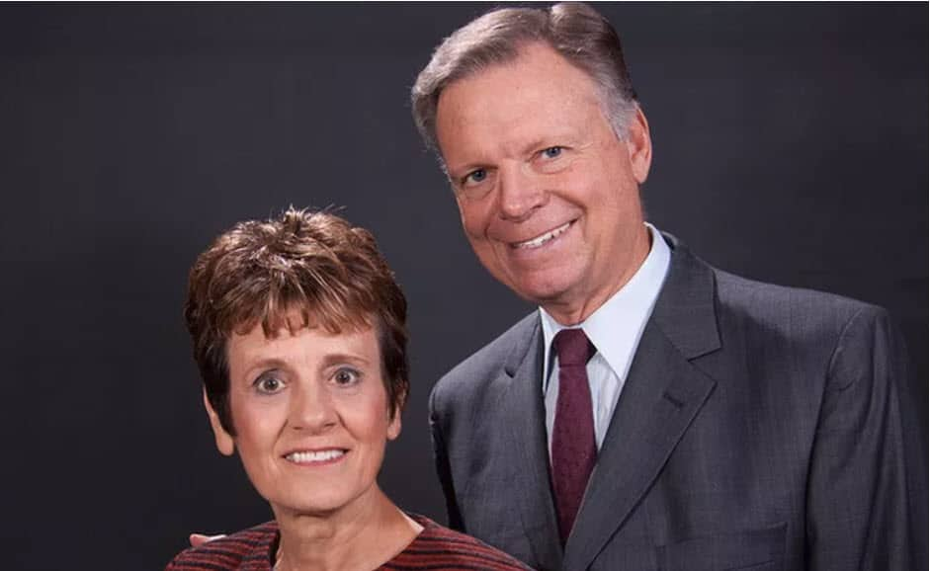
Finley Doubleheader
Mark and Teenie Finley interviews
Next Friday 1 p.m. & Sabbath 5:00 p.m.
on STR stations,
STR apps, or STR.fm

Slide 4
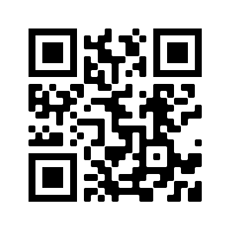
Point, click, and give!
﻿Give to Strong Tower Radio via the STR.fm giving page, with your smartphone, or mailing a check to:
P.O. Box 567, Cadillac, MI 49601

Slide 5
Christian Radio
104.7 fm /1540 am
STR phone apps, &
STR.fm

Slide 6
Strong Tower Radio
Area STR Stations
STR phone apps, &
STR.fm

