Slide 1
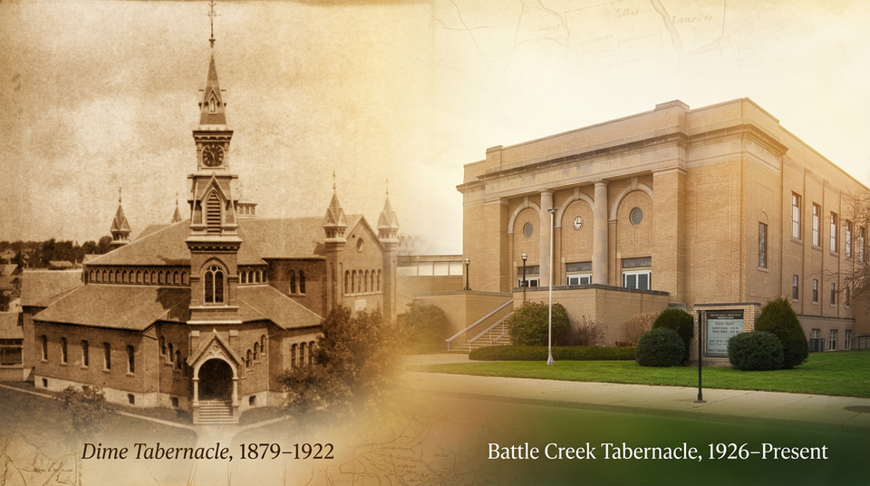

BC Tabernacle Centennial
The Celebration
October 2-10
Battle Creek Dime and present Tabernacle
Photo credit: Battle Creek Tabernacle
Strong Tower Radio

Slide 2
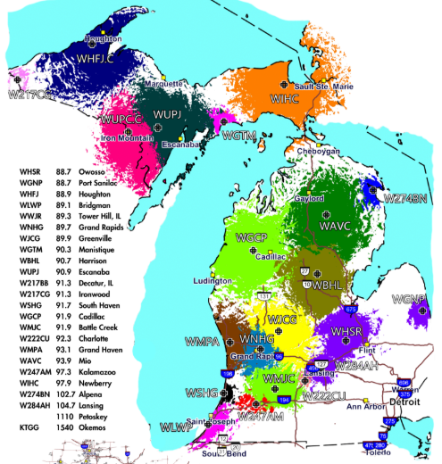
Radio Offering
Michigan Radio Ministries
October 10
Strong Tower Radio’s 23 Michigan Stations
Photo credit: STR
Strong Tower Radio

Slide 3
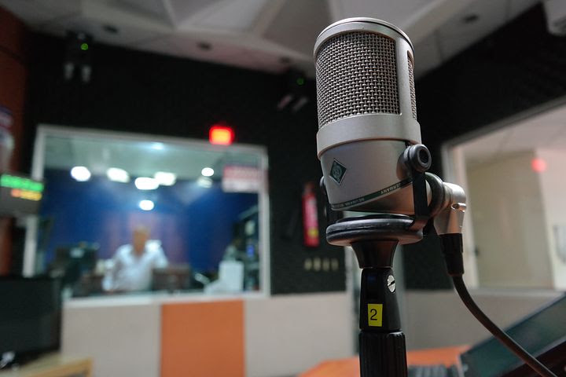
October Preview
Strong Tower Radio’s
October Programs and Specials
Studio recording in progress
Photo credit: source unknown
Sunday @ 5 pm, Monday @ 10 am, & Wednesday at 12 am
on STR stations,
STR apps, or STR.fm

Slide 4
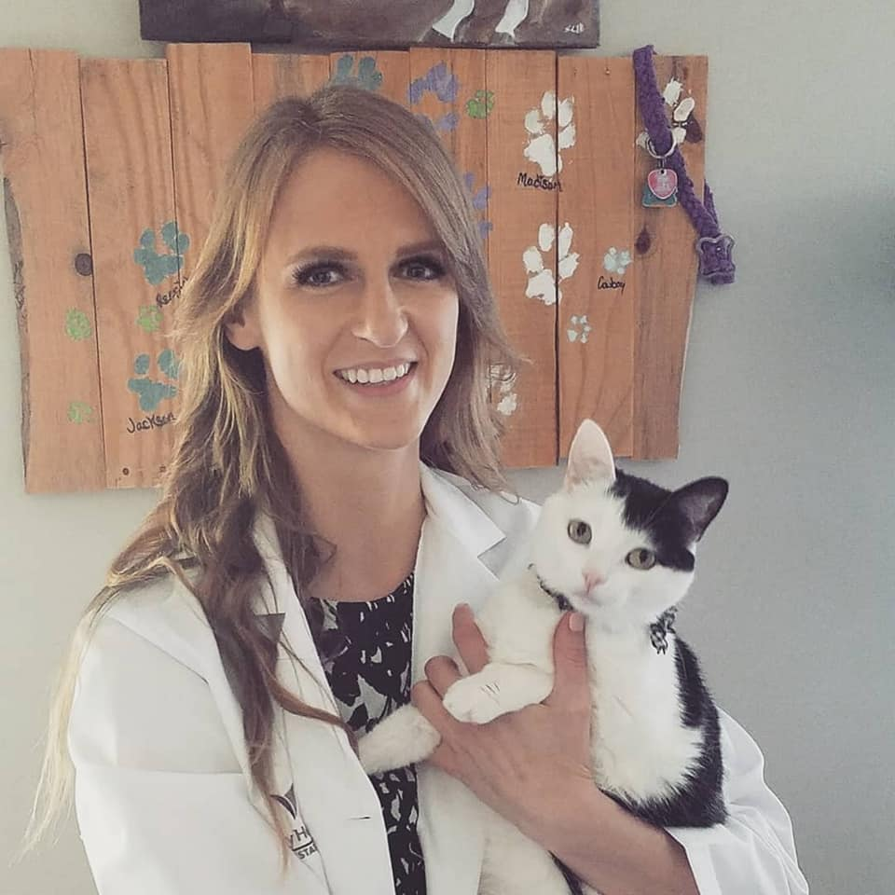
Animal Husbandry
the Andrews University
Animal Husbandry program
AU Animal Husbandry student Sara Lange
Photo credit: Andrews University
Sunday @ 3:30 am, Monday @ 4 pm, Wednesday @ 9 pm, and Thursday @ 1 pm
on STR stations,
STR apps, or STR.fm

Slide 5
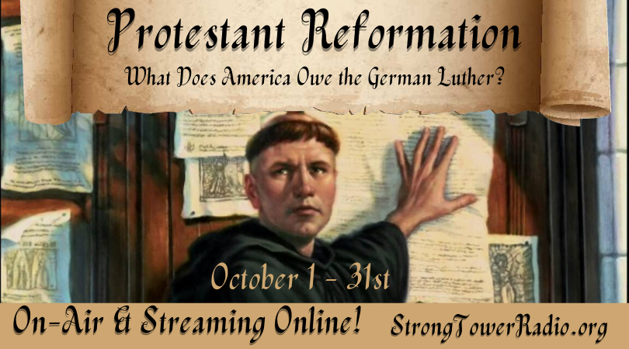
Strong Tower Radio
﻿Protestant Reformation
Grow your faith
and knowledge
2026 STR Protestant Reformation
Photo credit: STR
Daily @ 6 am & 6 pm
on STR stations,
STR apps, or STR.fm

Slide 6
Christian Radio
104.7 fm /1540 am
STR phone apps, &
STR.fm

Slide 7
Strong Tower Radio
91.9 FM & 97.3 FM
STR Android or ISO apps, &
STR.fm

Slide 8
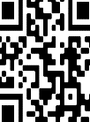
Point, click, and give!
﻿Give to Strong Tower Radio via the STR.fm giving page, with your smartphone, or mailing a check to:
P.O. Box 567, Cadillac, MI 49601

Slide 9
Strong Tower Radio
Area STR Stations
STR phone apps, &
STR.fm

