Slide 1
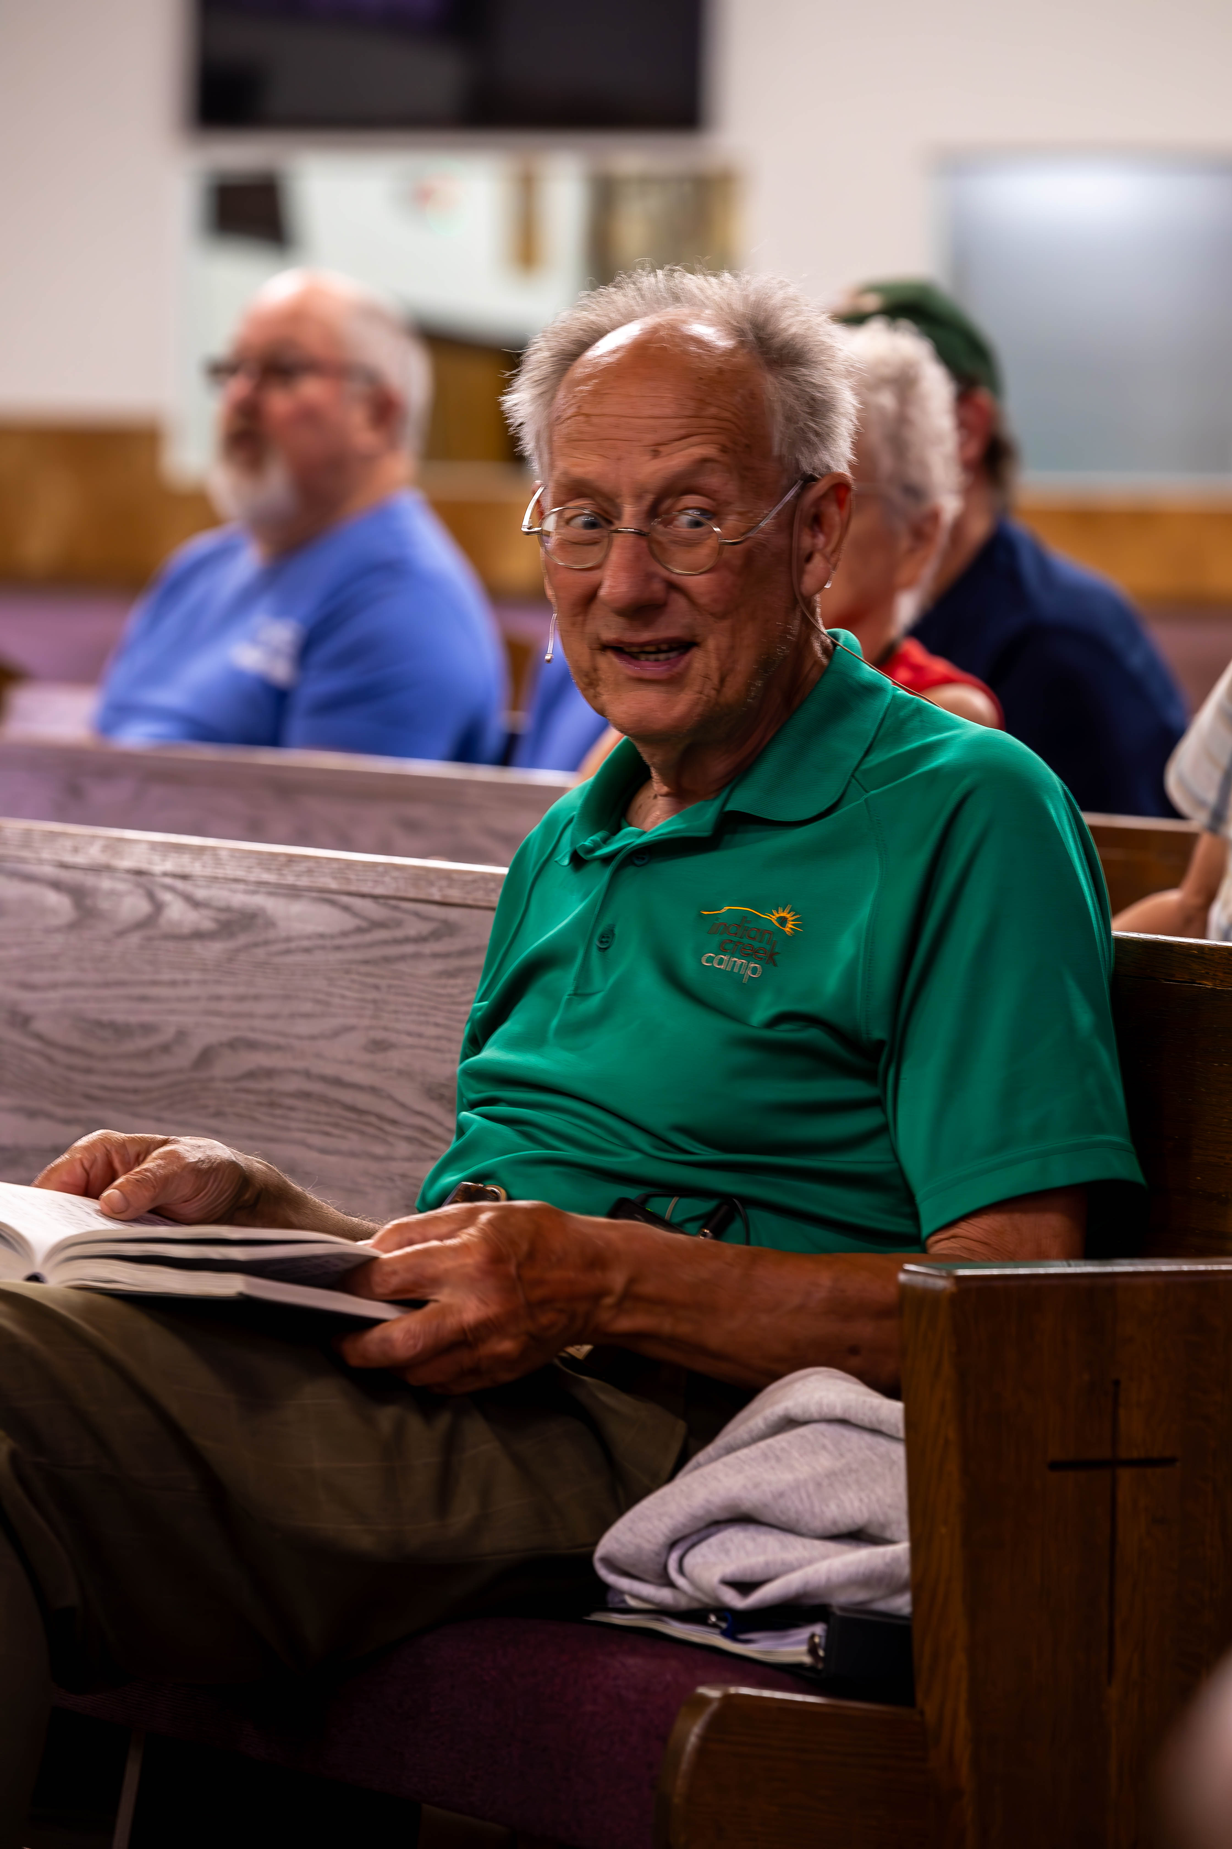

Blind Camp Devotionals
Devotional Talk
Resume
Pastor Fred Calkins
Photo Credit: Strong Tower Radio files
Fridays @ 1 pm & Saturdays @ 5 pm
on STR stations,
STR apps, or STR.fm

Slide 2
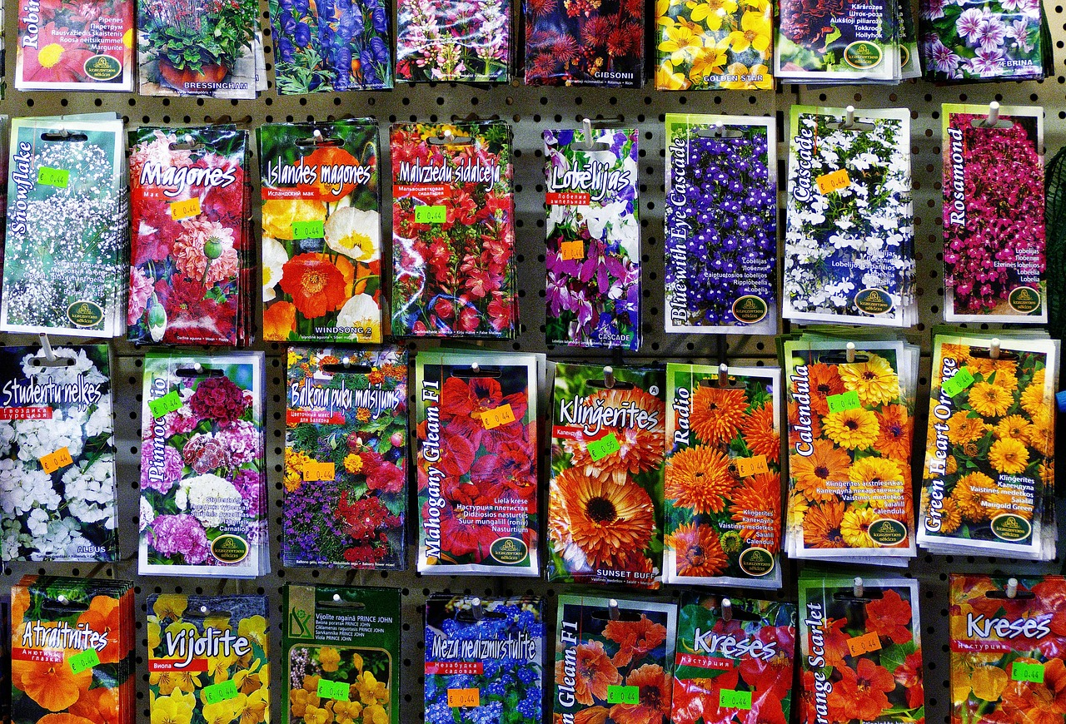
Seed ordering time
Chinese Vegetable Quiz
and
seed ordering prompts
Seed envelops on display
Photo credit: Anaterate via Pixabay
Sunday @ 5 pm, Monday @ 10 am, & Wednesday at 12 am
on STR stations,
STR apps, or STR.fm

Slide 3
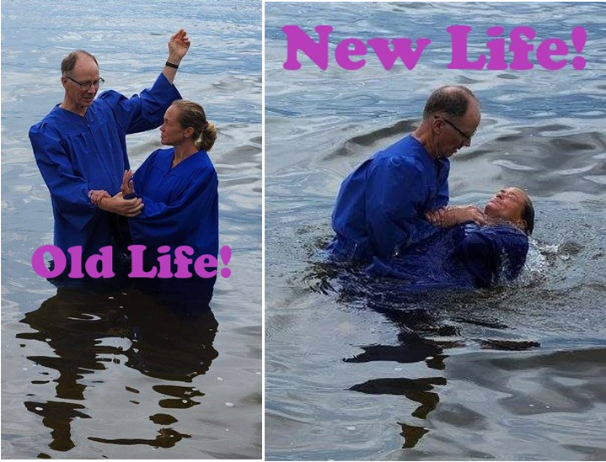
Testimony- 2
Joey’s Strong Tower Radio
Story Conclusion
Baptism Joey Ritzema's Baptism
Photo credit: Pastor Bob Benson
Sunday @ 3:30 am, Monday @ 4 pm, Wednesday @ 9 pm, and Thursday @ 1 pm
on STR stations,
STR apps, or STR.fm

Slide 4
Christian Radio
104.7 fm /1540 am
STR phone apps, &
STR.fm

Slide 5
Strong Tower Radio
91.9 FM & 97.3 FM
STR Android or ISO apps, &
STR.fm

Slide 6
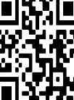
Point, click, and give!
﻿Give to Strong Tower Radio via the STR.fm giving page, with your smartphone, or mailing a check to:
P.O. Box 567, Cadillac, MI 49601

Slide 7
Strong Tower Radio
Area STR Stations
STR phone apps, &
STR.fm

