Slide 1
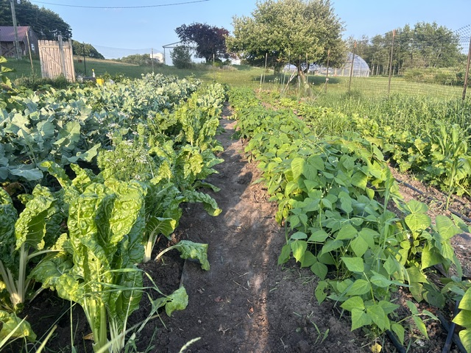

Garden Guy Q & A
Questions from
a Live audience
growing Season 2024
Photo credit: Tom mejeur
Sunday @ 5 pm, Monday @ 10 am, & Wednesday at 12 am
on STR stations,
STR apps, or STR.fm

Slide 2

Tough Gender Issues
﻿a ministry addressing
the gender issues of today
Coming Together Ministries logo
Photo credit: Coming Together Ministries
Sunday @ 3:30 am, Monday @ 4 pm, Wednesday @ 9 pm, and Thursday @ 1 pm
on STR stations,
STR apps, or STR.fm

Slide 3
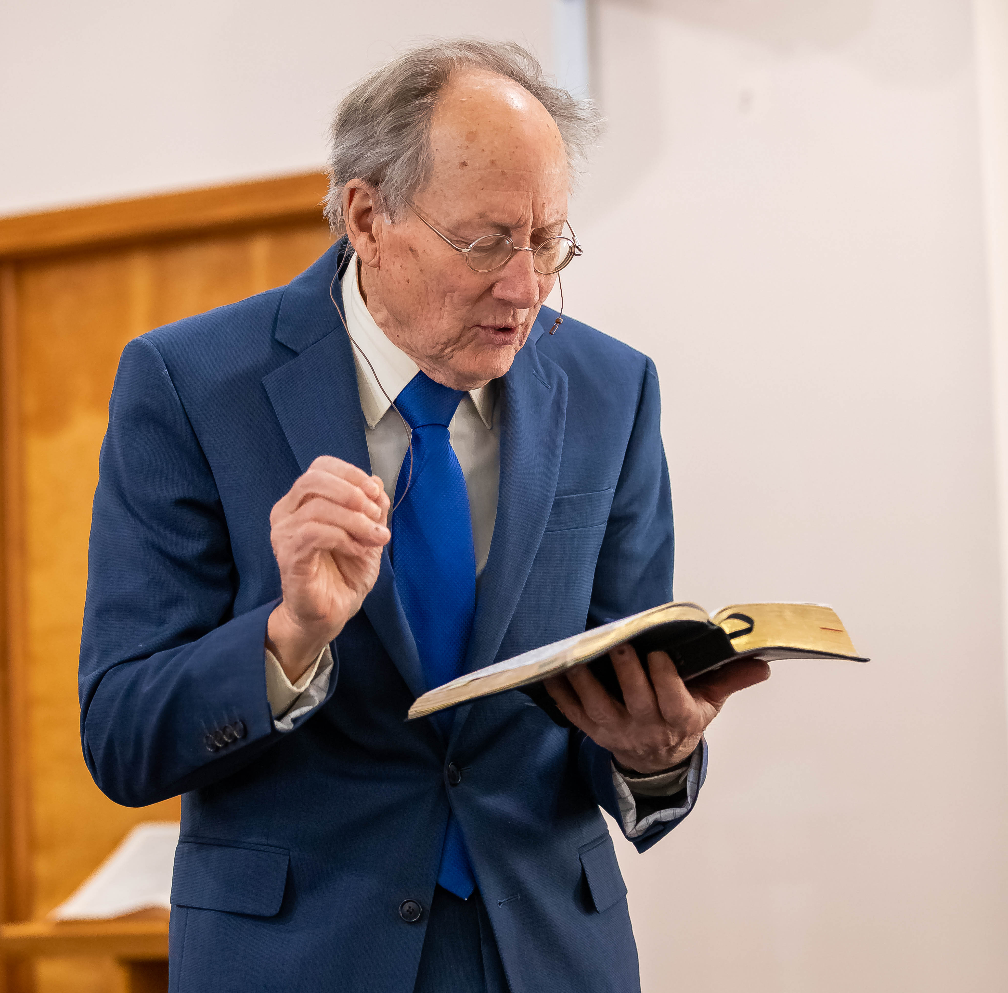
Blind Camp Devotions
Pastor Fred’s Latest
Blind Camp Devotions
Fred Calkins at Winter Blind Camp 2024
Photo credit: Shawna Campbell
Fridays @ 1 pm & Saturdays @ 5 pm
on STR stations,
STR apps, or STR.fm

Slide 4

The Mud Guy
STR adds
Creation program
Rich Aguilera, the "Mud Guy"
Photo credit: One Mustard Seed
Saturdays @ 7:30 pm & Sundays @ 9 am
on STR stations,
STR apps, or STR.fm

Slide 5
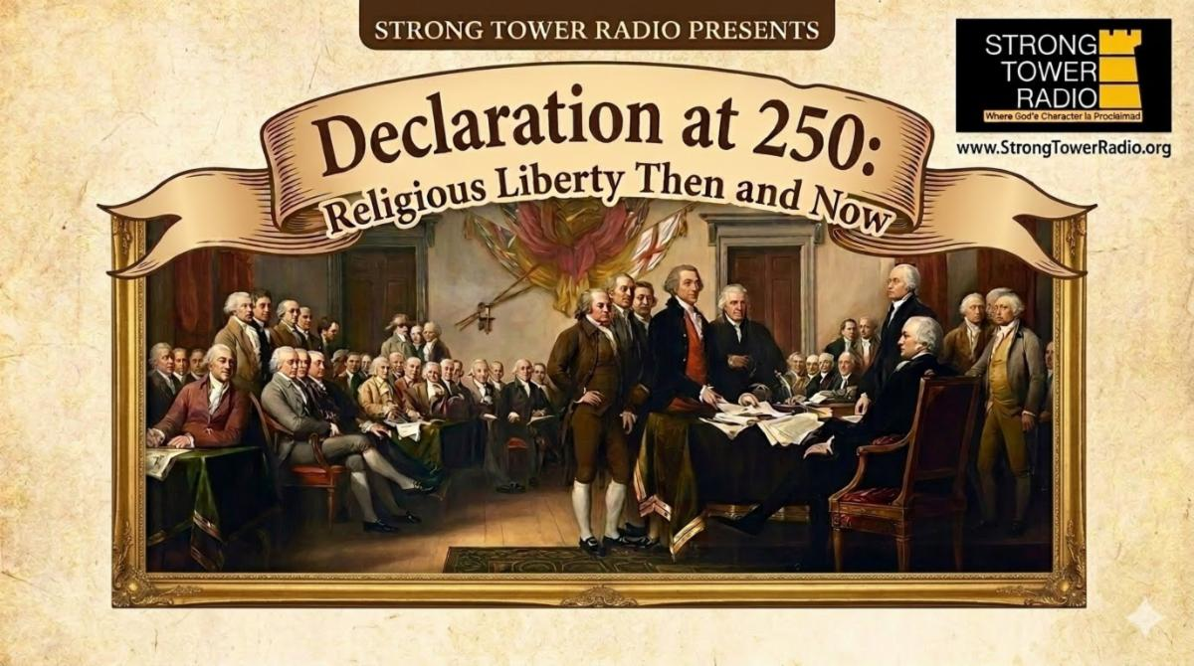
Religious Freedom
Then and Now
Religious Liberty
mini-series
Signing of the Declaration of Independence
Photo credit: STR
Sundays @ 11 am, Mondays at 8:30 pm, & Tuesdays @ 2:30 am
on STR stations,
STR apps, or STR.fm

Slide 6
Christian Radio
104.7 fm /1540 am
STR phone apps, &
STR.fm

Slide 7
Strong Tower Radio
91.9 FM & 97.3 FM
STR Android or ISO apps, &
STR.fm

Slide 8
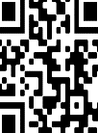
Point, click, and give!
﻿Give to Strong Tower Radio via the STR.fm giving page, with your smartphone, or mailing a check to:
P.O. Box 567, Cadillac, MI 49601

Slide 9
Strong Tower Radio
Area STR Stations
STR phone apps, &
STR.fm

