Slide 1


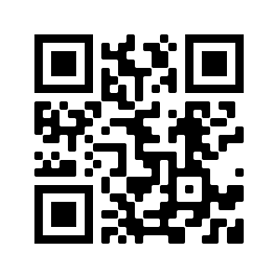
STR Announcements
STR Announcements
STR Announcements
Man questioning his identity.
Photo Credit: Constant Contact
Who Am I?
The Michigan Conference educational supervisor addresses the youth identity crisis in our society this Sunday at 3:30 a.m., Monday at 4 p.m., Wednesday at
9 p.m., and Thursday at 1 p.m.
Finley Doubleheader
Strong Tower Radio interviews international evangelist Mark Finley and health educator Teenie Finley Friday at
1 p.m. and next Saturday at 5 p.m.
Faith and Science
Faith and science are discussed with the Geoscience Research Institute's director and a researcher this Sunday at
5:00 p.m., Monday at 10:00 a.m., and Wednesday at 12:00 a.m.
Point, click, and give!
﻿Give to Strong Tower Radio via the STR.fm giving page, with your smartphone, or mailing a check to
P.O. Box 567, Cadillac, MI 49601
Man questioning his identity.
Photo Credit: Constant Contact
Who Am I?
The Michigan Conference educational supervisor addresses the youth identity crisis in our society this Sunday at 3:30 a.m., Monday at 4 p.m., Wednesday at
9 p.m., and Thursday at 1 p.m.
Finley Doubleheader
Strong Tower Radio interviews international evangelist Mark Finley and health educator Teenie Finley Friday at
1 p.m. and next Saturday at 5 p.m.
Faith and Science
Faith and science are discussed with the Geoscience Research Institute's director and a researcher this Sunday at
5:00 p.m., Monday at 10:00 a.m., and Wednesday at 12:00 a.m.
Point, click, and give!
﻿Give to Strong Tower Radio via the STR.fm giving page, with your smartphone, or mailing a check to
P.O. Box 567, Cadillac, MI 49601
Man questioning his identity.
Photo Credit: Constant Contact
Who Am I?
The Michigan Conference educational supervisor addresses the youth identity crisis in our society this Sunday at 3:30 a.m., Monday at 4 p.m., Wednesday at
9 p.m., and Thursday at 1 p.m.
Finley Doubleheader
Strong Tower Radio interviews international evangelist Mark Finley and health educator Teenie Finley Friday at
1 p.m. and next Saturday at 5 p.m.
Faith and Science
Faith and science are discussed with the Geoscience Research Institute's director and a researcher this Sunday at
5:00 p.m., Monday at 10:00 a.m., and Wednesday at 12:00 a.m.
Point, click, and give!
﻿Give to Strong Tower Radio via the STR.fm giving page, with your smartphone, or mailing a check to
P.O. Box 567, Cadillac, MI 49601
On-air, via Apple & Android apps, & STR.fm
On-air, via Apple & Android apps, & STR.fm
On-air, via Apple & Android apps, & STR.fm

