Slide 1
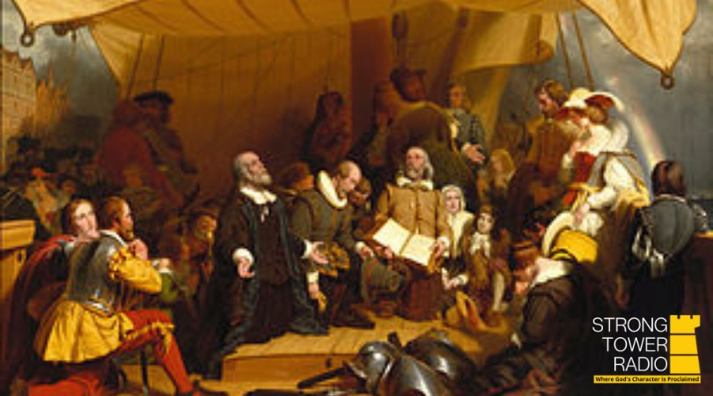

November Preview
Shelby AMEN Free Clinic,
the Marshall Prayer Pantry, and
the Salvation Army Thanksgiving
Photo credit unknown
Sunday @ 5 pm, Monday @ 10 am, & Wednesday at 12 am
on STR stations,
STR apps, or STR.fm

Slide 2

PARENTAL ALERT!
Disney's occult-themed
youth animation
openings Thanksgiving week
Sunday @ 3:30 am, Monday @ 4 pm, Wednesday @ 9 pm, and Thursday @ 1 pm
Photo credit: Little Light Studios
on STR stations,
STR apps, or STR.fm

Slide 3
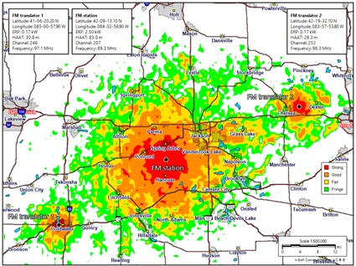
Strong Tower Radio
﻿New Stations
Spring Arbor
Battle Creek
Coldwater
Galesburg
Kalamazoo
Lansing
Chelsea
Strong Tower Radio's Spring Arbor station and translators
Photo credit: Strong Tower Radio
on STR stations,
STR apps, or STR.fm

Slide 4
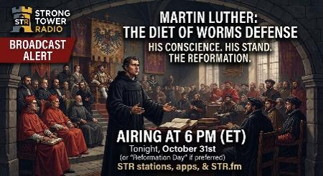
﻿"Here I stand" Speech
Airing
today
Martin Luther at the Diet of Worms
Photo credit: STR
Sabbath @ 6 pm
on STR stations,
STR apps, or STR.fm

Slide 5
Christian Radio
104.7 fm /1540 am
STR phone apps, &
STR.fm

Slide 6
Strong Tower Radio
91.9 FM & 97.3 FM
STR Android or ISO apps, &
STR.fm

Slide 7
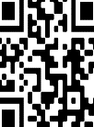
Point, click, and give!
﻿Give to Strong Tower Radio via the STR.fm giving page, with your smartphone, or mailing a check to:
P.O. Box 567, Cadillac, MI 49601

Slide 8
Strong Tower Radio
Area STR Stations
STR phone apps, &
STR.fm

