Slide 1
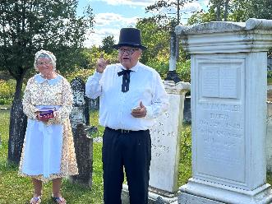

Adventist Pioneers
William Miller
And
Joseph Bates
Pioneer William Miller, home curator at Miller's gravesite
Photo credit: Tom Mejeur
Friday (8/08) @ 1 p.m. And Saturday (8/09) @ 5 p.m.
on STR stations,
STR apps, or STR.fm

Slide 2
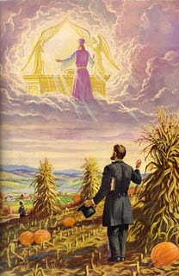
Adventist Pioneers
J. N. Loughborough
And
Hiram Edson
Hiram Edson’s depiction of the heavenly Sanctuary
Photo credit: Spirit of Prophecy 1844
Today @ 5 p.m.
on STR stations,
STR apps, or STR.fm

Slide 3
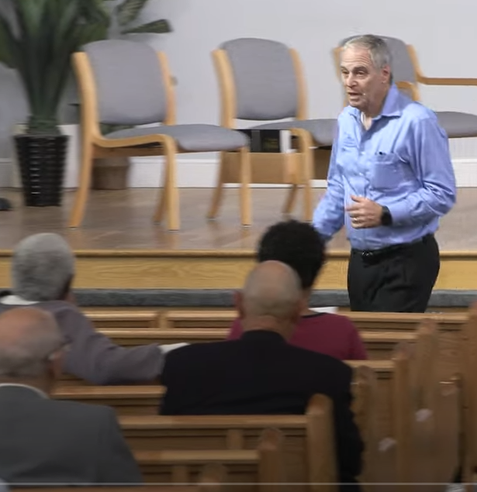
"Why Love Never Ends"
Eternal love
In a world
where love ends
Ron price
Photo credit: Village SDA Church
Friday @ 5:00 P.M. Mon. @ 10:00 A.m. Wed. @ 12:00 a.m.
on STR stations,
STR apps, or STR.fm

Slide 4

Healing Pre-school Families
Helping
Families
That hurt
Healing Roots Logo Banner
Photo credit- Healing Private Wounds
Sun. @3:30 am Mon. @4 pm Wed. @9 pm Thu. @1 pm
on STR stations,
STR apps, or STR.fm

Slide 5

Sabbath School Prep
Adult SS
Preparation Hours
Fridays 9-11 pm & Sabbath 9-11 am
3ABN Sabbath School Panel 3rd quarter 2025
credit- 3ABN
on STR stations,
STR apps, or STR.fm

Slide 6
Christian Radio
104.7 fm /1540 am
STR phone apps, &
STR.fm

Slide 7

Point, click, and give!
﻿Give to Strong Tower Radio via the STR.fm giving page, with your smartphone, or mailing a check to:
P.O. Box 567, Cadillac, MI 49601

Slide 8
Strong Tower Radio
Area STR Stations
STR phone apps, &
STR.fm

