Slide 1
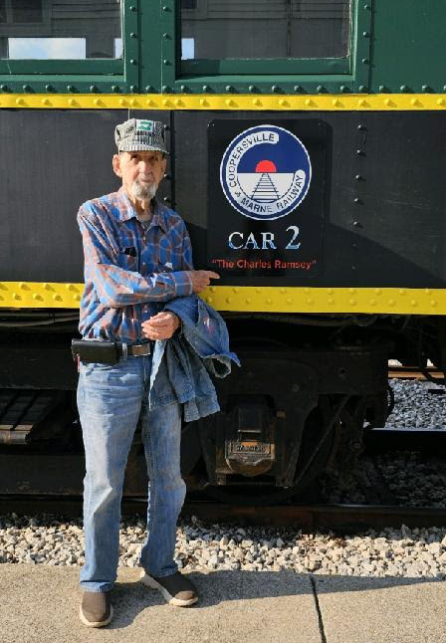

RR Crossing Risks
Learn the risks
And new Tech
Steve Kantner at the Coopersville Railroad
Photo credit: Strong Tower Radio file photo
Sunday @ 5 pm, Monday @ 10 am, & Wednesday at 12 am
on STR stations,
STR apps, or STR.fm

Slide 2

Lifestyle Matters
Learn from
A lifestyle Coach
Stretching before exercise
Photo credit: Mohamed Hassan via Pixabay
Sunday @ 3:30 am, Monday @ 4 pm, Wednesday @ 9 pm, and Thursday @ 1 pm
on STR stations,
STR apps, or STR.fm

Slide 3
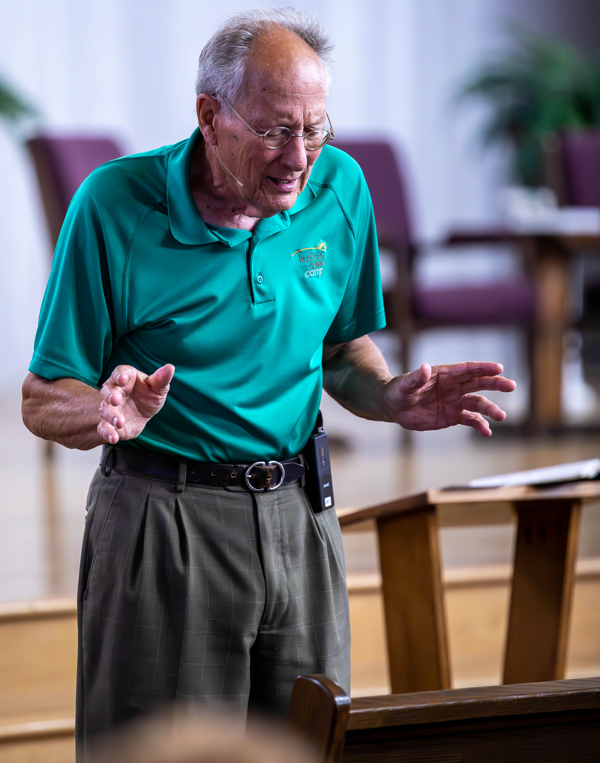
Blind Camp Devotions
Devotions
You will enjoy
Pastor fred calkins at Blind Camp
Photo Credit: Shawna Campbell
Fridays @ 1 pm & Saturdays @ 5 pm
on STR stations,
STR apps, or STR.fm

Slide 4
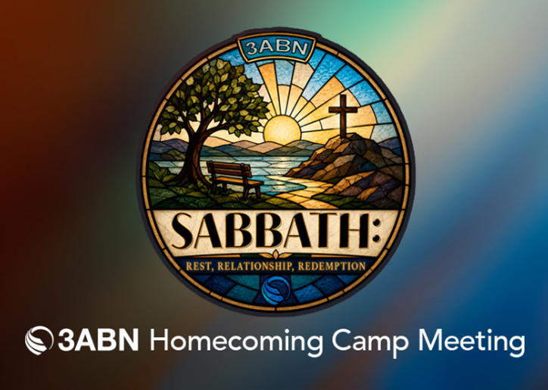
Strong Tower Radio
﻿Camp Meeting
3ABN Fall
﻿Camp Meeting
On STR
2026 3ABN Homecoming Camp Meeting Logo
Photo credit: 3ABN
September 26 to 28
on STR stations,
STR apps, or STR.fm

Slide 5
Christian Radio
104.7 fm /1540 am
STR phone apps, &
STR.fm

Slide 6
Strong Tower Radio
91.9 FM & 97.3 FM
STR Android or ISO apps, &
STR.fm

Slide 7
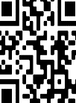
Point, click, and give!
﻿Give to Strong Tower Radio via the STR.fm giving page, with your smartphone, or mailing a check to:
P.O. Box 567, Cadillac, MI 49601

Slide 8
Strong Tower Radio
Area STR Stations
STR phone apps, &
STR.fm

