Slide 1
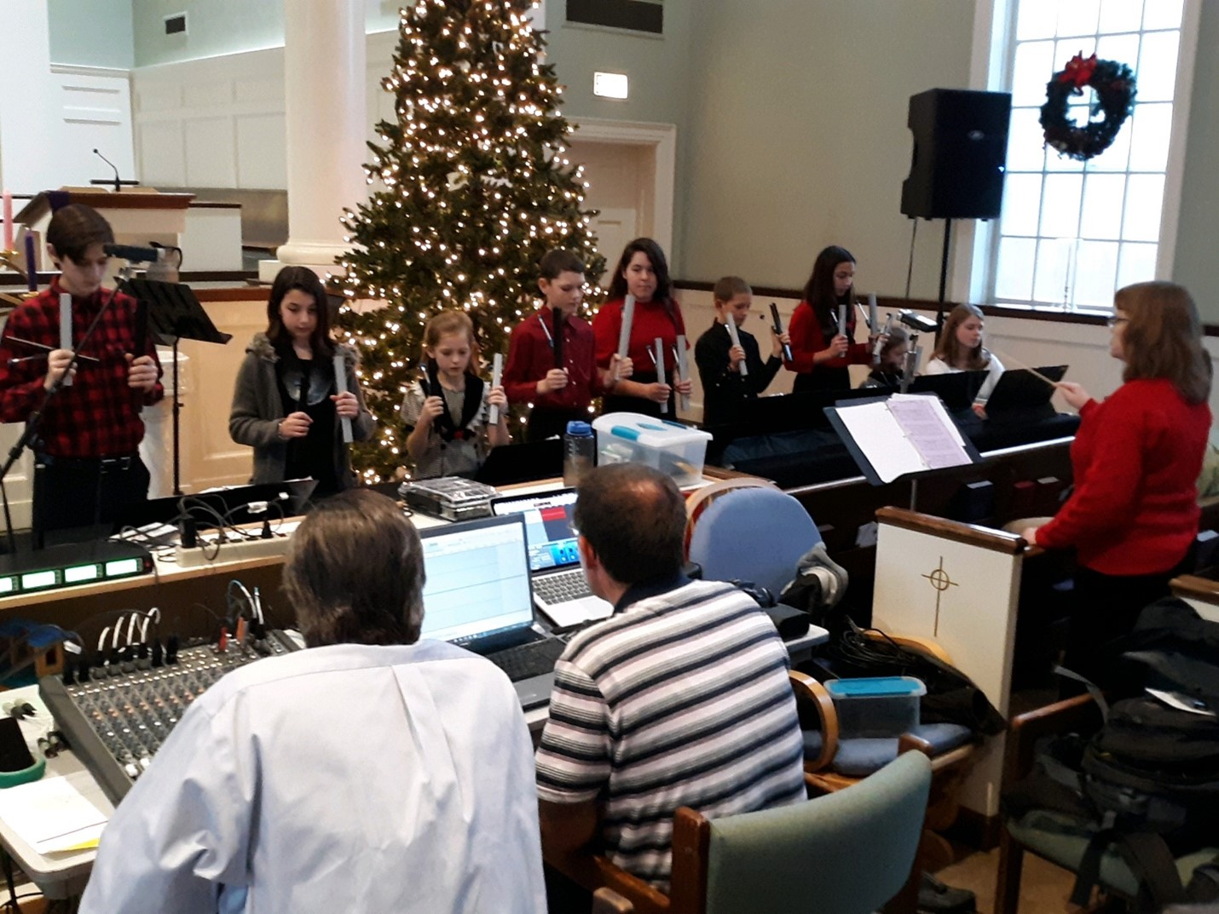

Christmas Variety Hour
Classic Programs
Thru Christmas
Mt. Pleasant STR Variety Hour 2019 program
Photo Credit: Strong Tower Radio
Friday @ 1 pm & Saturday @ 5 pm
on STR stations,
STR apps, or STR.fm

Slide 2

December Gardening
natural Christmas trees,
seasonal safety, and
the gardener's wish list
Photo credit: Jennifer Brooks
Sunday @ 5 pm, Monday @ 10 am, And Wednesday @ 12 am
on STR stations,
STR apps, or STR.fm

Slide 3

Listener’s Testimonies
Delivered from Satanism,
Drugs, and alcohol
Photo credit: Strong Tower Radio
Sunday @ 3:30 pm, Monday @ 4 pm, Wednesday @ 9 pm, and Thursday @ 1 pm
on STR stations,
STR apps, or STR.fm

Slide 4

Christmas
Classic Sermons
Christmas Sermons
Photo credit: Strong Tower Radio
Monday-Friday 1 & 11 am
on STR stations,
STR apps, or STR.fm

Slide 5
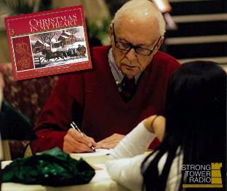
Christmas in My Heart
Heartwarming
Christmas
Stories
Joe Wheeler autographing Books
Photo credit: Strong Tower Radio
6 am & 6 pm Sunday through Thursdays
on STR stations,
STR apps, or STR.fm

Slide 6
Christian Radio
104.7 fm /1540 am
STR phone apps, &
STR.fm

Slide 7
Strong Tower Radio
91.9 FM & 97.3 FM
STR Android or ISO apps, &
STR.fm

Slide 8
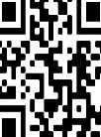
Point, click, and give!
﻿Give to Strong Tower Radio via the STR.fm giving page, with your smartphone, or mailing a check to:
P.O. Box 567, Cadillac, MI 49601

Slide 9
Strong Tower Radio
Area STR Stations
STR phone apps, &
STR.fm

