Slide 1

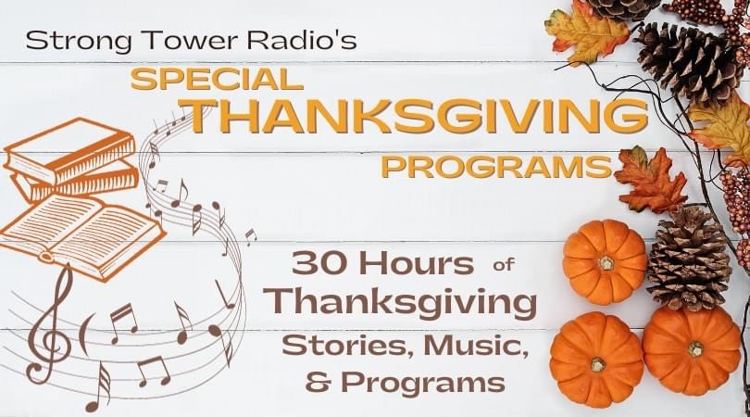
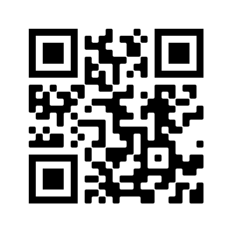
STR Announcements
STR Announcements
STR Announcements
Strong Tower Radio's Wed. and Thur. Thanksgiving programs
Bulletin Announcements for November 18th
STR's 30 Hours of Thanksgiving
Enjoy and share 30 hours of Thanksgiving stories, history, and music beginning Wednesday ONLY on STR stations, STR apps, or STR.fm.
Ritsema's Thanksgiving History
Scott Ritsema gives a comprehensive Christian view of Thanksgiving this Sunday at 5:00 p.m., Monday at 10 a.m., and Wednesday at 12:01 a.m. ONLY on STR stations, STR apps, or STR.fm.
Sheriff's Youth Programs
Strong Tower Radio (STR) talks with the "Andy Griffith" sheriff about his youth programs this Sunday at 3:30 a.m., Monday at 4 p.m., Wednesday at 9 p.m., and Thursday at 1 p.m. on STR stations, STR apps, or STR.fm.
Point, click, and give!
﻿Give to Strong Tower Radio via the STR.fm giving page, with your smartphone, or mailing a check to
P.O. Box 567, Cadillac, MI 49601
Strong Tower Radio's Wed. and Thur. Thanksgiving programs
Bulletin Announcements for November 18th
STR's 30 Hours of Thanksgiving
Enjoy and share 30 hours of Thanksgiving stories, history, and music beginning Wednesday ONLY on STR stations, STR apps, or STR.fm.
Ritsema's Thanksgiving History
Scott Ritsema gives a comprehensive Christian view of Thanksgiving this Sunday at 5:00 p.m., Monday at 10 a.m., and Wednesday at 12:01 a.m. ONLY on STR stations, STR apps, or STR.fm.
Sheriff's Youth Programs
Strong Tower Radio (STR) talks with the "Andy Griffith" sheriff about his youth programs this Sunday at 3:30 a.m., Monday at 4 p.m., Wednesday at 9 p.m., and Thursday at 1 p.m. on STR stations, STR apps, or STR.fm.
Point, click, and give!
﻿Give to Strong Tower Radio via the STR.fm giving page, with your smartphone, or mailing a check to
P.O. Box 567, Cadillac, MI 49601
Strong Tower Radio's Wed. and Thur. Thanksgiving programs
Bulletin Announcements for November 18th
STR's 30 Hours of Thanksgiving
Enjoy and share 30 hours of Thanksgiving stories, history, and music beginning Wednesday ONLY on STR stations, STR apps, or STR.fm.
Ritsema's Thanksgiving History
Scott Ritsema gives a comprehensive Christian view of Thanksgiving this Sunday at 5:00 p.m., Monday at 10 a.m., and Wednesday at 12:01 a.m. ONLY on STR stations, STR apps, or STR.fm.
Sheriff's Youth Programs
Strong Tower Radio (STR) talks with the "Andy Griffith" sheriff about his youth programs this Sunday at 3:30 a.m., Monday at 4 p.m., Wednesday at 9 p.m., and Thursday at 1 p.m. on STR stations, STR apps, or STR.fm.
Point, click, and give!
﻿Give to Strong Tower Radio via the STR.fm giving page, with your smartphone, or mailing a check to
P.O. Box 567, Cadillac, MI 49601
On-air, via Apple & Android apps, & STR.fm
On-air, via Apple & Android apps, & STR.fm
On-air, via Apple & Android apps, & STR.fm

