Slide 1

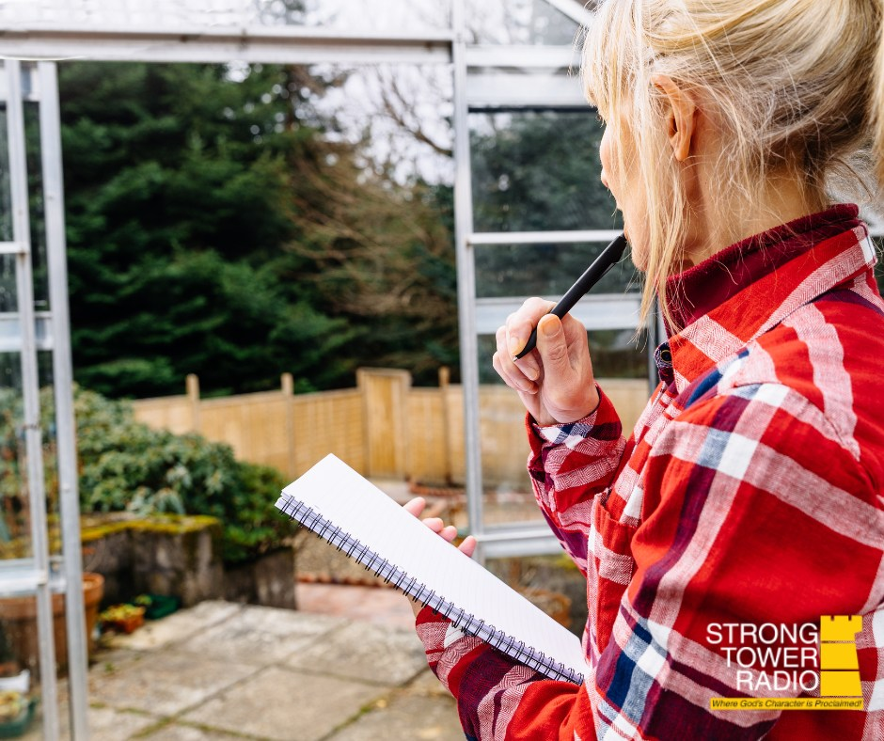
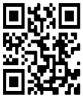
STR Announcements
STR Announcements
STR Announcements
STR Good Gardening Planning.
Photo credit: Jennifer Brooks
May Gardening
Strong Tower Radio's garden guy talks about apricots, asparagus, rhubarb, and May planting on Sunday at 5 pm, Monday at 10 am, and Wednesday at midnight, only on STR stations, STR apps, or STR.fm.
Soil is the Foundation
Soil testing is not optional for the serious gardener. Find out why on Sunday at
3:30 am, Monday at 4 pm, Wednesday at
9 pm, and Thursday at 1 pm.
Pastor's Prayer Seminar
Pastor Darrell Le Roux's camp meeting prayer seminar started yesterday. It will continue on Fridays at 1 pm and Saturdays at 5 p.m. until the June camp meeting.
Point, click, and give!
﻿Give to Strong Tower Radio via the STR.fm giving page with your smartphone, or mail a check to
P.O. Box 567, Cadillac, MI 49601
STR Good Gardening Planning.
Photo credit: Jennifer Brooks
May Gardening
Strong Tower Radio's garden guy talks about apricots, asparagus, rhubarb, and May planting on Sunday at 5 pm, Monday at 10 am, and Wednesday at midnight, only on STR stations, STR apps, or STR.fm.
Soil is the Foundation
Soil testing is not optional for the serious gardener. Find out why on Sunday at
3:30 am, Monday at 4 pm, Wednesday at
9 pm, and Thursday at 1 pm.
Pastor's Prayer Seminar
Pastor Darrell Le Roux's camp meeting prayer seminar started yesterday. It will continue on Fridays at 1 pm and Saturdays at 5 p.m. until the June camp meeting.
Point, click, and give!
﻿Give to Strong Tower Radio via the STR.fm giving page with your smartphone, or mail a check to
P.O. Box 567, Cadillac, MI 49601
STR Good Gardening Planning.
Photo credit: Jennifer Brooks
May Gardening
Strong Tower Radio's garden guy talks about apricots, asparagus, rhubarb, and May planting on Sunday at 5 pm, Monday at 10 am, and Wednesday at midnight, only on STR stations, STR apps, or STR.fm.
Soil is the Foundation
Soil testing is not optional for the serious gardener. Find out why on Sunday at
3:30 am, Monday at 4 pm, Wednesday at
9 pm, and Thursday at 1 pm.
Pastor's Prayer Seminar
Pastor Darrell Le Roux's camp meeting prayer seminar started yesterday. It will continue on Fridays at 1 pm and Saturdays at 5 p.m. until the June camp meeting.
Point, click, and give!
﻿Give to Strong Tower Radio via the STR.fm giving page with your smartphone, or mail a check to
P.O. Box 567, Cadillac, MI 49601
On-air, via Apple & Android apps, & STR.fm
On-air, via Apple & Android apps, & STR.fm
On-air, via Apple & Android apps, & STR.fm

