Slide 1


Prayer Series
Camp Meeting
Prayer Series
Praying.
Graphic credit: Himsan via Pixabay
Every Friday @ 1 p.m. & Saturday @ 5 p.m.
on STR stations,
STR apps, or STR.fm

Slide 2
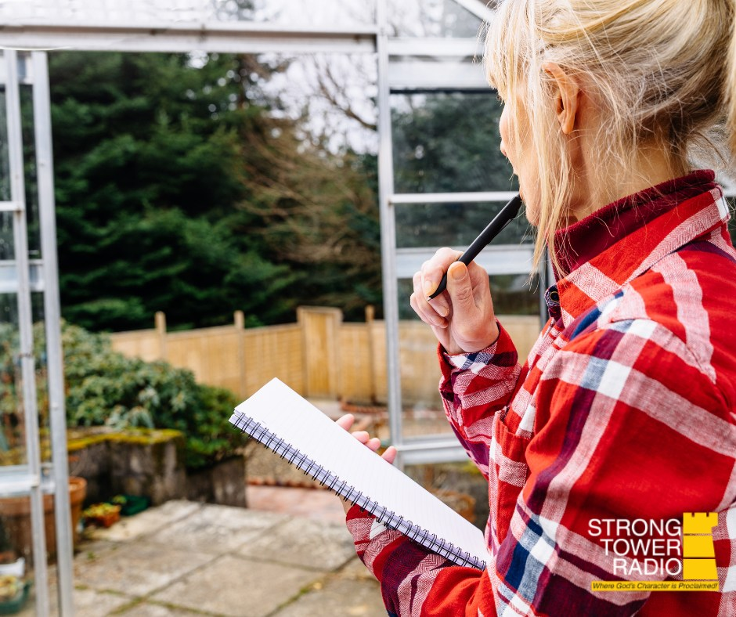
May Gardening
apricots, asparagus, rhubarb,
and May planting
STR Good Gardening Planning.
Photo credit: Jennifer Brooks
Sun. @ 5:00 P.M. Mon. @ 10:00 A.m. Wed. @ 12:00 a.m.
on STR stations,
STR apps, or STR.fm

Slide 3
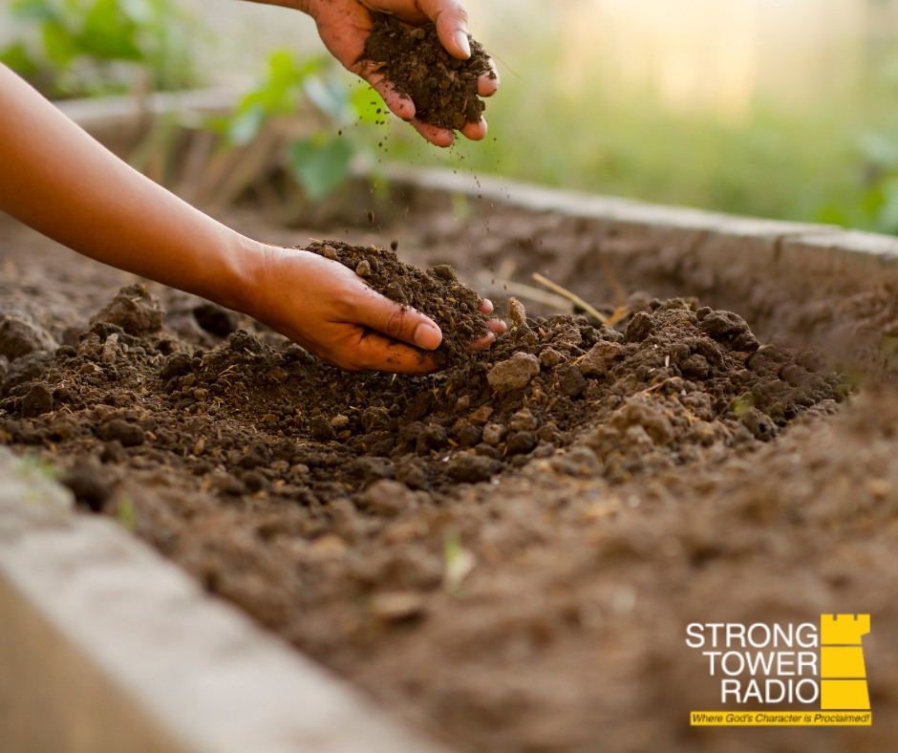
Soil is the Foundation
Testing
Your Soil
Garden Soil discussion.
Photo credit: Jennifer Brooks
Sun. 3:30 am Mon. @ 4 pm Wed. @ 9 pm Thu. @ 1 pm
on STR stations,
STR apps, or STR.fm

Slide 4
Christian Radio
104.7 fm /1540 am
STR phone apps, &
STR.fm

Slide 5
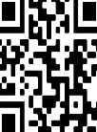
Point, click, and give!
﻿Give to Strong Tower Radio via the STR.fm giving page, with your smartphone, or mailing a check to:
P.O. Box 567, Cadillac, MI 49601

Slide 6
Strong Tower Radio
Area STR Stations
STR phone apps, &
STR.fm

