Slide 1
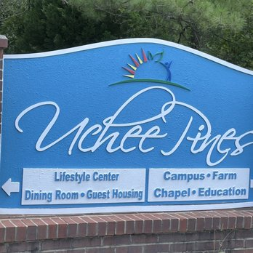

Lifestyle Center Visit
Immerse in a
Lifestyle Center experience
Uchee Pine Lifestyle Center sign.
Graphic credit: Yelp
Today @ 5 p.m.
on STR stations,
STR apps, or STR.fm

Slide 2
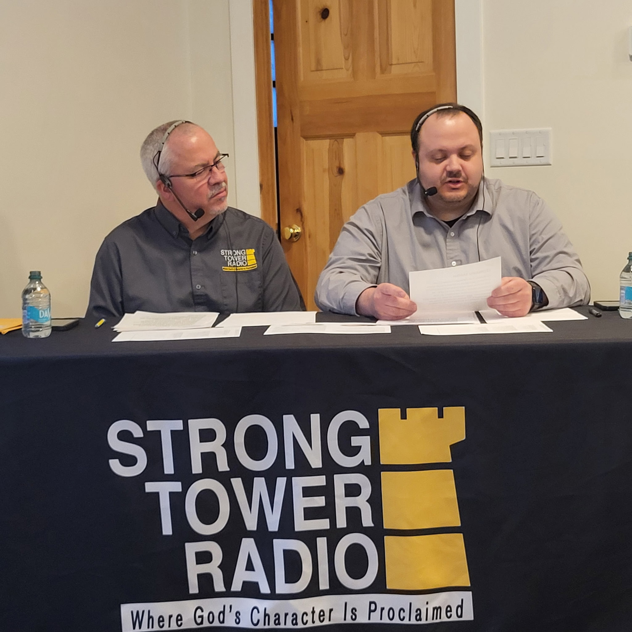
Grayling Debut
Grayling Variety Hour Debut
Grove Father-Son Hosts.
Graphic credit: Nancy Duman
Next Friday @ 1 p.m. & Saturday @ 5 p.m.
on STR stations,
STR apps, or STR.fm

Slide 3

New Pet Care
how to care
for a new pet
New-born puppy.
Photo credit: -StockSnap via Pixabay
Sun. @ 5:00 P.M. Mon. @ 10:00 A.m. Wed. @ 12:00 a.m.
on STR stations,
STR apps, or STR.fm

Slide 4
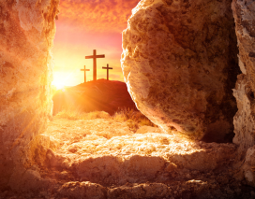
Passion Week
Share the Good News
With Family/Friends/Neighbors
The cross and the tomb.
Graphic credit: source unknown
Palm Sunday to Easter Sunday
on STR stations,
STR apps, or STR.fm

Slide 5
Passion Week
Share the Good News
With Family/Friends/Neighbors
The cross and the tomb.
Graphic credit: source unknown
Weekdays @ 1:00 A.m. & 11:00 a.m.
on STR stations,
STR apps, or STR.fm

Slide 6
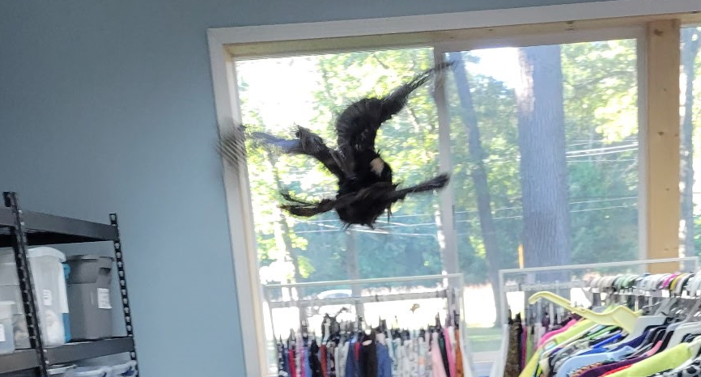
ACS Turkey Visit
Funny story
About
The turkey Roost
Sun. 3:30 a.m.
Mon. @ 4 p.m. Wed. @ 9 p.m. Thu. @ 1 p.m.
Turkey flight inside the Muskegon Adventist Community Center.
Photo credit: Brent Link
on STR stations,
STR apps, or STR.fm

Slide 7
Christian Radio
104.7 fm /1540 am
STR phone apps, &
STR.fm

Slide 8
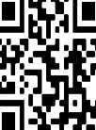
Point, click, and give!
﻿Give to Strong Tower Radio via the STR.fm giving page, with your smartphone, or mailing a check to:
P.O. Box 567, Cadillac, MI 49601

Slide 9
Strong Tower Radio
Area STR Stations
STR phone apps, &
STR.fm

