Slide 1
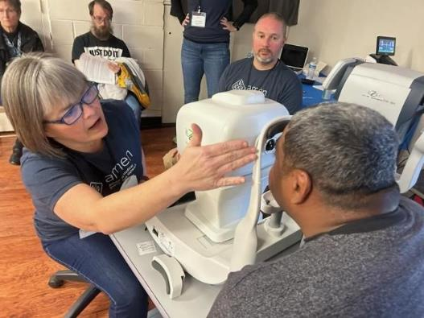

Free clinics
Dental / Optical
Volunteer Opportunities
ALMA & Troy
Photo credit: AMEN Free Clinics
Saturday (7/5) @ 5 p.m.
on STR stations,
STR apps, or STR.fm

Slide 2
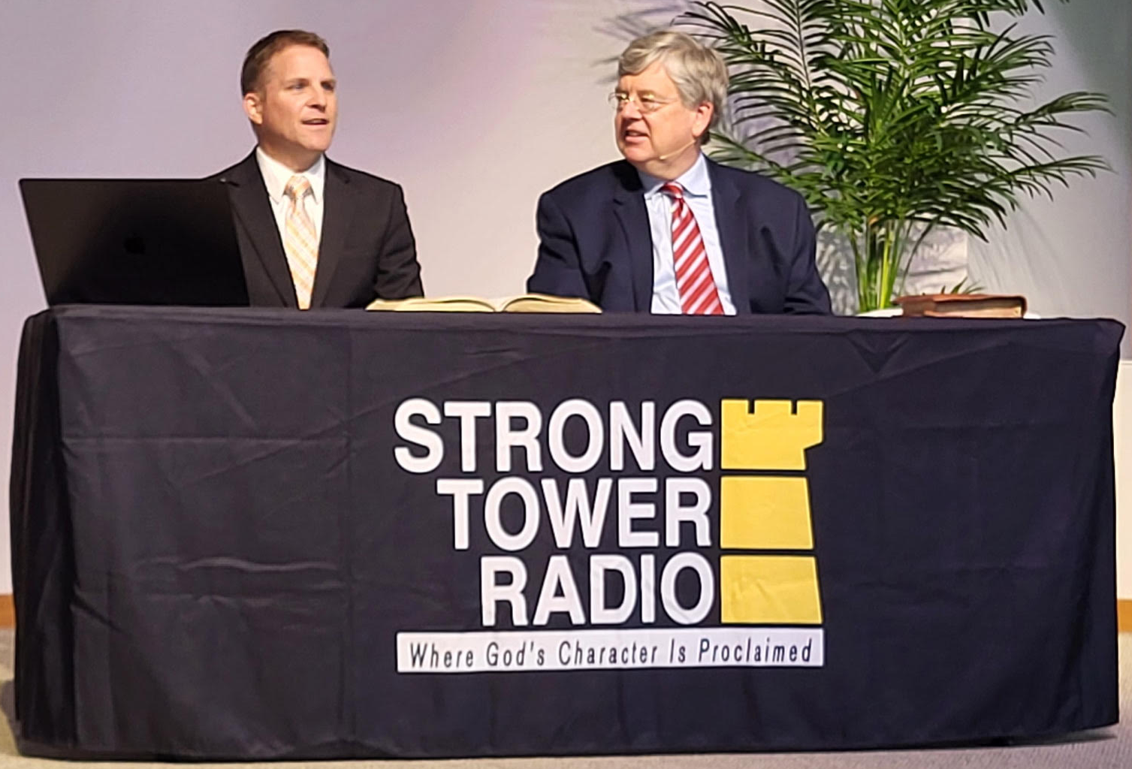
Variety Hour
Stevensville Variety Hour
Hosts Pastor Bryce Bowman & John Baxter
Photo credit: Nancy Duman
Friday (7/11) @ 1 p.m. & Saturday (7/12) @ 5 p.m.
on STR stations,
STR apps, or STR.fm

Slide 3
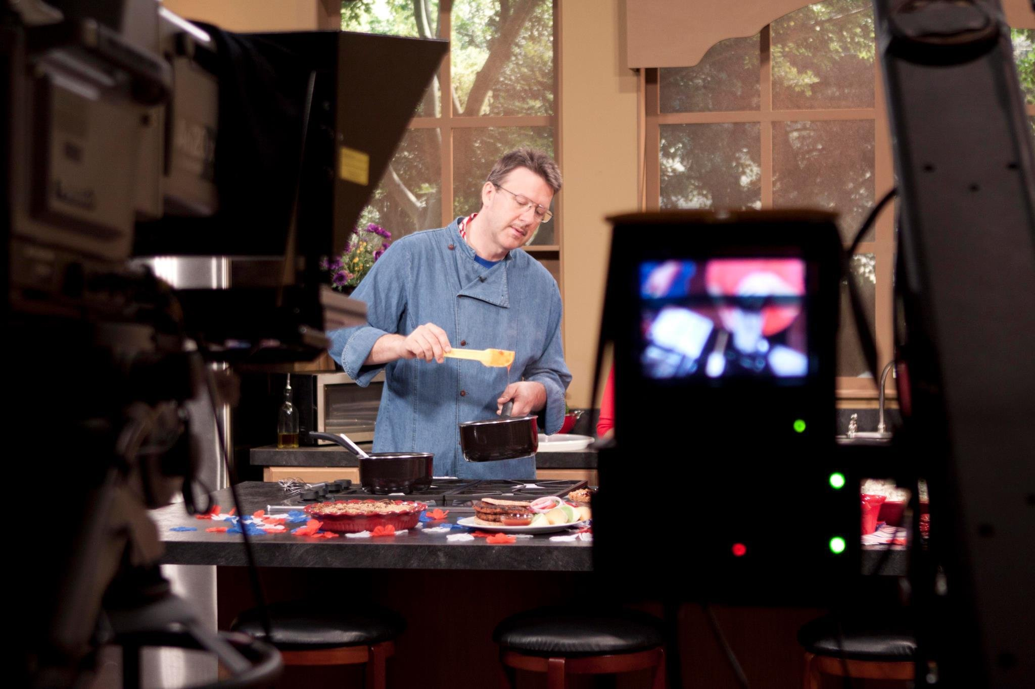
Lifestyle Center Secrets
Learn the Center’s
Best practices
for home use
Chef Mark Anthony Sharing Best Practices
Photo credit: Chef Mark Anthony
Sun. @ 5:00 P.M. Mon. @ 10:00 A.m. Wed. @ 12:00 a.m.
on STR stations,
STR apps, or STR.fm

Slide 4
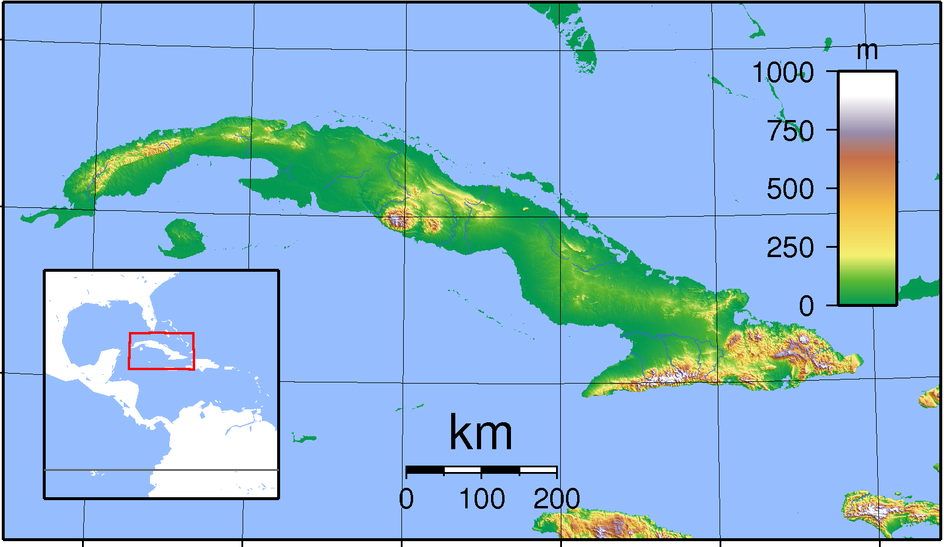
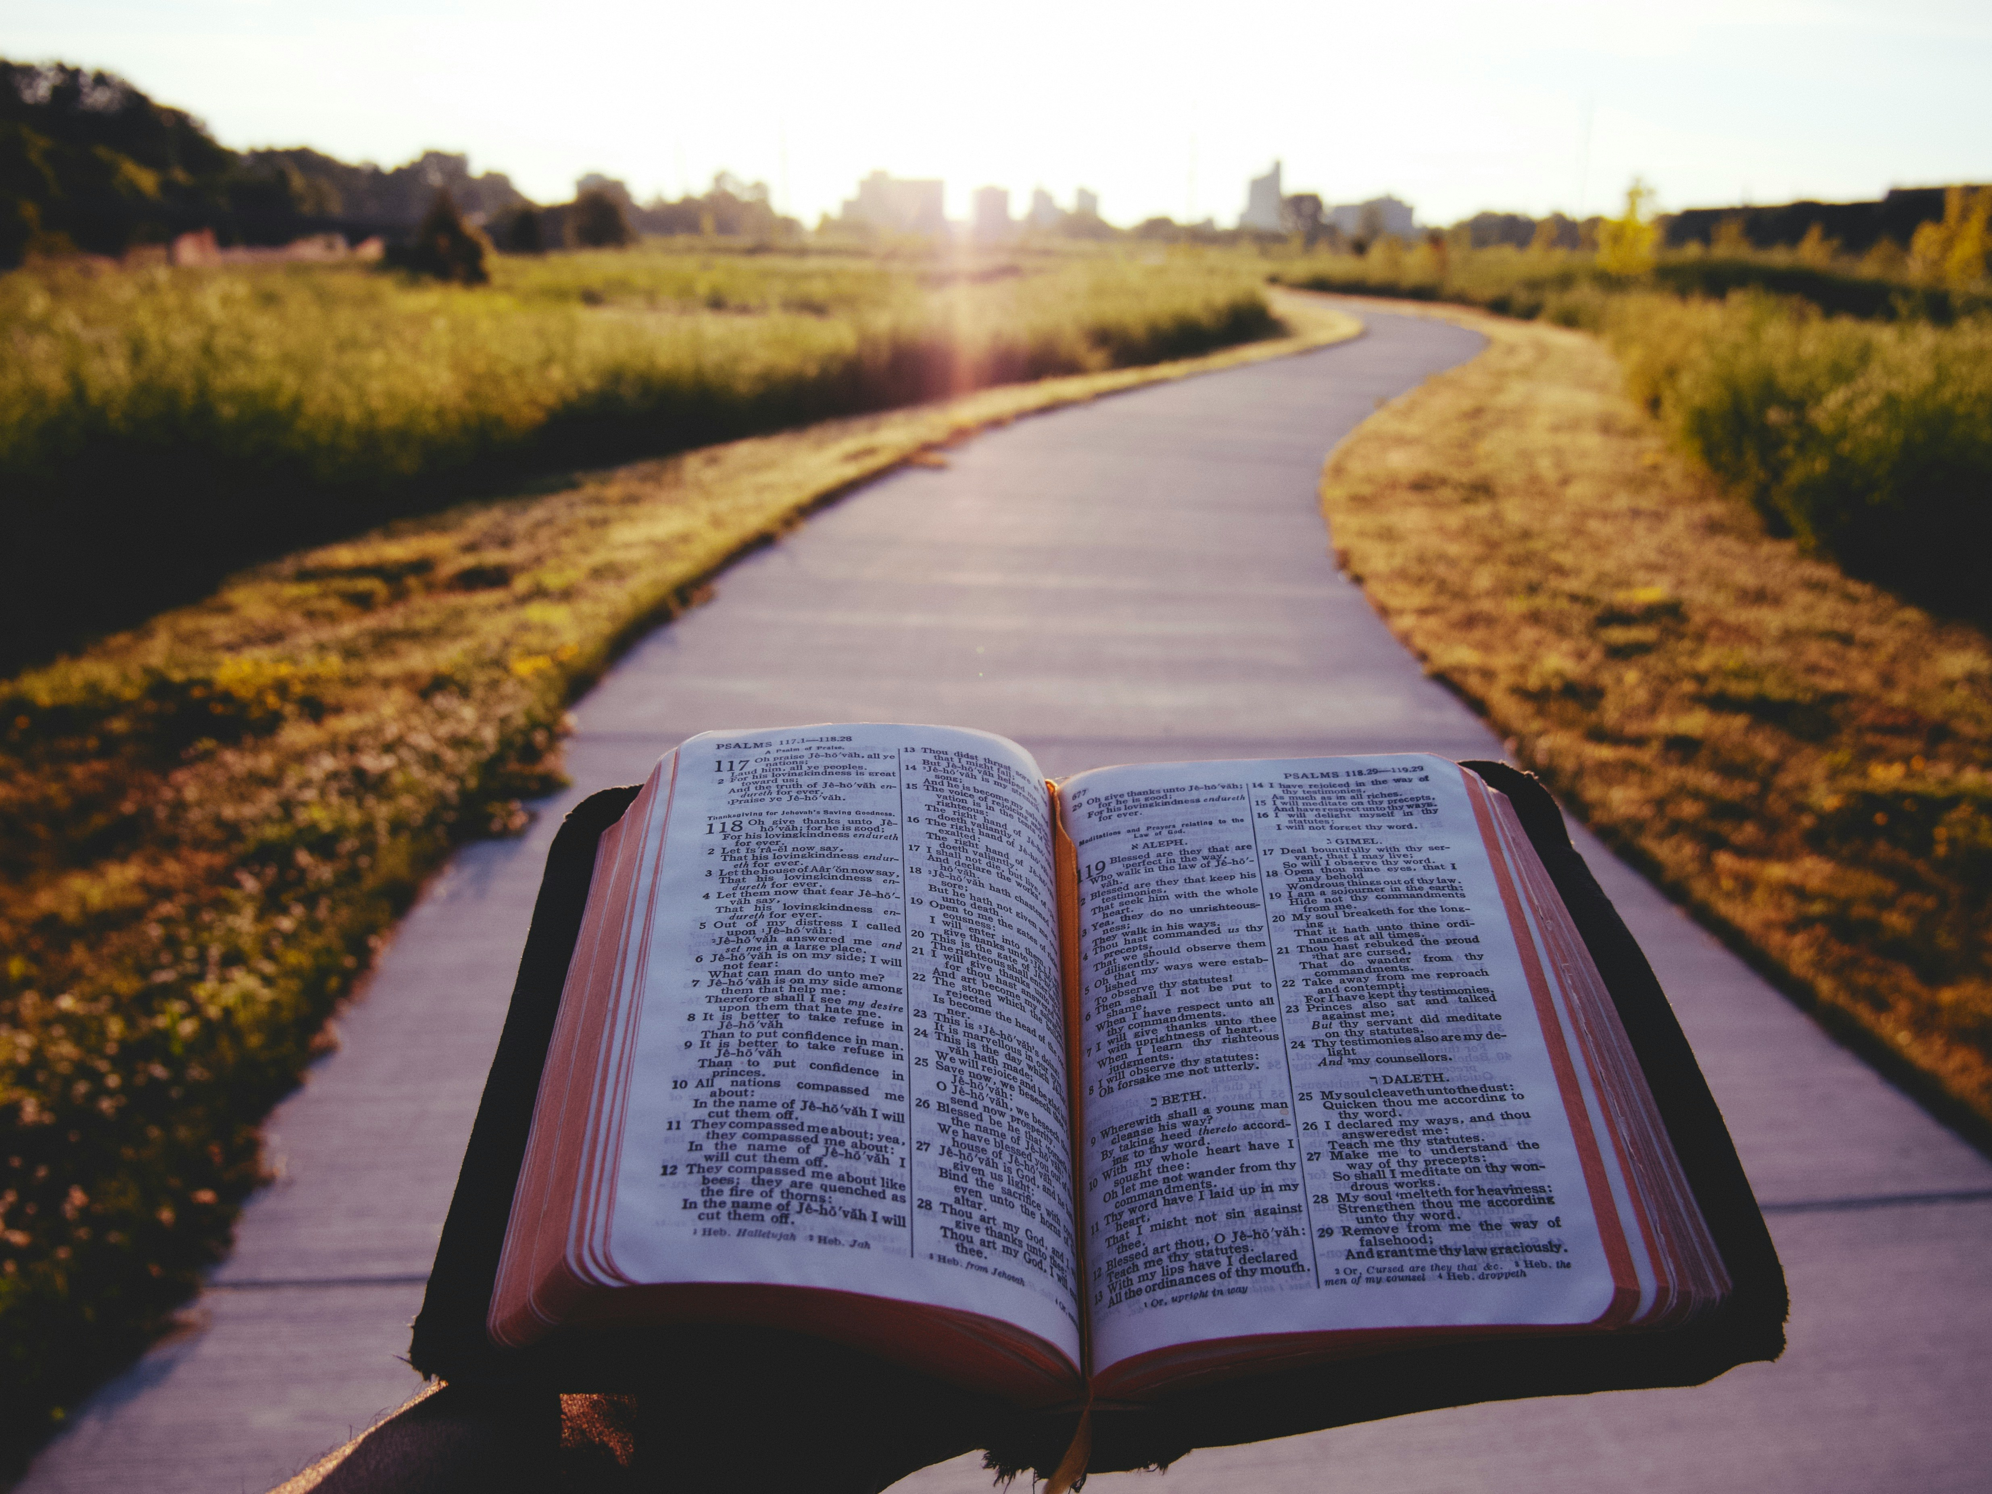
Bibles into Cuba
Discover how to
get bibles
into cuba
New Bibles for Cuba opportunity
Photo credit: Unknown/Sadalmelik-Wikipedia
Sun. @ 5:00 P.M. Mon. @ 10:00 A.m. Wed. @ 12:00 a.m.
on STR stations,
STR apps, or STR.fm

Slide 5
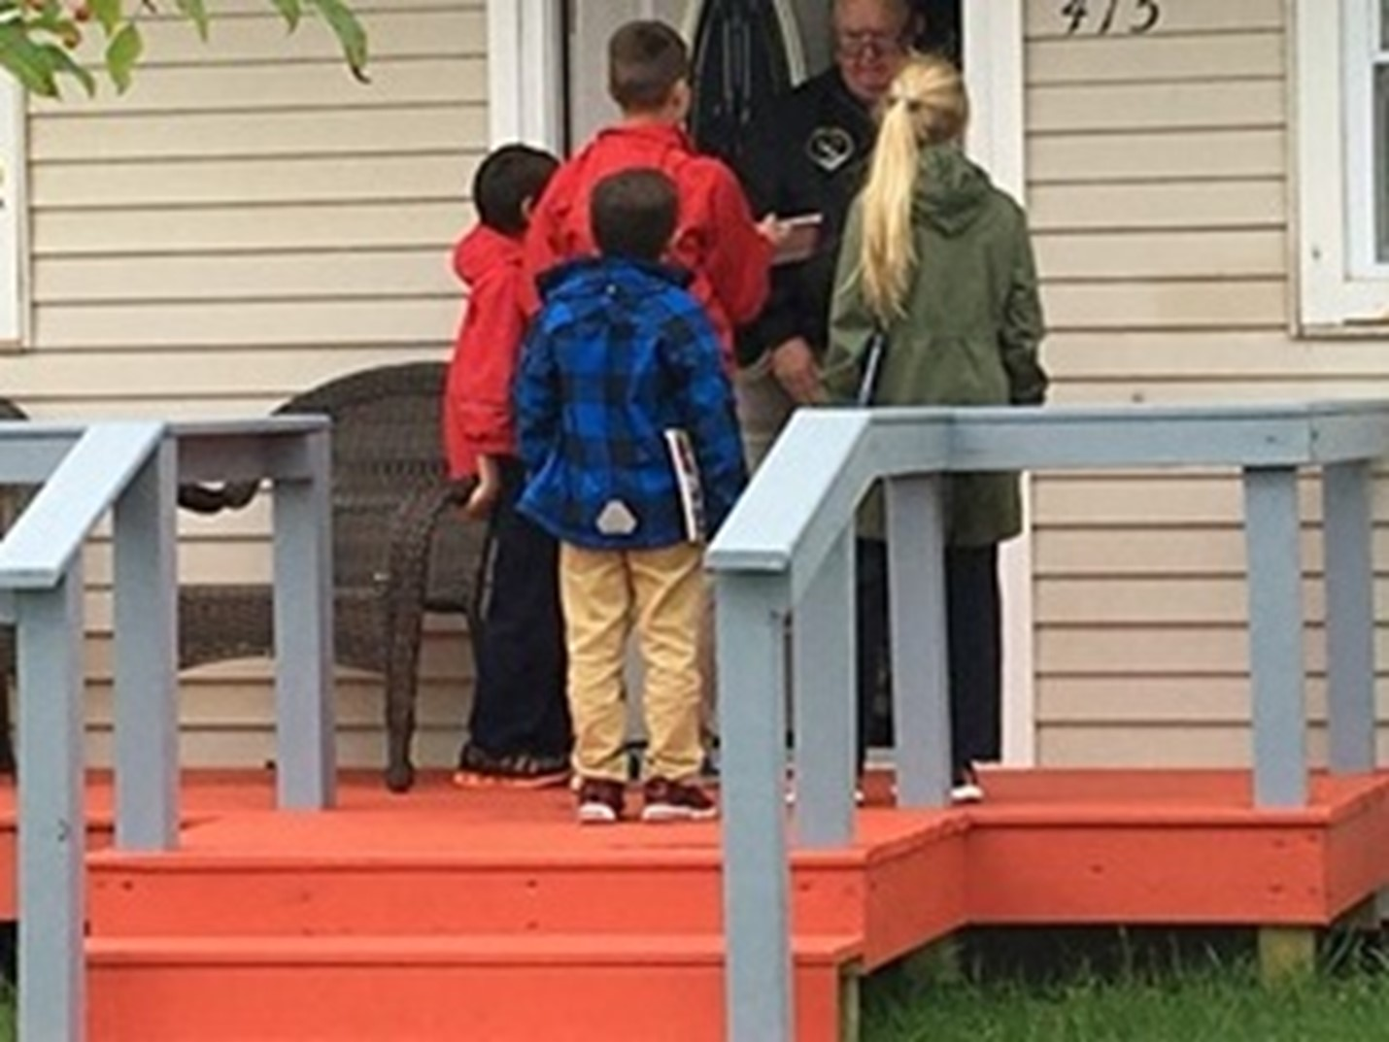
Youth with Christian Books
Annual
Youth Rush report
Youth sharing Christian books in our area
Photo credit: Marcia Mohr
Sun. 3:30 am Mon. @ 4 pm Wed. @ 9 pm Thu. @ 1 pm
on STR stations,
STR apps, or STR.fm

Slide 6
Christian Radio
104.7 fm /1540 am
STR phone apps, &
STR.fm

Slide 7
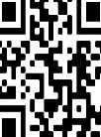
Point, click, and give!
﻿Give to Strong Tower Radio via the STR.fm giving page, with your smartphone, or mailing a check to:
P.O. Box 567, Cadillac, MI 49601

Slide 8
Strong Tower Radio
Area STR Stations
STR phone apps, &
STR.fm

