Slide 1

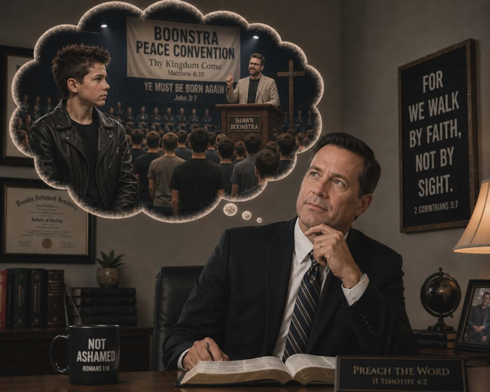
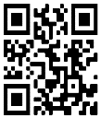
STR Announcements
STR Announcements
STR Announcements
The Rest of the Story - Pastors Shawn Boonstra and Nick Wanovic
Photo credit: Jessica Taylor
The Rest of the Story!
Hear the rest of the story of a young rebellious youth attending Pastor Boonstra's meetings. Airing this Sunday at 3:30 am, and again on Monday at 4 pm, Wednesday at 9 pm, and Thursday at 1 pm.
The Narrow Way
Northview Adventist School presents The Narrow Way to Heaven this Friday at 1 pm and Saturday at 5 pm.
New Winter Blind Camp Devotions
The new season of Winter Blind Camp Devotions begin this Friday at 1:30 pm and Saturday at 5:30 pm.
3ABN Camp Meeting Finale
3ABN's Summer Camp Meeting concludes with sessions at 3, 4, 7, and 8 pm.
Point, click, and give!
﻿Give to Strong Tower Radio via the STR.fm giving page with your smartphone, or mail a check to
P.O. Box 567, Cadillac, MI 49601
The Rest of the Story - Pastors Shawn Boonstra and Nick Wanovic
Photo credit: Jessica Taylor
The Rest of the Story!
Hear the rest of the story of a young rebellious youth attending Pastor Boonstra's meetings. Airing this Sunday at 3:30 am, and again on Monday at 4 pm, Wednesday at 9 pm, and Thursday at 1 pm.
The Narrow Way
Northview Adventist School presents The Narrow Way to Heaven this Friday at 1 pm and Saturday at 5 pm.
New Winter Blind Camp Devotions
The new season of Winter Blind Camp Devotions begin this Friday at 1:30 pm and Saturday at 5:30 pm.
3ABN Camp Meeting Finale
3ABN's Summer Camp Meeting concludes with sessions at 3, 4, 7, and 8 pm.
Point, click, and give!
﻿Give to Strong Tower Radio via the STR.fm giving page with your smartphone, or mail a check to
P.O. Box 567, Cadillac, MI 49601
The Rest of the Story - Pastors Shawn Boonstra and Nick Wanovic
Photo credit: Jessica Taylor
The Rest of the Story!
Hear the rest of the story of a young rebellious youth attending Pastor Boonstra's meetings. Airing this Sunday at 3:30 am, and again on Monday at 4 pm, Wednesday at 9 pm, and Thursday at 1 pm.
The Narrow Way
Northview Adventist School presents The Narrow Way to Heaven this Friday at 1 pm and Saturday at 5 pm.
New Winter Blind Camp Devotions
The new season of Winter Blind Camp Devotions begin this Friday at 1:30 pm and Saturday at 5:30 pm.
3ABN Camp Meeting Finale
3ABN's Summer Camp Meeting concludes with sessions at 3, 4, 7, and 8 pm.
Point, click, and give!
﻿Give to Strong Tower Radio via the STR.fm giving page with your smartphone, or mail a check to
P.O. Box 567, Cadillac, MI 49601
Only on-air, via Apple & Android apps, &
STR.fm on your computer!
Only on-air, via Apple & Android apps, &
STR.fm on your computer!
Only on-air, via Apple & Android apps, &
STR.fm on your computer!

