Slide 1
CHIEFS BRIEFING
DECEMBER 2017

Slide 2
Highlights
Introduction – Interim CEO
Transition Period in HART Leadership
Recruitment
Finance Division Update
FY2018 Budget and Finances
Regional Farecard Project Update
Maintenance Facility Project
HR Update
Welcome New HART Employees
HART FY18 Success Plan, Mission and Vision
Implementation of Human Resources Management System
Upcoming One HART Events
Operations Division Update
Mission MAX Update
Streetcar Enhanced Service Options and Programs
AV Project
Closing Remarks

Slide 3
Finance Division Update
FY2018 Budget and Finances
Regional Farecard Project Update
Maintenance Facility Project

Slide 4
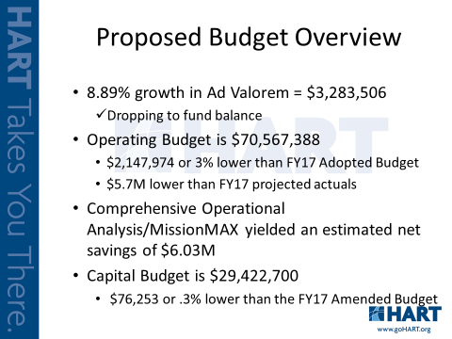
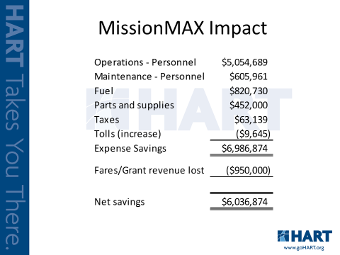
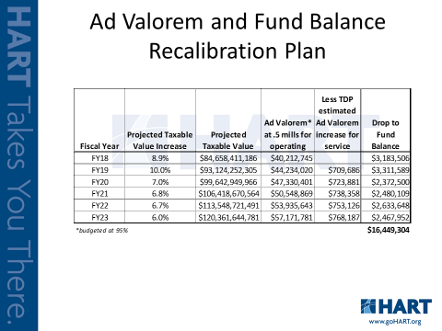
FY2018 Budget and Finances

Slide 5
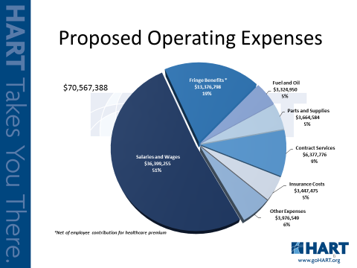
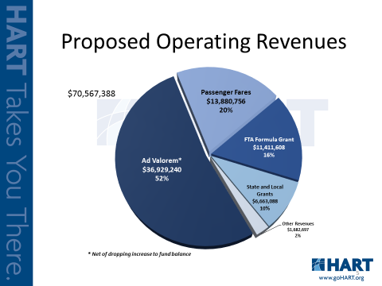
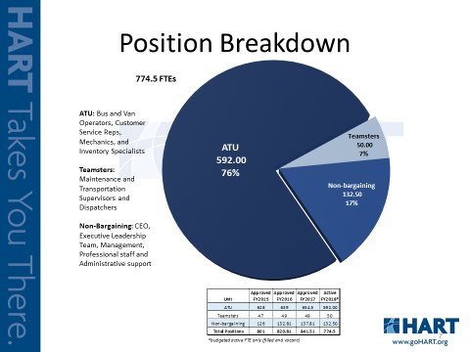
FY2018 Budget and Finances

Slide 6

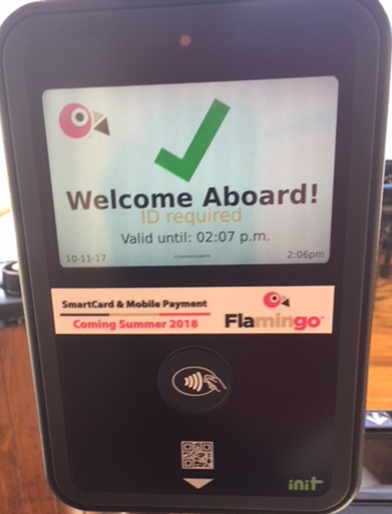
#flamingofares Update
Installations-
Bus: 13 left to install
Streetcar: 2 left to install
Testing-
We started Employee testing in December
We expect and want to find errors
If you are a tester, we need you to use our system
More Testing-
Next year in March-ish, we will have external testers
(conditions based)
Go Live in Summer of 2018

Slide 7
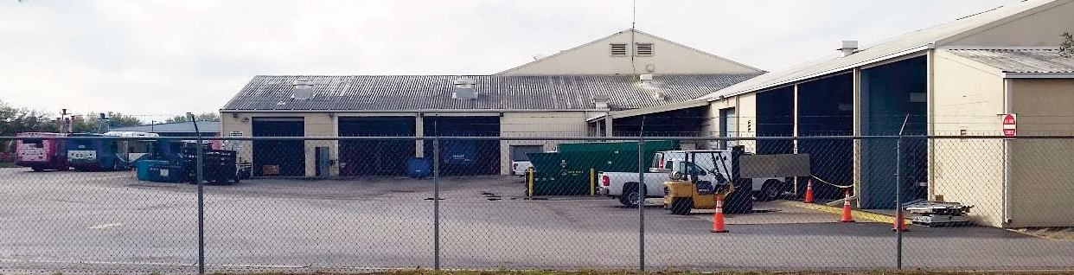
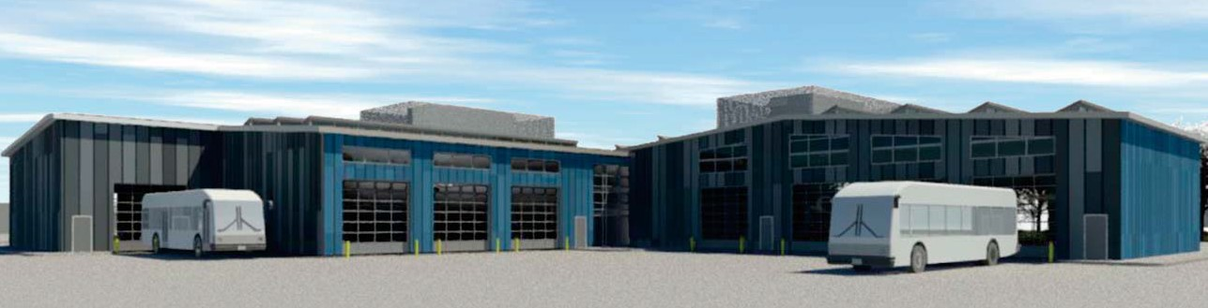
Rendering of New Heavy Maintenance Facility
New Heavy Maintenance Facility
Design Build
Current Heavy Maintenance Facility
Timeline
Funding
Next Steps

Slide 8
HR Update
Welcome New HART Employees
HART FY18 Success Plan, Mission and Vision
Implementation of HR Management System
Upcoming One HART Events

Slide 9
HR Update HR Management System
Innovate HART!
User friendly for all HR tools and technology
Online access to your employee information
Cost effective way to get up-to-date technology
Recruitment, Onboarding, Performance Management, Learning Management System, Benefits, Performance Management and Payroll
Full implementation during FY18

Slide 10
HR Update Upcoming One HART Events
Dec 15, 2017 One HART Holiday Celebration
Jan 8, 2018 One HART Benefits & Wellness Trivia Contest
Feb 15, 2018 One HART Black History Month Celebration – Did You Know?
March 16, 2018 One HART Transit Worker Appreciation Day – Hot Diggity Dog
April 26, 2018 One HART Lil’ Helpers – Take Your Child to Work
May 4, 2018 One HART Cinco de Mayo Celebration Walking Tacos
June 21, 2018 One HART Celebrates Diversity – Pot Luck
July 3, 2018 One HART Celebrates Independence Day – Red, White, & BBQ
Aug 16, 2018 One HART Celebrates the Florida Heat – Ice Cream Trucks
Sep 13, 2018 One HART Celebrates Hispanic Heritage Month
Sep 28, 2018 One HART Tailgate Pot Luck/Jeans and Jersey Day

Slide 11
Operations Division Update
Mission MAX Update
Streetcar Enhanced service Options and Programs
Autonomous Vehicles

Slide 12
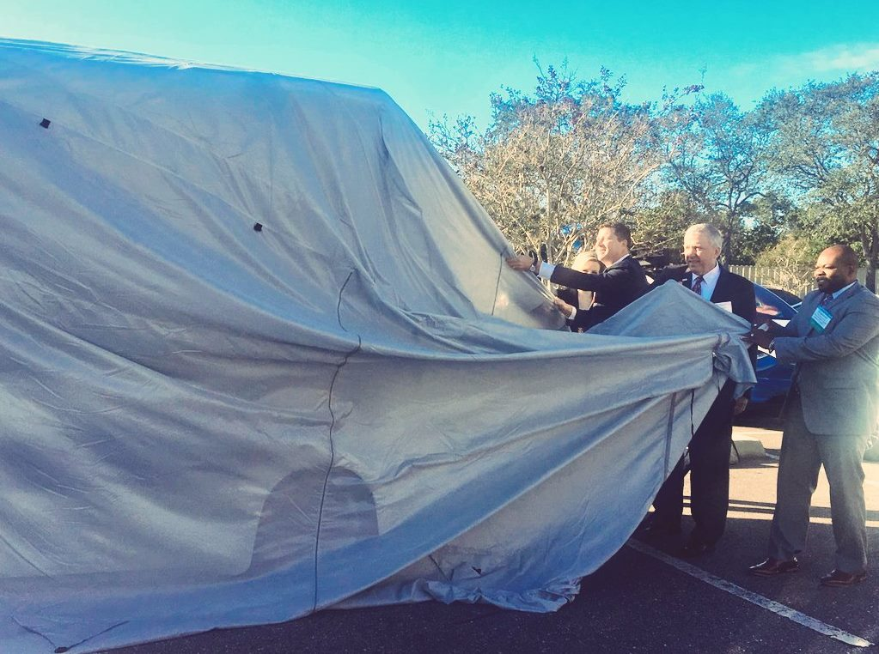
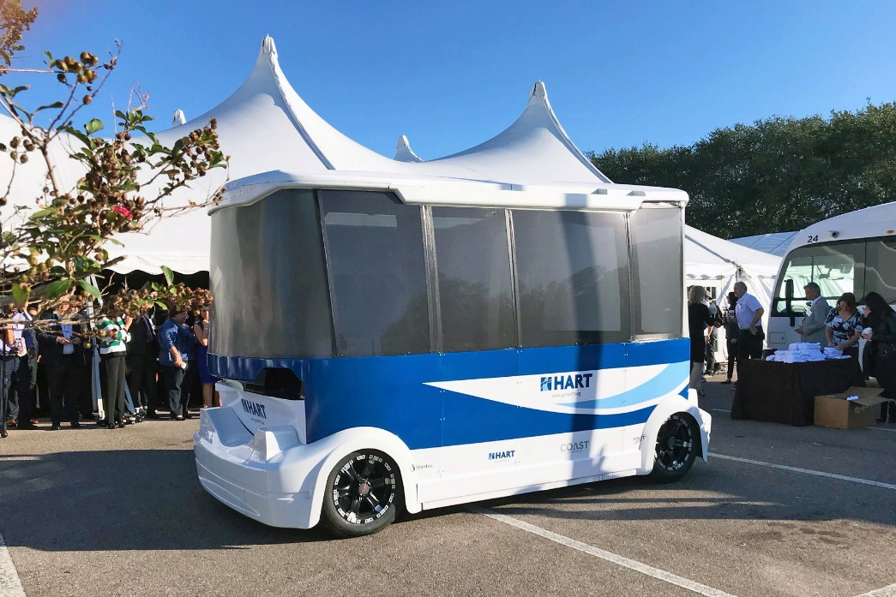
Operations Division Update
Autonomous Vehicles

Slide 13
Closing Remarks

