Slide 1
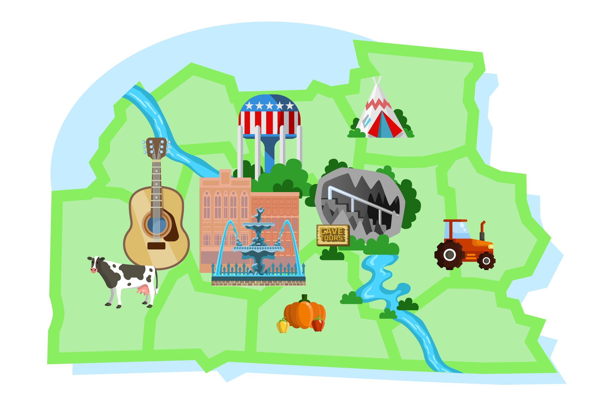

BRIGHT BEGINNINGS, STRONGER TOMORROWS.
A Chronic Disease Workshop
“Building Healthier Communities Together”

Slide 2
Agenda
12:00PM
Lunch provided by German American Bank
12:20PM
Vendor Showcase and Networking
12:40PM
Panel Discussion
10:30AM
Registration and Vendor Networking
1:40PM
BRIGHT Moves with Frank Lamanna
10:50AM
Welcome and Opening Remarks
2:00PM
Awards and Certificates
11:00AM
Opening Speaker — Dr. Eric Fisher
T.J. Regional Health
2:20PM
Closing Remarks

Slide 3







Thank you, Sponsors!
Wellness Sponsors
Thrive Sponsors

Slide 4

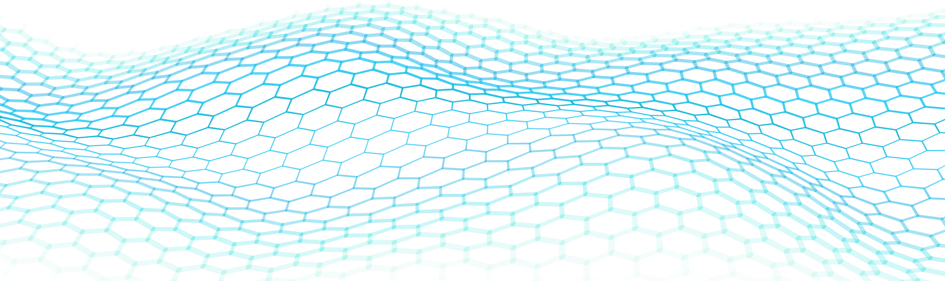
Dr. Eric Fisher
The Impact of Chronic Disease

Slide 5
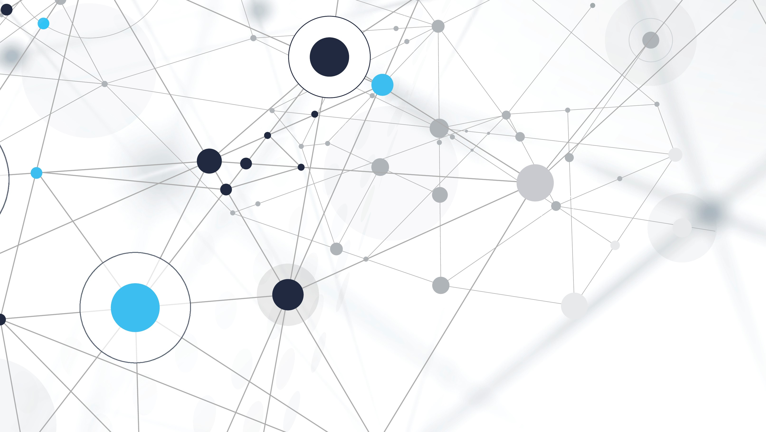
The impact of chronic disease
Eric L. Fisher, M.D.

Slide 6
objectives
At the end of the presentation, participants will be able to:
  Understand the impact of chronic disease on our nation, our state, our local communities and our patients/families/friends.
  Understand the importance of and need for chronic disease prevention in rural communities.
  Assess the burden of chronic disease within the local communities of south central Kentucky.
  Identify and describe challenges to chronic disease prevention specific to rural areas.
  Develop plans for how we expand and utilize local resources technology to combat the growing burden of chronic disease.

Slide 7
disclosures
No financial disclosures or relevant conflicts.
I’ve been doing this long enough to have seen too much.

Slide 8
What is chronic disease?
According to the CDC: “A condition that lasts 1 year or more and requires ongoing medical attention of limits daily activities.”
  What comes to mind?
  Diabetes, hypertension, heart disease, COPD, etc.
A simpler definition:
  Any issue that impairs an individual’s long term wellness.
  Osteoarthritis, mental health disorders, obesity.
  Poverty… of resources, of thought, of education, of accountability, of responsibility.
Is the disease the real issue?

Slide 9
Why are we focused on chronic disease?
Because we care about people.
Because we care about money.
Or maybe a little to a lot of both.

Slide 10
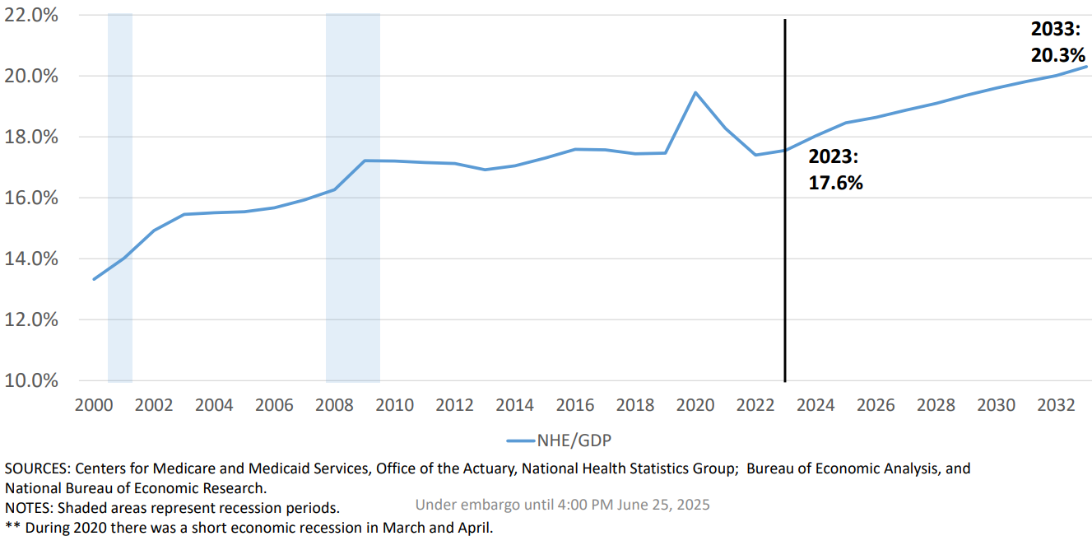
USA vs chronic disease
Healthcare spend % of US GDP
No

Slide 11

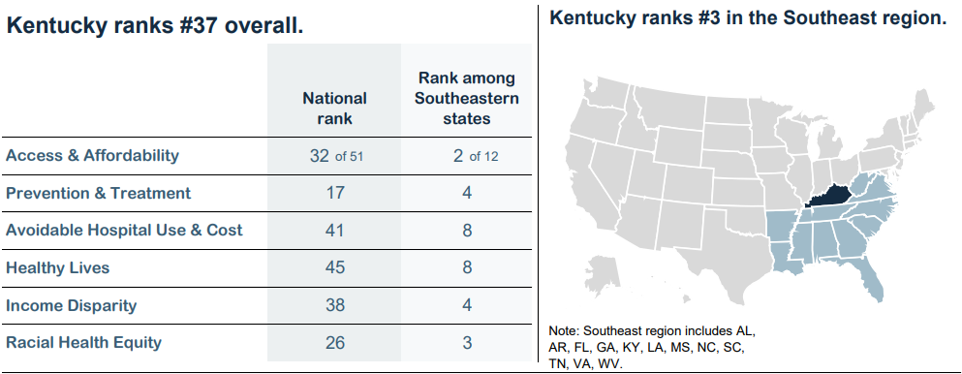
KY vs chronic disease
https://interactives.commonwealthfund.org/2025/state-scorecard/Kentucky.pdf

Slide 12
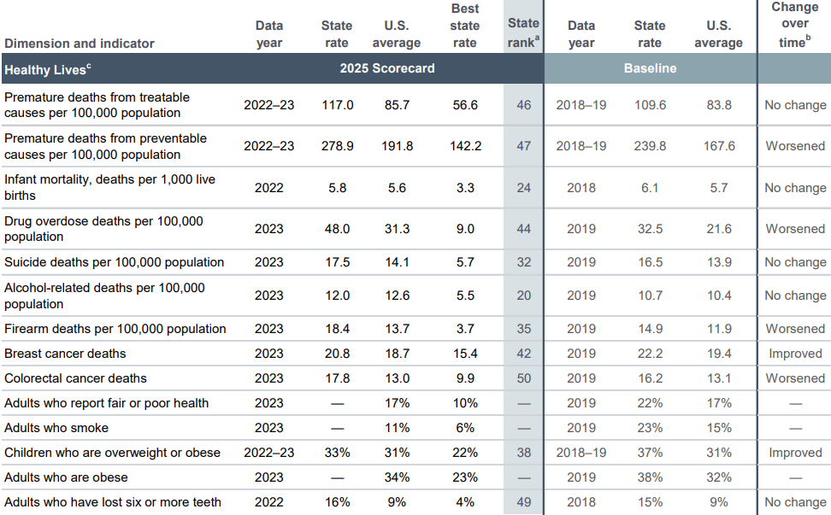
KY vs chronic disease
https://interactives.commonwealthfund.org/2025/state-scorecard/Kentucky.pdf

Slide 13
South Central KY vs chronic disease
“Highlights” from the Community Health Assessment:
  Poor eating habits cited as #1 factor negatively impacting health = 32.4%
  Lack of exercise cited as #2.
    Double those numbers and we might be in the ballpark.
  Mental health is the #1 unmet need across 9/10 counties.
  20% still reporting tobacco/vape use.
    53.7% want to quit but may lack support.
  11.4% report housing insecurity.

Slide 14
Patients vs chronic disease
The “who” is the real “why”.
Unfortunately, the consequences of chronic disease drag on for years, and in the end, it’s usually not pretty.
CHF
COPD

Slide 15
How do we prevent chronic disease?
Current state vs Future state

Slide 16
Chronic disease prevention in rural america
Current State = barriers, frustration and poor outcomes
  System barriers
    Fragmented primary care
    Lack of payment reform (FFS vs quality)
    Healthcare industrial complex (LDCT, Pharma, etc.)
  Cultural barriers
    “Clean your plate.”
  Bottom line
    We are decades behind and mostly digging the hole deeper.

Slide 17
Chronic disease prevention in rural america
Future State = “Stop mopping the floor and turn off the faucet.”
- Dr. David Nash
  Primary care/prevention revolution
    Restructure, payment reform, health departments, ADD programs
  Focus on wellness needs to be “cradle to grave”
  Technology
    Apps = CDC/ACIP, wellness/sleep, dietary, USPSTF
    Artificial intelligence (AI) = opportunities to analyze data and let people engage people
  Bottom line
    No magic pill or magic bill is going to save us.

Slide 18
Where do we go from here?
Start in the mirror and spread from there.
Treat the person, not the disease.
Treat the community, not the epidemic.

Slide 19

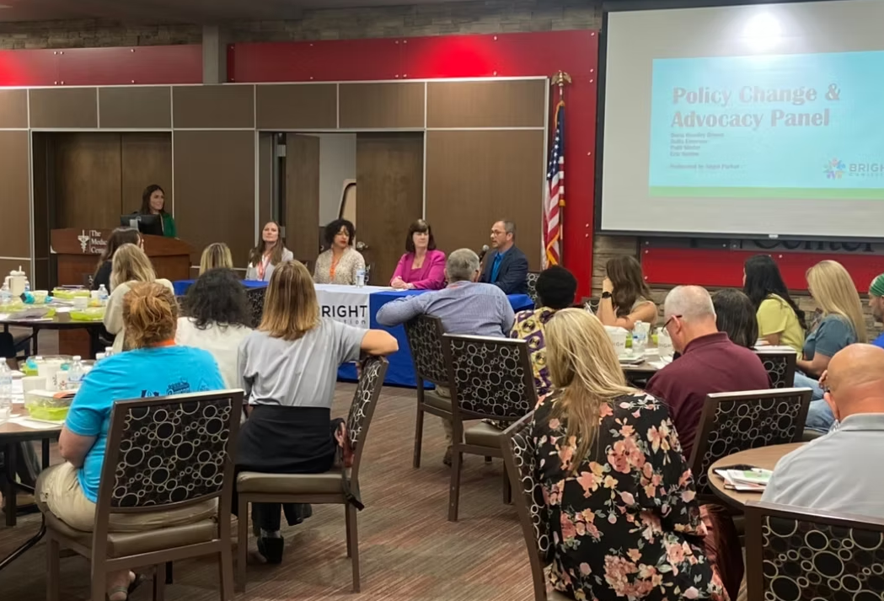
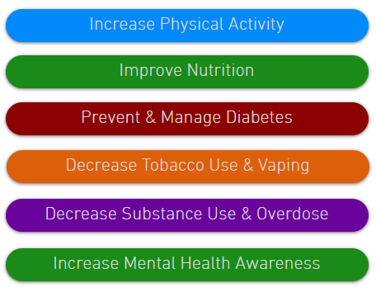
Thank you.

Slide 20

Thank you for generously sponsoring lunch!

Slide 21

Vendor Showcase & Networking
20 MINUTES

Slide 22
Panel Discussion
Sarah Widener, RD
Med Center Health
Amy Meador, RDN, LD, CDCES, MLDE
Allen County Health Department
Dr. Joshua Phillips, DMD
Med Center Health
Kristi Irvin, APRN
T.J. Regional Health
Dr. Zach Farley, Moderator
Western Kentucky University
Dr. Sherryl Reed, MD Graves Gilbert Clinic

Slide 23


BRIGHT Beginnings, Stronger Tomorrows
A Chronic Disease Workshop
Panel Moderator:
Zach S. Farley PhD, MPH
Assistant Professor – Public Health
Department of Public Health
Western Kentucky University
Notes:
Welcome back everybody. My name is Dr. Zach Farley, I am an assistant professor of public health here at WKU. I know we all have full bellies and we are in the latter part of the day now, but let’s give our attention to our great panelists.
(Set ground rules… asking for shortish responses from panelists… holding questions until the end (will have 10-15 minutes for that)… we have a number of questions for the panelists, we may not get through them all, but we will try and keep things moving along well!)

Slide 24






Thank You to Our Sponsors
Notes:
Prior to introducing the panelists, we do want to thank the amazing sponsors of the BRIGHT coalition, shown here on the screen.

Slide 25
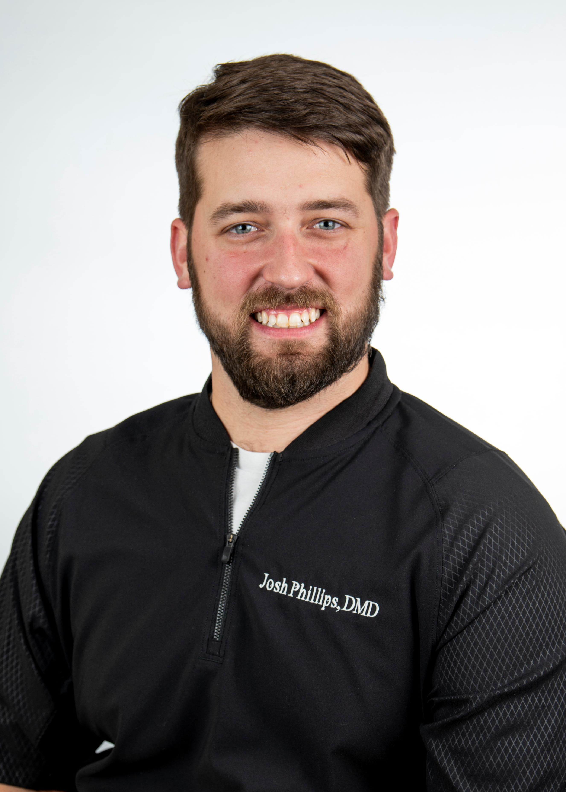
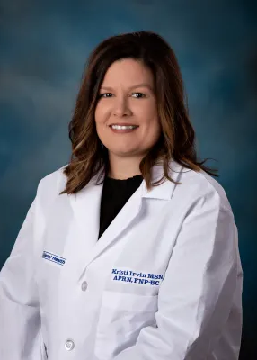
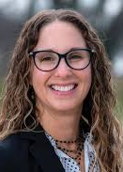
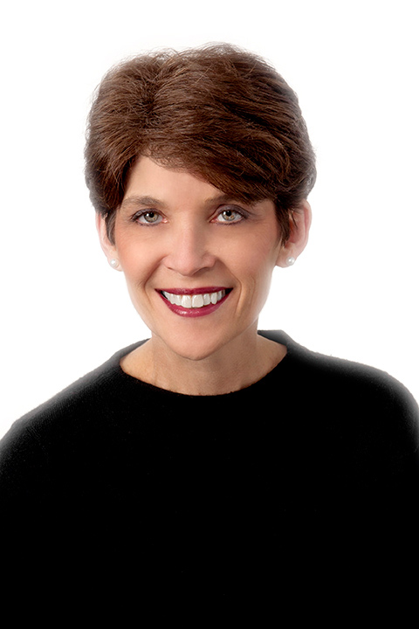
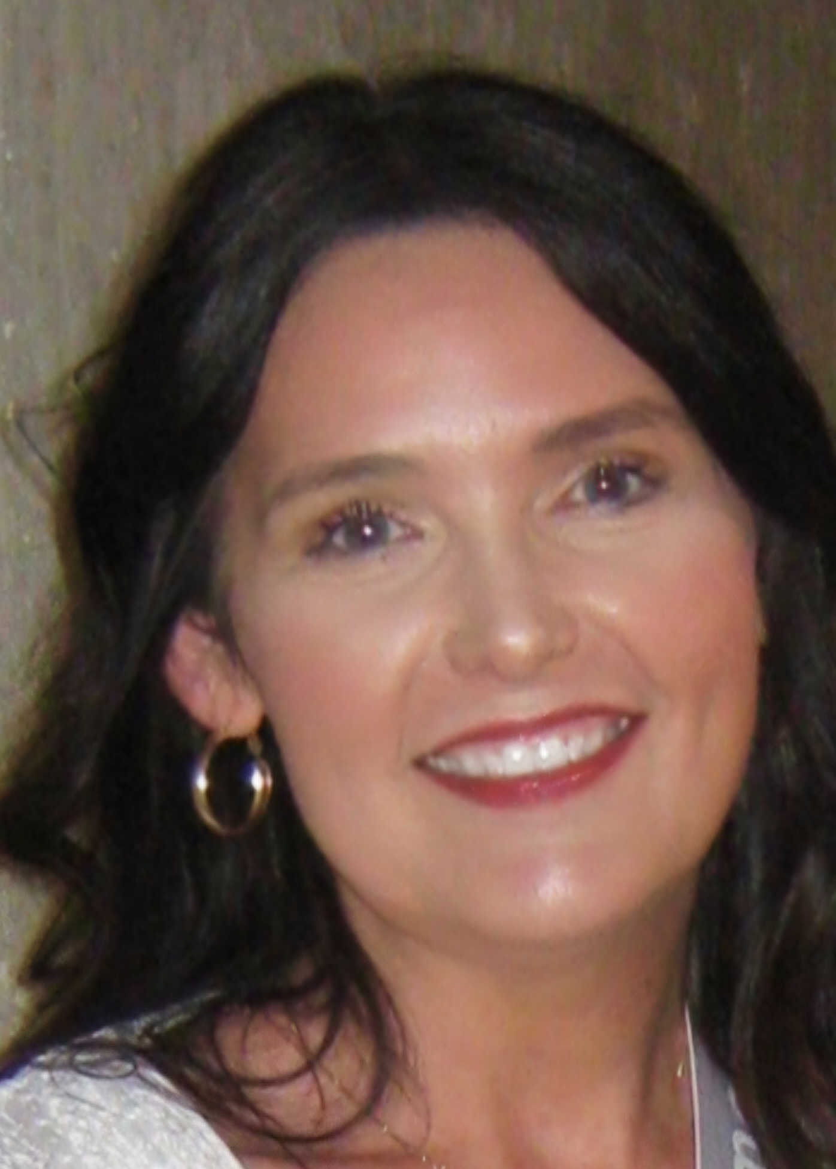


Our Panelist
Dr. Joshua Phillips, DMD
General Dentistry
Med Center Health
Kristi Irvin, APRN
Pain Medicine
T.J. Regional Health
Sarah Widener, RD
Director of Community Wellness
Med Center Health
Dr. Sherryl Reed, MD
Internal Medicine
Graves Gilbert Clinic
Amy Meador, RDN, LD, CDCES, MLDE
Nutrition Services Supervisor
Allen County Health Department
Notes:
Now to the stars of the show. We are very grateful to have five amazing panelists. From left to right on the slide here, we have Dr. Joshua Phillips, a Dentist that works at Med Center Health; (dr?) Kristi Irvin, an APRN for TJ Regional Health; Sarah Widener, a registered dietitian who serves as the director of community wellness for Med Center Health; Dr. Sherryl Reed, a practitioner from Graves Gilbert Clinic; and, lastly, we have Amy Meador, a registered dietician nutritionist who works as the nutrition services supervisor at Allen County Health Department. Thank you to all of you for being here today, and we are going to get straight into some discussion here.

Slide 26
Foundational Questions
Everyone | Briefly, what are the most common chronic conditions you are seeing in your patient/community population(s)?
Dr. Phillips | What is the link between oral health and systemic chronic diseases like diabetes and cardiovascular health?
Amy Meador & Sarah Widener | What misconceptions about diet and chronic disease do you encounter most often?
Dr. Reed & Kristi Irvin | What screening and preventive measures do you prioritize to catch chronic diseases early?
Notes:
"Before we discuss community and system strategies, let's hear from each panelist about chronic disease through your professional lens... We will ask for brief responses here, but enough to lay the groundwork“
This is one is open to all of you. So, briefly, what are the most common chronic conditions you are seeing in patient/community populations you work with?
For our dentist on the panel, we may not often think about oral health and chronic conditions as other things, but what do you see as the link between oral health and systemic chronic diseases like diabetes and cardiovascular health?
For our dietician and nutritionists here, Amy and Sarah, What misconceptions about diet and chronic disease do you encounter most often?
And for our two practitioners, Dr. Reed and Kristi, What screening and preventive measures do you prioritize to catch chronic diseases early?

Slide 27
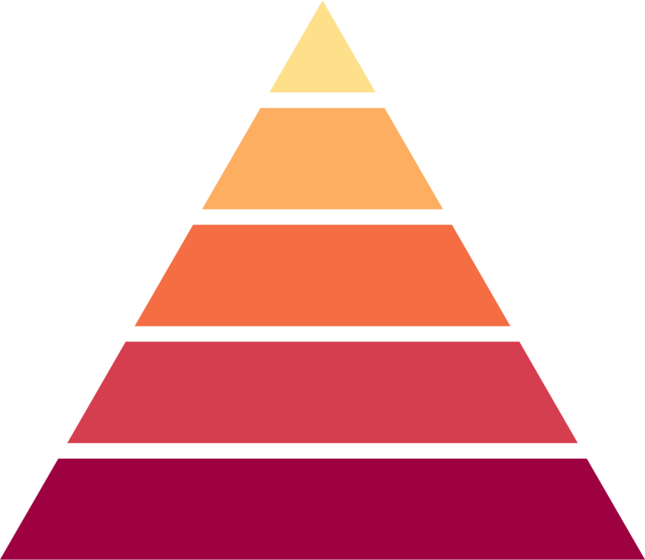

Addressing Chronic Disease in the Barren River Area
Multi-Level, Multi-Discipline
Perspectives & Approaches
Counsel & Edu
Clinical
Intervention & Screening
Increasing Population Impact
Lasting Protective Interventions
Increasing Individual/Patient Effort
Changing the Context: Community & Environment
Socioeconomic Factors & System Change
Adapted from: Frieden (2010), A Framework for Public Health Action: The Health Impact Pyramid
Notes:
That was great at laying some foundation, but now we are going to move on to some more targeted questions using Frieden’s Health Impact Pyramid to scaffold our discussion. For those of you that have not seen this figure before, from the bottom up, these the domains of Socioeconomic factors and system change; Community and Environmental Context; Lasting Protective Interventions; Clinical Intervention and Screening; and Counseling and Education… As we go up the pyramid this typically requires increased individual or patient effort, where as when you work down the pyramid, these are factors or strategies where we often see increasing population impact.

Slide 28

  What are the systems within communities doing well to serve all people in need of healthcare/services for chronic disease prevention/care?
    Systems Level Barriers or Facilitators
  What are some bigger picture thoughts on what the systems within our communities can do better to effectively serve everyone?
    Where are the gaps?
    Who are the key players?
  If you could change one thing about our healthcare system to improve chronic disease prevention, what would it be?
Greatest Population Impact
Socioeconomic Factors & System Change
Notes:
So, lets start at the base of this pyramid… at this level we are thinking about the systems and structural factors that have the greatest impact on population health, thinking about our entire region or community.
The first question here: What are the systems within communities doing well to serve all people in need of healthcare/services for chronic disease prevention and care? Thinking along the lines of systems level barriers and facilitators.
Great, and that leads us into the next question: What are some bigger picture thoughts on what the systems in our communities can do better to effectively serve everyone?
(Click): Last question on this, we want to hear your true perspective here, but I will challenge you to keep it to a max of 2 sentences; bonus points if you can keep it the 5 or less words: If you could change one thing about our healthcare system to improve chronic disease prevention, what would it be?

Slide 29

  What successful community-based approaches have you seen (or would like to see) to reduce chronic conditions here?
    Things helpful in our communities?
  What are some practical things we can do as a community (connected networks) to reduce the impact of chronic issues?
    Anything at the community-level specific to our rural communities?
Changing the Context: Community & Environment
Community-Level Impact & Action
Greatest Population Impact
Socioeconomic Factors & System Change
Notes:
“Working our way up the pyramid, we are now thinking about the community context and our environment, generally speaking. So, at this level we are thinking about our community-level factors that can help promote health and prevent chronic disease with the impact focused on the community level and actions taken. Simply, How can we help our community thrive, together?”
This may be a question more targeted to our panelists who work at the health department and/or are focused more at the community engagement level: What successful community based approaches have you seen (or would like to see) to reduce chronic conditions in our communities? So, things that are helpful that we do?
And to follow that up, what are some practical things we can do as a community (or connected communities in our region) to reduce the impact of chronic issues? And, if anything comes to mind, is there anything specific to our rural communities?

Slide 30

  What evidence-based strategies have been most effective in communities like ours to address and/or manage the impact of chronic conditions?
    Programs like Chronic Disease Self-Management Program and other more targeted strategies?
    Anything specific to rural communities?
    Telehealth?
More Targeted Interventions - Communities Like Ours
Lasting Protective Interventions
Community-Level Impact & Action
Changing the Context: Community & Environment
Greatest Population Impact
Socioeconomic Factors & System Change
Notes:
Alright, working our way up this pyramid now, we want to hear a bit about evidence-based strategies that provide a more targeted approach in communities like ours, for members that may be facing a chronic disease diagnosis; some interventions or strategies proven to be protective and provide lasting effects. This one is open for everyone, because I think you all will have some unique perspective here.
So, What evidence based strategies have been most effective in communities like ours to address and/or manage the impact of chronic conditions? I am thinking about chronic disease self management programs and similar, more targeted interventions and approaches.
(Prompt on rural communities and telehealth if not brought up).

Slide 31

  What are some common screenings or early interventions you use in your practice?
    What do you see as screening priorities?
  How do you approach early detection and prevention of chronic conditions during routine visits, especially when patients may have limited access to specialists?
    What helps facilitate early screening in your settings?
Early Intervention & Screening in Clinical Settings
Clinical
Intervention & Screening
Targeted Interventions - Communities Like Ours
Lasting Protective Interventions
Community-Level Impact & Action
Changing the Context: Community & Environment
Greatest Population Impact
Socioeconomic Factors & System Change
Notes:
“Now, we are getting close to the top here… moving into the more focused clinical interventions and screening. So we are thinking early identification through clinical screenings and early interventions; here we are more focused on an even more targeted at-risk group for interventions.” These may be more directed at our clinical practitioners on the panel:
First, What are some common screenings or early interventions you use in your practice? And what do you see as screening priorities?
A follow up and extension of that first question; How do you approach early detection and prevention during routine visits, especially when your patients may have limited access to specialists?
Is there anything that helps facilitate early screenings in your settings, for your patients?

Slide 32
  What barriers prevent patients from prioritizing dental care as part of their overall health, and how can we break down those barriers as a community, in healthcare settings, or even for individuals?
    How important is it for collaboration between dental and traditional medical settings?
    How can this happen better?
Early Intervention & Screening in Clinical Settings
Clinical
Intervention & Screening
Targeted Interventions - Communities Like Ours
Lasting Protective Interventions
Community-Level Impact & Action
Changing the Context: Community & Environment
Greatest Population Impact
Socioeconomic Factors & System Change
Notes:
Staying on this clinical intervention and screening level, to tie in the dental perspective to this conversation, Dr. Phillips:
What barriers prevent patients from prioritizing dental care as part of their overall health, and how can we break down those barriers as a community, in healthcare settings, or even for individuals?
How important is it for collaboration between dental and traditional medical settings and how can this be done better?

Slide 33

  What can someone do today to make a difference for their own health?
    What are some daily activities or small adjustments to reduce risk?
  What advice would you give to patients to advocate for themselves across different healthcare settings?
Individual/Patient Focus & Effort, Individual Impact
Counsel
& Education
Early Intervention & Screening in Clinical Settings
Clinical
Intervention & Screening
Targeted Interventions - Communities Like Ours
Lasting Protective Interventions
Community-Level Impact & Action
Changing the Context: Community & Environment
Greatest Population Impact
Socioeconomic Factors & System Change
Notes:
We have bopped to the top of this pyramid now (for those of you that get that reference, thank you). At the patient or individual-level of the pyramid, we are thinking about counseling and education for patients trying to prevent chronic disease or actively managing a chronic condition…
This one is for everyone:
What can someone do today to make a difference for their own health?
Are there any daily activities or small adjustments people can be make to reduce their risk?
Lastly here, we all know about the high-paced environment of a healthcare setting, but from the provider and practitioner side, I am sure we would all love to hear what advice you would give to patients to advocate for themselves across different healthcare settings?

Slide 34



Wrap-Up: Barriers
  What do you see as the biggest challenges patients face in preventing chronic diseases today?
  What are the biggest barriers you see to patient follow-up and continuity of care?
Notes:
“We've discussed interventions and topics at every level of the pyramid. Now let's talk about some themes that cuts across all levels: how do we actually engage patients as active partners in their health? First, let’s think about the barriers we have brought up or one’s that we failed to mention. Brief answers here from any of you…”
What do you see as the biggest challenges patients face in preventing chronic diseases today?
What are the biggest barriers you see to patient follow-up and continuity of care?

Slide 35

Wrap-Up: Solutions & Facilitators
  How can we help those in our community overcome barriers and find solutions?
  What strategies have you found/do you see as most effective?
    At what level?
    In engaging patients to take on an active role in their health?
Notes:
“And now, bridging the gap between barriers to health into solutions and facilitators for health and prevention and management of chronic disease… Ending on a promising note here. Again, briefly for any of you…”
How can we help those in our community overcome barriers and find solutions, together?
What strategies have you found/do you see as most effective? Or, just any final notes you did not get a chance to bring up today?

Slide 36

Questions for the Panel
What you mentioned was interesting, I was wondering…
What about in my line of work…
When working with communities that…
How can we work together to…
I’ll just wait until after the session to ask…
What can I
do to support…
What can be done to…
Notes:
Thank you panelists for some great discussion today… but, you are not free from your chairs yet…
Now we have the opportunity for those of you in the audience to ask any lingering questions, need for clarifications, or anything else you may want to hear from our panelists related to Bright beginnings and stronger tomorrows related to chronic disease?

Slide 37


Slide 38

What is the BRIGHT Coalition?
The BRIGHT Coalition is a group of individuals
…working to make sure every resident in the Barren River Area Development District has the best quality of life, possible by ensuring a safe place to live, work, and play.
BRIGHT Members come from a variety of sectors such as:
Healthcare
Nonprofit
Business
Mental Health
Our goals for a three-year period are determined by the community’s needs!
Government
Public Health
Education
The community
& more!

Slide 39
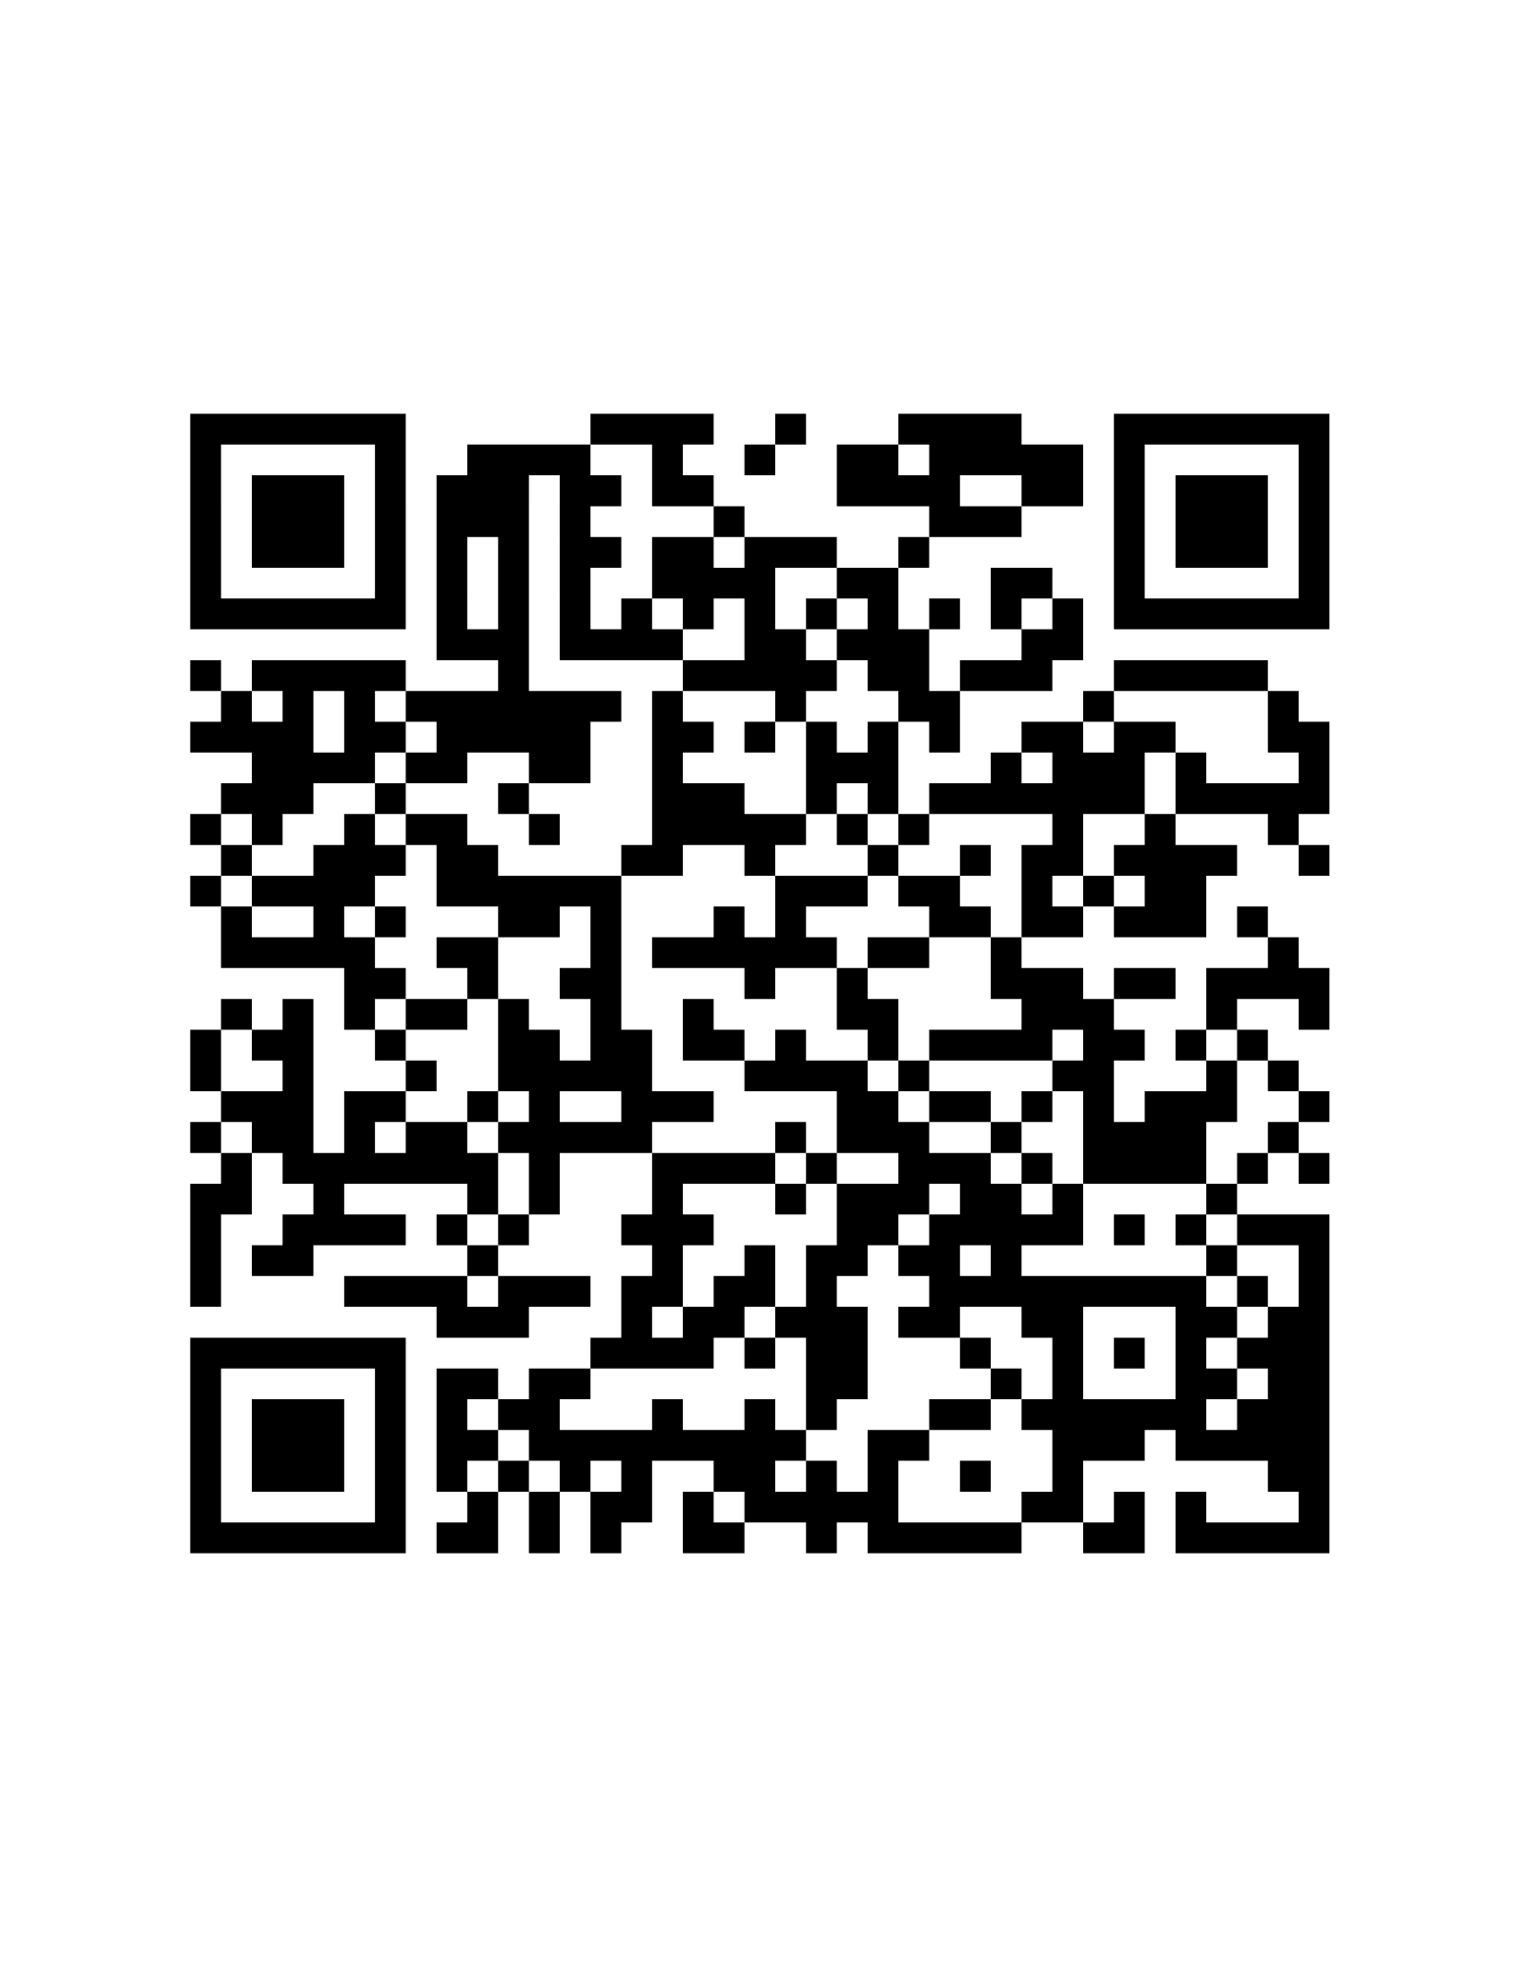
Apply for a mini-grant!
The BRIGHT Coalition is awarding three $750 mini-grants for organizations working to better the health of the Barren River Area Development District (Allen, Barren, Butler, Edmonson, Hart, Logan, Metcalfe, Monroe, Simpson or Warren Counties).
Interested in applying?
Pick up a paper application or request a digital copy from Amanda.
Email finished applications to Amanda.Reckard@barrenriverhealth.org by February 17th.

Slide 40

Awards and Certificates
Celebrating Excellence in Chronic Disease Work

Slide 41
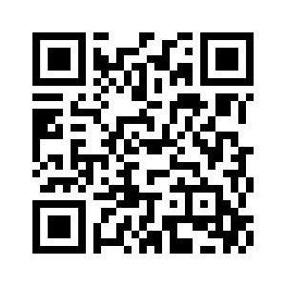
KBN Hours
The South Central Kentucky Area Health Education Center (AHEC) is approved by the Kentucky Board of Nursing (KBN) as a provider of continuing education under the Provider Numbers 5-0026, expiration date 12-31-27. 2.4 contact hours will be awarded after attending the offering and completing evaluations. 0 of those hours is approved for Pharmacology credit.
KBN# 5-0026-12-27-1427

Slide 42

Upcoming Meetings
March 3, 2026
No April meeting
May 5, 2026

