Slide 1

TIABC Board Nominees
2022 - 2024 Term

Slide 2
TIABC AGM Election Update
In accordance with our bylaws, the Tourism Industry Association of BC's (TIABC) recent Call for Nominations for director positions closed on Friday, September 30th at 5pm.
The Board of Directors is made up of a maximum of 13 directors, consisting of 11 directors elected by the active members. TIABC is seeking a total of six (6) candidates for the 2022-2024 term:
For the 2022 - 2024 term, TIABC is seeking a total of six (6) candidates:
From the DMO category, two (2) directors are required for a two-year term.
From the Sector Association category, one (1) director is required for a two-year term.
From the Business Membership category, three (3) directors are required for a two-year term.
Based on the nominations received by the closing date, there will be an election in one category (DMO) with the following candidates seeking a Director position:

Slide 3
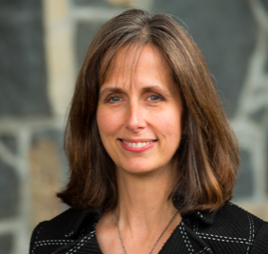
DMO CATEGORY NOMINEE
BARRETT FISHER is the President & CEO of Tourism Whistler. She brings to her position more than 20 years of tourism experience, and is responsible for marketing, communicating and selling Whistler to the world.
In addition to heading up the destination tourism organization of Research, Marketing, Communications, Media Relations, Travel Trade Relations, Conference Sales, Events and Partnerships, Fisher oversees the operations of the Whistler Conference Centre, the Whistler Golf Club, the Whistler Visitor Centre and Whistler.com Central Reservations. In the past year as a Director with TIABC, she has served as the Vice-Chair and Chair of the Policy Committee.
Before becoming President & CEO, Barrett held a number of key positions with Tourism Whistler, including President, Vice President of Marketing & Sales, Vice President of Marketing, Director of Marketing, and Director of Advertising & Promotion.
Barrett served on the board of the Vancouver Organizing Committee of the 2010 Olympic and Paralympic Winter Games for 10 years from 2003 to 2013, and she is a past board member of the Whistler Chamber of Commerce and the Pemberton Airport Authority.

Slide 4
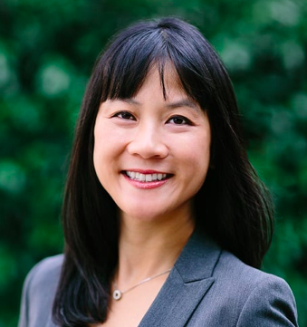
DMO CATEGORY NOMINEE
MIRANDA JI is currently Vice President of Sales at Destination Greater Victoria. She has been involved in the tourism industry for over 15 years in various roles. She holds the Certified Meeting Professional designation from the Convention Industry Council, and the Certified Association Sales Executive designation from the Professional Convention Management Association. She has been named an Industry Leader in the Smart Women in Meetings Award.
Miranda has served on various industry boards as Vice President of Partnerships of Meeting Professionals International’s B.C. Chapter, Director on the Meetings Mean Business Board, Director at Large on the Vancouver Island South Film and Media Commission. She is currently the Vice President on the Board of the Inter-Cultural Association of Greater Victoria.
Miranda is also a member of the Institute of Corporate Directors and has received certification in various areas of Board Governance training including ”Not-for-Profit Governance” and “Boardroom Dynamics for Executives”. She is also actively involved in various committees related to promoting Equity, Diversity, and Inclusion and is part of Destination International’s EDI Committee as well as St. Michaels University EDI Advisory Committee.

Slide 5

DMO CATEGORY NOMINEE
MIKE RETASKET brings many positive strengths and commitment to the table. He has made significant contributions into many areas of aboriginal tourism, aboriginal issues of Title and Rights, culture, education and leadership. Mike is a champion for traditional knowledge and cultural and heritage values and is a storyteller, Traditional Pipe Carrier, Dancer, Drummer, and Singer.
He is a compassionate, analytical and focused professional who has the ability to utilize problem-solving, exceptional communication and patience in providing guidance in negotiations with third parties or Government organizations.
Mike currently serves as a Director on the Cariboo Chilcotin Coast Tourism Association and New Pathways to Gold Society and has served on numerous other Boards including the Thompson Basin Fisheries Council, Fraser Basin Council, First Nation Emergency Services, Forest Stewardship Council, Indigenous Caucus, Shuswap Nation Tribal Council Executive, First Nations Forestry Council – Secretary/Treasurer, Mountain Pine Beetle Working Group (appointed member) and Blueprint Implementation Advisory Committee. Mike has also served five terms as Chief of the Bonaparte Indian Band, Union of BC Indian Chiefs/Secretary Treasurer, and a Founding Member of BC First Nations Leadership Council. As Director of TIABC for the past two years, he has served as the Chair of the Membership & Communications Committee.

Slide 6
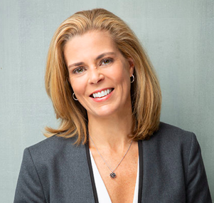
BUSINESS CATEGORY From the Business Membership category three (3) are required for a two-year term. Based on the nominations received by the closing date, an election is not required in the BUSINESS CATEGORY.
Elected to the TIABC Board of Directors BY ACCLIMATION:
JOANNE BURNS-MILLER is the CEO of Pacific Destinations Inc. (PDS), a Vancouver-based destination management, event production and strategic solutions company.
Joanne is a passionate, visionary leader who is known for lighting the way for her team. Drawing on her background as an elite athlete on Canada’s National Netball team for over ten years, Joanne knows the determination and dedication it takes to put together a winning team. Integrity, experience and collaboration are the beating heart she placed within PDS. With a steady hand, clear vision and thoughtful strategy, she selected a team of loyal individuals who all share the same goal; creating unforgettable experiences throughout Western Canada for their treasured clients.
A thoughtful and intentional leader, Joanne is highly respected within the industry and sits on the Advisory Committee for Destination Canada, Business Events division and on the Board for Destination Vancouver.

Slide 7
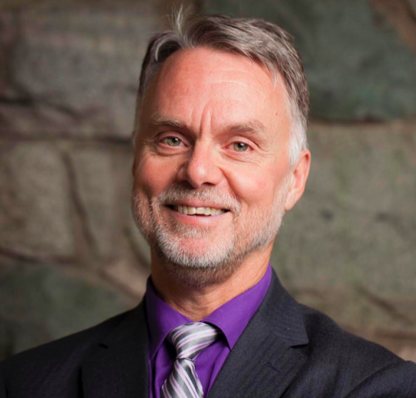
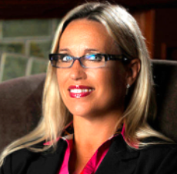
BUSINESS CATEGORY From the Business Membership category three (3) are required for a two-year term. Based on the nominations received by the closing date, an election is not required in the BUSINESS CATEGORY.
Returning to the TIABC Board of Directors:
DENNIS INNES
Director / Dean of Hospitality, Culinary & Baking Vancouver, Community College
SANDRA VAN STEIJN
Director / CEO, St. Eugene Golf & Casino Resort

Slide 8
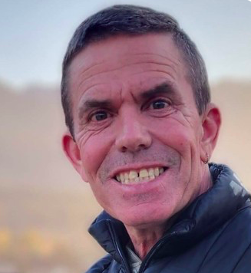
SECTOR CATEGORY From the Sector Association category one (1) is required for a two-year term Based on the nominations received by the closing date, an election is not required in the SECTOR CATEGORY. Returning to the TIABC Board of Directors are:
Returning to the TIABC Board of Directors are: Returning to the TIABC Board of Directors is:
JAMIE COX
Director / Chair, BC Lodging & Campgrounds Association

Slide 9
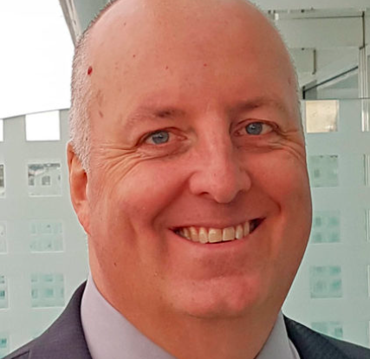
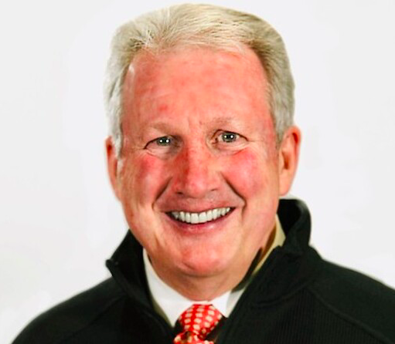
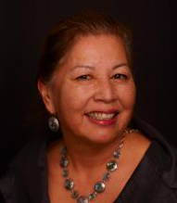
6 BOARD MEMBERS – Mid Term
J.J. BELANGER (Chair)
Chair / General Manager, Crystal Cove Resort – Tofino, BC
MICHAEL J. BALLINGALL
Director / Senior VP, Marketing & Sales, Big White Ski Resort
BRENDA BAPTISTE
Director / Chair, Indigenous Tourism BC

Slide 10
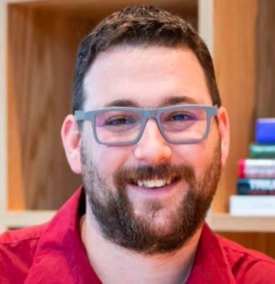
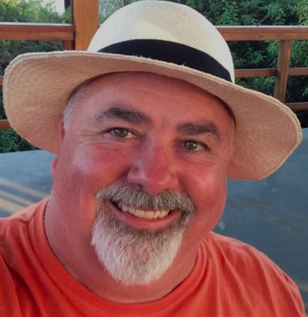
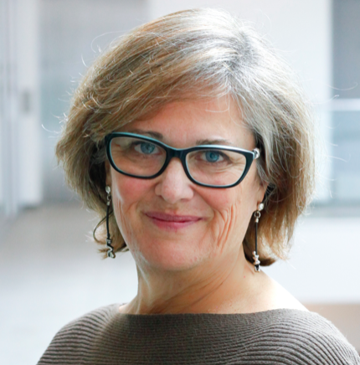
6 BOARD MEMBERS – Mid Term
CHRIS LEWIS
Director / Director of Community & Visitor Engagement, Tourism Kelowna
IAN MACPHEE
Director / Controller, Prince of Whales
SANDRA OLDFIELD
Director/ Principal, Elysian Projects

