Slide 1
Planning Strategies for Charitable Giving
Christina Larkin, CPA, CFP®
Tax Manager
Sciarabba Walker & Co., LLP
clarkin@swcllp.com

Slide 2
Agenda
Estate planning and charitable giving
Federal and NY exclusions and NYS Cliff
Methods of Charitable Giving in Estate Planning
Consideration of assets to leave to Charity vs Individual
Lifetime gifting
  Stocks, QCD’s and Charitable Gift Annuities

Slide 3
Estate Planning
Through estate planning, you can dictate who will inherit your assets
Charitable giving often falls by the wayside
Many people forget to include it in their estate-planning process, or don’t know the best way to integrate their charitable wishes
Think it will happen automatically so they do nothing
You should look at your overall estate plan and talk with your attorney

Slide 4
Why Charitable Giving:
Satisfaction of benefitting an organization and cause important to you
Potential income and estate tax savings

Slide 5
Why Charitable Giving:
It takes more than just a desire to do good, compliance issues must be addressed

Slide 6
Current Exclusions-Federal estate tax
2024 exclusion Federal $13,610,000
Sunset after 2025, base exclusion will decrease from $10M to $5M adjusted for inflation
Portability for federal exclusion-a spouse can use any unused exemption of the first to die spouse
40% tax rate on estate in excess of the exclusion

Slide 7
Current Exclusions-NY estate tax
NY 2024 exclusion $6,940,000
NYS Cliff- which means that if an estate’s value exceeds the threshold (e.g. $6.94 million) by more than 5% (e.g. $7,287,000), the entire estate is subject to taxation, not just the portion exceeding the threshold
Estates exceeding this threshold are taxed on a graduated scale, with rates ranging from 3.06% to 16% for the portion of the estate exceeding the threshold
No Portability

Slide 8
Current Exclusions-NY estate tax
Need for estate planning is important and charitable giving a method to accomplish this
You can reduce the impact of the cliff by bequeathing to charity assets in excess of the NYS exemption amount.

Slide 9
Example
For example, if someone dies in January 2023, leaving a taxable estate of $6,909,000, the estate exceeds the New York estate exemption of $6,580,000 by $329,000.
Since this amount exceeds $6,909,000 (5% of the basic exclusion amount), the entire $6,909,000 estate is subject to New York estate tax with an amount payable of $626,365 (calculated on Form ET-706).
The heirs in this example would avoid paying $626,352 in estate tax and have a better financial outcome if the estate were valued only $330,000 less!

Slide 10
Example

Slide 11
Methods of Charitable giving in Estate Planning

Slide 12
Leave Money to a Charity in Your Will
Naming a charity as the beneficiary in your will or living trust is one of the simplest ways to donate to charity through estate planning
Use a will to designate a charitable bequest for a set dollar amount or residuary % of remainder-amounts will go directly to the charity
Plus, it can lower the amount of your taxable estate and any estate taxes.

Slide 13
Leave Money to a Charity in Your Will
Compliance
Provision for charity MUST be in the will in order to receive any tax benefit!

Slide 14
“Santa Clause” Provision in a Will and Charitable Giving
Commonly known as a “Santa Clause” provision among estate planning practitioners, it is possible to make a conditional bequest in a will or revocable trust to a charity that will happen only if an estate is valued over a certain amount (most commonly the New York estate tax cliff number).
This may be a great way to plan for an unexpected increase in asset size before death and is often used in conjunction with other New York estate tax planning methods.
Families would rather have the excess money go to a charity of their choice rather than the state of New York.

Slide 15
IRA’s and Retirement accounts
Generally largest accumulated wealth at death
Leave by naming one or more charities as beneficiary of your IRA or retirement plan
Name the charity directly on your beneficiary form. The money will go directly to the charity, avoiding both the time and expense of probate.
Dollar amount or %

Slide 16
IRA’s and Retirement accounts
Set up separate accounts. Consider transferring the portion you intend to leave to charity into a separate IRA account

Slide 17
IRA’s and Retirement accounts
Balance the named beneficiary with your bequests. If you have made provisions for certain charities under your will and also have retirement plans, an effective tax strategy would be to reverse the bequests with non-retirement assets for individuals instead of the charity.
This way, the charity receives the same amount that you were going to leave them in your will, but your heirs will end up with more because the money they will inherit will not be subject to income tax, as the retirement plan would be
More on this later

Slide 18
Reasons individuals don’t include charities in estate planning?
Concern over stewardship of the funds,
Is my gift going to be used wisely?
Will the charity effectively handle large donations at once?

Slide 19
Donor Advised Fund (DAF’s)
Option if you don’t have a single charity in mind, concern for stewardship, want longer term impact
Can be set up during lifetime or at death through a bequest or naming the DAF on your beneficiary form
Grant to charities either specific or a field of interest over time

Slide 20
Types of assets-Individual vs Charitable Beneficiary tax considerations

Slide 21
Types of assets-Individual vs Charitable Beneficiary tax considerations
501(c)(3) charitable organizations don’t pay tax
Individual beneficiaries will pay tax on the income based on their individual rates
What assets do you select for each to minimize their tax impact?

Slide 22
IRA’s and Retirement accounts
Individual beneficiary will generally be subject to federal and state income tax on any distribution that he or she receives from the inherited IRA or plan
The post-death distributions will be taxable according to the beneficiary's income tax bracket.
By contrast, if you name a charity as beneficiary, that charity will not have to pay any income tax on the IRA or plan funds the charity receives after your death (provided that the charity qualifies as a tax-exempt charitable organization under federal law)

Slide 23
IRA’s and Retirement accounts
Example(s): Assume you have an IRA valued at $100,000, and a bank savings account also valued at $100,000. You want to leave $100,000 to your favorite charity. Whether you leave the charity the IRA or the bank savings account makes no difference to the charity. The charity is able to keep the full $100,000 either way, since no income tax applies to the receipt of an IRA or a savings account by a charity. If you leave the $100,000 savings account to an individual beneficiary such as your child, your child will receive the full $100,000 without a reduction for income tax.

Slide 24
IRA’s and Retirement accounts
However, if you instead leave the $100,000 savings account to the charity and leave your $100,000 IRA to an individual beneficiary such as your child, your child will end up with less than $100,000, since income tax must be paid on IRA distributions received by an individual beneficiary.
The portion of the funds that your child loses to taxes could be substantial, depending on his or her income tax bracket and how quickly the funds are distributed from the IRA or plan.

Slide 25
IRA’s and Retirement accounts

Slide 26
IRA’s and Retirement accounts
Generally a great asset to leave to charity
EXCEPTION-ROTH
  Individual beneficiary will receive tax free withdrawals

Slide 27
Stock or other appreciated assets, Basis Basics
  Basis of an inherited asset is generally FMV on date of decedent’s death or, if elected, the alternate valuation date (IRC § 1014(a))
  Appreciated assets receive a “step-up” in basis at death
  Saves income tax when the property is sold by “heirs”

Slide 28
Stock or other appreciated assets, Basis Basics
10,000 shares of stock, cost basis of $5, currently trading for $10
To original owner:
Sale price |  | $ 100,000
Cost basis |  | $ 50,000
Gain |  | $ 50,000

Slide 29
Stock or other appreciated assets, Basis Basics
STEP UP Basis-FMV at date of death10,000 shares of stock, cost basis of $5, currently trading for $10
Sale price |  | $ 100,000
Cost basis |  | $ 100,000
Gain |  | $ -0-

Slide 30
Gifts during your lifetime

Slide 31
Stock gifts-during lifetime
Gifts to individuals: had the assets been given away during one’s lifetime, the basis to the donees would be the carryover basis of the donor, most likely leading to more capital gain and net investment income tax liability for the donees

Slide 32
Stock gifts-during lifetime
Gifts to charity:
Ability to gift, take a charitable deduction based on the FMV and avoid paying capital gains tax on the sale of the stocks
Donating appreciated stocks, rather than selling the stocks then donating cash, can minimize a donor’s tax burden and maximize generosity.
Establish your donor advised fund

Slide 33
Qualified Charitable Distributions (QCDs)
Persons who have reached age 70½ may transfer up to $105,000 (2024 limit, $100,000 indexed for inflation) directly from an IRA to a qualified charity (but not to a donor-advised fund or a private foundation).
If this is done, the taxpayer is not required to report the IRA withdrawal as income, and the taxpayer does not get an income tax deduction on Schedule A for making the transfer.
The transfer from the IRA does count as or toward the taxpayer’s required minimum distribution for the year in which it is made.
The QCD has the advantage of reducing one’s AGI, which may allow for a larger medical expense deduction and reduced exposure to the net investment income tax and a reduction in one’s Medicare Parts B and D premiums.

Slide 34
Qualified Charitable Distributions (QCDs)
Beginning in 2023, a QCD may be taken to fund a Charitable Remainder Unitrust, Charitable Remainder Annuity Trust, or Charitable Gift Annuity up to a maximum one-time amount of $53,000 in 2024 ($50,000 indexed for inflation).

Slide 35
Charitable Gift Annuities
A charitable gift annuity is a contract between a donor and a charity with the following terms: As a donor, you make a sizable gift to charity using cash, securities or possibly other assets.
In return, you become eligible to take a partial tax deduction for your donation (in most cases), plus you receive a fixed stream of income from the charity for the rest of your life.
At the end of your life the charity receives the remainder of the gift.
May become more popular due to the provision to allow the one time QCD to establish a CGA

Slide 36
Charitable Gift Annuities
Higher interest rates mean larger payments (rates determined by IRS 7520 rates and age of donor)

Slide 37
Charitable Gift Annuities
Benefits of a charitable gift annuity
Income stream for the rest of your life
Immediate (partial) tax deduction, based on your life expectancy and the anticipated income stream
Potential for a portion of the income stream to be tax-free
Possibility of donating many types of assets: cash, securities plus personal property
Reduced or eliminated capital gains tax liability for gifts of appreciated securities and personal property
Supporting an organization you care about

Slide 38
Charitable Gift Annuities
Potential drawbacks
Parting irrevocably with funds donated to create the annuity
Subject to income tax on the income stream (payments from the annuity)
Payments are fixed and won’t be adjusted for inflation
Payments may be lower than with a non-charitable annuity because the primary purpose is for nonprofit support
Cannot be used to support multiple charities unless you set up multiple annuities

Slide 39
CGA Example
Mary Elizabeth, age 78, has enough savings to meet her retirement needs.
She wants to help the charity with a generous donation but is concerned about her future income with the low interest rates available to her.
She established a $10,000 Charitable Gift Annuity, which specified that the remainder of the annuity balance benefit her local parish upon her death

Slide 40
CGA Example
Elizabeth’s Benefits
Cash Donated $10,000.00
Annuity Rate 6.80%
Annual Annuity Payment $680.00
Charitable Deduction $4,826.10
Mary Elizabeth, who itemizes her deductions when filing her tax return, includes the charitable deduction of $4,826.10. At her 25% tax bracket, this generates a tax savings of $1,206.52.

Slide 41
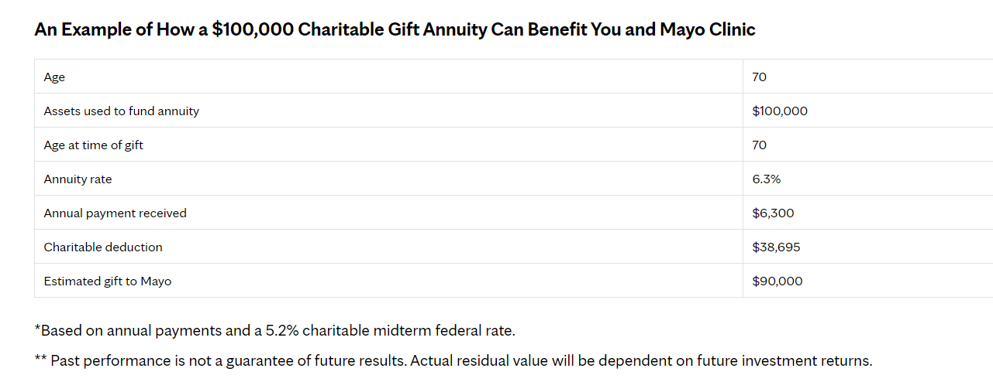
Online example-Mayo Clinic

Slide 42
Questions?

