Slide 1
SchoolCash : Auto-Subscribe

Slide 2

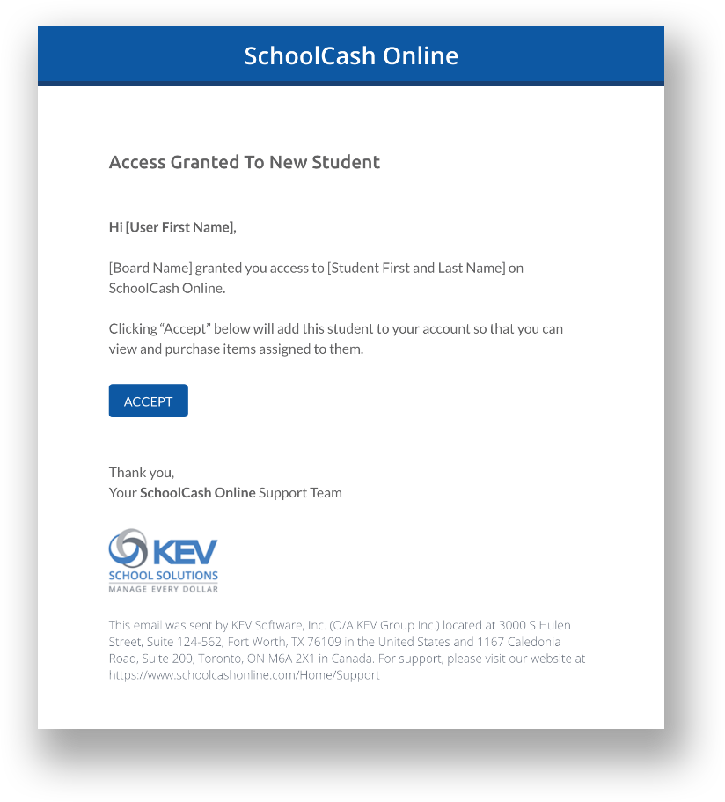
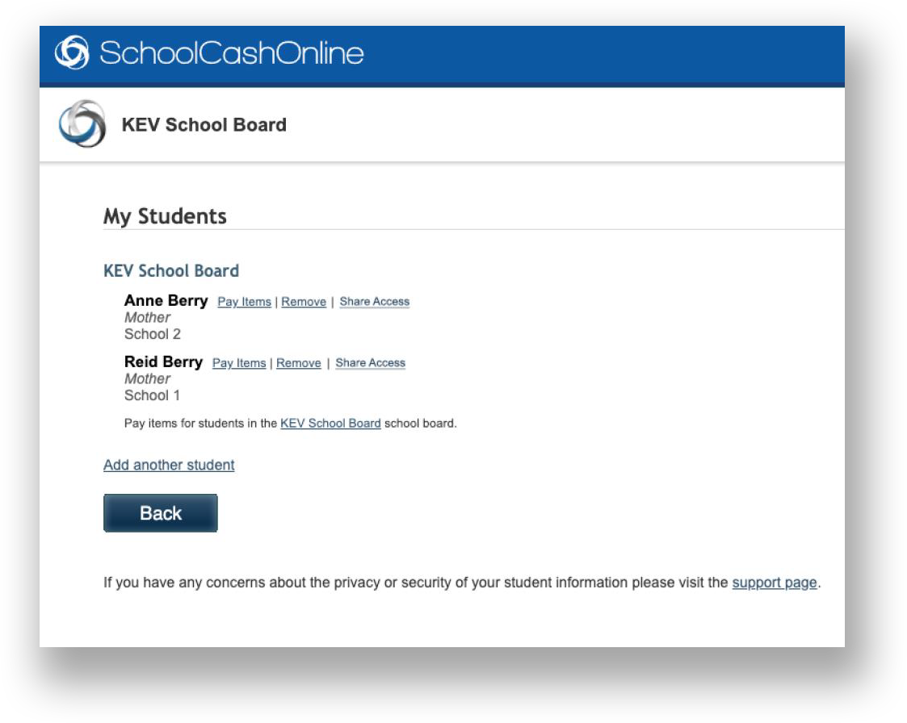
New Auto-Subscribe Feature
Make it easier for parents to attach their children to their SchoolCash Online account.
Primary Guardians without an SCO account receive an Invitation email
Primary Guardians who haven’t yet linked students to their account receive an Accept email
Fewer steps for parents, higher adoption rates, and higher likelihood parents can see and pay for items
Automated email for Primary Guardians: The parent can accept auto-linking of children (per SIS data) to SCO account
New “Share Access” feature: Primary Guardian can share/remove access with other guardian(s)
© 2023 KEV Group. All rights reserved.

Slide 3
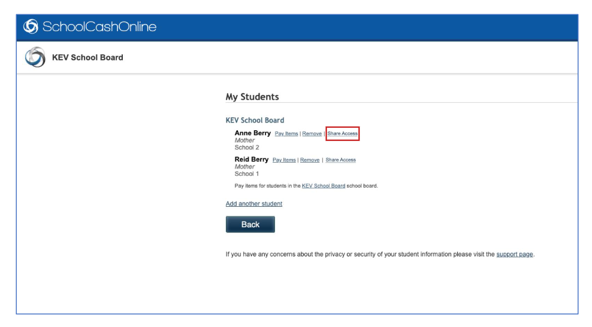
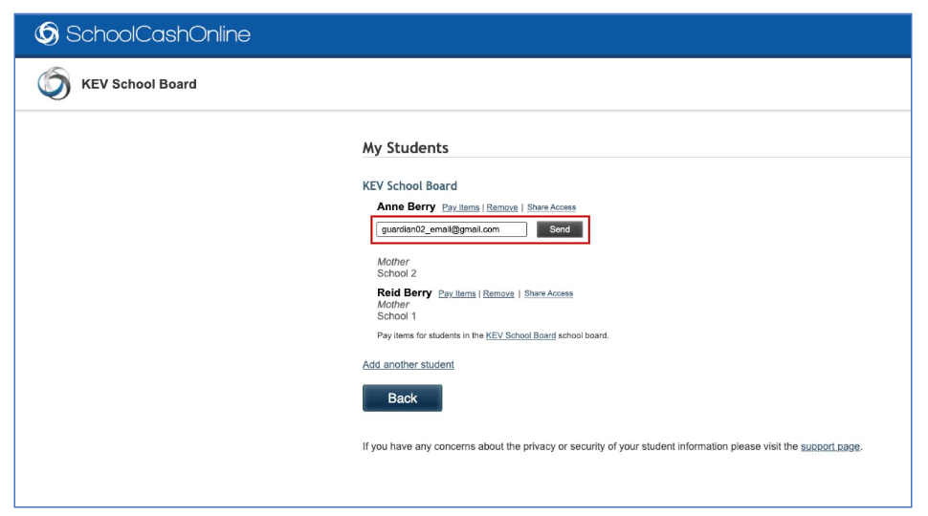
Auto-Subscribe
Parents can share access, to other family members via the “Share Access” link.
Simply enter the email address you want to share access and click “Send”

Slide 4
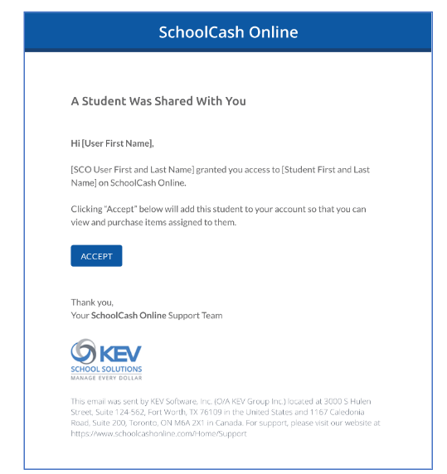
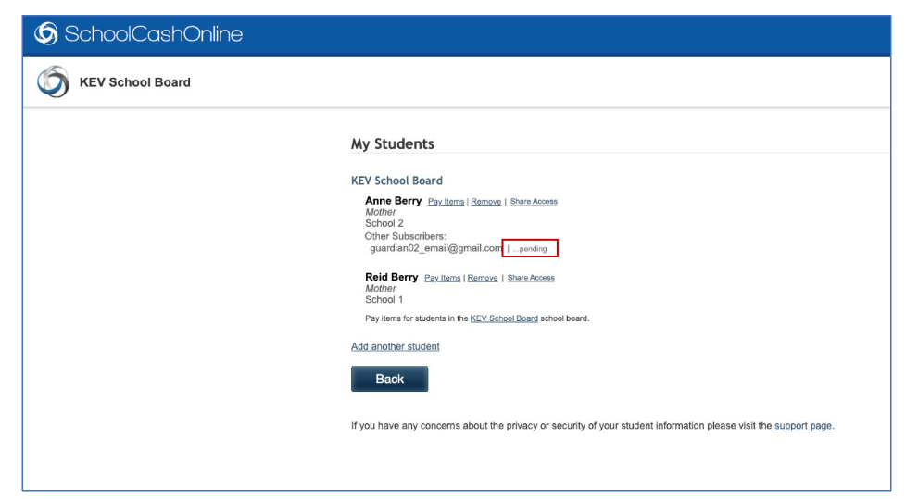
SchoolCash Online-Auto-Subscribe
The invitation will remain pending until it is accepted by the new subscriber.

Slide 5
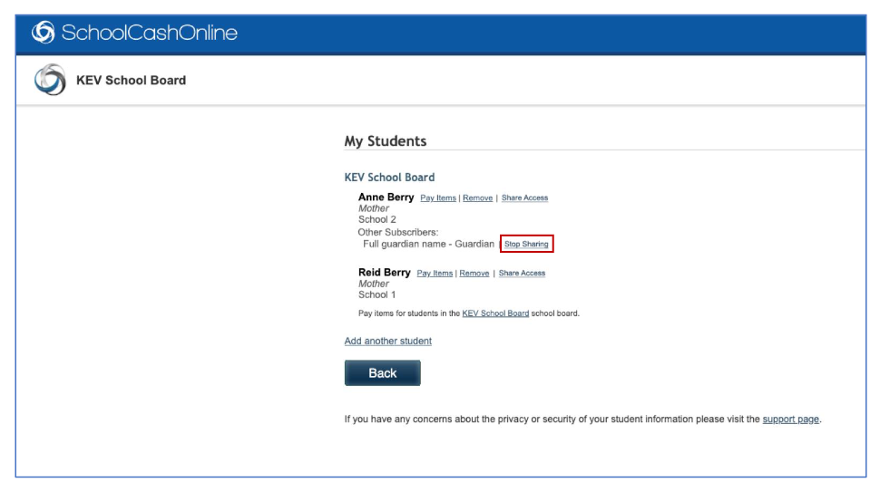
SchoolCash Online-Auto-Subscribe
To unsubscribe a student from another SchoolCash Online user, click on the “Stop Sharing” link.

