Slide 1
New Bankruptcy Rules Effective December 1, 2025
Going through the New Rules, New Forms, & the Impacts on Bankruptcy for claims secured by the Debtor’s Principal Residence

Slide 2
Agenda & Goals
Rule Changes taking Effect December 1, 2025
New Forms effective December 1, 2025
Now with more Motions! We are discussing Motion to Determine Status filed during the bankruptcy.
Potential benefit for dealing with Home Equity Loans
New “Mid-Case” Audit Motion
Requires all Trustees to file Notice of Final Cure.
Notice of Final Cure is being replaced by a potentially two step process if it’s a disagreed response
What this means for Creditors, Debtors and Trustee offices
2

Slide 3
DECEMBER 1ST IS ONLY 27 DAYS AWAY -- LOTS OF NEW RULES AND NEW FORMS!!!!

Slide 4
Update/New Official Forms – 12/1/2025
(Required Official Forms)
410S1 – Notice of Mortgage Payment Change
410C13-M1/M1R – Motion to Determine Status of Mortgage Claim / Response to Motion to Determine Status
410C13-N/NR – Trustee’s Notice of Payments Made / Response to Trustee’s Notice of Payments Made
410C13-M2/M2R – Motion to Determine Final Cure / Response to Motion to Determine Final Cure

Slide 5
Purpose of Changes
Enhance transparency and accountability in Chapter 13 Cases involving claims secured by the debtor’s residence
The National Rule Committee thought the Creditors needed to bill more for attorney fees -- Just kidding they thought there need to be more transparency, more rules and more forms
All the Rules go into effect December 1st
5

Slide 6
More Mortgages covered by Rule 3002.1 Requirements
Current Rule
Rule after December 1, 2025
This rule applies in a Chapter 13 case to claims (1) that are secured by a security interest in the debtor’s principal residence, and (2) for which the plan provides that either the trustee or the debtor will make contractual installment payments.
**NO REVERSE MORTGAGES, NO TOTAL DEBT LOANS NO CRAMDOWNS ***
This rule applies in a Chapter 13 case to a claim that is secured by a security interest in the debtor’s principal residence and for which the plan provides for the trustee or debtor to make payment on the debt.

Slide 7
          IMPACT
Now 3002.1 applies to reverse mortgage, total debt treatments, and cram-down treatments on Principal Residences
  This new language targets the previous exclusion of certain loans such as those that may be paid in full during the plan or reverse mortgages. This expanded scope is critical to servicers who operationally excluded these types of loans from 3002.1 filings, such as a Payment Change Notices (PCNs) or Post-Petition Fee Notices.

Slide 8
Rule 3002.1(b) Notice of Payment change
      Home equity line of credit
      Creditors are required to file a notice of payment change 21 days prior to the actual change in payment to provide notice to the borrower and trustee.
      Home equity lines of credit (HELOCs) have historically been a pain for creditors filing PCNs due to the frequency of payment changes (which are often in small amounts) and the timing (sometimes monthly) .
      The amendments (theoretically) streamline this process – allowing creditors to instead file a PCN annually for HELOC loans, unless the payment changes by more than $10.

Slide 9
Rule 3002.1(b) Notice of Payment change
      The rule provides for certain content requirements for an annual HELOC PCN notice:
      Must include a reconciliation amount (net overpayment or underpayment for last year).
      Additionally, the servicer must ensure the first payment due after a timely annual notice be increased or decreased by any “reconciliation” amount.

Slide 10
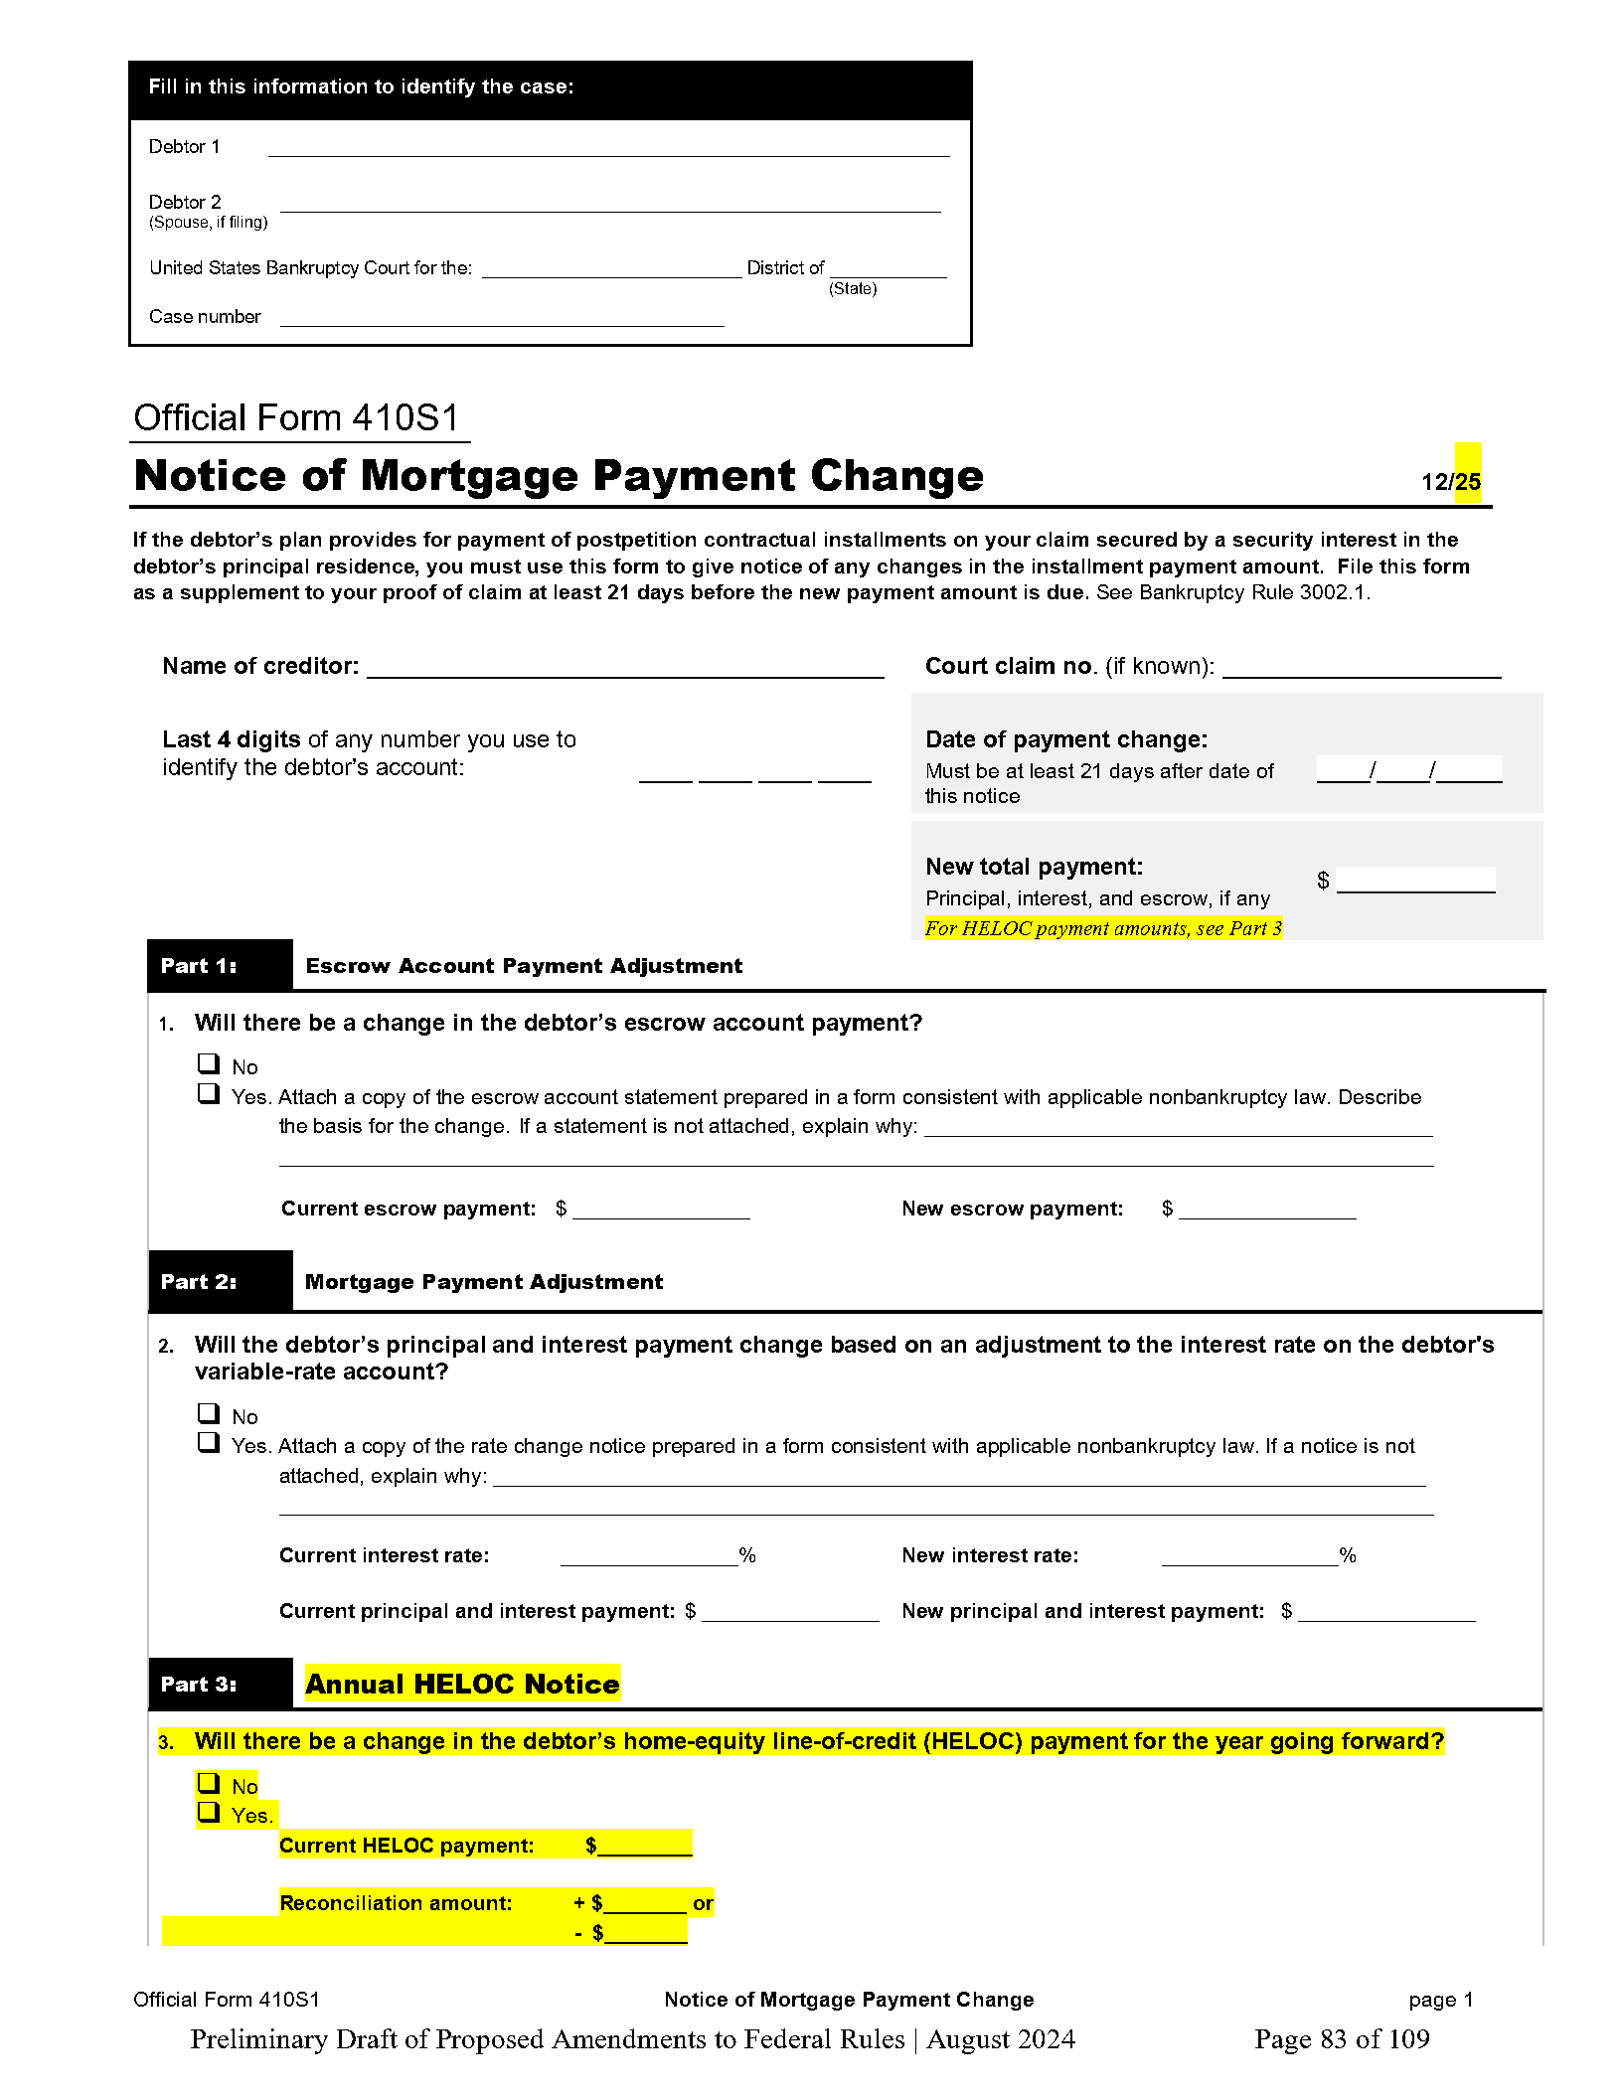
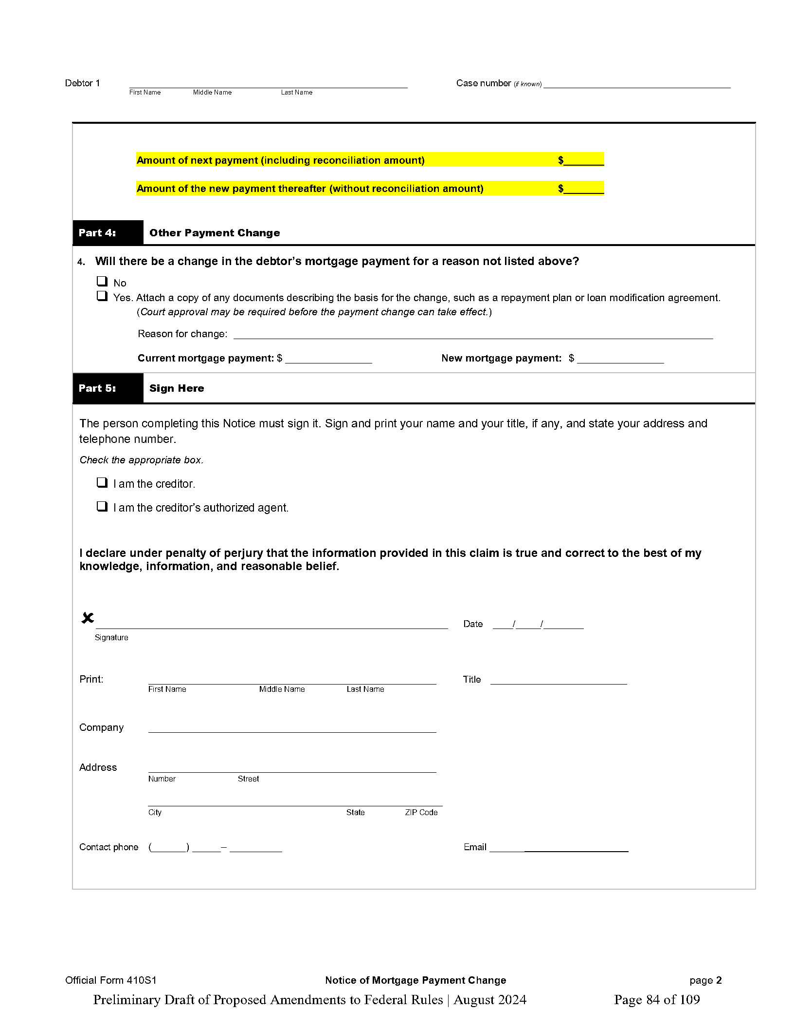
410S1 – Notice of Mortgage Payment Change
10

Slide 11
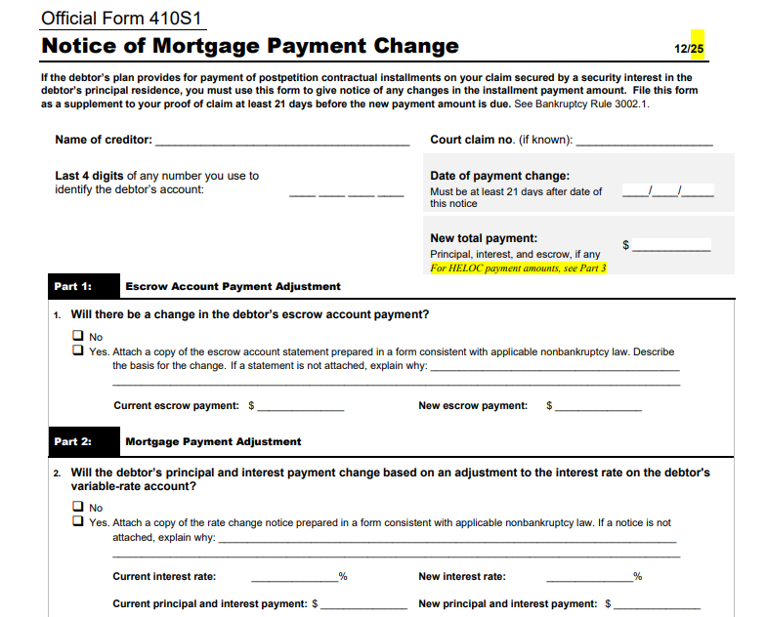

Slide 12
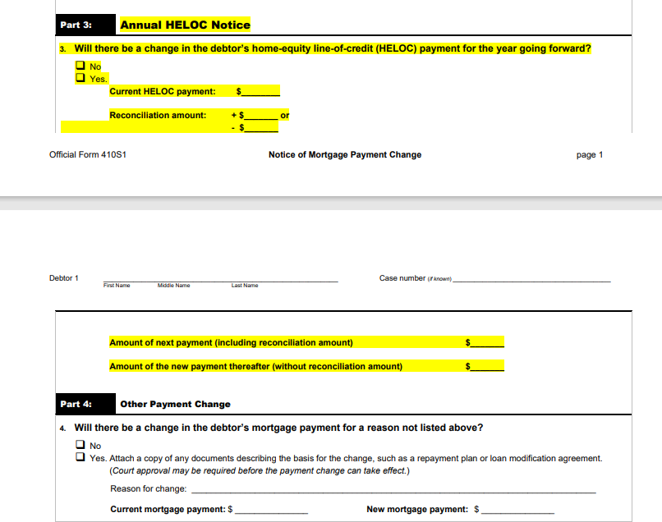

Slide 13
Clarification of Effect of Untimely PCNs – non HELOC
3002.1(b) now clarifies the effect of an untimely PCN, which is currently considered an industry standard remediation practice:
If the payment increased, the new payment should not become effective until at least 21 days after filing/service.
Typically, this will be addressed via credit to borrower’s account for the difference between the old and new payment amount for each relevant month (non- HELOC).
If the payment decreased, the new payment becomes effective immediately

Slide 14
Change to 3002.1(e)
3002.1(e) – party in interest can ask court to shorten time from 1 year for challenges to PPFNs – helpful in cases near completion
Now for creditors the fees incurred for the Notice of Payments Made or the Motions

Slide 15
Motion to Determine Status FRBP 3002.1(f)
A new mechanism for the trustee or debtor
“Motion to Determine Status,” may be filed at any time after the bankruptcy filing until the End-of-Case Notice of Disbursements Made is filed
If the creditor disagrees with the amounts included in the motion, it must file a response within 28 days of the motion.
This response must be filed on a designated form.
The court will determine the status of the mortgage claim after notice and a hearing.
The objective here is to provide a mid-case “check-in” to address any questions or accounting discrepancies prior to the end of the case.
The industry will have to stay tuned to see how frequently this is used by trustees and/or the debtors’ bar and the downstream impact on servicers.

Slide 16
Key changes to be aware of under the Rule:
The revised rule introduces a mid-case motion to determine the status of a mortgage claim
Must be filed by the Trustee or Debtor using Form 410C13-M1.
Requires service on all relevant parties (debtor, debtor’s attorney, trustee).
Is intended to resolve discrepancies in mortgage accounting before the end of the case, reducing surprises at discharge

Slide 17
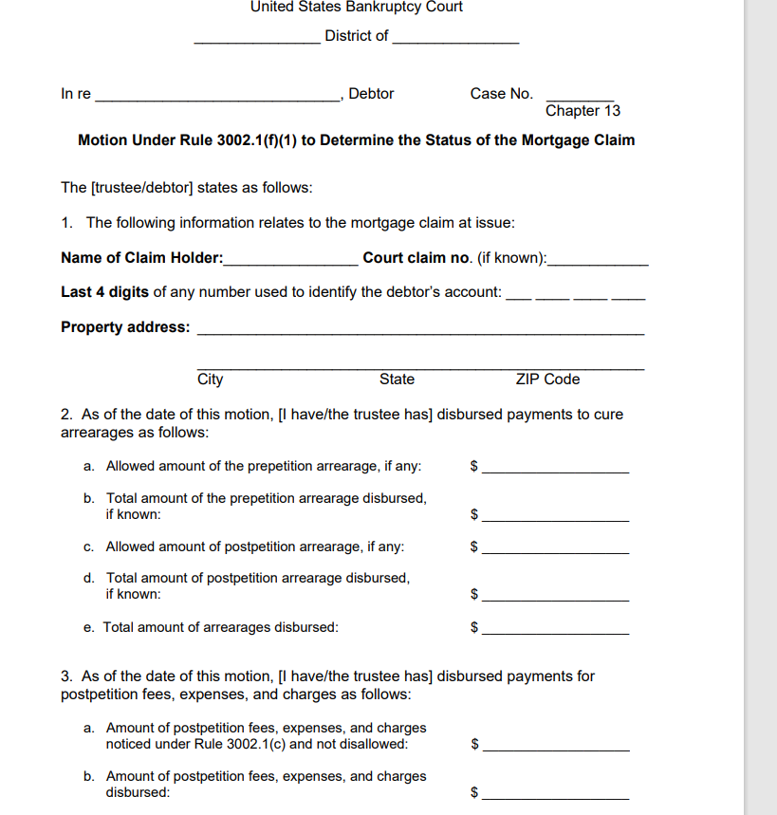
Official Form 410C13-M1 – Motion to Determine Status
“Mid-Case Audit”
17

Slide 18
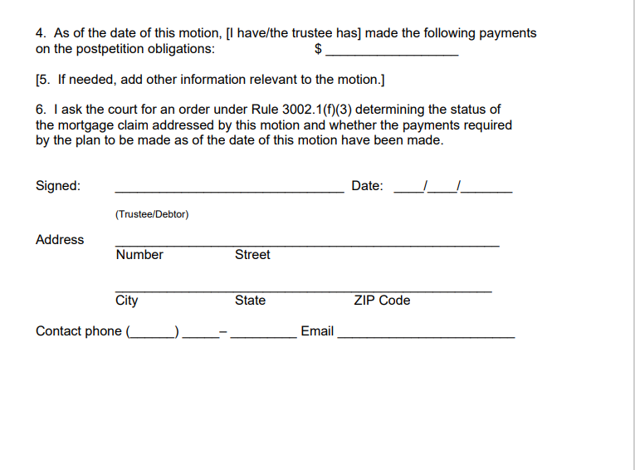
Official Form 410C13-M1 – Motion to Determine Status
“Mid-Case Audit”
18

Slide 19
What does the Motion do?
The Motion provides two (three?) types of information and seeks to verify that the servicer/mortgagor’s records are consistent with that information.
  Amounts disbursed for pre and post arrearages
  Amounts disbursed for fees, expenses and charges
  Amounts disbursed for post petition obligation
19

Slide 20
What else can the Motion seek to verify?
  Post petition due date
  Whether post petition payments were made by Debtor outside the Trustee conduit
  Contractual due date
  Unpaid principal balance
  Suspense balance
  Post petition escrow debits/credits or balance

Slide 21
If Trustee files Motion, what must they include?
If the trustee files the motion, must disclose the payments made to the holder of the mortgage claim so far in the case.
If the debtor, rather than the trustee, has been making the post-petition payments, the trustee should state in part 4 that she has paid $0.

Slide 22
If the Debtor files the Motion, what must be included?
If the debtor files the motion, they should provide information about any payments they made and any payments made by the trustee of which the debtor has knowledge.

Slide 23
Response to Motion to Determine Status
Within 28 days after service of the trustee’s or debtor’s motion, the holder of the mortgage claim must file a Response using Official Form 410C13-M1R, if it disputes any facts set forth in the motion
23

Slide 24
Ooooooohhhhh boy Lots of additional information needed:
The creditor must indicate whether the debtor has paid the full amount required to cure any arrearage; and
  whether the debtor is current on all post-petition payments.
  The claim holder must provide a payoff statement, and, if the claim holder says that the debtor is not current on all payments, it must attach an itemized payment history for the post-petition period

Slide 25
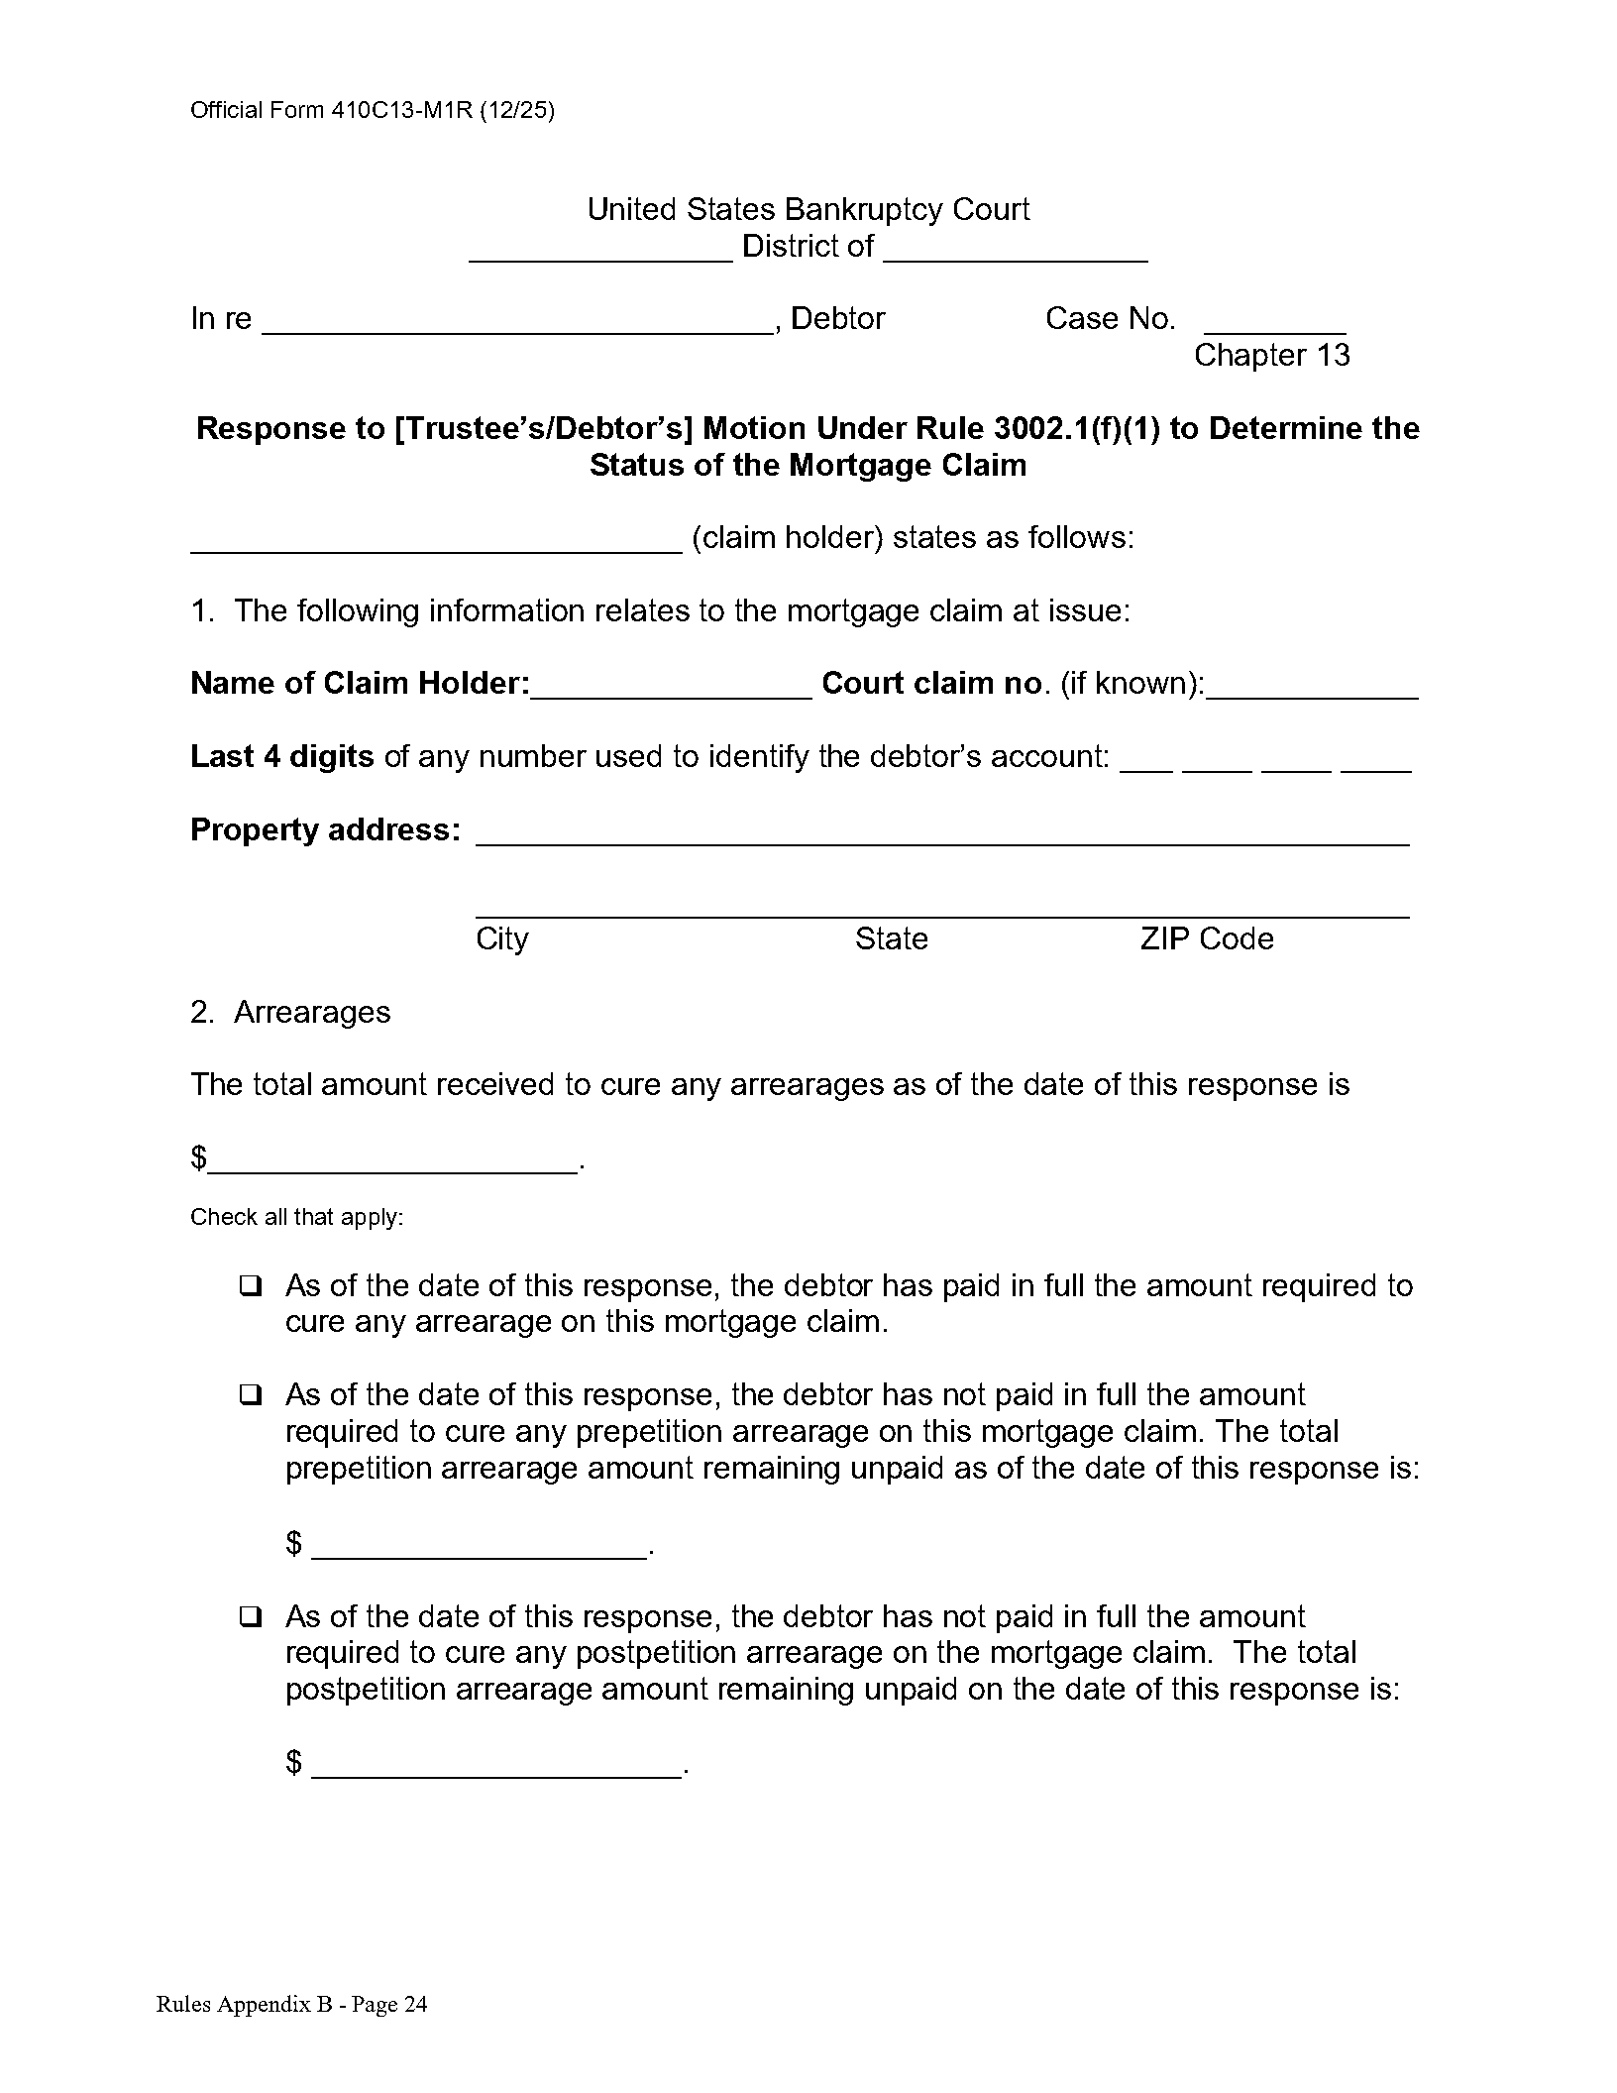
Official Form 410C13-M1R (12/25)
“Mid Case Audit” “R” - Response
25

Slide 26
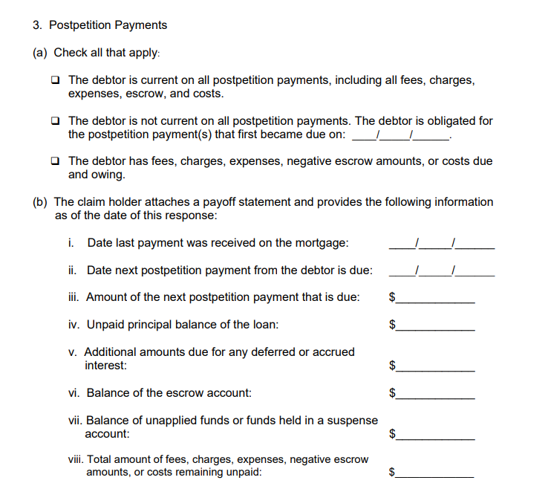
Official Form 410C13-M1R (12/25)
“Mid Case Audit” “R” - Response
26

Slide 27
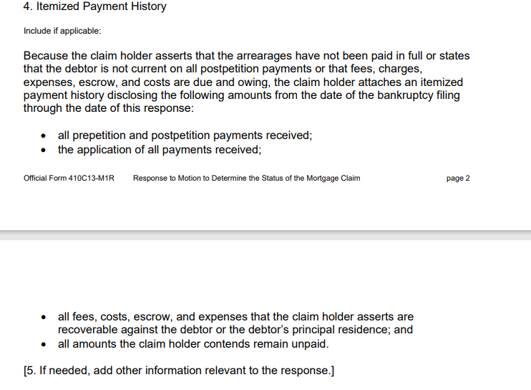
Official Form 410C13-M1R (12/25)
“Mid Case Audit” “R” - Response
27

Slide 28
The claim holder must attach an itemized payment history disclosing the following amounts from the date of the bankruptcy filing through the date of this response
All prepetition and post-petition payments received;
The application of all payments received;
All fees, costs, escrow, and expenses that the claim holder asserts are recoverable against the debtor or the debtor’s principal residence;
And all amounts the claim holder contends remain unpaid.
If Response states Debtor is not current or that fees, charges, expenses, escrow and costs are due and owing:

Slide 29
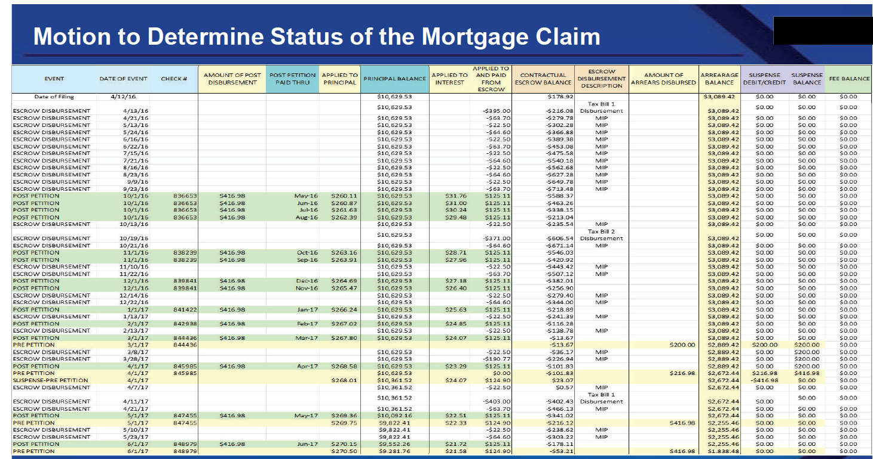
Sample History

Slide 30
What happens if the Response doesn’t agree with the Motion?
Court Determination
  If the claim holder’s response asserts a disagreement with facts set forth in the motion, the court must, after notice and a hearing, determine the status of the claim and enter an appropriate order.
  If the claim holder does not respond to the motion or files a response agreeing with the facts set forth in it, the court may grant the motion based on those facts and enter an appropriate order.
After Court Determination
  Creditors need to make sure that the appropriate changes are made in their system of record.
  Continuing to show variations from the Court’s Orders in statements, payoffs and monthly payment determinations could lead to sanctions.
30

Slide 31
Creditors need to respond and have counsel appear at the hearing.
Failure to respond can result on the Motion’s figures and amount be included in the Court’s Order.
Failure to respond during the case can result in the mid case audit figures being used at the end of the bankruptcy.

Slide 32
When would a conduit Trustee file this Motion?
To verify that the Debtor is making the ongoing mortgage payments outside the Trustee conduit during the life of the plan.
To verify the Creditor is properly applying the payments to principal, interest and escrow.
To verify escrow balances when a NOPC appears to be incorrect.
When the monthly mortgage statement information doesn’t match the disbursement information in their system.
When a mortgage is transferred and it appears the loan was incorrectly boarded.

Slide 33
When would a conduit Trustee file this Motion?
When the Creditor returns checks on the pre petition arrearage
When the post office returns your check as the loan appears to have transferred.
When a mortgage is transferred and it appears the loan was incorrectly boarded, and you don’t know who to send the Notice of Final Cure to.
If mortgage payments are required to be current to obtain discharge, send a Notice 2 months before completion to verify Debtor has been making the payments.

Slide 34
When would a Debtor file this Motion?
When the mortgage statement information doesn’t match the Debtor’s payments.
When there is a large increase in escrow but the Debtor’s taxes and insurance have not increased.
Approximately 3 months prior to the end of the case to verify that there are no payments, fees or costs filed for under 3002.1 still outstanding.
Approximately 3 months prior to the end of the case to verify that the pre-petition arrears and post petition payments have all been made.

Slide 35
  Going to vary in usage across the country – Direct Pay Trustees v. Conduit Trustees
  Might be used a lot after service transfers, if there appears to be escrow issues, or payments do not appear to be accounted for – MFRs or Notice of Defaults filed
  Potential abuse: -- by Debtor’s
  In Committee Notes discusses about courts taking action to make sure this is being appropriately used and not being used to play “Gotcha”
  Debtor and Trustee’s need to be selective as to how many times to use this is a case.

Slide 36
End-of-Case Notice of Disbursements Made -- Rule 3002.1(g)
The prior Bankruptcy Rule 3002.1 included a “Notice of the Final Cure Payment,” which served a similar objective to this notice.
The trustee is now required to file a designated form that states the amount the trustee has paid to cure any default on the claim and whether the default has been cured.
The creditor must file a response within 28 days of the motion. This response must also be filed on a designated form.
The trustee or debtor may file a motion to determine whether the debtor has cured all defaults and paid all required payments within 45 days after service of the creditor’s response or the trustee’s notice if the creditor did not file a response.

Slide 37
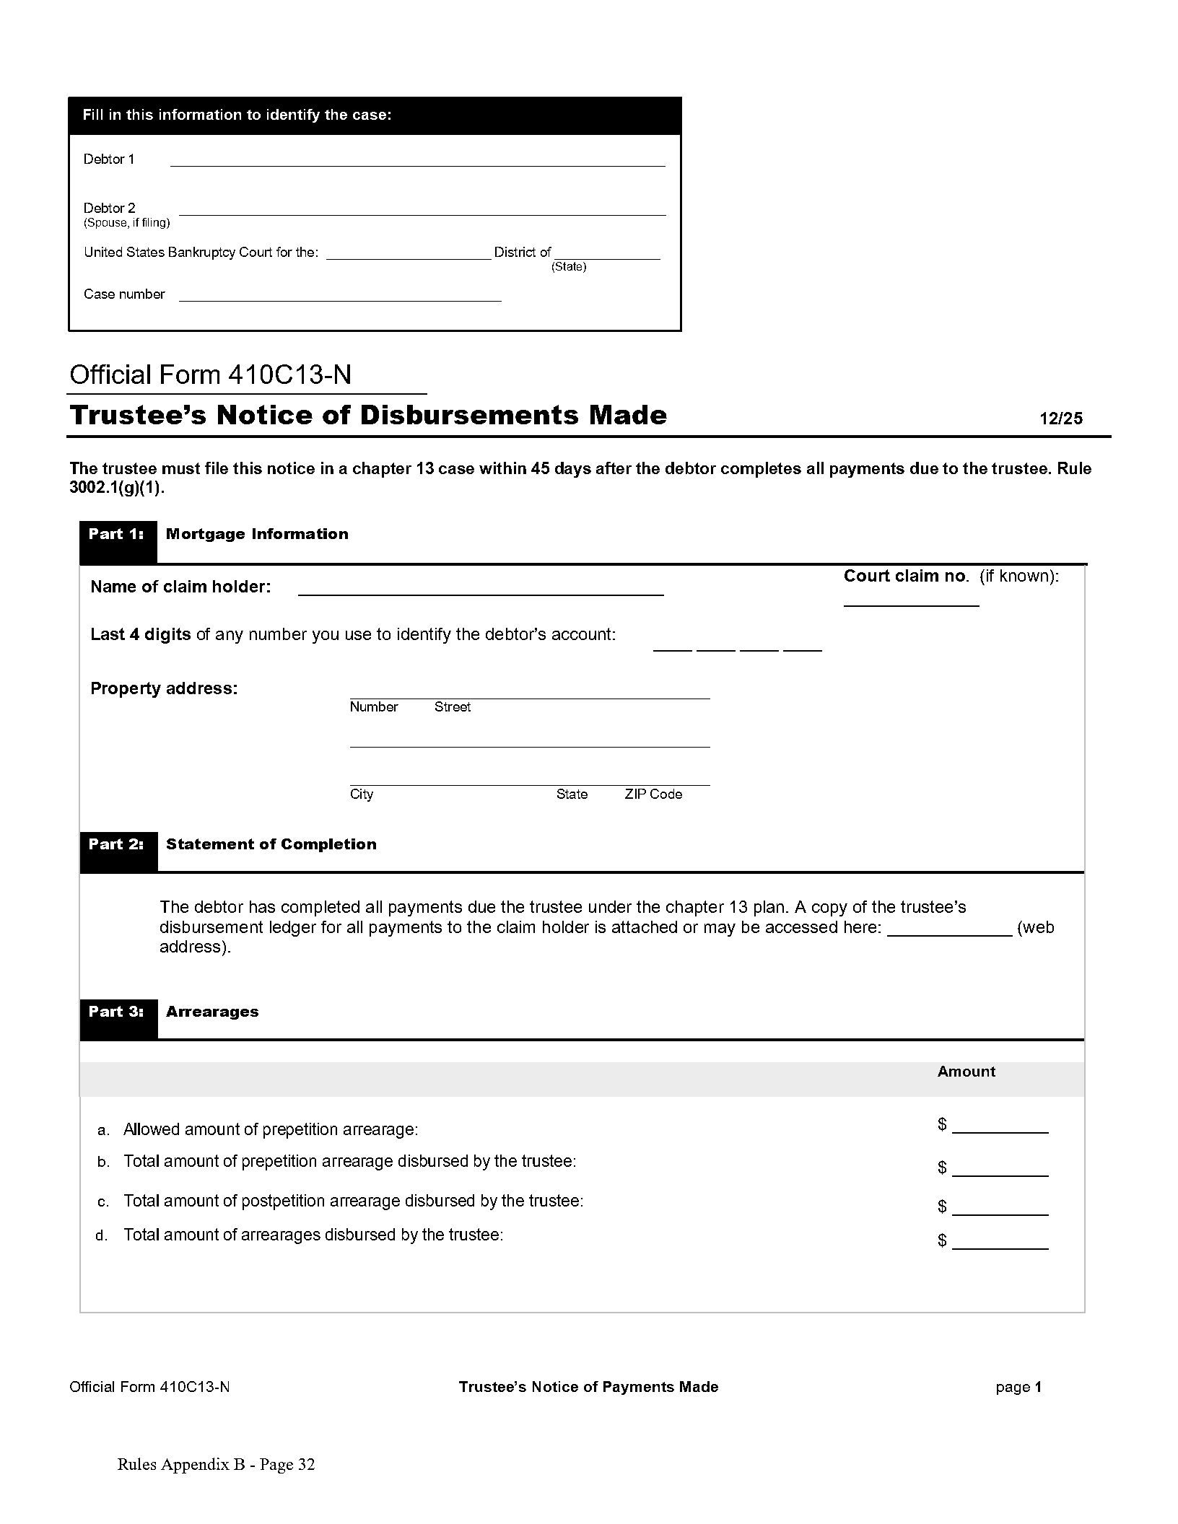
Official Form 410C13 –N (“N” – Notice) of Distributions Made - Replacing Notice of Final Cure
37

Slide 38
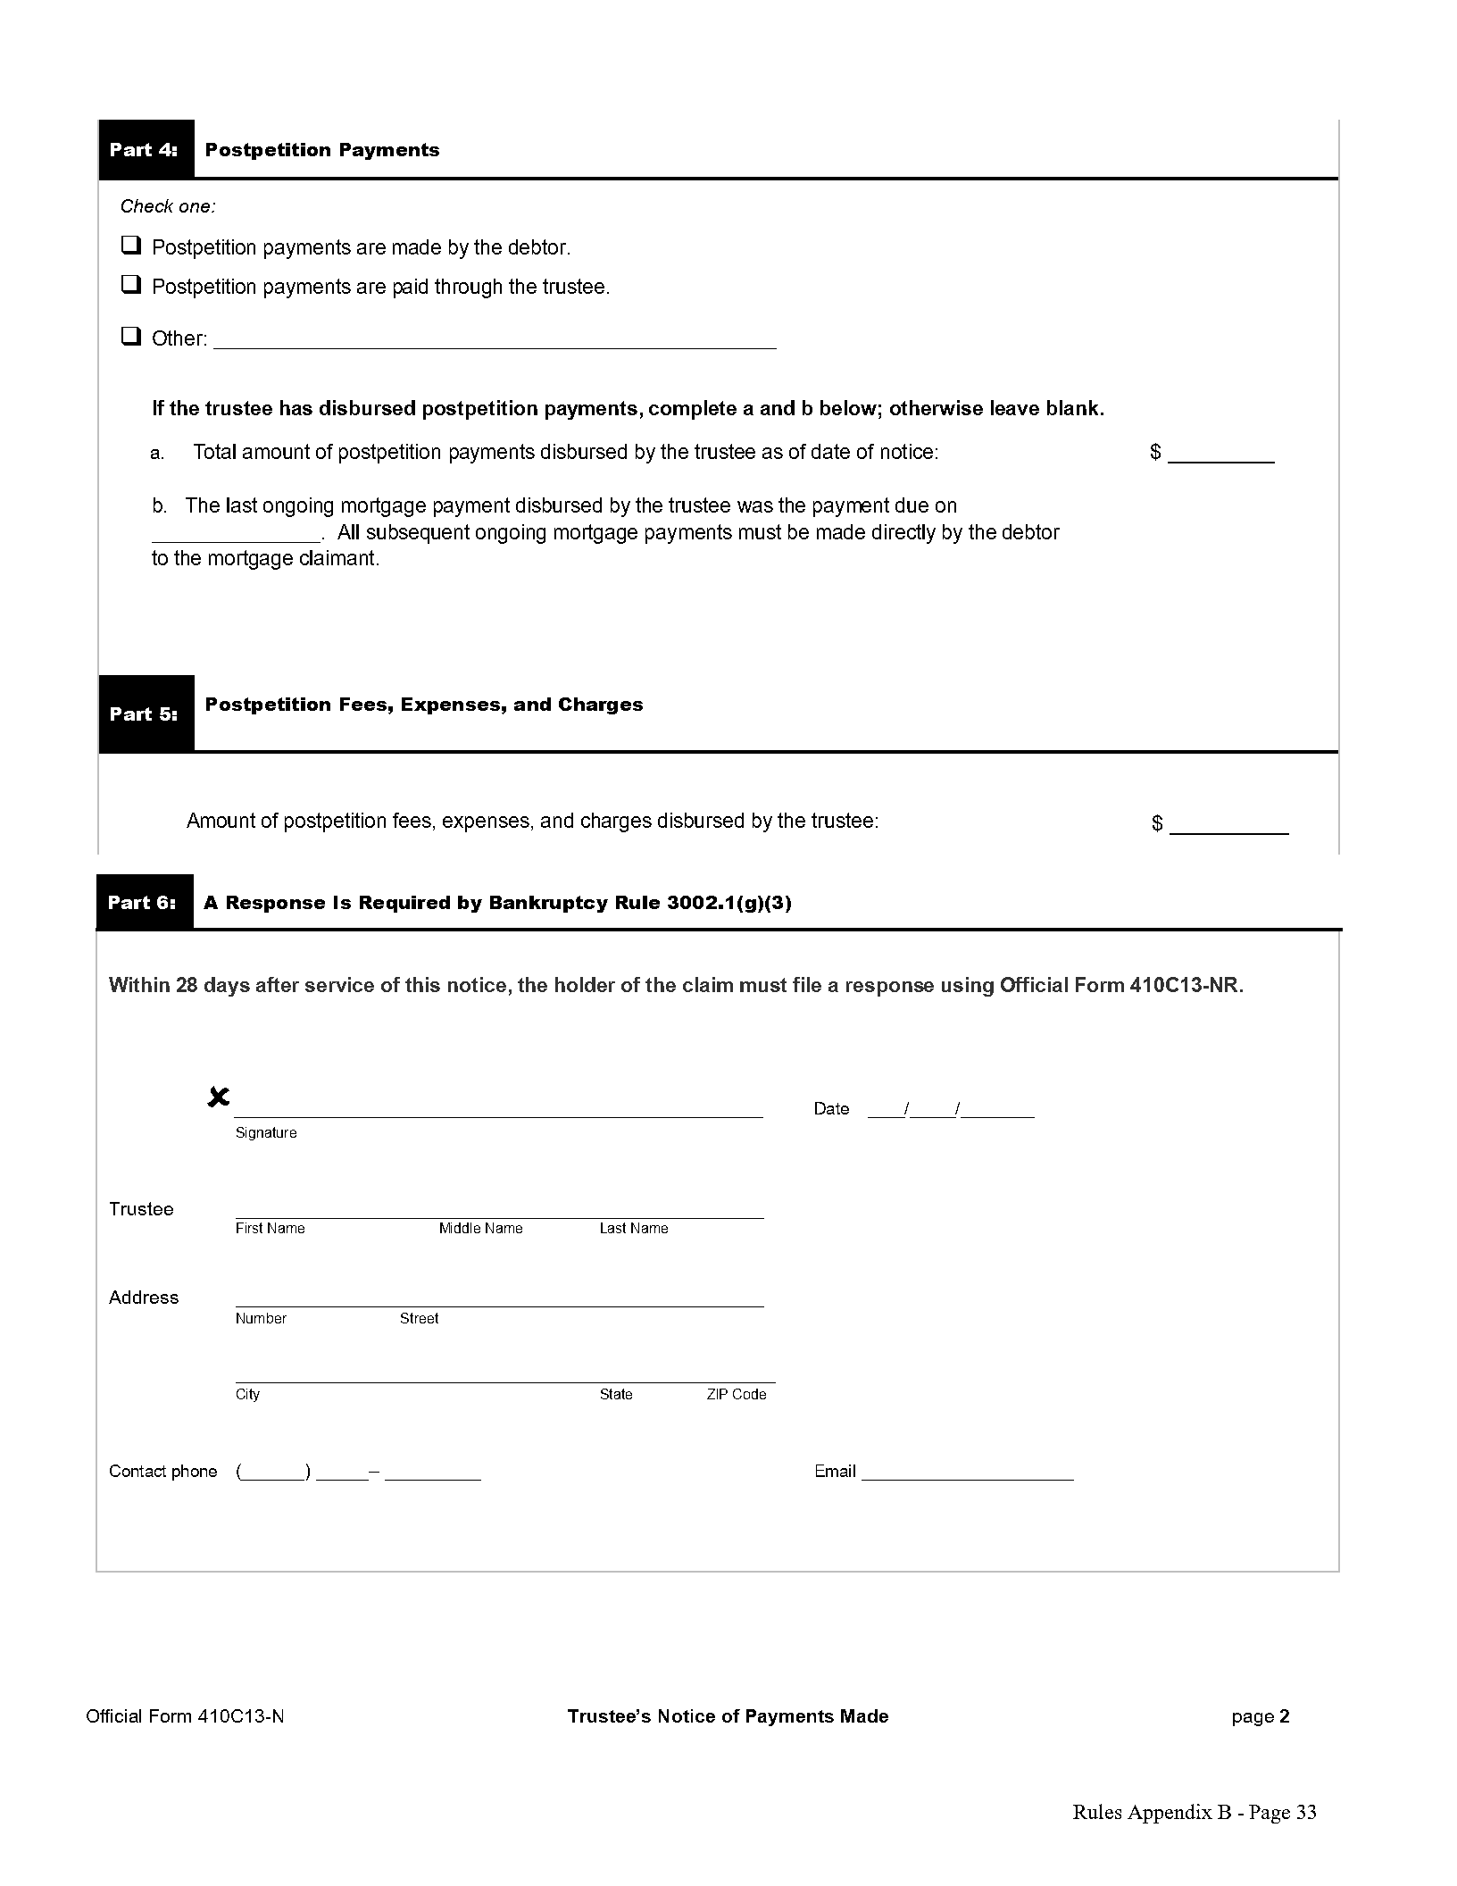
Official Form 410C13 –N (“N” – Notice) of Distributions Made - Replacing Notice of Final Cure
38

Slide 39
Response to Trustee’s notice of Disbursements Made
Creditor MUST file a response – 28 days
Lot of additional information needed to be specifically provided and broken down
Must attach a payoff statement
Have to provide an itemized payment history if disagree that details – SEE THE PRIOR HISTORY SLIDE
  All pre and post petition payments made
  Application of all payments made
  All fees, costs and expenses that the creditor asserts are recoverable against the debtor or the principal residence
  All amounts the creditor contends remain unpaid
Failure to Respond – same consequences as before
  Prevent from presenting additional information
  Attorney’s fees
39

Slide 40
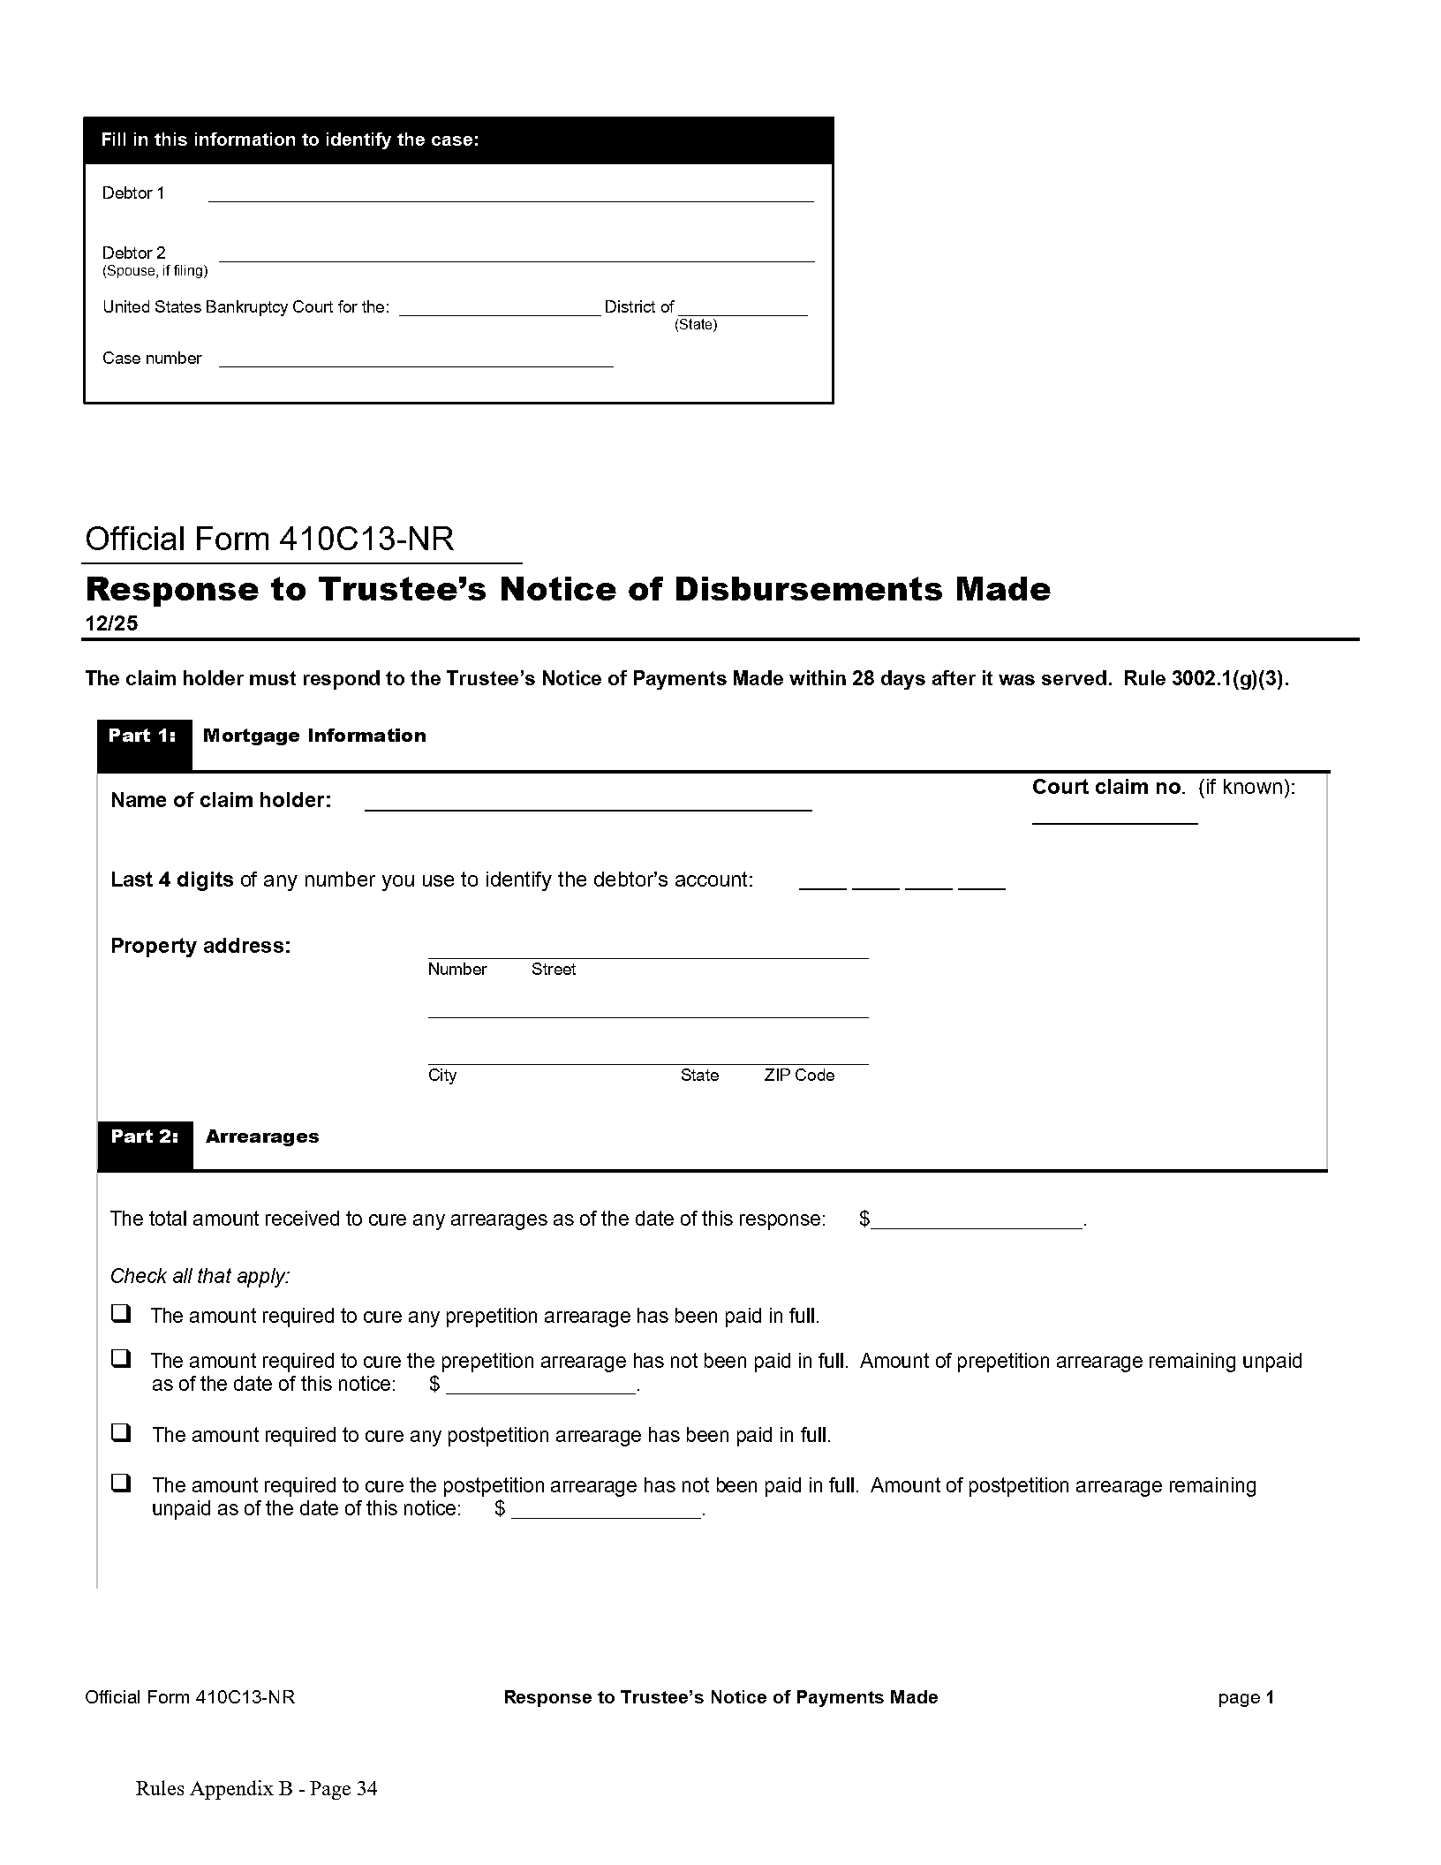
Official Form 410C13-NR (“NR –Notice Response”)
Replacing Response to Notice of Final Cure
40

Slide 41
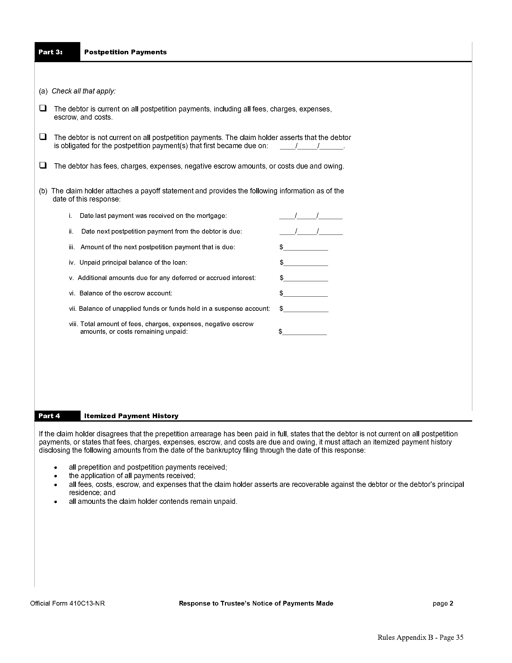
Official Form 410C13-NR (“NR –Notice Response”)
Replacing Response to Notice of Final Cure
41

Slide 42
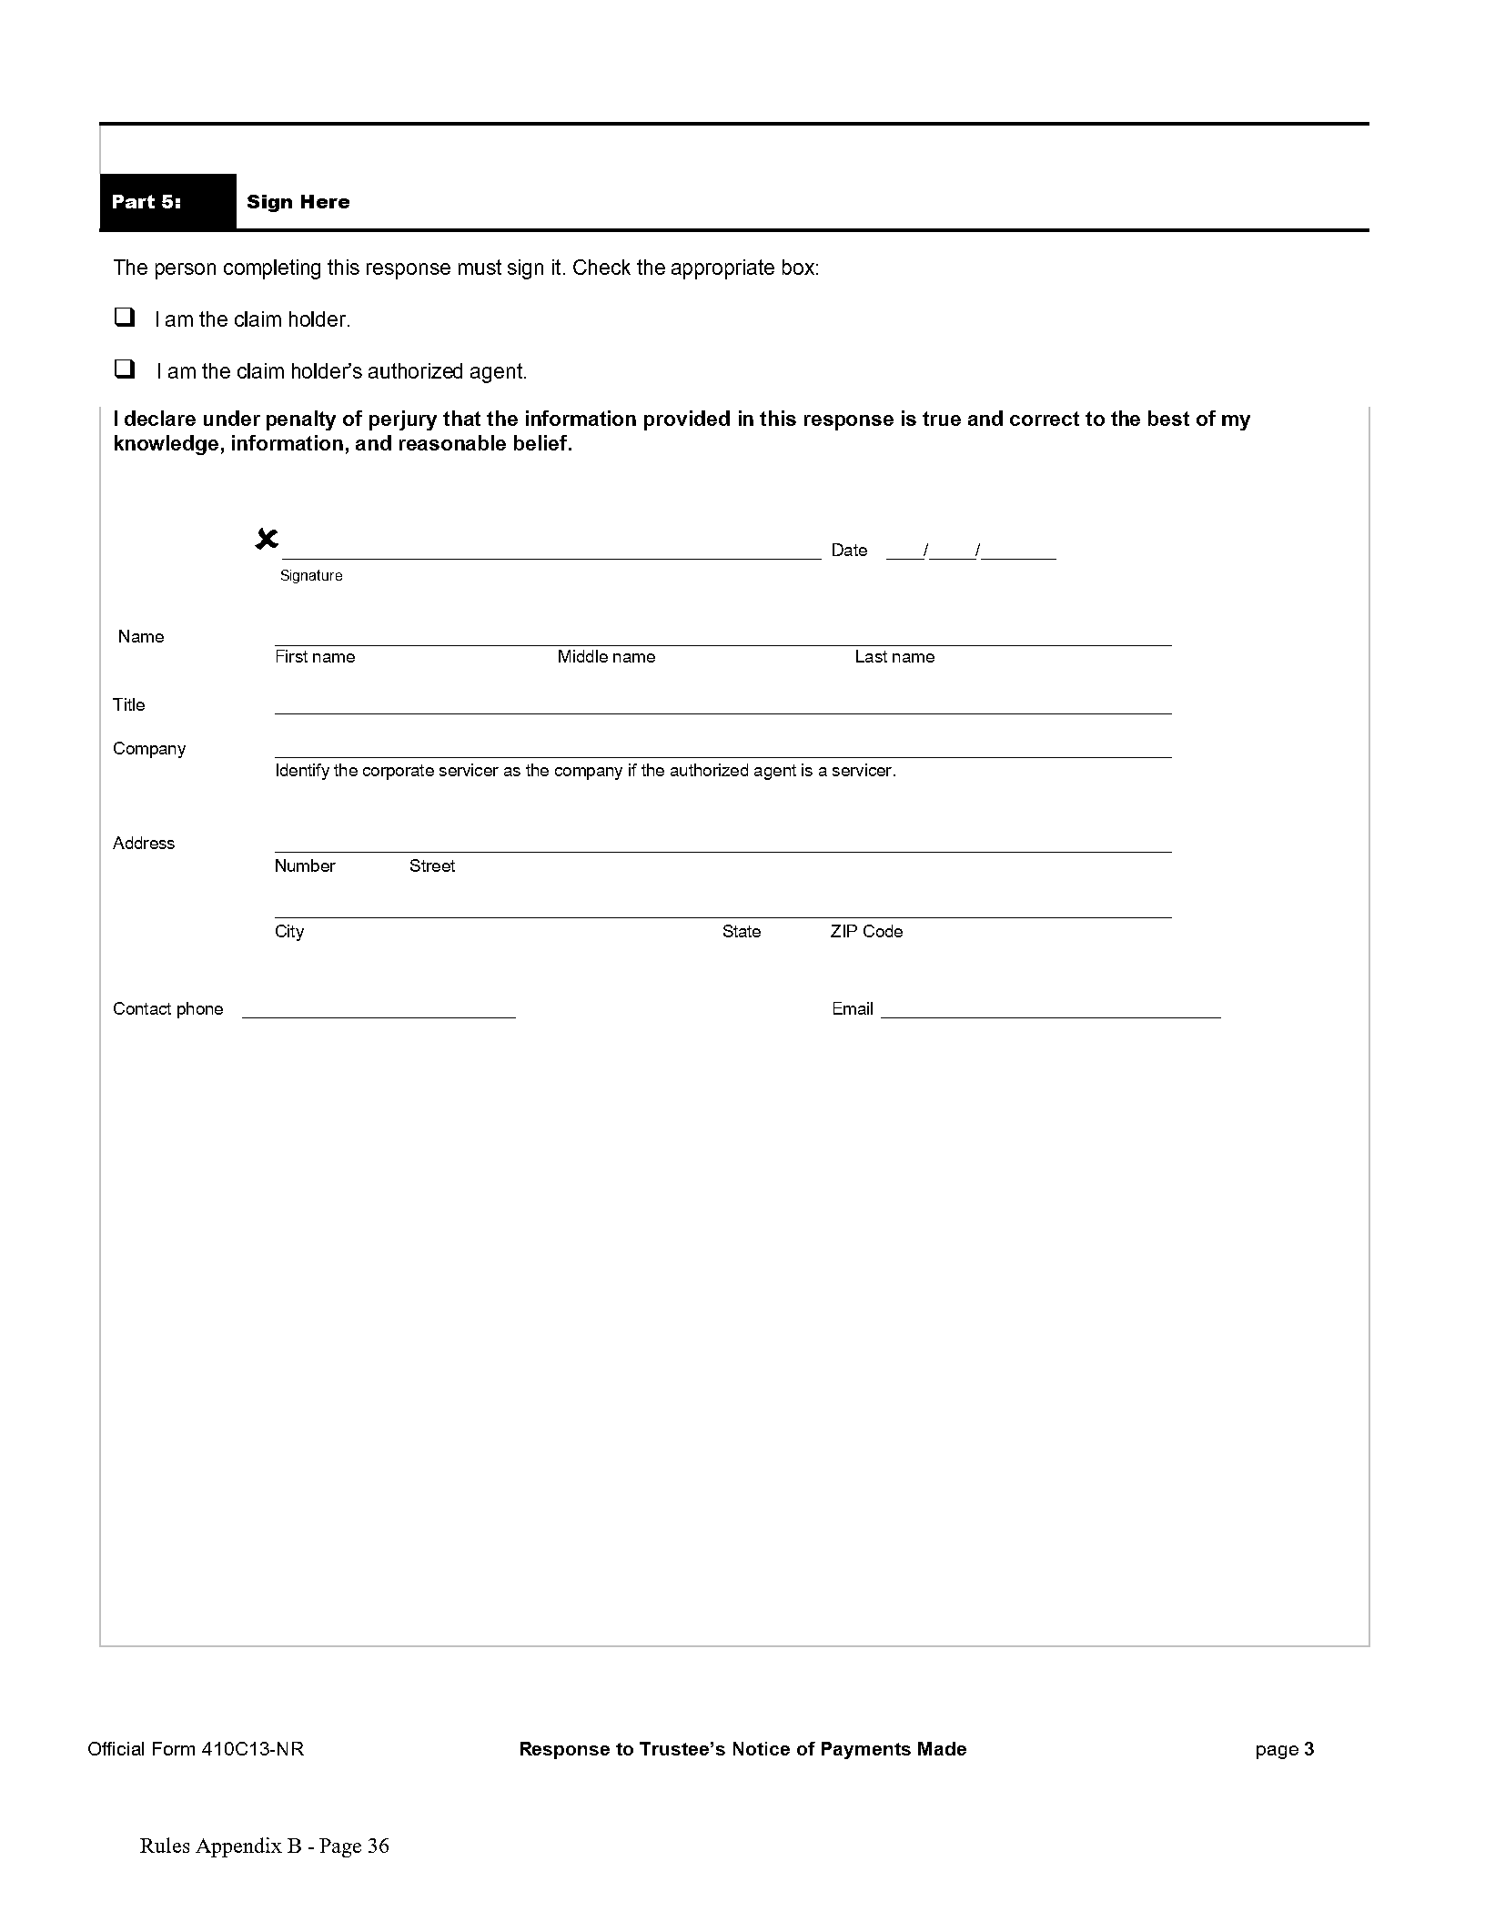
Official Form 410C13-NR (“NR –Notice Response”)
Replacing Response to Notice of Final Cure
42

Slide 43
Motion 2 – Determine final cure 410c13-m2
  Debtor or Trustee may file if no response to the Notice of Disbursements is made
  Also likely to be filed if Trustee/Debtor DOES NOT agree with the response filed
  28 days for Creditor to respond
  Failure to Respond – same consequences as before
    Prevent from presenting additional information
    Attorney’s fees
43

Slide 44
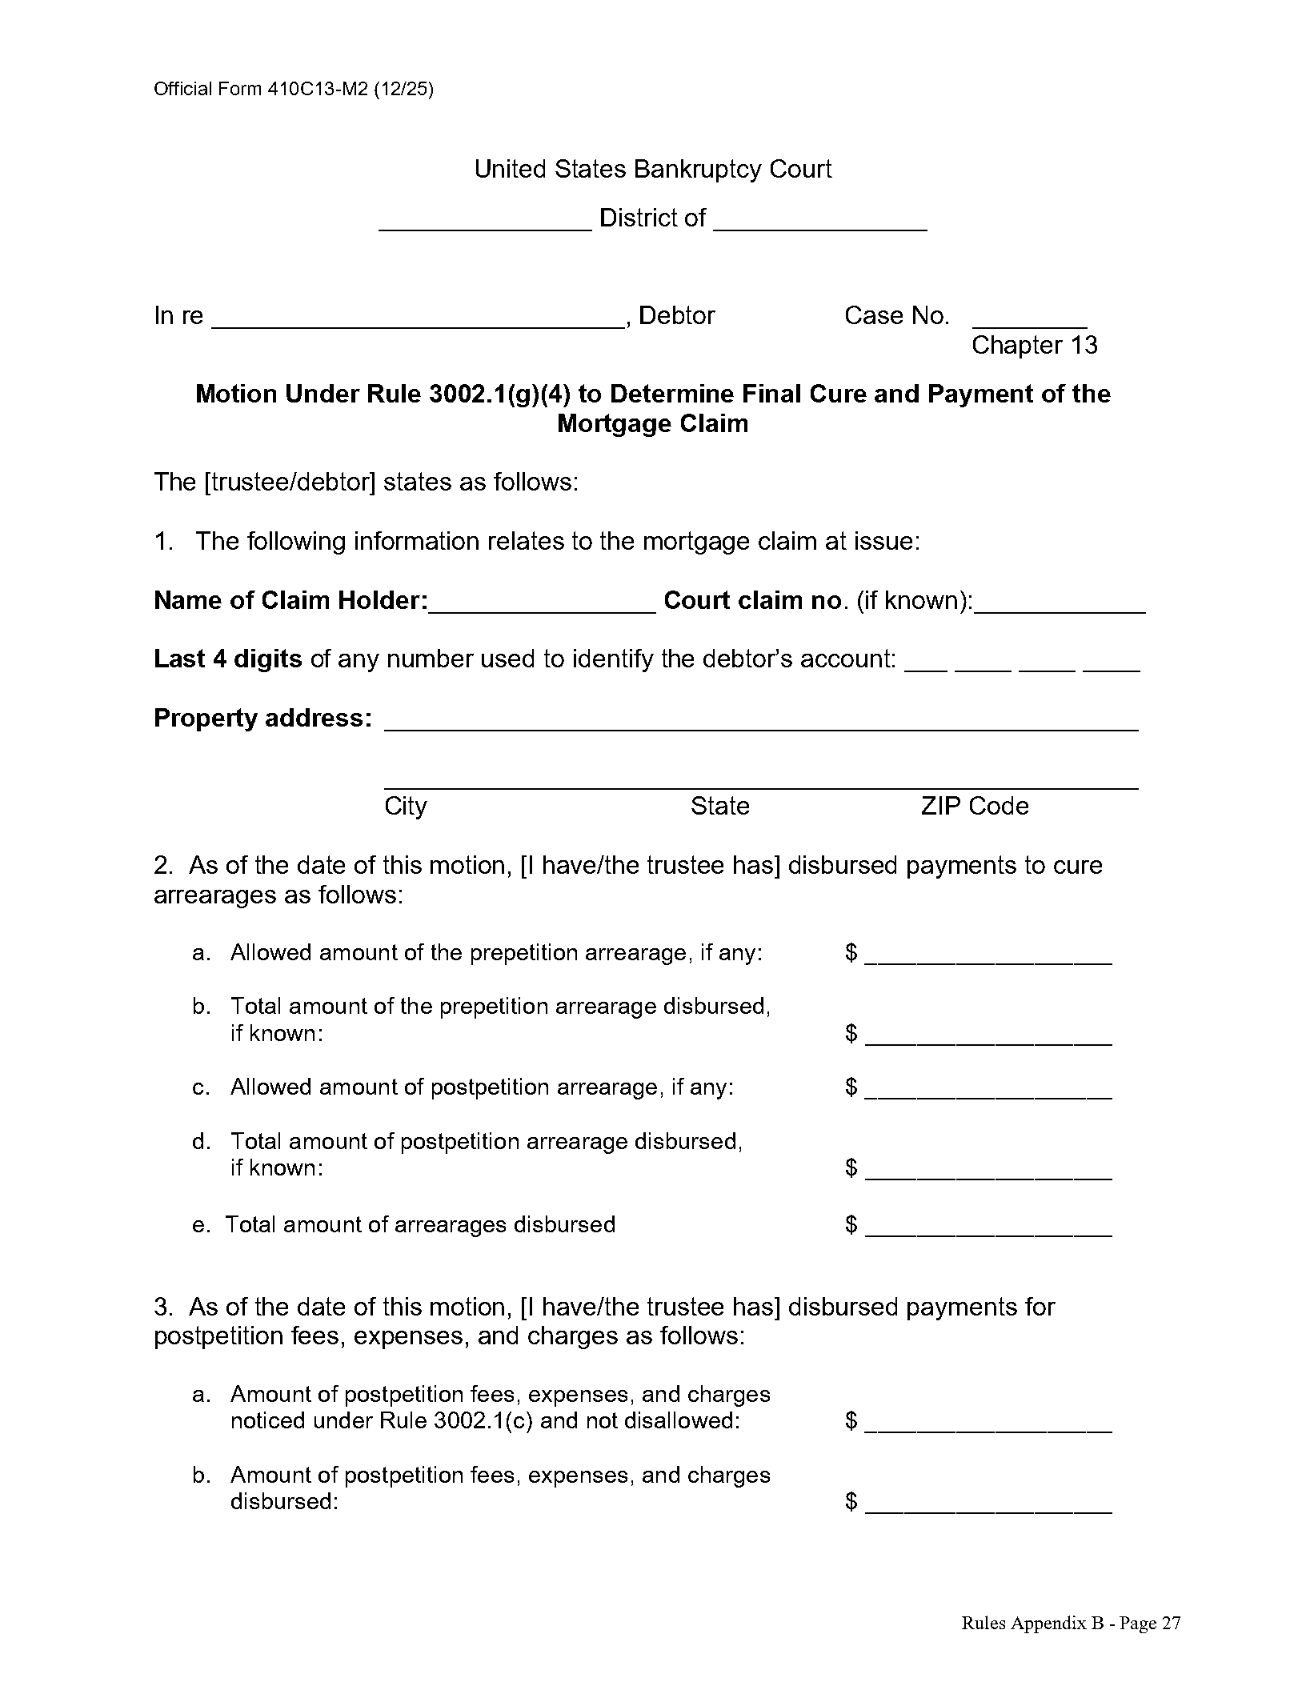
Official Form 410C13-M2 (Motion #2)
44

Slide 45
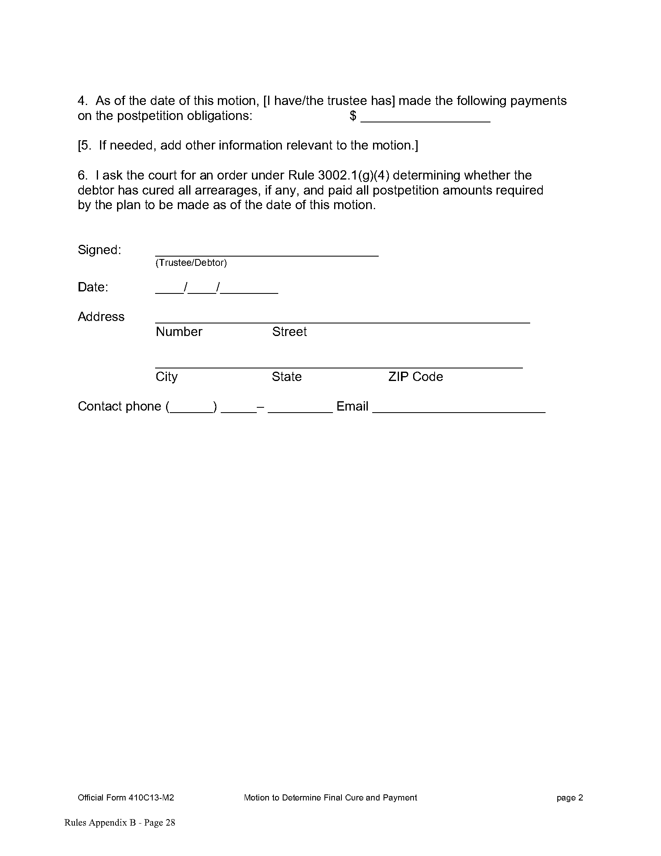
Official Form 410C13-M2 (Motion #2)
45

Slide 46
Response to Motion to Determine final cure
Creditor MUST file a response – 28 days
Again, going to have to attach a payoff statement
Have to provide an itemized payment history if disagree that details:
  All pre and post petition payments made
  Application of all payments made
  All fees, costs and expenses that the creditor asserts are recoverable against the debtor or the principal residence
  All amounts the creditor contends remain unpaid.
Failure to Respond – same consequences as before
  Prevent from presenting additional information
  Attorney’s fees
46

Slide 47
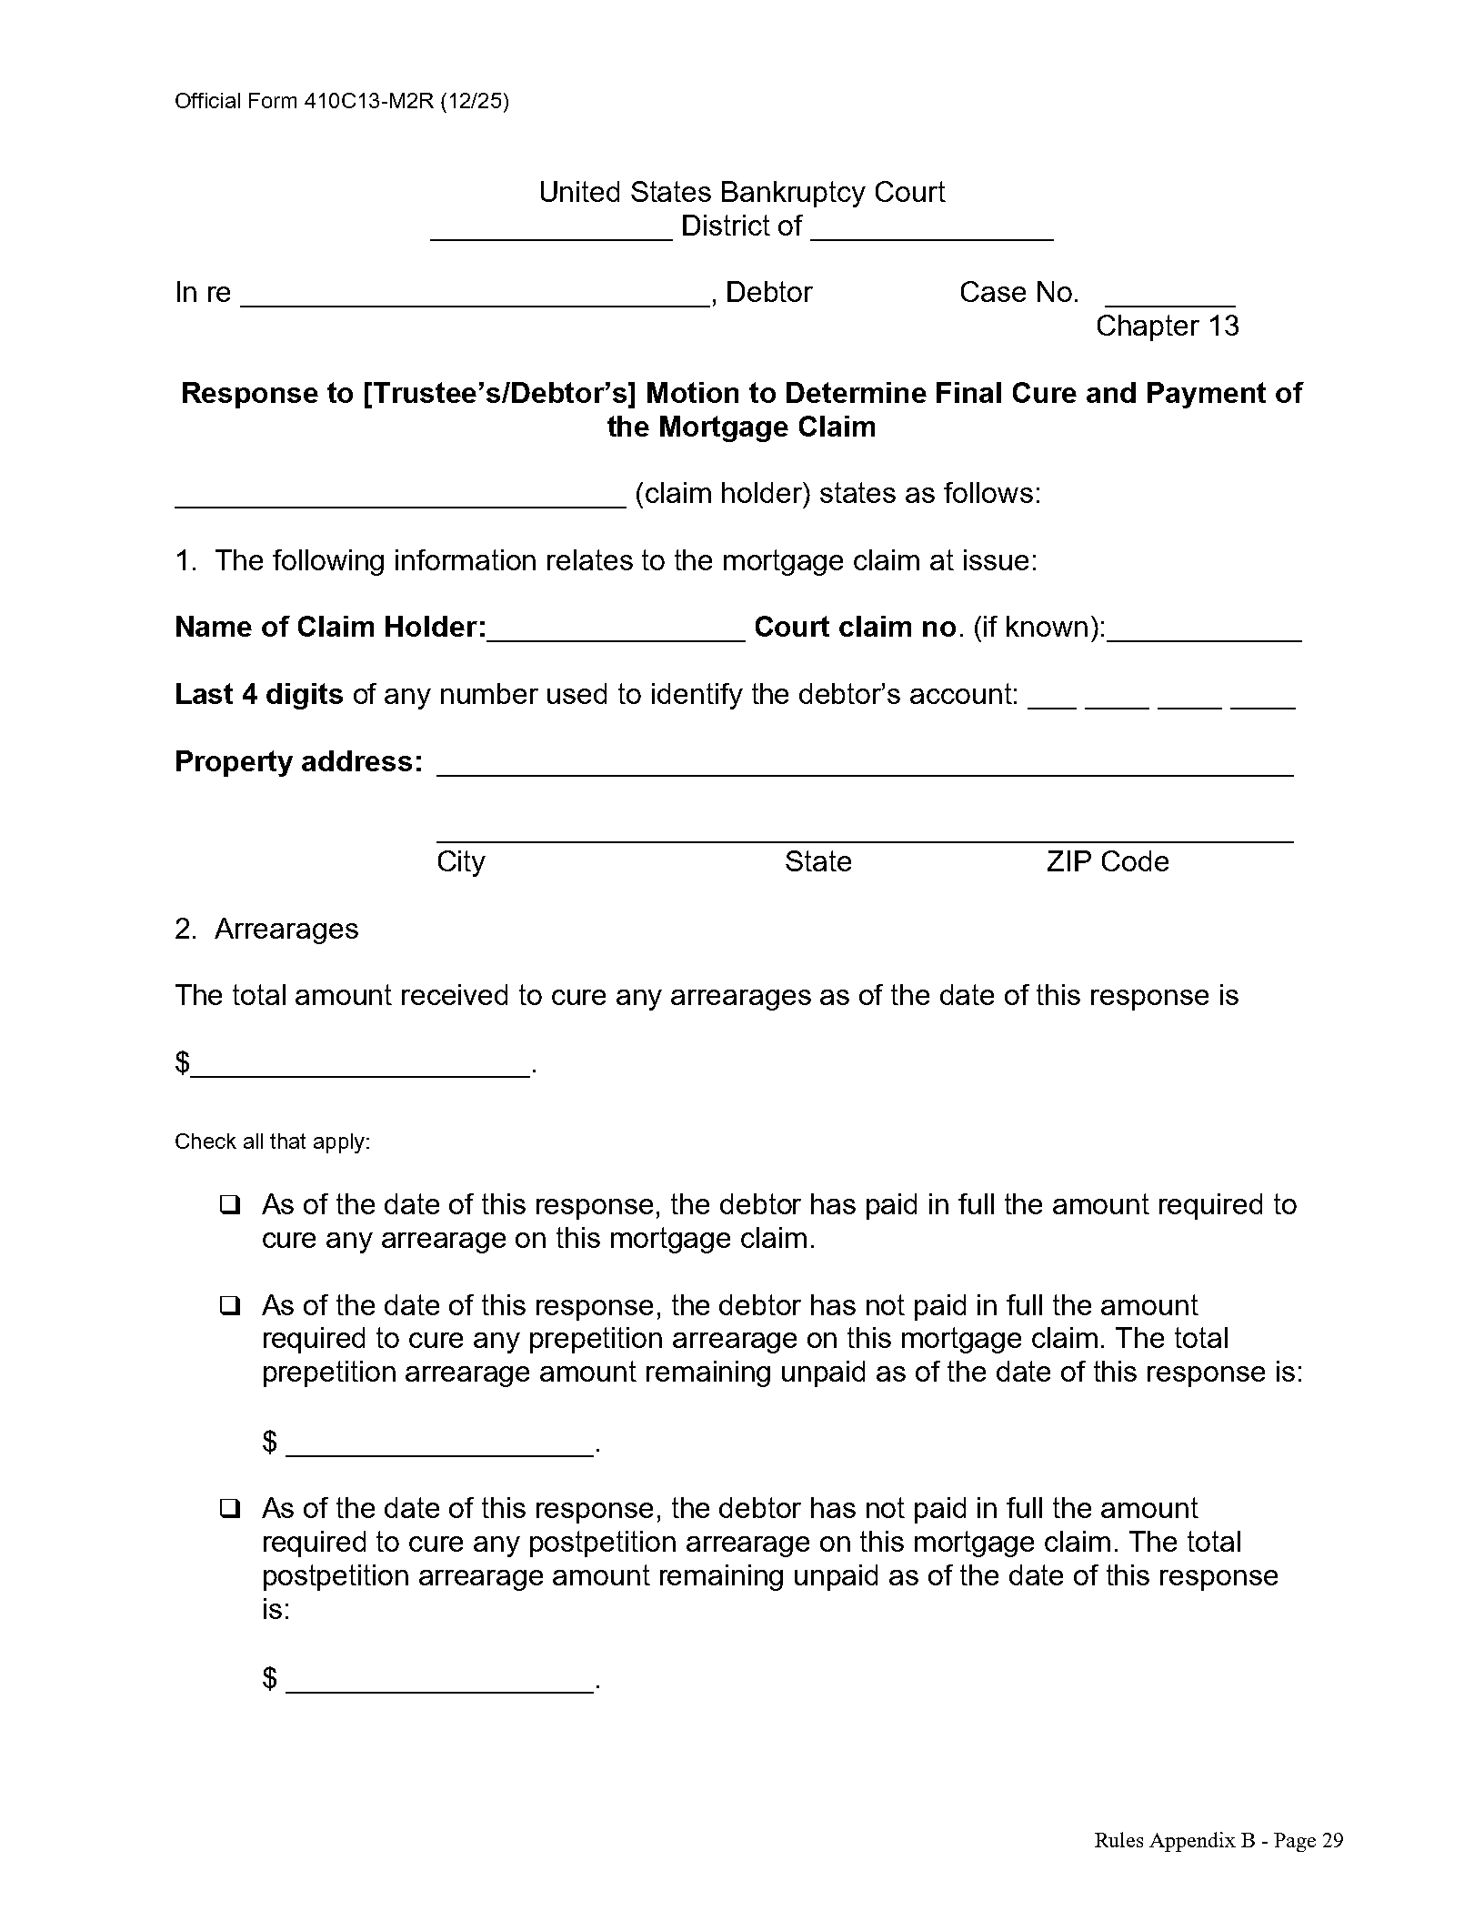
Official Form 410C13-M2R (Motion 2 Response)
47

Slide 48
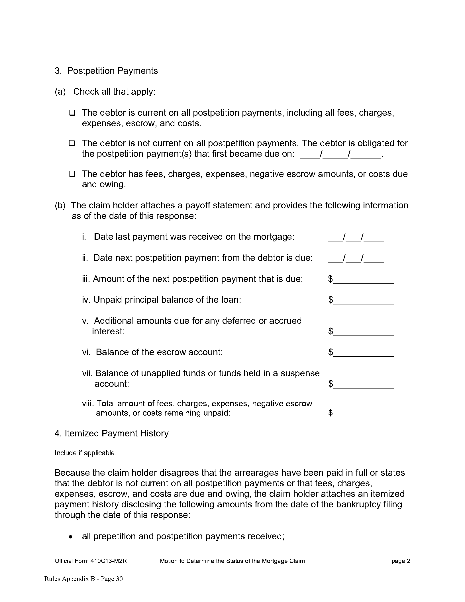
Official Form 410C13-M2R (Motion 2 Response)
48

Slide 49
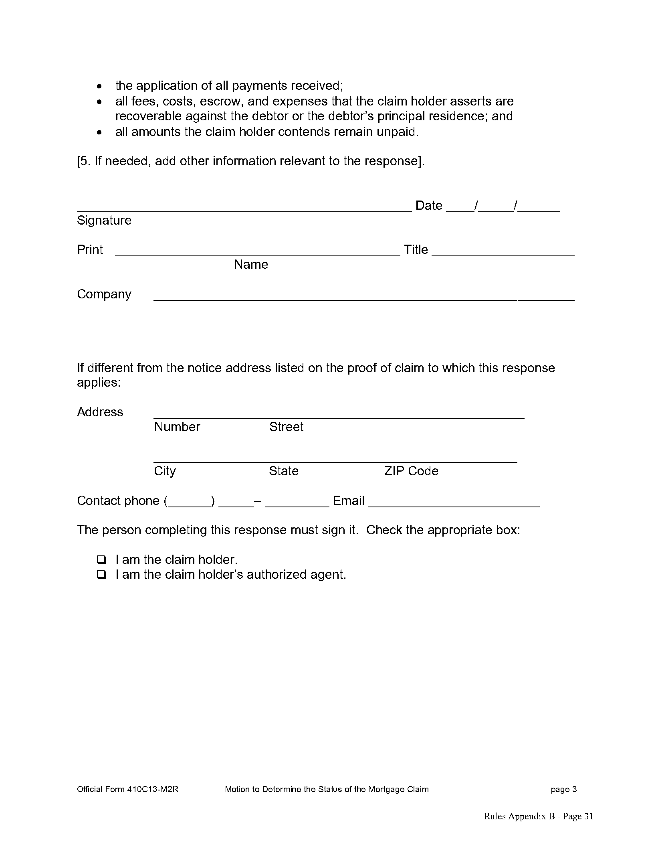
Official Form 410C13-M2R (Motion 2 Response)
49

Slide 50
Questions?

