Slide 1
Lynn Workforce Development Plan Update
March 28, 2023
Notes:
Received a Technical Assistance Program grant from MAPC in mid-2022
City Council awarded other funds through ARPA in July 2022

Slide 2
WFD Plan Overview
Purpose is to develop a comprehensive workforce strategy that connects the dots between local workforce development resources, programming and the regional labor market (including private sector employers and organized labor)
Awarded Technical Assistance Program grant from MAPC in mid-2022
Mayor and Lynn City Council awarded funding through ARPA in July 2022
Builds upon previous planning efforts (e.g., Housing Lynn, Vision Lynn, MAPC Office Parks Study–Cummings Center, Cherry Hill and Centennial)
Of ~13,200 jobs, 17% of workers at Cherry Hill, 7% of workers at Cummings Center and 13% of workers at Centennial Park are Lynn residents

Slide 3
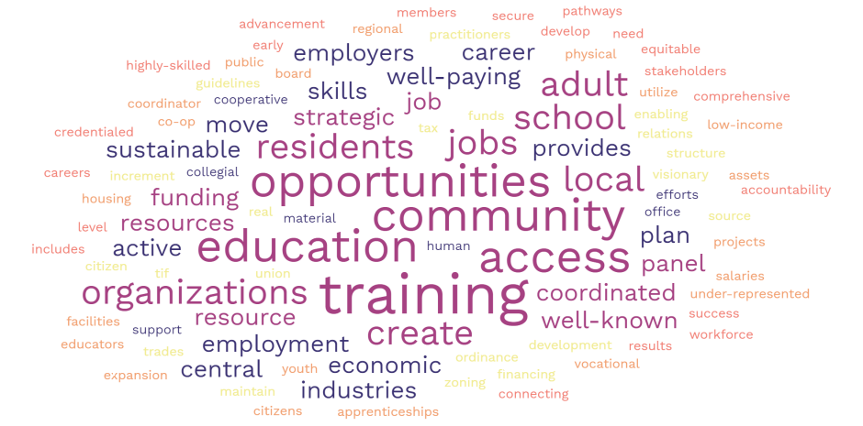
Thank you to our Steering Committee!
MassHire North Shore Workforce Board
Lynn Tech/Lynn Public Schools
North Shore Community College (NSCC)
North Shore Latino Business Association
EforAll/EparaTodos
Lynn Community Health Center (LCHC)
Greater Lynn Chamber of Commerce
North Shore Labor Council/E-Team Machinist Program
New Lynn Coalition - Lynn Community Enrichment Program (LCEP)
Essex Tech
Lynn Economic Opportunity (LEO)
Pathways
“In 5 years, this workforce development plan will have accomplished…”
Notes:
Role of the SC:
Ambassadors to the workforce community
Provide content expertise and interviews
Help develop/distribute surveys to residents/workers (input from survey design, questions, to data collection)
Help develop a stakeholder map

Slide 4
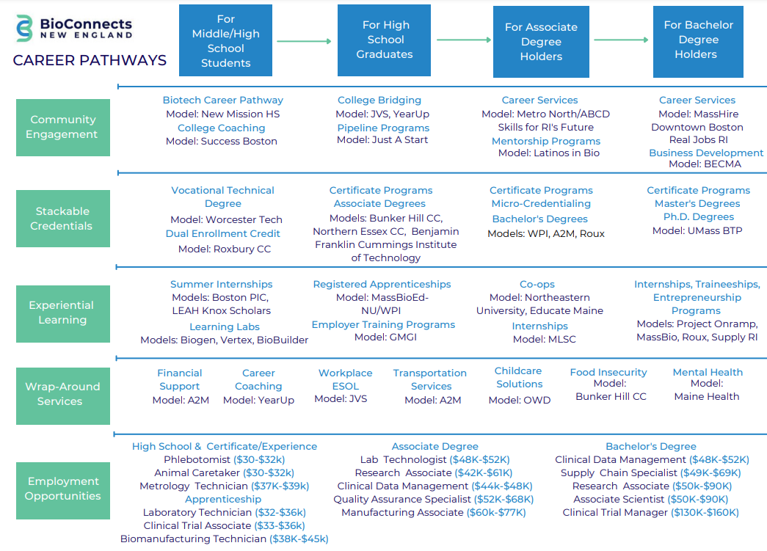
Priority Industries and Career Pathways
Life Sciences Career Pathways, BioConnects New England
These are the priority industries:
Manufacturing
Health Care
Construction/Building Trades
Education
Life Sciences
Clean Energy
Technology
Young Adults (ages 14-26)
Notes:
Will help articulate occupations and career pathways within priority industries

Slide 5
Target Population including Challenges
WFD Plan has honed in on two target populations:
Young Adults (ages 14-26)
Incumbent Workers with a focus on low-wage earners and immigrants
Specific Challenges to Training/Employment:
Transportation
Child Care
Housing
Awareness (resources, value of training)
Need for Adult Basic Education (including computer literacy, ESOL)
Time and Cost of Trainings

Slide 6
Provide greater awareness of resources and programming, as well as value of training
Articulate occupations and career pathways aligned with priority industries
Pair training/programming with stipends (e.g., child care, transportation, etc.)
Greater coordination among workforce development- and social service-providers (‘no wrong door approach’)
Potential opportunities for workforce development- and social service-providers to better support workers
Notes:
Focus Groups with youth- and immigrant-serving organizations
Employer/Stakeholder Outreach
GE
MA Building Trades Union (MBTU)
NASRCC
Groom Construction
Cell Signaling Technology
Medtronic
Krohne
MA Clean Energy Center
Workforce Stakeholder Mapping
Coordination

