Slide 1
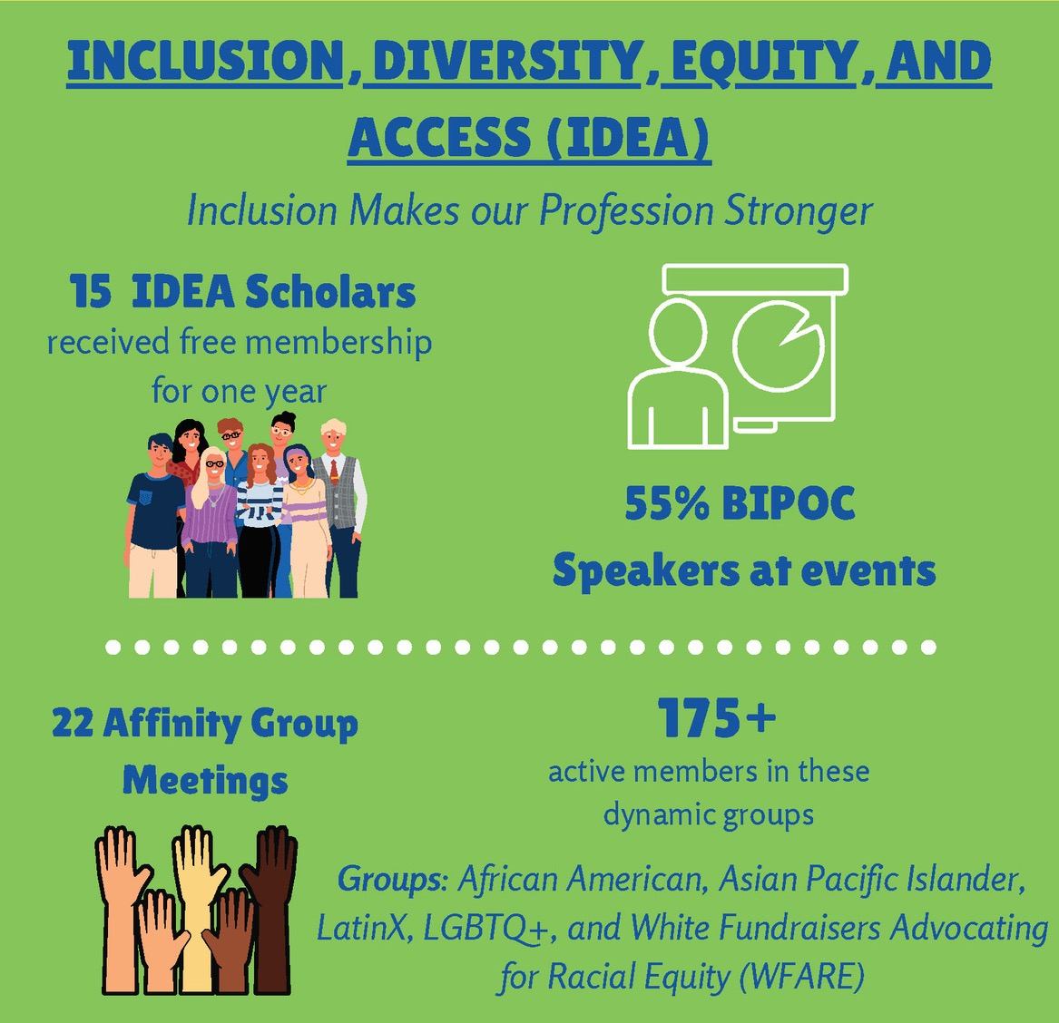
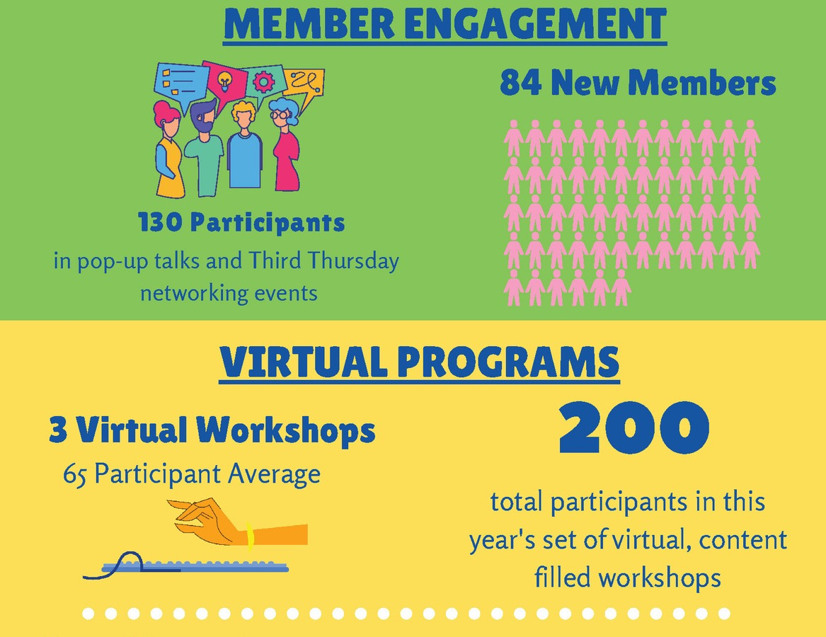
We've been busy!
2021 By the Numbers

Slide 2

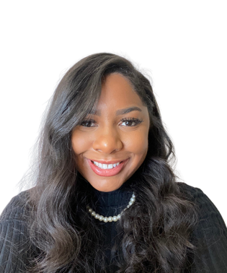
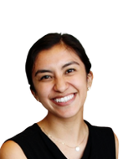
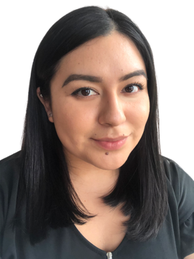
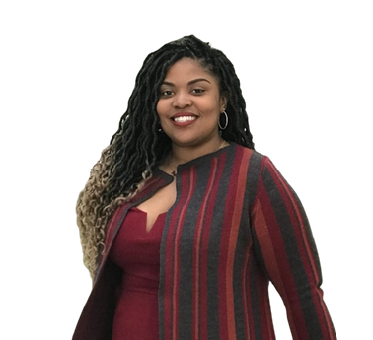

Peer
Mentoring
Fellows
2021
24 Matches
12 - spring
12 - Fall
5 fellows

Slide 3

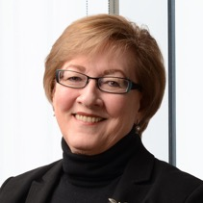
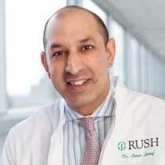
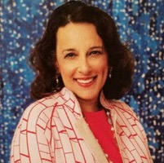
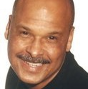
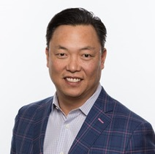
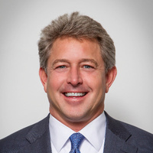
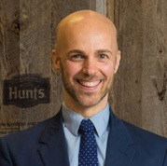
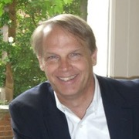
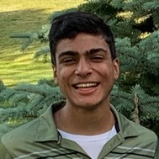
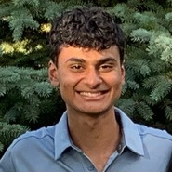
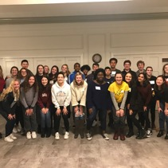


11 Honorees
Over 300 Registrants
Over $81K in Sponsorships and Donations
45
th
ANNUAL
PHILANTHROPY AWARDS
FRIDAY, NOVEMBER 5, 2021
12:00 pm - Virtual
Maree G. Bullock
Benjamin Franklin Award
Dr. Omar Lateef
Outstanding Community Leader Award
Denise & Gary Gardner
Distinguished Philanthropists Award
David J. Koo
Emerging Philanthropist Award
Scott C. Swanson
Executive Leader Award
Robert Rizzo
Outstanding Volunteer Award
Donald A. Cooke
Professional Grantor Award
Ravi & Rohan Mahajan
Future Philanthropists Program
Oak Park-River Forest
Community Foundation
Chicago Community COVID-19 Response Fund
The Chicago Community Trust &
United Way Metro Chicago
Special Award
Outstanding Youth in Philanthropy Award

Slide 4

Chicago Chapter is Growing!
MEMBERSHIP METRICS
573
582
566
Jan
557
555
Feb
1,000
January - 817
October - 774
-43
March
750
+50
April
October - 576
January - 526
January - 517
-65
May
October - 452
-15
-8
January - 360
January - 366
500
October - 345
October - 358
June
July
250
August
Sept
0
1042
Chicago
D.C.
Boston
NYC
LA
593
Oct

