Slide 1


Emergency Water Supply Interconnection Study
Town of Berwick, ME
August 2026
Arthur Capello - Berwick
James Bellissimo - Berwick
Collin Stuart, PE - WP

Slide 2
Presentation Overview
Background
Interconnection Alternatives
Conceptual Cost Summary
Hydraulic Modeling Review
Water Quality Compatibility Review
Evaluation Summary
Next Steps

Slide 3
Background
Town of Berwick Water System
No current back up water supply/interconnections
WTP taken offline in recent years
Berwick WTP Upgrades in progress
Seeking ~0.57 MGD interconnection
Emergency Only

Slide 4
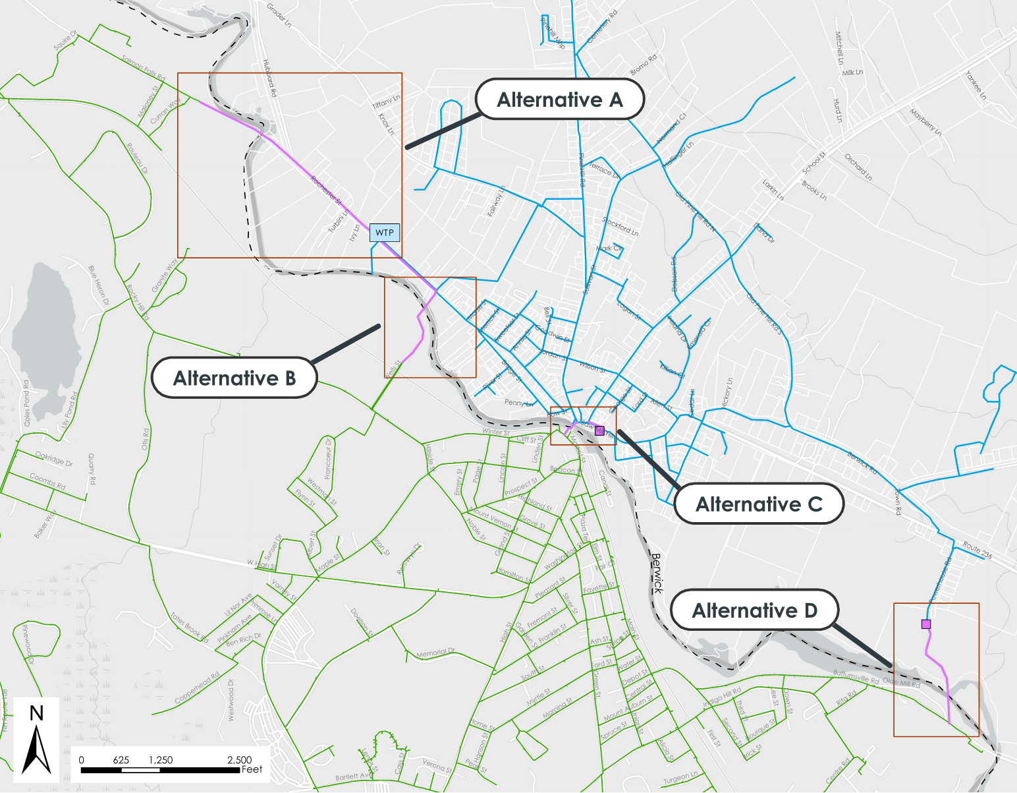
Interconnection Alternatives Summary

Slide 5
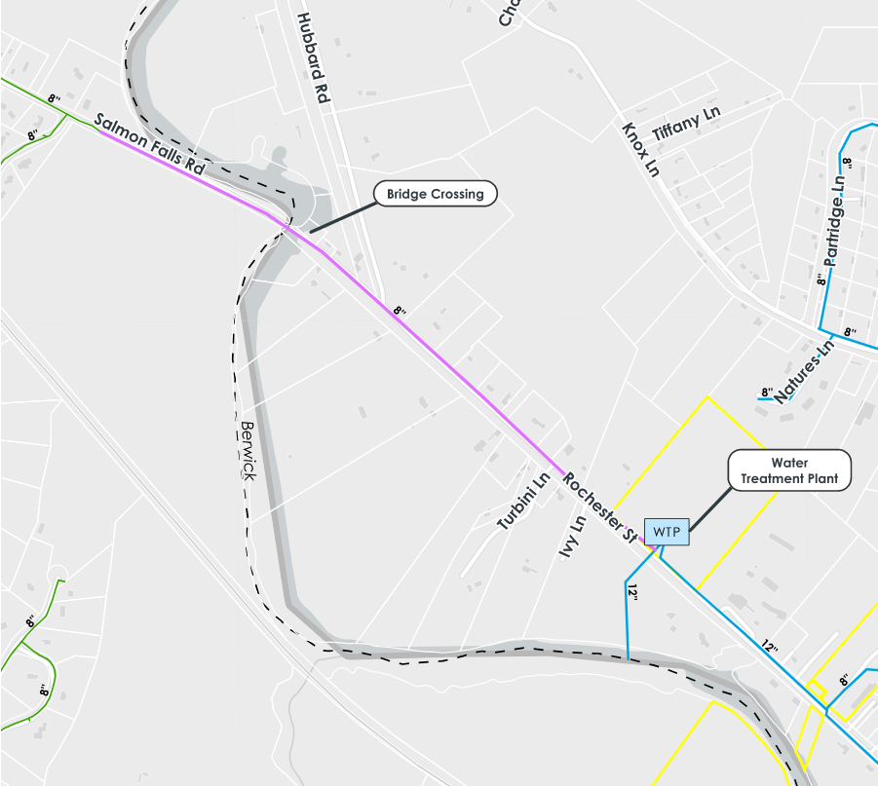
Alternative A – Rochester Street Water Main
4,000 LF of 8-inch water main
Connect directly to Berwick WTP
Bridge Crossing
Permitting Review
  Town of Berwick
  City of Somersworth
  MaineDEP/NHDES
  MaineDOT/NHDOT Bridge Load Rating Review
Conceptual Cost Estimate: $2,500,000

Slide 6
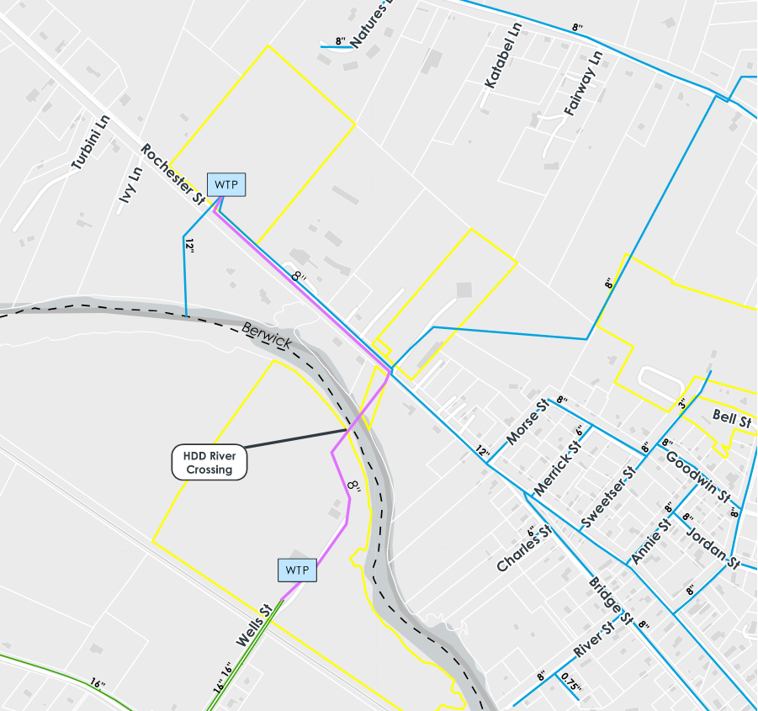
Alternative B – Direct Connection Between WTPs
2,900 LF of 8-inch water main
Connect directly to Berwick WTP
Directional Drill under Salmon Falls River
  Additional feasibility Study Required
  Geotechnical Boring in River
Permitting Review
  Town of Berwick
  City of Somersworth
  MaineDEP/NHDES
Conceptual Cost Estimate: $2,600,000

Slide 7
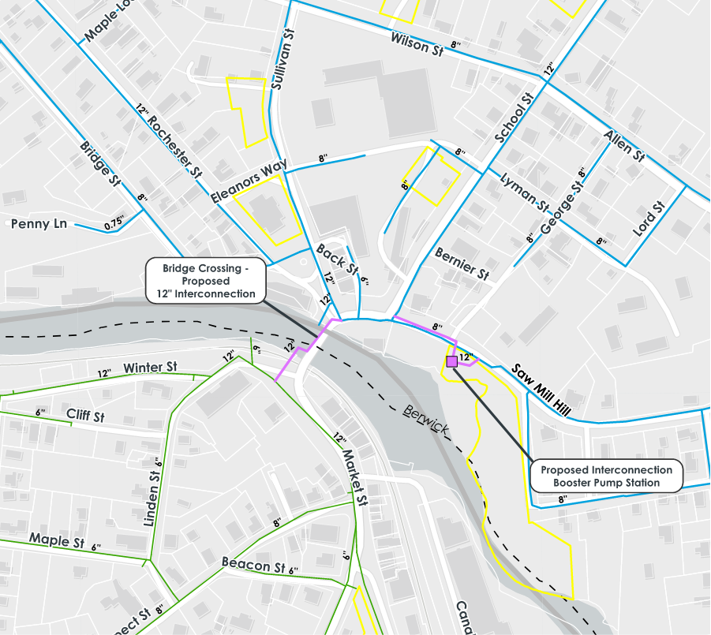
Alternative C – Route 9 Bridge and Booster Pump Station
1,100 LF of 12-inch water main
Connect Across Route 9 Bridge
Booster Pump Station Required
  Chemical Addition Required
Railroad Crossing
Bridge and Embankment Structural Evaluation Required
Permitting Review
  Town of Berwick
  City of Somersworth
  MaineDEP/NHDES
  MaineDOT/NHDOT Bridge Load Rating Review
  New Hampshire Northcoast Railroad
Conceptual Cost Estimate: $3,000,000

Slide 8
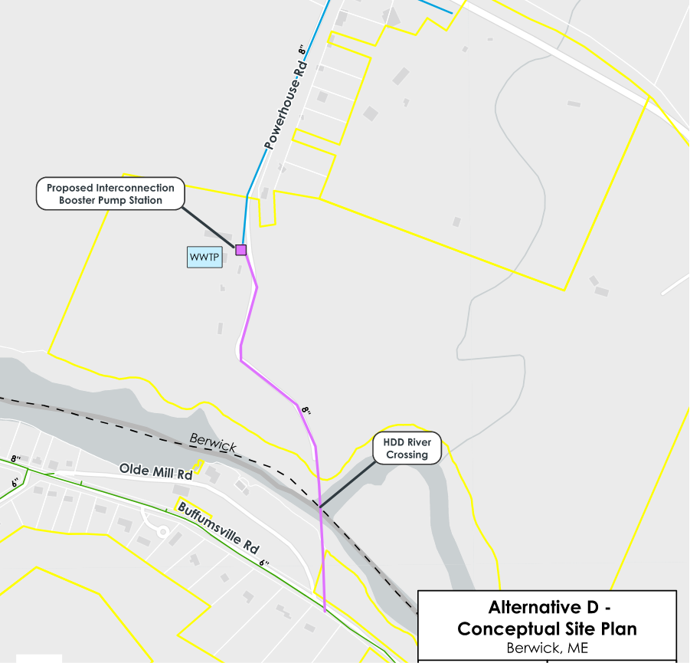
Alternative D – Power House Road River Crossing
2,700 LF of 8-inch water main
Connect between Buffumsville Road and Power House Road
Booster Pump Station Required
  Chemical Addition Required
Directional Drill under Salmon Falls River
  Additional feasibility Study Required
  Geotechnical Boring in River
Negotiation with Berwick Sewer Dept.
Permitting Review
  Town of Berwick
  City of Somersworth
  MaineDEP/NHDES
Conceptual Cost Estimate: $3,800,000

Slide 9
Conceptual Cost Estimate Summary
Interconnection Alternative | Planning Cost Estimate
Alternative A – Rochester Street Bridge | $2,500,000
Alternative B – Direct Connection Between Berwick and Somersworth WTPs | $2,600,000
Alternative C – Route 9 Bridge and Booster Pump Station | $3,000,000
Alternative D – Power House Road River Crossing | $3,800,000
Conceptual Cost Estimate Include:
Borings/Geoprobes
Survey
Wetlands Delineation
Permitting
Construction
Engineering & Administrative Contingencies (15%)
Construction Contingency (30%)

Slide 10
Hydraulic Model Evaluation
Modeling Base Conditions
Modeling Results
Somersworth:
  HGL 390 ft
  3 MGD Treatment Capacity (N-1)
    Potentially 5 MGD (future)
  1 MGD Dover Interconnection
  2025 MDD: 2.07 MGD
  2042 MDD: 2.58 MGD
Berwick:
  HGL 475 ft
  0.576 MGD
Alternative A:
  No Interconnection: 68 – 87 psi
  Interconnection Active: 66 – 8 psi
Alternative B:
  No Interconnection: 77 – 87 psi
  Interconnection Active: 77 – 86 psi
Alternative C:
  No Interconnection: 80 – 84 psi
  Interconnection Active: 79 – 83 psi
Alternative D:
  No Interconnection: 101 – 117 psi
  Interconnection Active: 93 – 103 psi

Slide 11
Water Quality Compatibility Review
Somersworth Water Quality
Berwick Water Quality
Water Source: Salmon Falls River
Potassium Permanganate
Sodium Hypochlorite
Ammonium Sulfate
Orthophosphate
Sodium Hydroxide
Fluoride
Powdered Activated Carbon
Water Source: Salmon Falls River
Potassium Permanganate
Sodium Hypochlorite
Ammonium Sulfate
Orthophosphate
Sodium Hydroxide
Fluoride
Powdered Activated Carbon

Slide 12
Evaluation Summary
Criteria | Alternative A | Alternative B | Alternative C | Alternative D
Land use approvals | No | Yes | No | Yes
Technical feasibility | Yes | Possibly | Unlikely | Possibly
Integration with water treatment facility | Yes | Yes | No | No
Additional studies required | Limited | Yes | Yes | Yes
Separate pumping facility/chemical addition | No | No | Yes | Yes
Permitting Requirements | Favorable | Moderately favorable | More extensive | More extensive

Slide 13
Next Steps
1
2
3
4
Finalize Study
Interconnection Agreement
Obtain Funding
Design/Construction

