Slide 1
Suggested Segregated Fund Mix
75/75 & 100/100 Guarantees
Prudent Mix | Moderate Mix | Balanced Mix | Growth Mix | Aggressive Mix
100% High Interest Savings Account (HISA) | 60% Strategic Corporate Bond (Found under Income Funds) 15% Dividend Growth (iA) (Found under Canadian Equity Funds) 15% Fidelity Insights (Found in US & International Equity) 10% Global Equity (iA) (Found in US & International Equity) | Mix 1: 30% SRI Balanced (Inhance) (Found under ESG Funds) 35% Global Diversified (Loomis) 35% Strategic Income (2 funds found under Diversified Funds) Mix 2: 40% Strategic Corp Bond (Found in Income Funds) 30% Dividend Growth (iA) (Found in Canadian Equity) 15% Global Equity 15% Fidelity Insights (2 funds found in US & International Equity) | 20% Strategic Corporate Bond (Found in Income Funds) 30% Dividend Growth (iA) (Found in Canadian Equity) 25% Global Equity (iA) (Found in US & International Equity Funds) 25% Fidelity Insights (Found in US & International Equity Funds) | 30% Fidelity Insights (Found in US & International Equity Funds) 30% Dividend Growth (iA) (Found in Canadian Equity Funds) 30% Global Equity (Found in US & International Equity Funds) 10% Fidelity Global Innovators (Found in Specialty Funds)
Canada 100%
USA 0%
Global 0%
(As of Feb 28/25)
Growth/Stocks 0%
Fixed Income 100%
Canada 43%
USA 54%
Global 3%
(As of Feb 28/25)
Growth/Stocks 40%
Fixed Income 60%
Canada 56%
USA 41%
Global 3%
(As of Feb 28/25)
Growth/Stocks 60%
Fixed Income 40%
Canada 43%
USA 54%
Global 3%
(As of Feb 328/25)
Growth/Stocks 80%
Fixed Income 20%
Canada 34%
USA 62%
Global 4%
(As of Feb 28/25)
Growth/Stocks 100%
Fixed Income 0%

Slide 2
Funds/Guarantees | 75/75 |  |  | 75/100
Pre Fix Code = INA | CB3 | CB5 | FEL | CB3 | CB5 | FEL
High Interest Saving Account | - | - | D020 | - | - | D020
Strategic Corporate Bond | INA44501 | INA44503 | INA44505 | INA34501 | INA34503 | INA34505
SRI Balanced (Inhance) | INA44251 | INA44253 | INA44255 | INA34251 | INA34253 | INA34255
Strategic Income | INA44521 | INA44523 | INA44525 | INA34521 | INA34523 | INA34525
Global Diversified (Loomis Sayles) | INA45851 | INA45853 | INA45855 | INA35851 | INA35853 | INA35855
Dividend Growth (iA) | INA46951 | INA46953 | INA46955 | INA36951 | INA36953 | INA36955
Global Equity (iA) | INA44221 | INA44223 | INA44225 | INA34221 | INA34223 | INA34225
Fidelity Insights | INA41061 | INA41063 | INA41065 | INA31061 | INA31063 | INA31065
Fidelity Global Innovators | INA46081 | INA46083 | INA46085 | INA36081 | INA36083 | INA36085

Slide 3
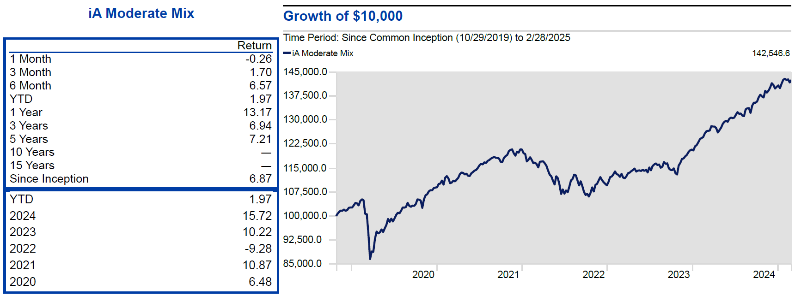
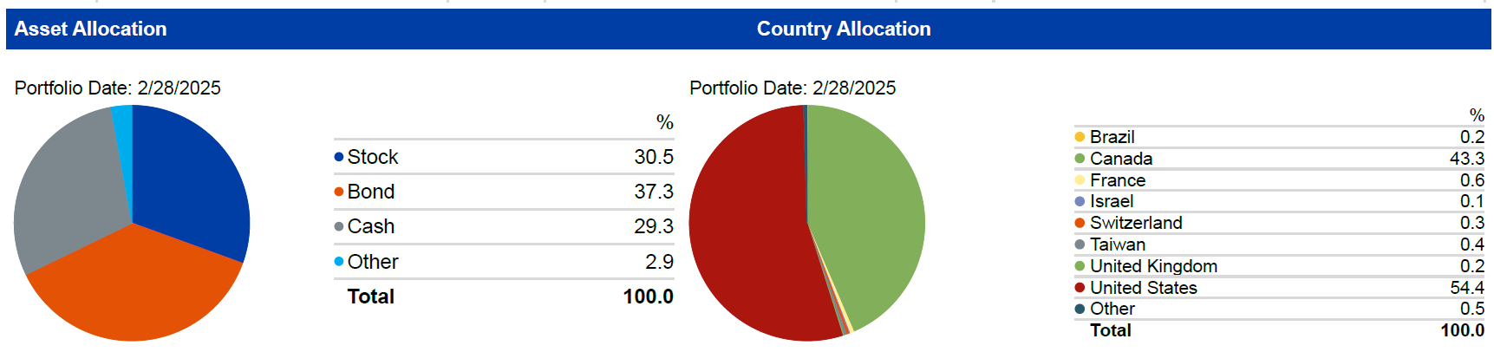
iA Moderate Mix

Slide 4
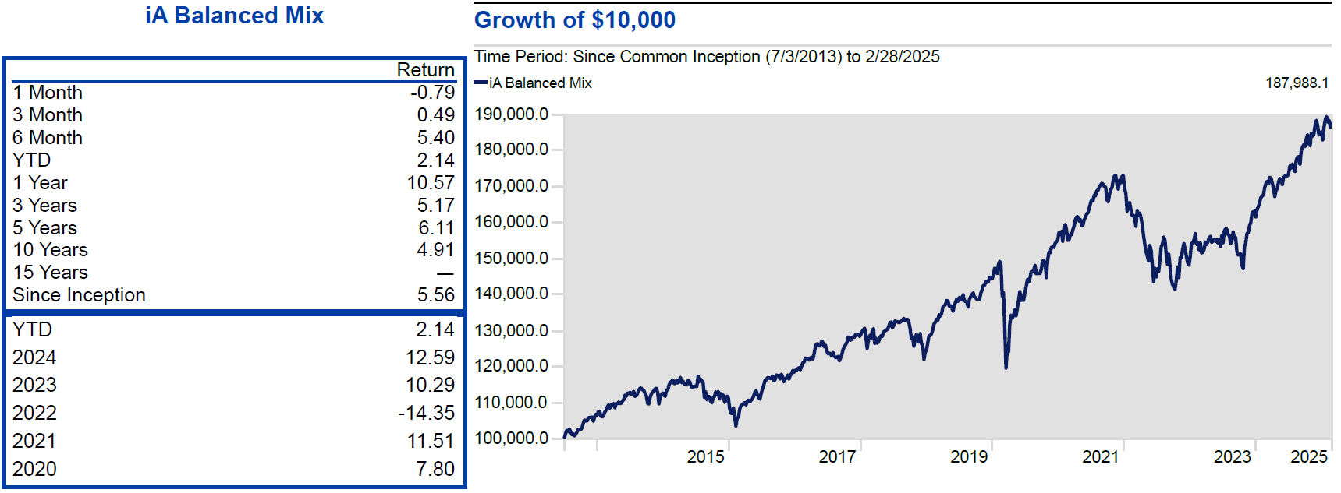
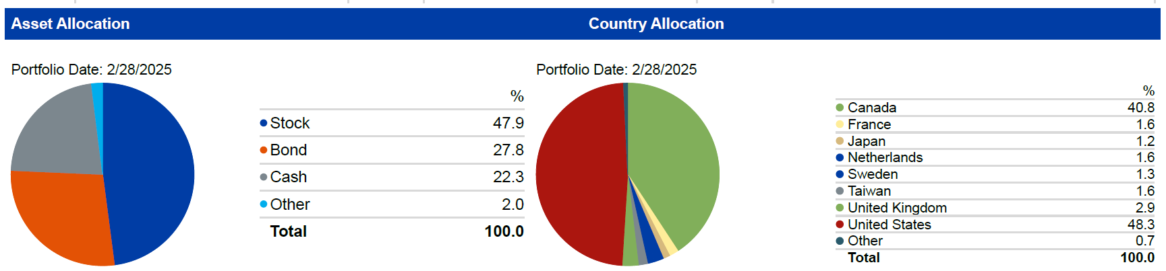
iA Balanced Mix #1

Slide 5
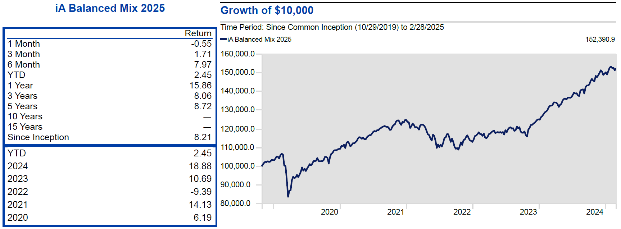
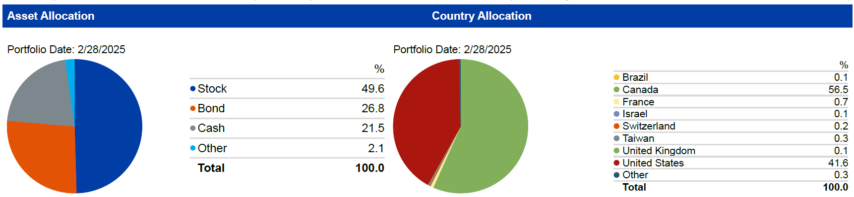
iA Balanced Mix #2

Slide 6
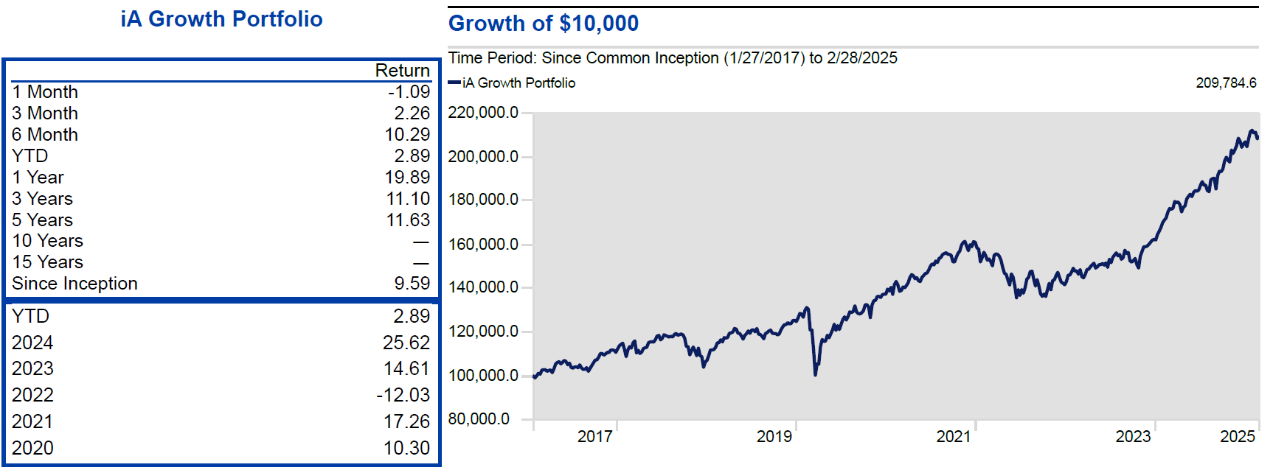
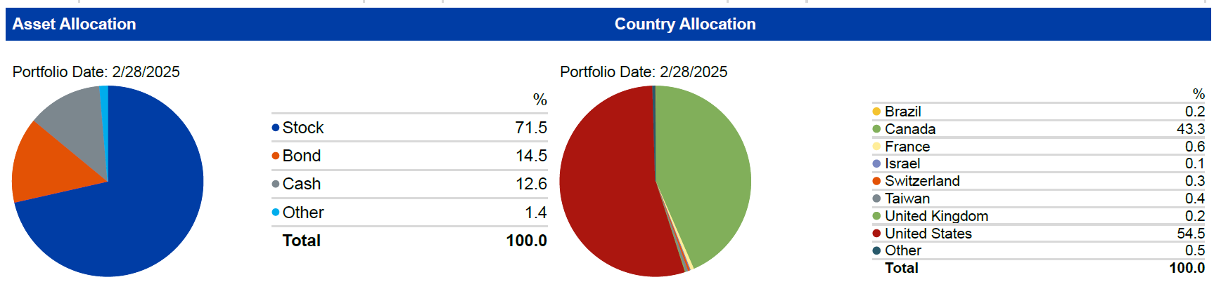
iA Growth Mix

Slide 7
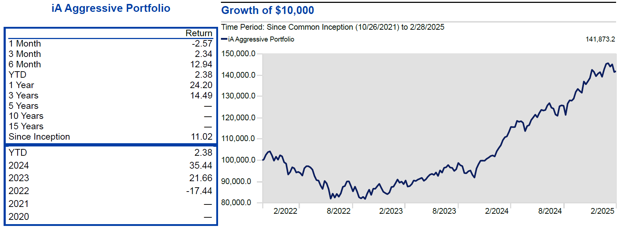
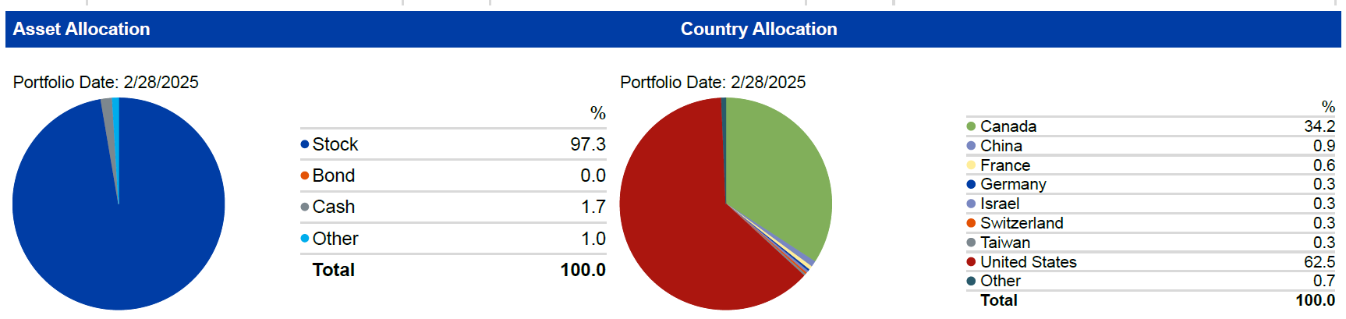
iA Aggressive Mix

Slide 8
3 Compensation Options with Seg Funds
iA Seg Funds | CB5 | CB3 | Front End
Commissions | 5.6% | 3.5% | 0-5%
Trailer Fees | 0.49% | 0.49% | 1%
Service Fee Increase | From 8th year 1% | From 5th year 1% | N/A
Paid By | Paid by iA |  | Client
iA - Commissions paid out every Thursday after trade settles
iA – Service Fees start in the 13th month
10% Free available on CB3 & CB5 for redemptions
Additional Highlights
No charges on the first 10% of assets surrendered each year
1.4%* commission upon RRIF conversion (if already held for 24 months)
4.2%* commission upon rollover to the spouse following death*. N/A for FEL

Slide 9

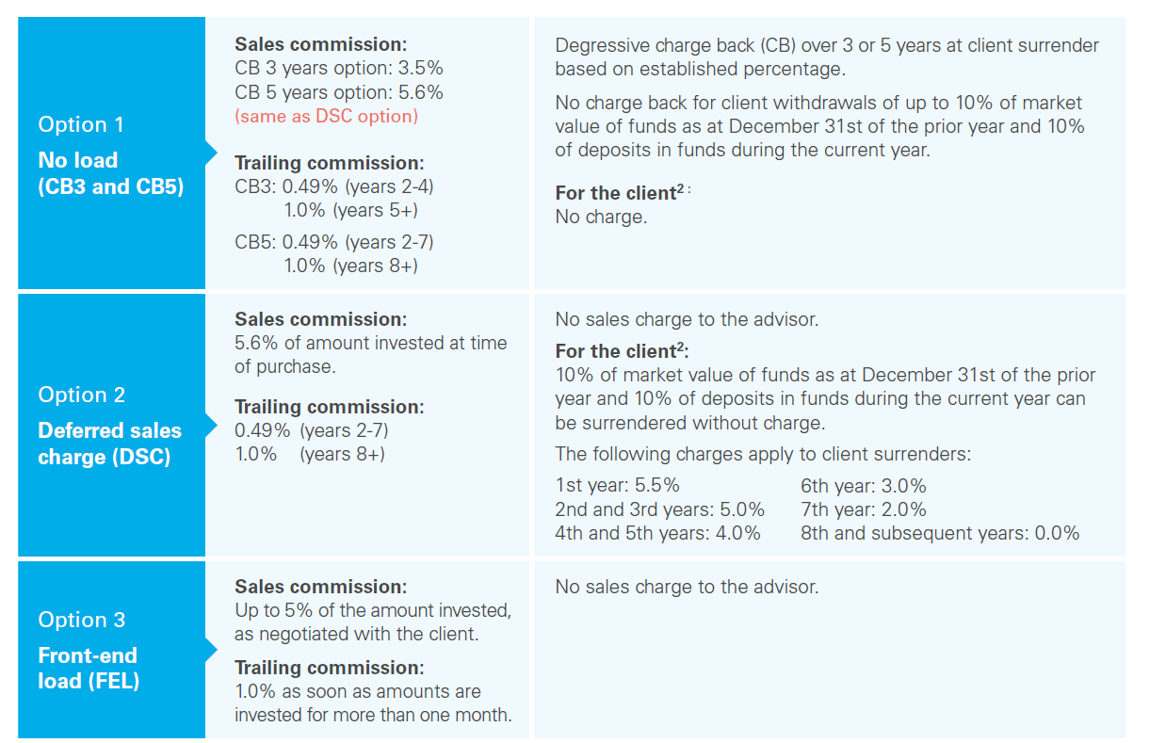
3 Compensation Options

Slide 10

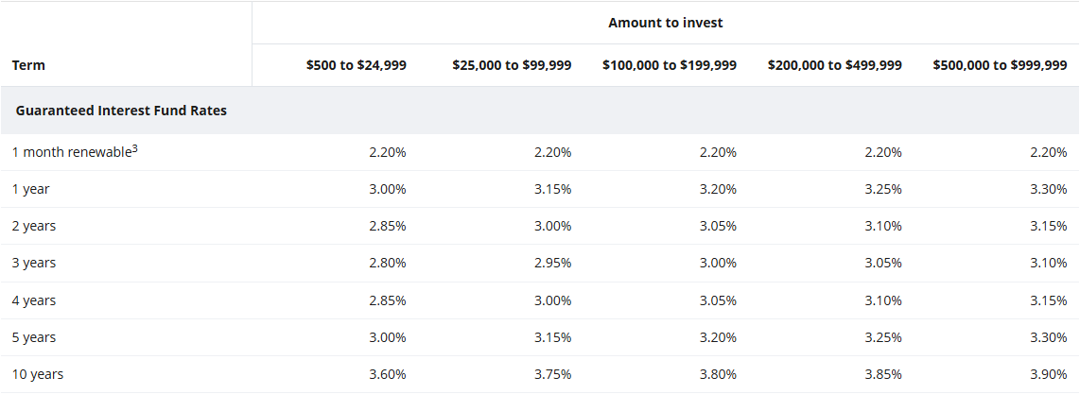

Our current GIF rates
      Key features
          Principal and interest fully guaranteed
          Predictable returns compared to fixed income funds
          Potential bonus interest rate increase of up to 0.25% at the advisor’s discretion
          Grouping of all GIF assets for the same client so as to reach a higher interest rate category
          Redeemable if necessary (with a Market Value Adjustment – MVA)
          Cashable upon death without any penalty
          Can be used as liquidity to benefit from market opportunities
          Counts towards qualifying for Prestige Preferential Pricing
          Meets the needs for retirement income

