Slide 1

Where We Stand: Understanding Social Cognition and Implicit Bias
alliance

Slide 2
Outcomes
Understand
Understand how our lived experiences have shaped our beliefs, attitudes, and biases about ourselves and others;
Connect
Deepen
Connect implicit bias to current practices/policies/procedures within the Alliance and member organizations;
Deepen awareness of implicit bias, its implications for our clients and colleagues, and its impact on our ability to create inclusive environments.

Slide 3
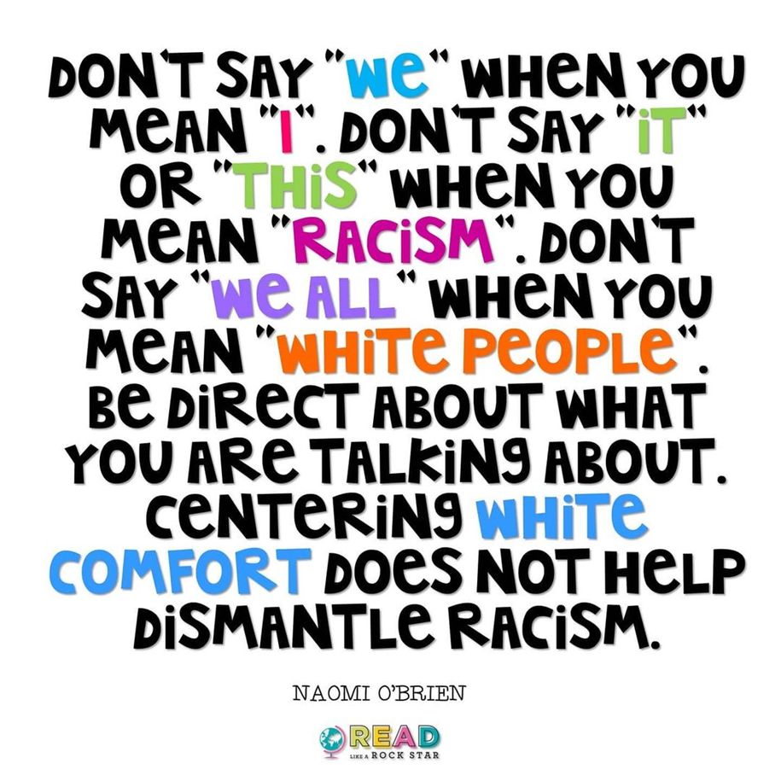
LISTEN
Be Present: Actively Listen to what others are saying.
REFLECT
Reserve Judgment: Seek to understand before responding and reacting; Reflect Honestly
SHARE
Share the Air; Share Bravely
OWN
OWN Impact: Assume positive intent but OWN impact of our own words.
COMMIT
Push through Discomfort: Despite any unease, commit to the dialogue. TAKE A RISK!
NOTICE
Notice Assumptions: Play close attention to your thoughts and any assumptions you begin to make.
Acknowledge the difference between comfort and safety.
ACKNOWLEDGE

Slide 4
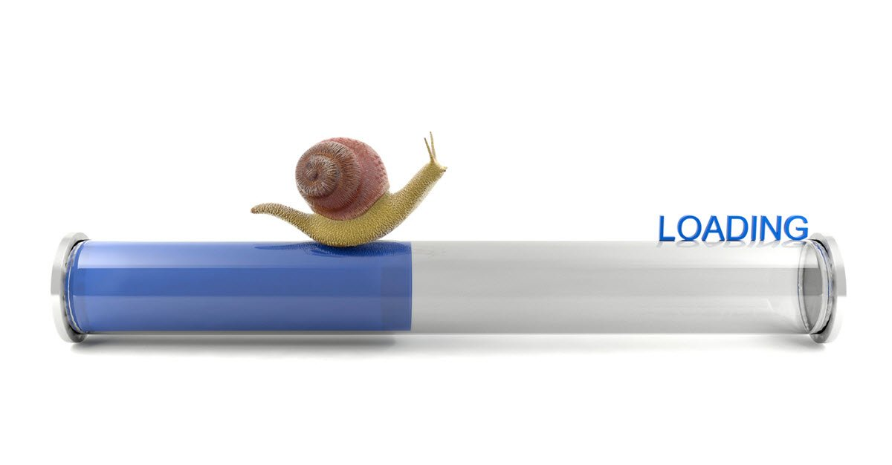

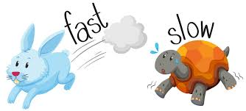
Finding the Balance

Slide 5
Social Threat Advisory System
Severe
Severe risk of burnout or snapping
High
High Risk of Exhaustion
Elevated
Significant level of disengagement
Guarded
Generalized apprehension
Low
Feeling Ok and ready to engage

Slide 6
The most valuable takeaway from today was
Felt like opening a door and building connection for more challenging conversation
How deeply woven racism is in the nation; The great historic examples of what has contributed to shaping our current racialized world.
Listening to BIPOC participants share their experiences - specifically in the work setting- on race and white-centeredness
Much improvement/change is needed
I have felt frustrated at the lack of self awareness/education by fellow white people, and the perpetuation of centering white feelings, defensiveness, etc during these conversations. I recognize that I am also in the process of unlearning my racism and have much to learn, but it is frustrating to me to see that others have not cared enough to take the same steps that I have to educate myself about structural racism, privilege, implicit bias etc to begin the process of unlearning my racism. If this is how I feel, as a white person, I cannot even begin to imagine how this must affect my BIPOC colleagues. While I have been frustrated at the amount of dialogue needed to raise this awareness, and the necessary focus on this caused by the lack of awareness of structural racism and personal unlearning of racism, and the additional harm and emotional tax to BIPOC individuals as a result, I am hopeful that we can start having discussions about tangible steps we can take to breakdown the racism within the Alliance.
I didn't realize how so much of our structure is white-culture-only based. I didn't realize how people of color don't feel included in that space. So I guess my ignorance to a lot was my biggest takeaway as I learned a lot.
How whiteness shows up in the organizations within the Alliance
I think the conversation about language, and the language we use to talk about racism (performative allyship, for example) may not be accessible to everyone or be the type of language people use. This feels rooted in white supremacy! Or academic elitism or something. It was really helpful for me to reflect on.

Slide 7
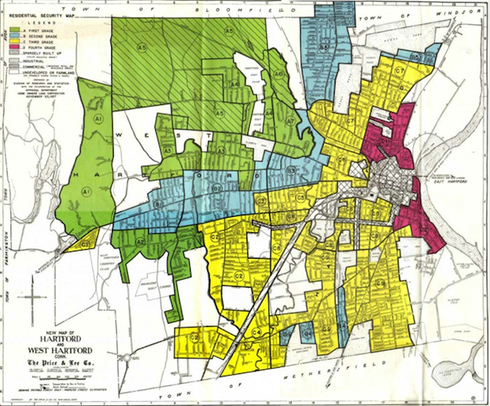
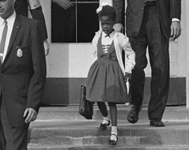
A series of mutually reinforcing federal policies across multiple domains have contributed to the disparities we see today.
It’s our context!
It informs our interactions, our experiences, our beliefs, our perceptions, and how we interpret our world.

Slide 8
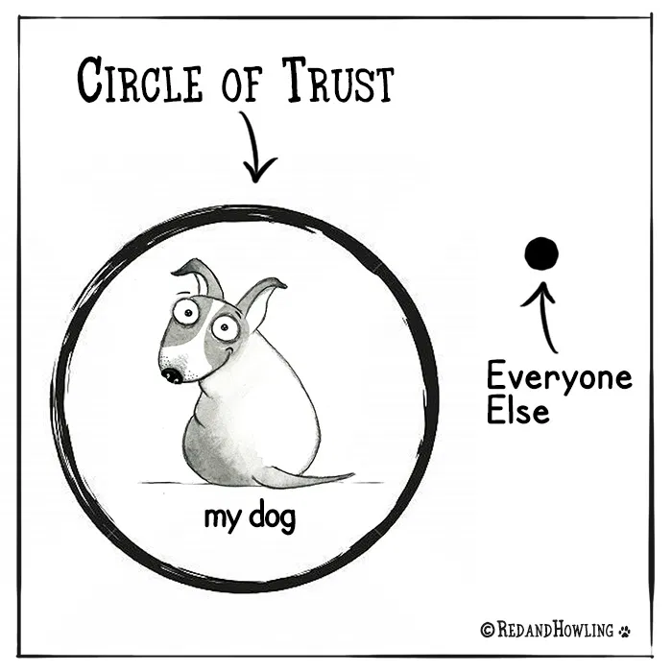
Your Trusted Circle
List the people you trust, excluding family.

Slide 9
One Step Further
Looking at your list, identify each person’s identity
Out of the seven demographics, if your trusted friend matches at least five of your own demographics, place a checkmark or star next to their name.
Trusted Friend | Age | Race | Sexual Orientation | Ability Status | Gender Identity | Educ. level | Marital Status

Slide 10
Trusted Friend | Age | Race | Sexual Orientation | Ability Status | Gender | Educ. level | Marital Status
O.B. | 44 | B | Heterosexual | Able-bodied | Female | MBA | Divorced
R.P. | 53 | W | Heterosexual | Able-bodied | Male | Ph.D. | Married
T.S | 45 | B | Heterosexual | Able-bodied | Female | J.D | Married
E.L. | 71 | H | Heterosexual | Able-bodied | Female | Ph.D. | Married
B.B. | 44 | B | Heterosexual | Able-bodied | Male | H.S. | Married
J.P. | 49 | B | Queer | Able-bodied | Female | MFA | Single
N.M. | 40 | W | Heterosexual | Able-bodied | Female | Ph.D. | Married
E.S. | 62 | B | Heterosexual | Able-bodied | Female | MBA | Married

Slide 11
15-minute Breakout Session
#1 - When looking at your trusted circle, what, if anything, surprised you?
#2 - What are the implications of your circle on your beliefs and attitudes as it relates to working with colleagues and clients?

Slide 12
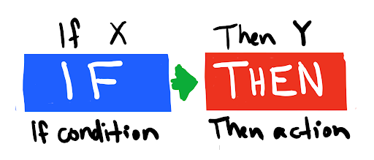
100% - Strongly Agree or Agree - As a result of today's workshop, I have a richer understanding of how racist structures have shaped my experiences and beliefs.
57.9% - Strongly Agree or Agree - As a result of today's workshop, I expect the dialogue will continue in-between sessions.
52.6% - Strongly Agree or Agree - Throughout today's workshop, I was unsure of how best to participate or engage.
73.7% - Strongly Agree or Agree – In future workshops, it may be helpful to break into and self-select into affinity groups i.e. BIPOC (Black, Indigenous, People of Color), White, and an Interracial groupings (individuals self select to process and participate across lines of racial difference)
78.9% – Strongly Agree or Agree - Reflecting upon the Jamboard responses, I understand my colleagues fears and concerns better than I did prior to the workshop.
89.5% - Strongly Agree or Agree - As a result of today's workshop, I am better equipped to identify the ways that whiteness is centered within the Alliance and the coalition.
100% - Strongly Agree or Agree - Reflecting upon the Jamboard, I understand how my salient identities shape my experiences.

Slide 13

For each group, please be sure to consider:
Based on the post-assessment results, please determine what action would you expect to see. For example, if 97% of respondents expected the dialogue to continue in-between sessions, the resulting action should be ongoing discussion and possibly, planned action steps.

Slide 14

