Slide 1

Connecticut Alliance to End Sexual Violence Awareness + Action = Accountability: A Four-Part Series Exploring Race, Power, and Privilege
Kathy Taylor, Esq.
September 2021
Notes:
Some may recognize the symbol, the Sanfoka. Sankofa is a west African word from the Akan tribe . The literal translation of the word and the symbol is “it is not taboo to fetch what is at risk of being left behind.”
The word is derived from the words:
SAN (return),
KO (go),
FA (look, seek and take).
The sankofa symbolizes the quest for knowledge with the implication that the quest is based on critical examination, and intelligent and patient investigation.
The symbol is based on a mythical bird with its feet firmly planted forward with its head turned backwards. Thus, the tribe believes the past serves as a guide for planning the future. To the Akan, it is this wisdom in learning from the past which ensures a strong future.
It is in this spirit of Sankofa that we look back. One cautionary note, I know many of you may want to charge forward and move to action. And that is important! It is also important to be firmly grounded in the why – the purpose of the work, who we are – who we bring to the work. This allows for a common and shared commitment and enough shared understanding to withstand the challenges of the road ahead. This is about fortifying ourselves for the journey. With that in mind, we look at the goals for this evening.

Slide 2
Our Ground Rules Ground Rules
LISTEN
Be Present: Actively Listen to what others are saying.
REFLECT
Reserve Judgment: Seek to understand before responding and reacting.
SHARE
Share the Air
OWN
OWN Impact: Assume positive intent but OWN impact of our own words.
COMMIT
Push through Discomfort: Despite any unease, commit to the dialogue.
NOTICE
Notice Assumptions: Play close attention to your thoughts and any assumptions you begin to make.
Where We Are: Learning is not linear.
RECOGNIZE

Slide 3
Our Destination: Moving Forward: How to Move Past Where We've Been and Where We Are
Identify Focused, Targeted Action Steps
Examine past practices that cultivated an isolating environment
Explore the emotional tax of racial equity work
Notes:
Based on the feedback, and thank you for completing the poll, it’s important to develop a shared understanding of the Council’s role, identify and address power dynamics, think about how implicit bias and privilege impacts the Council’s responsibility. As we develop more and more competency in this area, we are better prepared to tackle the work. This evening, we begin this work and will continue at our May meeting. Hopefully, in between, the work continues.

Slide 4
Themes and Threads:
1. We must have a clear understanding of our collective and individual responsibility to address racial inequities within the Alliance;
2. We must examine who we are in the process i.e. how does implicit bias, privilege, and power influence our interactions and shape the Alliance’s work;
3. We must cultivate a space where white people are committed to the work when it’s difficult and everyone is included to share and own the work; and
4. We must move beyond aspirational dialogue to concrete, focused next steps.

Slide 5
The Alliance’s Mission & Vision = what you hope to create for others, you must first create for yourself.
The mission of Connecticut Alliance to End Sexual Violence is to create communities free of sexual violence and to provide culturally affirming, trauma-informed advocacy, prevention, and intervention services centered on the voices of survivors. The Alliance envisions and hopes to create a world in which everyone believes sexual violence is a preventable problem and actively plays a role in ending it.
In carrying out our mission and pursuing our vision, The Alliance is guided by the following core values: victim-centered decision-making, empowerment, compassion and empathy, accessibility and choice, diversity and inclusion, intersectionality, dignity and respect, safety and confidentiality, wellness and self-care, integrity and accountability, collaboration and partnership, and community-building and engagement.
Notes:
Monitor and provide feedback on district priorities using the Farmington Public Schools Equity Framework – it requires that we know the Equity Framework and every component of it; - SUBCOMMITEE
2. Learn about and consider ways to address unconscious bias – acknowledges that we know that our work is impacted by our own biases and the more we are unaware of them, the greater the likelihood that they will unknowingly shape the work
3. Model the norms of civil discourse and collaborative problem solving;
4. Engage with outside experts;
5. Discuss ways to improve an inclusive climate and culture in our schools;(what are the best practices associated with a more equitable and inclusive climate and culture in schools - SUBCOMMITTEE
and
6. Support action at the school level to promote Equity Framework goals and representatives of this council,
All of these goals are in furtherance of racial equity. And that requires a detailed understanding of what equity means.
And would anyone like to define and explain how equality differs from equity. Let’s take a stab at it.

Slide 6
How to Move Past Where We've Been and Where We Are
“There was concern expressed about many of our colleagues being quiet during these conversations. However, I think that this may be in part due to a workplace dynamic we are currently attempting to unlearn. A few former staff members at the Alliance created a hostile, toxic, and often adversarial environment. Said environment discouraged transparent dialogue, connection with one another, and, ultimately, change. It isolated, disheartened, and ultimately harmed staff. While those individuals are no longer working with us, I believe that some of that residual discouragement exists in our environment, and I've wondered if the previous harm perpetuated may need to be acknowledged by some in order to understand that we can move forward now. I do think that it is a present roadblock in our path towards change, growth, and equity.”
“What the session brought up for me is seeing just how uncomfortable people are having these discussions, so it is clearly needed- but if this is the only space where it's happening, I don't think it will lead anywhere. In my own personal team, there has been no discussion about the training whatsoever for reflection. It's back to the same old routine.”
“Where are we headed as a coalition? Do I have the energy to engage in these discussions? Will this negatively impact the relationships I have on my own team or with my supervisor? When will I be able to have honest discussions?”

Slide 7



#2
#1
#3

Slide 8
Collaborating in a Shared Space:
https://jamboard.google.com/d/1lIXfFW8t90NJOKSJejDR4qd-aHSRQJ_xR1iUceEFhP4/edit?usp=sharing
In the Jamboard, you can participate and share feedback anonymously.
Step One: Click on the link - https://jamboard.google.com/d/1lIXfFW8t90NJOKSJejDR4qd-aHSRQJ_xR1iUceEFhP4/edit?usp=sharing –
Step Two: On the left, slick the fourth icon, the Sticky Note, to add your comment.
Step Three: After typing your remark, click save. As others share their remarks, we’ll be able to view and discuss.

Slide 9
1. What immediately stands out to you? Why?
2. Is there a remark that you would like to explore? Why?
3. Is there a comment that we need to unpack?

Slide 10
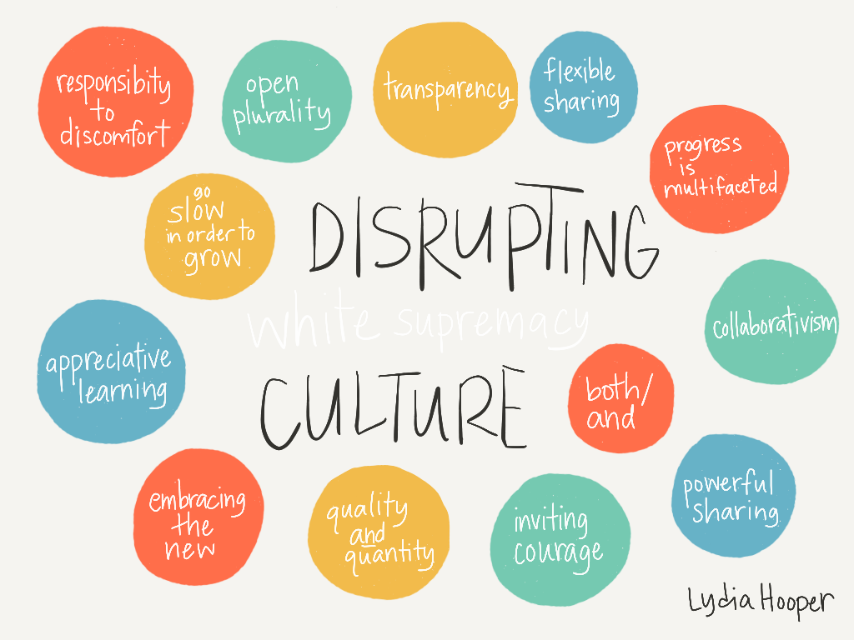
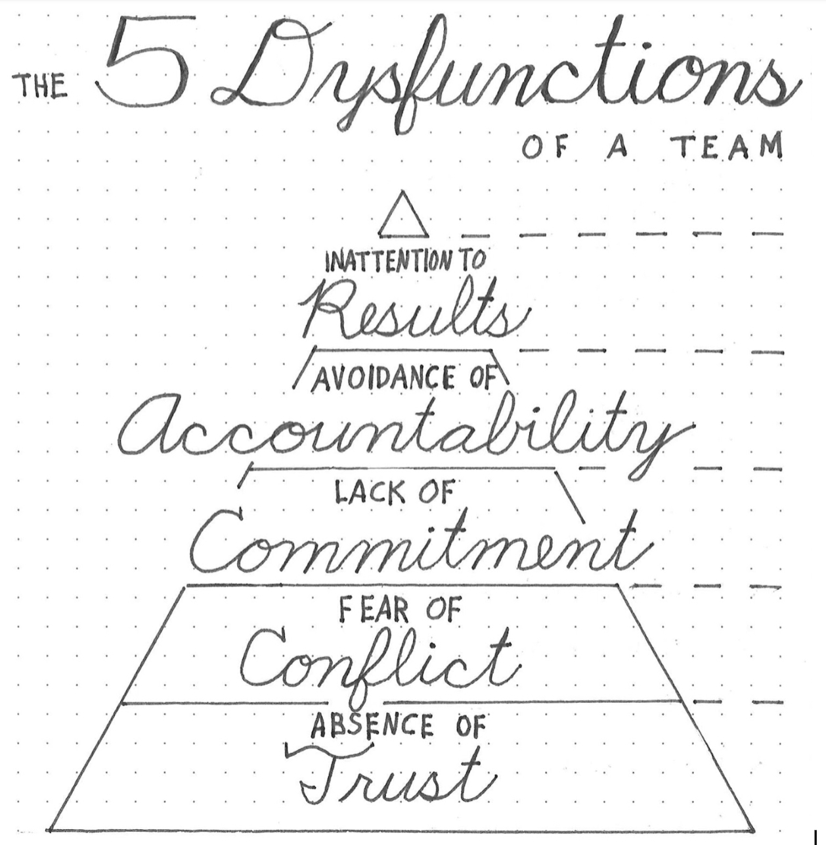
Compare

Slide 11
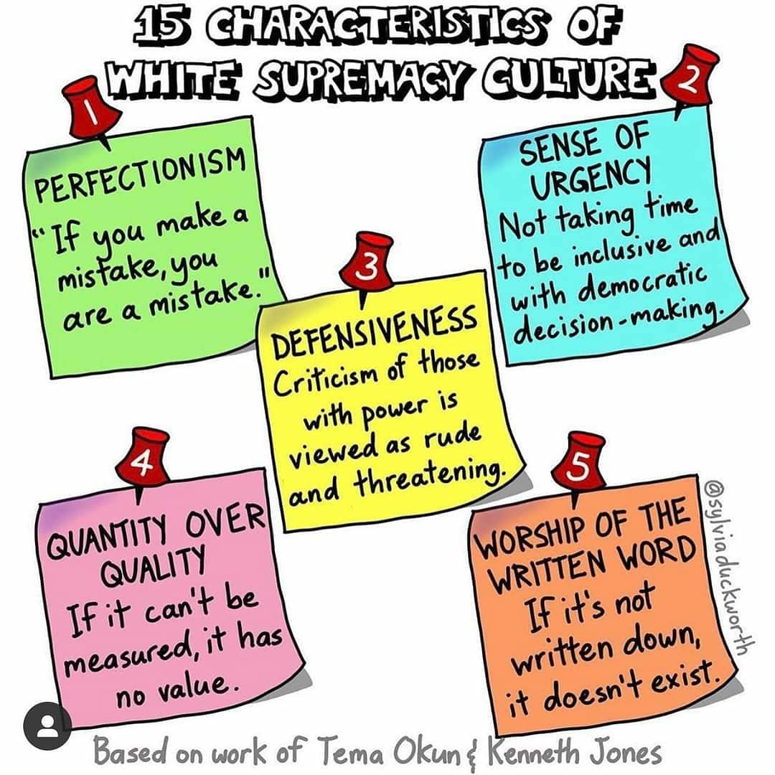
Identifying any two aspects of a white supremacy culture, let’s brainstorm ways that it appears at the Alliance and how best to combat and dismantle that frame of thinking/way of being.

Slide 12

Here’s the Task:
Promoting, cultivating, maintaining, and ensuring a more racially equitable Alliance.
Here’s the How:
Shifting mindsets, challenging assumptions, and elevating equitable practices.
Here’s the Guiding Principles:
We work to change the policies, practices and mindsets that stand in the way of equity.
We pursue our task with courage and urgency.
We embrace opportunities to learn and improve continuously, striving to be better as individuals, and as an Alliance.

