Slide 1
New Member Dues
Kara Jackson, Membership Manager

Slide 2
lower budget tiers and rates
All members receive the same early bird rates
Our new member dues transition the previous emerging and seasonal dues into standard dues and grant voting rights to all members of the League.
All dues are now in one membership model by budget group

Slide 3
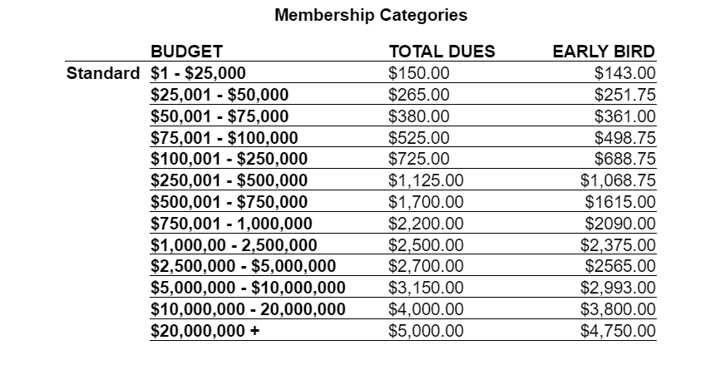
New Member Dues
These dues will take affect in the Fall of 2023

Slide 4
Member Benefits
AUDIENCE DEVELOPMENT
• Hot Tix, discount ticket program
• Cooperative Advertising
• Chicago Theatre Week
RESOURCES
• Industry Site
• Summer Guide, Holiday Guide, Fall Guide
• Jobs and Auditions Listings
• Opening Night Calendar
PROFESSIONAL DEVELOPMENT
• Workshops
• Industry Nights
• Job Fair
• Networking Events

Slide 5


We so appreciate your membership and all of us at the League hope you continue to find value in all that we do. Please don’t hesitate to contact us anytime with any questions or concerns you might have. These dues will go in affect this upcoming renewal season in September 2023.

