Slide 1


Slide 2

Thank you to all of our sponsors

Slide 3

Title Sponsor:
Nicolet National Bank

Slide 4


Major Sponsors

Slide 5

12K Sponsor

Slide 6

Jr Noque Sponsor

Slide 7

Adaptive Sponsor:
Superior Alliance for Independent Living (SAIL)

Slide 8

Nutrition Sponsor

Slide 9

Volunteer sponsor

Slide 10



Accommodation Sponsors

Slide 11

Special Thanks to
For our video production services

Slide 12



Media sponsors

Slide 13

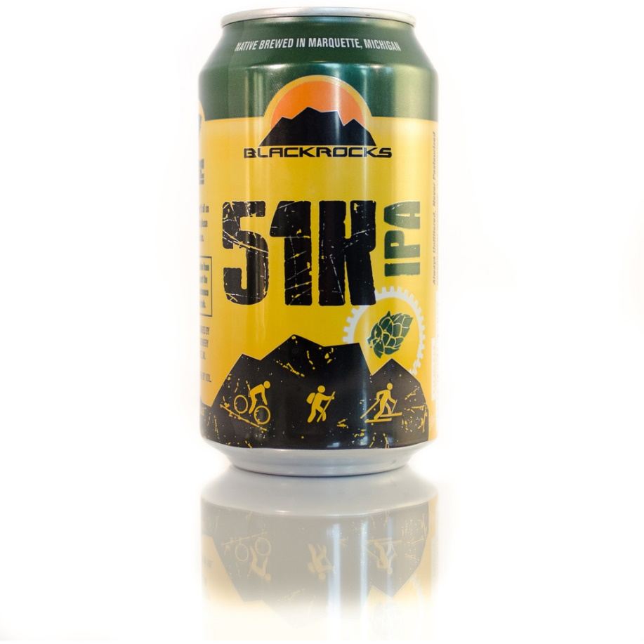
Official Beer Sponsor

Slide 14
Thank you to all of our landowners
This event would not be possible without the support of the following people and groups:
Karen and Al Koskey
American Transmission Company
Lowell Anderson
Barry Patterson
Blue Heron Bluffs Condominium Association
Blue Heron Bluffs 2
City of Ishpeming
City of Marquette
Cleveland-Cliffs Inc
Dead River Campers Association
Dead River Storage
David and Linda Denofre
Megan and Shannah Erath
Noquemanon Trails Network
Jesse LaForest
Hancock Forest management Inc
Ishpeming School District – Birchview School
Carol Gamber and Cary Gottlieb
Longyear Realty Corporation and JML Heirs LLC
LS&I Railroad
Marquette Board of Light and Power
Northern Michigan University
Brad and Elizabeth Heinzman
Peggy and Karl Weber
Shelley Saxwold
Hoponaussu OZ LLC
UPPCO
WE Energies
Lyme Great Lakes Timberland

Slide 15

LEGACY SKIERS
CONGRATULATIONS TO ALL LEGACY SKIERS
10 Year – 15 Year – 20 Year - Founder

Slide 16
Adaptive Skiers
3K: Sam Bradbury – Marquette, MI
1K: Julie Johnson – Gwinn, MI

Slide 17
1st Place: Carilyn Hayes – Oakdale, MN
2nd Place: Laura Wills- Gwinn, MI
3rd Place: Karen Prusi – Negaunee, MI
15 Mile Snowshoe – Overall Women

Slide 18
1st Place: Ryan Low Edwardson – Escanaba, MI
2nd Place: Forrest Gilfoy- Marquette, MI
3rd Place: William Nolan – Marquette, MI
15 Mile Snowshoe – Overall Men

Slide 19
1st Place: Ella Debruyn - Traverse City, MI
2nd Place: Katie Williams – Duluth, MN
3rd Place: Elisa Malherbe – Marquette, MI
12K Freestyle – Overall Women

Slide 20
1st Place: Carter Dean – Traverse City, MI
2nd Place: Evan Sysko – Marquette, MI
3rd Place: Jack Parent – Marquette, MI
12K Freestyle – Overall Men

Slide 21
1st Place: Elodie Malherbe – Marquette, MI
2nd Place: Althea Bruggink – Marquette, MI
3rd Place: Lucille Ampe – Gwinn, MI
12K Classic – Overall Women

Slide 22
1st Place: William Haapala – Traverse City, MI
2nd Place: Samuel Markey – Marquette, MI
3rd Place: Luke Janofski – Marquette, MI
12K Classic – Overall Men

Slide 23
1st Place: Lindsey Dehlin – Marquette, MI
2nd Place: Lucy Campbell – Superior, WI
3rd Place: Lily Den Hartog – Minnetonka, MN
24K Freestyle – Overall Women

Slide 24
1st Place: Henry Campbell – Superior, WI
2nd Place: Ethan Anderson – Rogers, MN
3rd Place: David Maclean – Ludington, MI
24K Freestyle – Overall Men

Slide 25
1st Place: Shelby Suhr – Wales, WI
2nd Place: Elizabeth Becker – Duluth, MN
3rd Place: Eleanor Dolan – Excelsior, MN
24K Classic – Overall Women

Slide 26
1st Place: Jordan Woods – Mora, MN
2nd Place: Nathan Bich – Duluth, MN
3rd Place: Alexander Gude – Burnsville, MN
24K Classic – Overall Men

Slide 27
Keith Kreag & Jim Argeropoulos
50K Relay – Overall

Slide 28
1st Place: Laura Cattaneo – Rochester, MN
2nd Place: Hanna Derby – Marquette, MI
3rd Place: Quinn Schollett – Minneapolis, MN
50K Freestyle – Overall Women

Slide 29
1st Place: Zach Varty – Elk River, MN
2nd Place: Zachary Nelson – Saint Paul, MN
3rd Place: Jorden Wakeley – Grayling, MI
50K Freestyle – Overall Men

Slide 30
1st Place: Caitlin Gregg – Minneapolis, MN
2nd Place: Vivian Hett – Burnsville, MN
3rd Place: Molly Watkins – Duluth, MN
50K Classic – Overall Women

Slide 31
1st Place: Brian Gregg – Minneapolis, MN
2nd Place: Christian Gostout – Minneapolis, MN
3rd Place: Andrew Millan – Minneapolis, MN
50K Classic – Overall Men

