Slide 1

SAPA 2025 SUMMER MEETING
AUG. 2-5, 2025 MONTEREY

Slide 2

SEE FOR YOURSELF!
(Click on SAPA logo!)

Slide 3
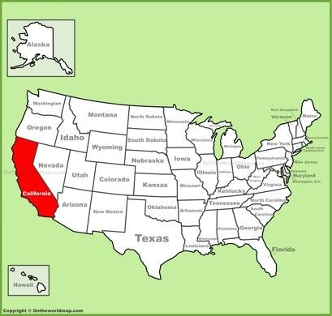
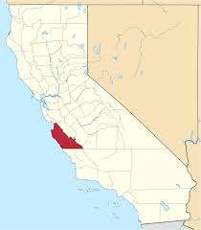
YOU WILL BE HERE

Slide 4
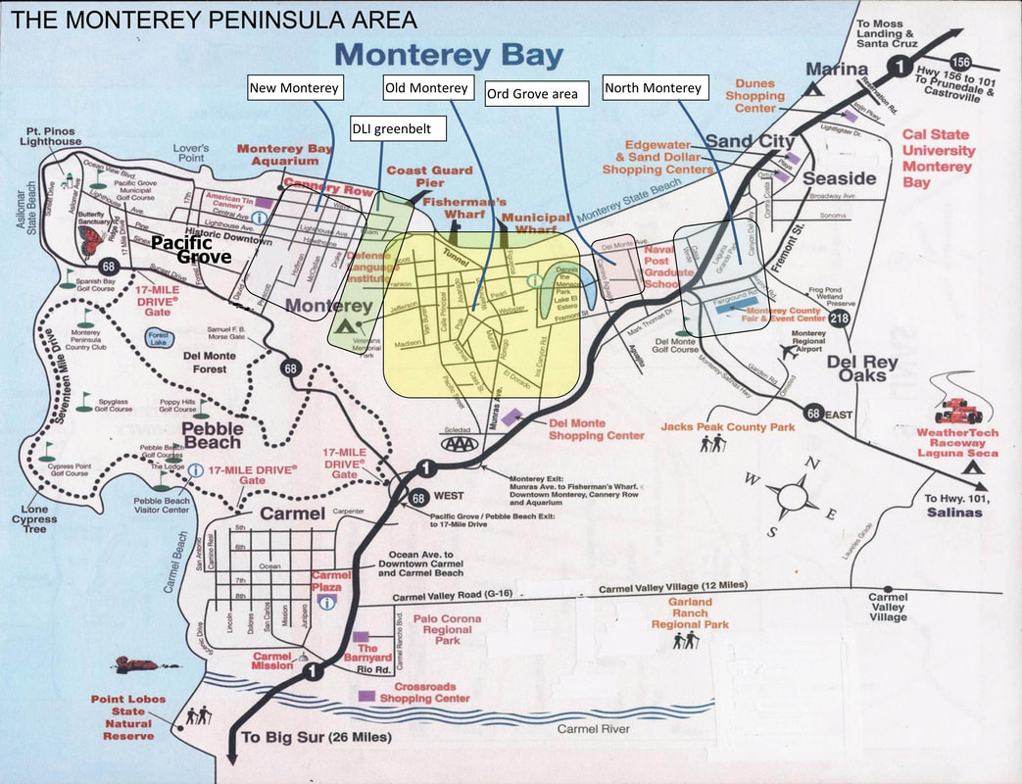
YOU WILL BE HERE

Slide 5
GETTING THERE
MONTEREY REGIONAL AIRPORT (MRY)
  Alaska Airlines; Allegiant; American Airlines; United Express; US airways
MAJOR AIRPORTS
San Jose International Airport (SJC)
San Francisco International Airport (SFO)
San Francisco Bay-Oakland International Airport (OAK)
OTHER NOTEWORTHY AIRPORTS IN CALIFORNIA
  Sacramento (SMF), Los Angeles (LAX), Burbank (BUR), Long Beach (LGB), Ontario (ONT), Orange County (SNA), San Diego (SAN), Santa Barbara (SBA)

Slide 6
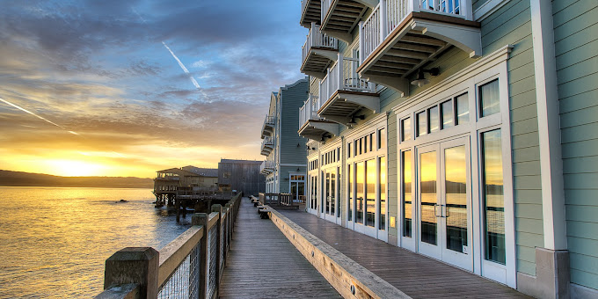
THE VENUE
InterContinental The Clement Hotel Monterey
750 Cannery Row
Monterey, California 93940
1-888-424-6835

Slide 7
ROOM RATES
GUEST ROOM BLOCK:
$329 (Inland)
$429 (Ocean View Upgrade)
$799 (Suites)
Room block dates: Friday, Aug. 1 to Tuesday, Aug. 5
Valet Parking $45 + tax per vehicle (unlimited in-out)

Slide 8
WHAT TO DO? PLENTY!
MAJOR ATTRACTIONS IN MONTEREY COUNTY:
Monterey Bay Aquarium
17 Mile Drive
Big Sur
Cannery Row
Carmel-by-the-Sea
Old Fisherman’s Wharf
Golf! Golf! Golf!
Whale Watching
Monterey Wine Country
Pinnacles National Park
National Steinbeck Center

Slide 9
EVENT REGISTRATION
Event information page active Sept. 1 (link to SAPA)
On-line registration opens early Spring 2025
Discount room rate link active early Spring 2025
New: Register & Pay in advance.
Estimated registration fee: $1,200 per person
Guest registration $1,200 includes 2 excursions
2 optional golf outings

Slide 10
SOME CALIFORNIA HISTORY
Indigenous peoples lived in California for at least 19,000 years (109 federally recognized tribes)
Spanish explorers arrived in the 16th century and began colonization. The first of 21 Spanish missions was built in 1769.
California’s name comes from a 16th century Spanish novel that describes a mythical paradise.
Was part of Spain until the 18th Century, then part of Mexico until the Spanish-American War (1846-1848).
Became a state in 1850 (after the 1849 Gold Rush); the 31st state (skipped territory status)
State Motto: “Eureka!” (Greek for “I have found it!”)

Slide 11
CALIFORNIA GEOGRAPHY
California has 9 different climate zones
California has 840 miles of coastline (#3 to Alaska and Florida)
Death Valley is the hottest, driest and lowest national park in the country.
There are 100,000 earthquakes in California each year.
WEATHER: Monterey in August averages 70 degrees for the high & 54 degrees for the low with virtually % 0 chance of rain and low humidity (but breezy and coastal fog possible)

Slide 12
CALIFORNIA ALMANAC
California is No. 1 in the U.S. in terms of population, with more than 39 million residents
Los Angeles County alone has 9.86 million residents, or more than the individual population of 40 states.
California has the largest Congressional delegation in Congress: 2 Senators and 52 Representatives (40 Democrats and 12 Republicans)
The largest county by land area in the United States is San Bernardino County (20,105 square miles)

Slide 13
CALIFORNIA ECONOMY
California has been the 5th largest economy in the world for the past 7 years, with a nominal GDP of nearly $3.9 TRILLION in 2023.
Home to Hollywood, Silicon Valley, Agriculture, aerospace industry (among many others).
Half of all fruits and vegetables grown in the U.S. come from California; California produces 80% of the world’s almonds.
California exported $154.9 billion in goods in 2023, with the largest category manufactured goods.

Slide 14
CALIFORNIA ON THE MOVE
6 of the 10 busiest freeways are in California (I-5 in L.A.-Orange County is No. 1 @ 504,000 ADT)
The busiest U.S. international border crossing is the San Ysidro Land Port of Entry, San Diego
The Port of Los Angeles & Port of Long Beach are among the world’s busiest seaports & handle 31% of U.S. Container movements.
Caltrans, the state DOT, manages 58,000 miles of freeways and highways; California has 58 counties and 482 cities, which collectively manage 396,540 total lane miles of pavement (#2 behind Texas).
95 % of California freeways, highways and local roads are surfaced with asphalt (FHWA)

Slide 15
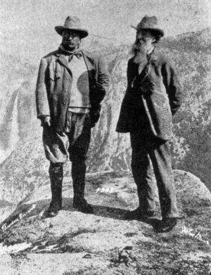
“CALIFORNIA DREAMING”

Slide 16
“CALIFORNIA HERE I COME”
2025 SAPA Chairman & Annual Meeting host:
RUSSELL W. SNYDER, CAE
Executive Director
California Asphalt Pavement Association (CalAPA)
(916) 791-5044 (Office)
(925) 548-5409 (Mobile)
rsnyder@calapa.net
www.calapa.net
2024 SAPA Executive Committee:
John Hickey, OAPA (Chair); Russell W. Snyder, CalAPA (Vice Chair); Kevin Burke, IAPA (Secretary); Erich Ponti, LAPA (Treasurer); Kevin Monaco, NJAPA (Immediate Past Chair); Bruce Barkevich, NYM (Chairman Emeritus).

