Slide 1
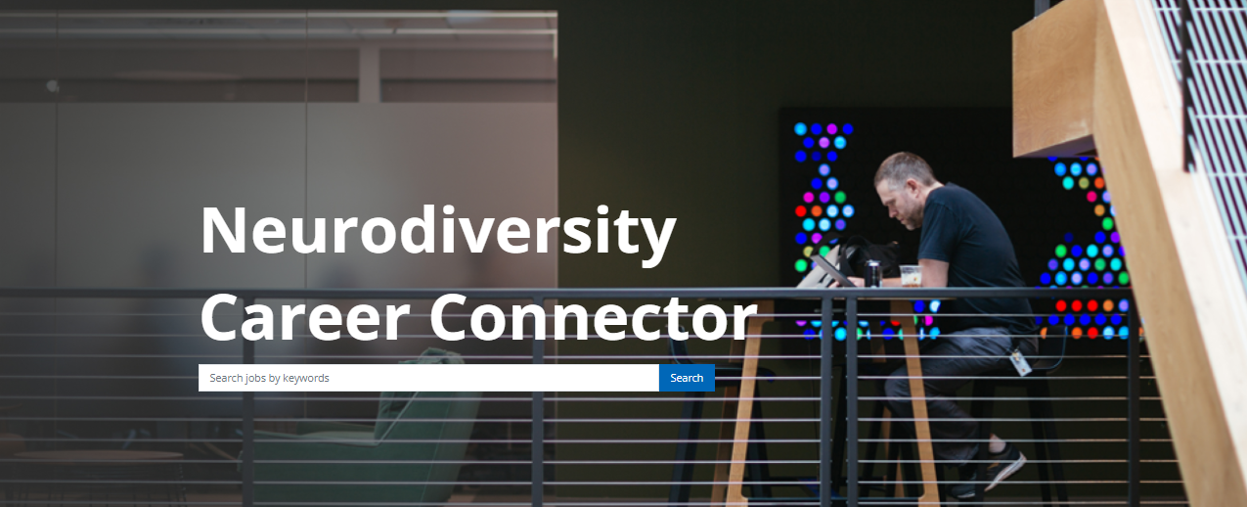
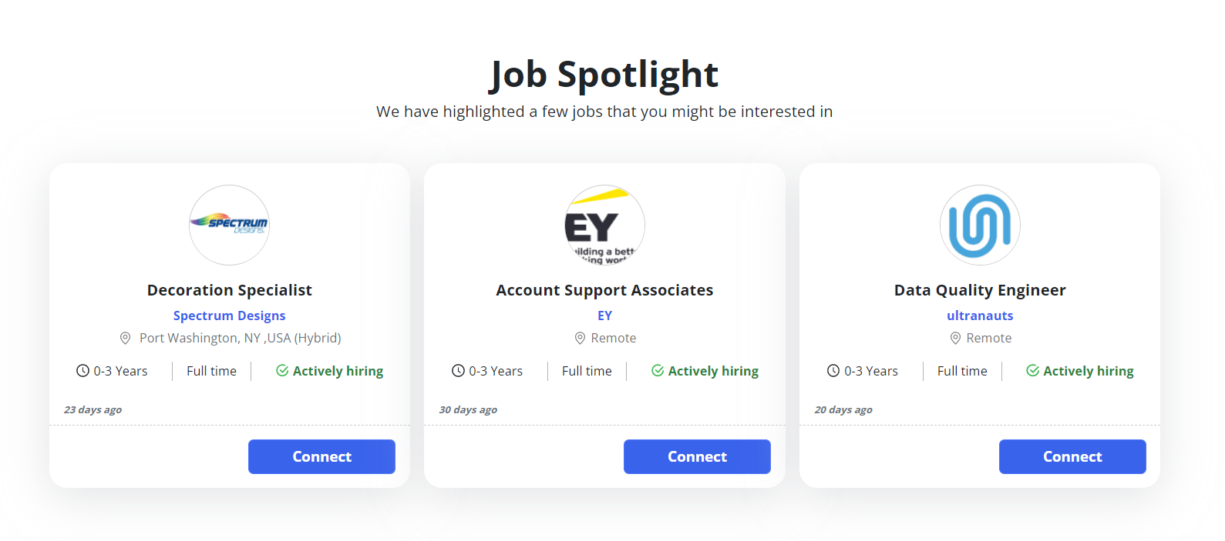
Connecting job seekers to neurodiverse friendly employers
Finding Meaningful Employment
This free job marketplace is to connect Neurodivergent individuals with employers looking to specifically hire and support Neurodiverse talent.
It’s a job marketplace with only employers who have a track record of hiring and supporting ND individuals and are members of the Neurodiversity @ Work Employer Roundtable.
https://aka.ms/NDCC
Notes:
General Information & Frequently Asked Questions
What is Neurodiversity Career Connector (NDCC)?
A: NDCC is a free platform for neurodivergent individuals to connect with inclusive employers by expressing interest in their organizations. Neurodivergent job seekers can upload their resume and connect with Neurodiversity @ Work employers – organizations that intentionally hire neurodivergent talent.
How are employers selected to participate?
A: Eligible employers are member of the Neurodiversity @ Work employer roundtable. In order to join the roundtable, organizations, both large or small, must have a Neurodiversity hiring program in place for at least one year and are publicly committed to hiring and supporting Neurodivergent talent. This may also include small businesses in which the majority of the organization identifies as neurodivergent.
Can organizations or job seekers outside of the United States access Neurodiversity Career Connector?
A: As of February 2022, NDCC is only available to job seekers and employers based in the United States. In the future, there are plans to gradually expand to additional countries.
I’m a job seeker what do I need to do with the career connector to sign up?
A: NDCC is free of charge and open to Neurodivergent job seekers of all backgrounds and experiences. You simply need to sign up on the platform and upload your resume. Completing your profile is optional when you register; however, this will allow employers to see your skills and experiences and identify if you are a potential match for current or future positions at their organizations.
By connecting with an employer, does that mean I have submitted my application for employment?
A: No, connecting with an employer simply informs the organization/recruiter that you are interested in the position. It does not mean you have officially applied to the position. In the job posting on NDCC, the company may state how to formally apply to the position – whether email, a resume, or apply directly on the organization’s hiring platform / website.
Should I expect to hear from a recruiter from each organization with whom I connect ?
A: You can click ‘connect’ on any role that is posted. This will notify the company that you are interested in the position. Employers may connect back with a job seeker to follow up, but every “connection” does not equate to a conversation with an employer’s recruiter. This marketplace allows Roundtable Employers to discover candidates who are interested in their organization and career opportunities.
Will you be adding new roles and employers; if so, how often?
A: We will be adding new employers monthly, as well as updating and adding new roles on an ongoing basis. Please check back often for new job postings and companies.
Is there a cost for job seekers to utilize the Career Connector?
A: Nope, it is free! Job seekers can upload their resumes and connect with employers at no charge.
If you are an employer interested or focused on hiring Neurodiverse talent and want to post your jobs on this platform, what should you do?
A: Employers that are interested in joining the Neurodiversity @ Work Employer Roundtable should click here to learn more about joining. New employers can join the Roundtable, free of charge, as long as they meet the minimum requirement of having a neurodiverse hiring program for at least one year. This site is a community platform that houses open roles from many employers in the Neurodiversity@Work Roundtable.
What types of employers and roles are posted on this site?
A: Neurodiversity Career Connector includes large enterprise employers and small businesses of all backgrounds, from IT, engineering, quality, and data analytics to customer service, financial services, retail, business, and more! All of the employers are focused on hiring, supporting, and growing neurodivergent talent.
Which companies are posting jobs on Neurodiversity Career Connector (NDCC)?
A: NDCC features an ever-changing and growing list of participating employers that are focused on hiring and creating a supportive culture for the Neurodivergent community. At launch, the following companies plan to participate: Aspiritech, Bank of America, CAI Neurodiverse Solutions, Chevron, Dell, EY, Ford, Freddie Mac, HP, IBM, John Crazy’s Socks, Microsoft, Prudential, Rangam, Rising Tide Carwash, Salesforce, SAP, SAS, Spectrum Designs, Travelers, Ultranauts, Ventures ATL, and Wells Fargo. This list will constantly evolve as the community of employers and job seekers grows. The best way to see who is hiring is by signing up for Neurodiversity Career Connector or browsing the current job postings.
What type of employment is available on Career Connector?
A: The focus of Career Connector is to assist job seekers in pursuing gainful employment, which may include traditional full-time roles, part-time roles, and paid internships (short term employment). Most job seekers on NDCC will be looking for early-career opportunities in tech and tech-enabled roles; however, NDCC is not limited to only technical roles or technology organizations. Roles posted will specify location or indicate if the position can be remote or hybrid.
Who is running the backend of the platform and what is their role?
A: Microsoft is partnering with Simplify to run the end-to-end digital platform. More information about Simplify can be found at https//simplifyvms.com/.
Will Microsoft or Simplify sell, rent, or give away my organization’s information or a job seeker’s personal information?
A: No, neither Microsoft nor Simplify will sell, rent, or give away an organization’s information or any job seeker’s personal information. Details of Microsoft’s and Simplify’ s respective privacy policies can be found on the Neurodiversity Career Connector website.. (add new l
Who Decides who is hired?
A: As with any staffing decision, the employer makes the final decision and offers employment to the job seeker. NDCC provides job seekers and employers with a digital platform and professional recruitment services to help connect these parties to one another and find a strong, mutual fit; but the final hiring decision rests with each individual employer.
16. How do I request accommodation during the recruitment process?
Answer: Each employer will have their own process to request accommodation. You may also reach out to the concierge service (add new LINK) for assistance and advice.
17. I still have questions. Who can I contact?
A: For additional information and Neurodiversity Career Connector support, please contact JobsNow@microsoft.com. (add new link)

