Slide 1

Dual Enrollment Registration
Student and Admin Walk-through
2022-2023

Slide 2
Student Timeline Overview
Sept. - Dec. 2022
New dual enrollment students apply to Atlantic Cape on the website.
Returning dual enrollment students ensure you can log into Self-Service and Buccaneer email.
Jan. 2023
Jan 14 - deadline to apply using Spring 2023 application.
After applying, students will receive their acceptance letters and welcome packet.
March - May 2023
March 15 - registration open on Self-Service portal. Payment due at time of registration.
May 15 - registration closes for dual credit.

Slide 3
HS Admin Timeline Overview
Sept. - Dec. 2022
Ensure that all NEW dual enrollment students have applied to Atlantic Cape.
Enrollment Services will send a list of current students registered for verification.
Ensure current students can login to self-service and Buccaneer email.
Jan. 2023
Jan 14 - deadline to apply using Spring 2023 application.
After applying, students will receive their acceptance letters and welcome packet.
Feb. 2023
Feb/ 17 - deadline for Atlantic Cape to receive transcript, report card, or schedules of students in dual credit program
Schedules, transcripts, report cards should be sent to hsenrollment@atlantic.edu
Notes:
by november

Slide 4
HS Admin Timeline Overview
March - May 2023
March 15 - registration open on Self-Service portal for dual enrollment students. Payment due at time of registration*
May 15 - registration closes for dual credit
*This does not apply to schools with other means of funding.
June - July 2023
June 30 - grades due from HS to post on Atlantic Cape transcripts
July 13 - Deadlines for Atlantic Cape to have all grades posted on official transcripts

Slide 5
New Student Application Steps:
If you are new to dual enrollment, follow these steps:
STEP 1: Apply to Atlantic Cape. Click here! (Tip: Use a non-school email address that you check regularly.)
STEP 2: Select the correct application. Select the “Early College Application,” select “2023 Spring” for Anticipated Term, and select “Dual Credit” for Interests.
STEP 3: Complete the application. Your acceptance packet will be mailed including important information, such as your Buccaneer and Self-Service login credentials.

Slide 6
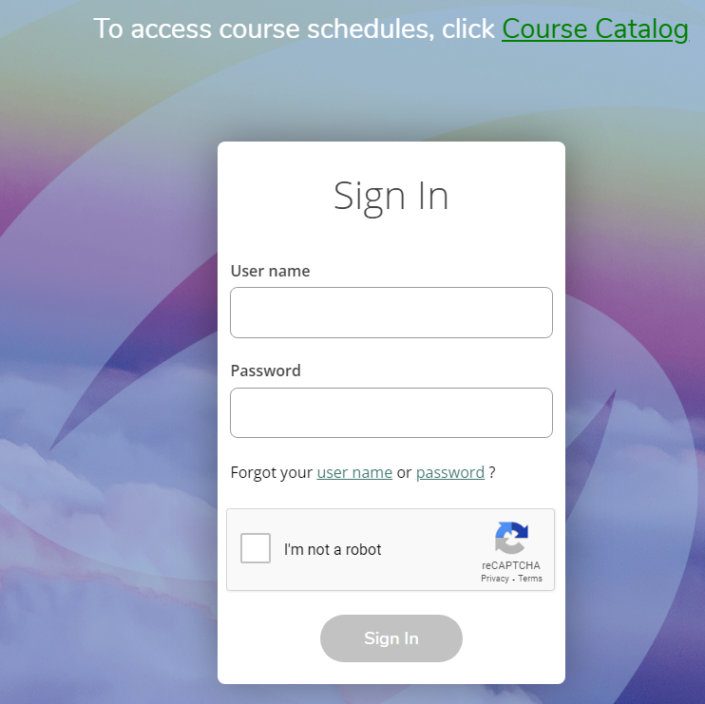
Student Registration Steps:
STEP 1: Locate your credentials to log into Self-Service - you received your username in your acceptance letter and your Buccaneer email (buccaneer.atlantic.edu)
STEP 2: Log into Self-Service - click here!
Having issues? Visit the next two slides for troubleshooting solutions!

Slide 7
Troubleshooting Steps 1 & 2
Troubleshooting:
Your login is your first name, middle initial (if you have one) and last name up to a total of 23 characters. For example: William Harry Robertson would have a WebAdvisor login of "williamhrobertson"
When logging in for the first time, the student will need to create a password. They will click the “Forgot Password” link to be authenticated by our system and receive an email that will allow them to create a personal password.
If a student does not receive an email, they are most likely either: a) using an email address that we do not have on file, or b) using their high school email address that does not allow communication outside of their district.

Slide 8
Troubleshooting Steps 1 & 2
Troubleshooting:
To reset your password, select "Forgot Password" on the Self Service site. Enter your username and an email address that is associated with your record. You will then receive a second email allowing you to create a new password.
If a student is still having trouble, students are encouraged to reach out to us at hsenrollment@atlantic.edu to confirm their login information if they continue to experience difficulties.

Slide 9
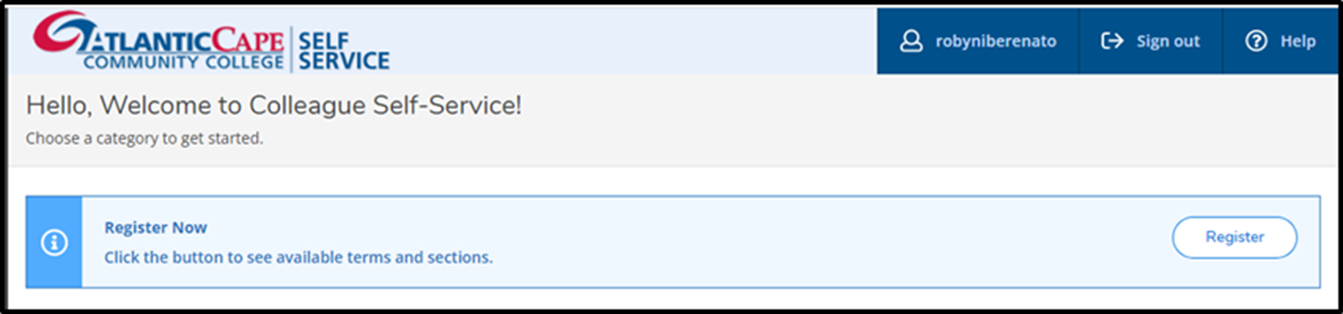
Student Registration Steps:
STEP 3: When the student logs in, a blue banner will display near the top of the page, with the message “Register Now.” Click the “Register” button, the pre-planned courses will appear for the current academic year.
You are already are in these classes! You are now just applying to acquire the college credit.

Slide 10
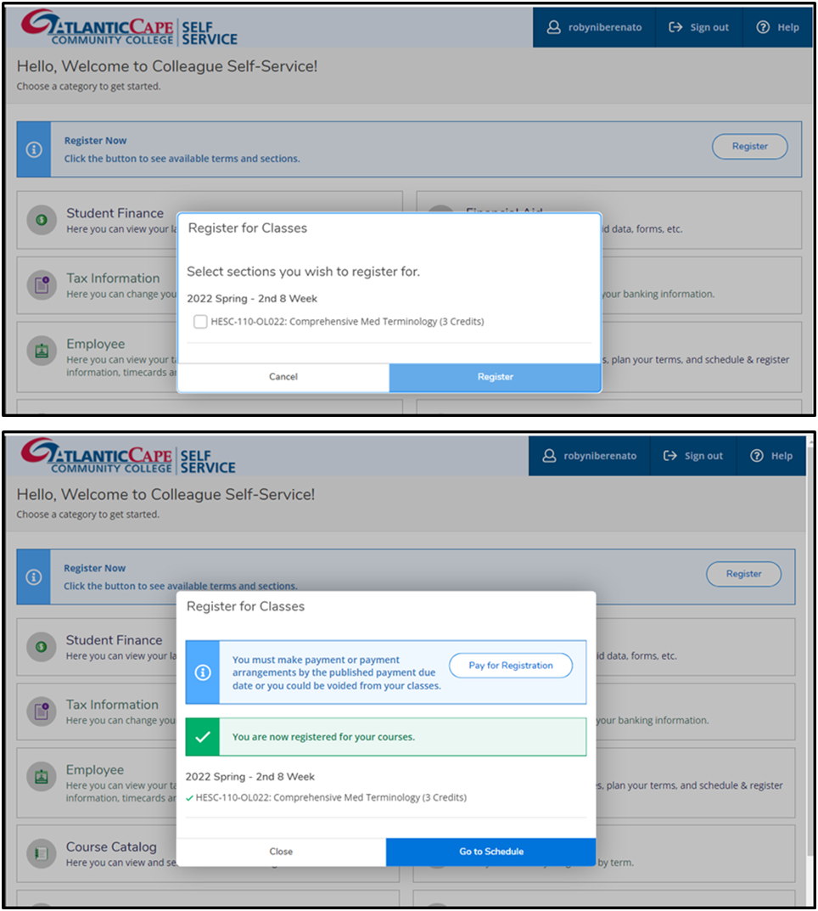
Student Registration Steps:
STEP 4: The student selects the checkbox for each course they wish to register for that they are currently taking at their High School. Then click the blue “Register” button.
STEP 5: A confirmation message and a payment message will then appear. It is recommended click “Go to Schedule.”

Slide 11
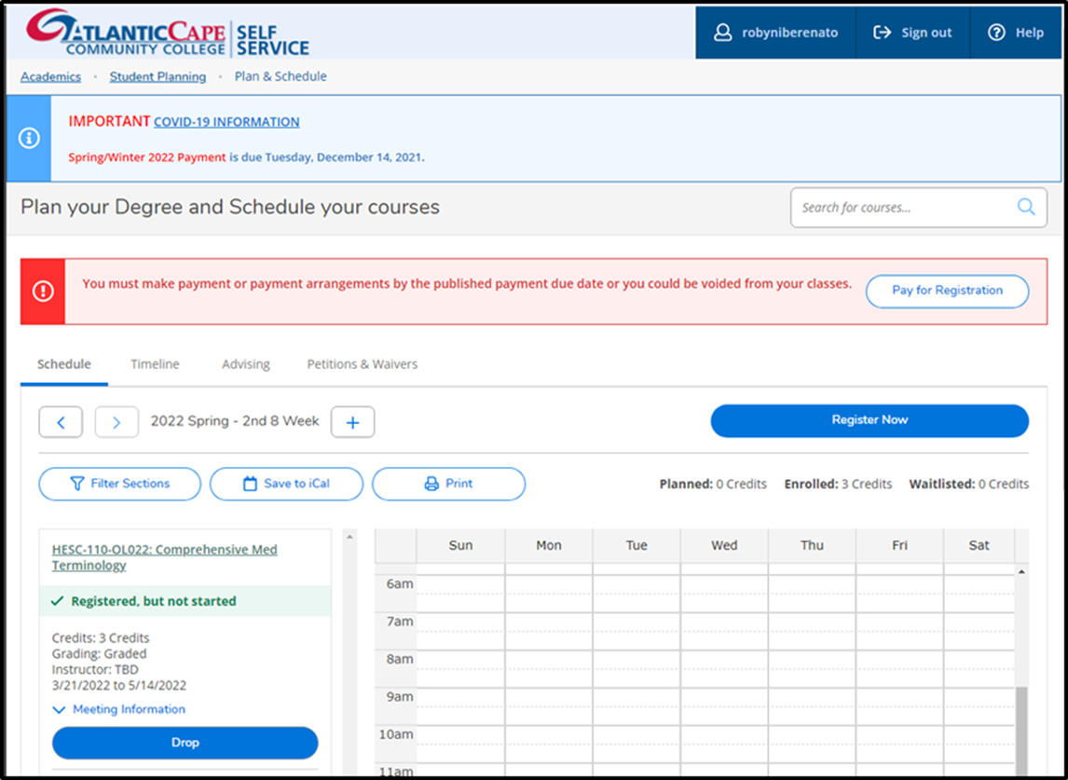
Student Registration Steps:
STEP 6: A calendar will appear showing the courses for which the student is registered. They may click the print button to print their schedule.
STEP 7: Check with your school if you are responsible for payment. If you are, select “Pay for Registration.” If you are not responsible, do not click.

Slide 12
What are the student expectations and responsibilities of dual credit?
Complete the application process
Meet deadlines for both high school and Atlantic Cape
Communicate with college with questions about dual enrollment registration, classes, credit, etc.
Check college email and Self-Service account regularly
Check personal email account regularly
More information in the Early College Programs Parent and Student Handbook.
Student Responsibilities

Slide 13
What are the parent expectations and responsibilities of of dual credit students?
Talk to your student about the rigor and expectations of a college-level course
Encourage your student to seek help from tutoring and other campus resources
Communicate with your student regularly about deadlines
Encourage your student to advocate for themselves
More information in the Early College Programs Parent and Student Handbook.
Parent Responsibilities

Slide 14
Library
Free to our students
Library assistance with research and digital resources
(including free New York Times digital subscription)
Online tutoring available 24/7
Center for Accessibility
Provides accommodations for all students with documented disabilities on an individual basis
Our CFA team is committed and ready to assist students with disabilities to reach their academic goals
Resources You Should Know

Slide 15
Questions?
Andrea Enders
Executive Director of Innovation and Academic Resources
scriscio@atlantic.edu
Kayla Scannell
Senior Manager of Early College Programs
kscannel@atlantic.edu

