Slide 1
EMPOWERING
THE FUTURE

Slide 2
Discussion
Review of Key Initiatives for “Empowering the Future”
Request for Congregational Discernment
Discussion and Observations

Slide 3
OUR MISSION STATEMENT
With open hearts and minds, Village Church
welcomes the curious, the seeker, and the sure at every stage of life.
Guided by the love of Jesus, our growing congregation shares in
inspiring worship, inclusive community, and intentional service.
We are continually transformed by following Jesus’ example that
in giving we receive, in feeding we are fed, and in loving, we are loved.
Our intergenerational ministries deepen our faith and compel our service.
We are called to pursue justice and joy for all people, and
we care passionately about God’s creation and the shared health of our world.
Energized by the Holy Spirit, we joyfully live into our future together.

Slide 4
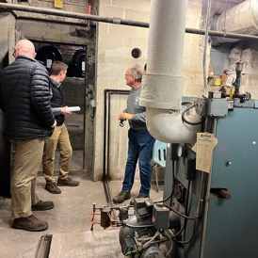
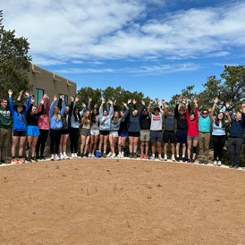
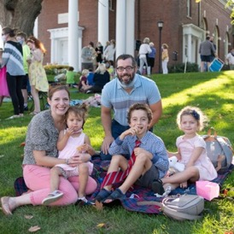
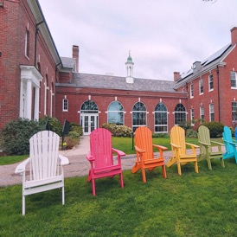
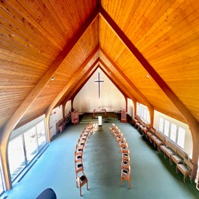
EMPOWERING THE FUTURE: FIVE CATEGORIES
REPLACE AND
MODERNIZE
THE HVAC SYSTEM
EXPAND COMMUNITY
OUTREACH INCLUDING
VILLAGE TABLE
CREATE AN ENDOWMENT
FOR CHILDREN
AND YOUTH MINISTRY
GREEN THE WESTON
CAMPUS (SOLAR,
INSULATED ROOF)
SECURE THE
PROPERTY RESERVE

Slide 5



A CALL FOR DISCERNMENT
EMPOWERING THE FUTURE
POWERING
THE FUTURE
FINANCING
THE FUTURE
FUNDING
THE FUTURE

Slide 6
STREAM ONE
POWERING THE FUTURE

Slide 7







CURRENT HVAC SYSTEM
FUEL SOURCE
SYSTEM
DISTRIBUTION
CHALLENGES
End of life
Average quality
Lowest efficiency
COOLING
WMLP*
electricity,
on-site solar
ventilation,
air conditioning
ducts
End of life
Highest operating cost
Highest emissions
Lowest efficiency
HEATING
oil
boiler
radiators
* Wellesley Municipal Light Plant

Slide 8



PROPOSED SOLUTION: OPTION 1
FUEL SOURCE
SYSTEM
DISTRIBUTION
PROS / CONS
Average lifespan
Lower emissions
Higher efficiency
Can offset some heat
PRIMARY HEATING AND
COOLING
electricity (potential for 100% renewable)
ventilation, air-source heat pumps
(heating and AC)
ducts
Lower operating cost
Slightly lower emissions
Higher efficiency
SECONDARY
HEATING
natural gas
boiler
radiators

Slide 9



PROPOSED SOLUTION: OPTION 2
FUEL SOURCE
SYSTEM
DISTRIBUTION
PROS / CONS
U
U
U
U
U
Longest lifespan
Lowest operating cost
Lowest emissions
Highest efficiency
HEATING AND COOLING
geothermal
radiators
ventilation, water source heat pumps (heating and AC)
electricity (potential for 100% renewable)
ducts

Slide 10

COST COMPARISON: INITIAL OUTLAY
Costs | Option 2: Geothermal |  | Costs | Option 1: heat pump/nat gas
System, gross cost | $4,674,000 |  | System, gross cost | $2,143,000
Contingency (3.5%) | $164,000 |  | Contingency (3.5%) | $75,000
Interest | $240,000 |  | Interest | $68,000
Roof repairs | $25,000 |  | Roof repairs | —
Rebate: IRA 30% | $(1,451,000) |  | Rebate: IRA 30% | —
Rebate: IRA 10% | $(484,000) |  | Rebate: IRA 10% | —
Rebate: Mass Save | $(675,000) |  | Rebate: Mass Save | $(80,000)
TBD | — |  | TBD | —
TBD | — |  | TBD | —
NET | $2,493,000 |  | NET | $2,206,000
Notes:
Quotes from GreenerU are stipulated sum (fixed)
Pricing has been developed based on significant engineering effort to date
There is some uncertainty as to IRA rebates due to the current political climate
Data from

Slide 11
COST COMPARISON: INITIAL CASH FLOW
Costs | Geothermal | 2024 | 2025 | 2026 | 2027 | 2028
System, gross cost | $4,674,000 | $561,000 | $4,113,000 | — | — | —
Contingency (3.5%) | $164,000 | $20,000 | $144,000 | — | — | —
Interest | $240,000 | $3,000 | $99,000 | $110,000 | $28,000 | —
Roof repairs | $25,000 | — | — | — | — | —
Rebate: IRA 30% | $(1,451,000) | — | — | — | $(1,451,000) | —
Rebate: IRA 10% | $(484,000) | — | — | — | $(484,000) | —
Rebate: Mass Save | $(675,000) |  |  | ($675,000)
Capin Crouse | $25,000 | $25,000
TBD | — | — | — | — | — | —
NET | $2,493,000
FUNDS BORROWED |  | $400,000 | $2,067,000 | $2,409,000 | $630,000 | —
Costs | Heat pump / natural gas | 2024 | 2025 | 2026 | 2027 | 2028
System, gross cost | $2,143,000 | $714,000 | $1,429,000 | — | — | —
Contingency (3.5%) | $75,000 | $25,000 | $50,000 | — | — | —
Interest | $68,000 | $4,000 | $54,000 | $11,000 | — | —
Roof repairs | — | — | — | — | — | —
Rebate: IRA 30% | — | — | — | — | — | —
Rebate: IRA 10% | — | — | — | — | — | —
Rebate: Mass Save | ($80,000) | — | — | $(80,000) | — | —
TBD | — | — | — | — | — | —
NET | $2,206,000
FUNDS BORROWED |  | $425,000 | $1,191,000 | $235,000 | — | —

Slide 12
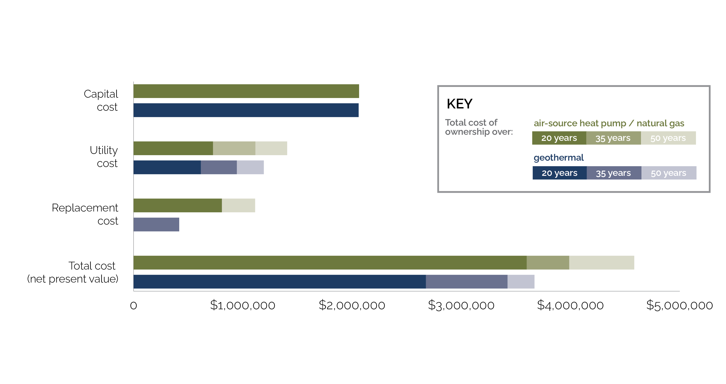
TOTAL COST OF OWNERSHIP
Data from

Slide 13
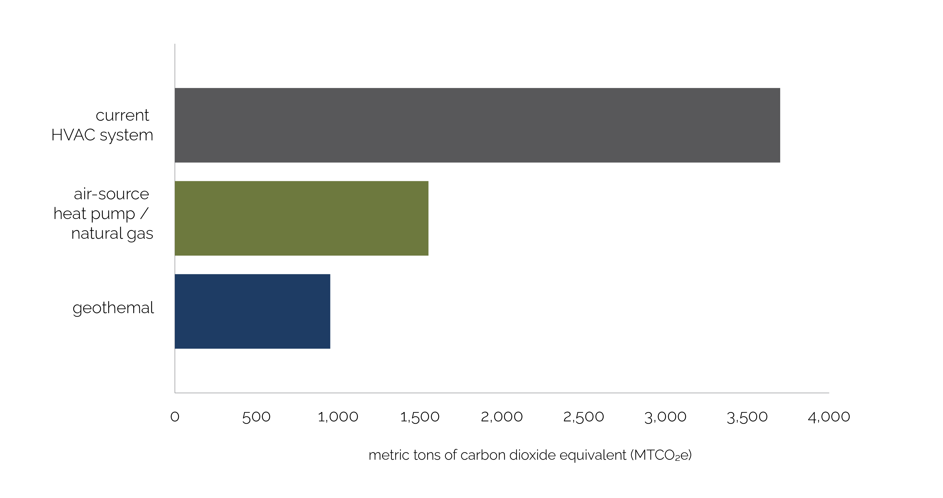
SYSTEM COMPARISON: EMISSIONS
Data from

Slide 14
STREAM TWO
FUNDING THE FUTURE

Slide 15
EMPOWERING THE FUTURE: FIVE CATEGORIES
REPLACE AND
MODERNIZE
THE HVAC SYSTEM
EXPAND COMMUNITY
OUTREACH INCLUDING
VILLAGE TABLE
CREATE AN ENDOWMENT
FOR CHILDREN
AND YOUTH MINISTRY
GREEN THE WESTON
CAMPUS (SOLAR,
INSULATED ROOF)
SECURE THE
PROPERTY RESERVE

Slide 16
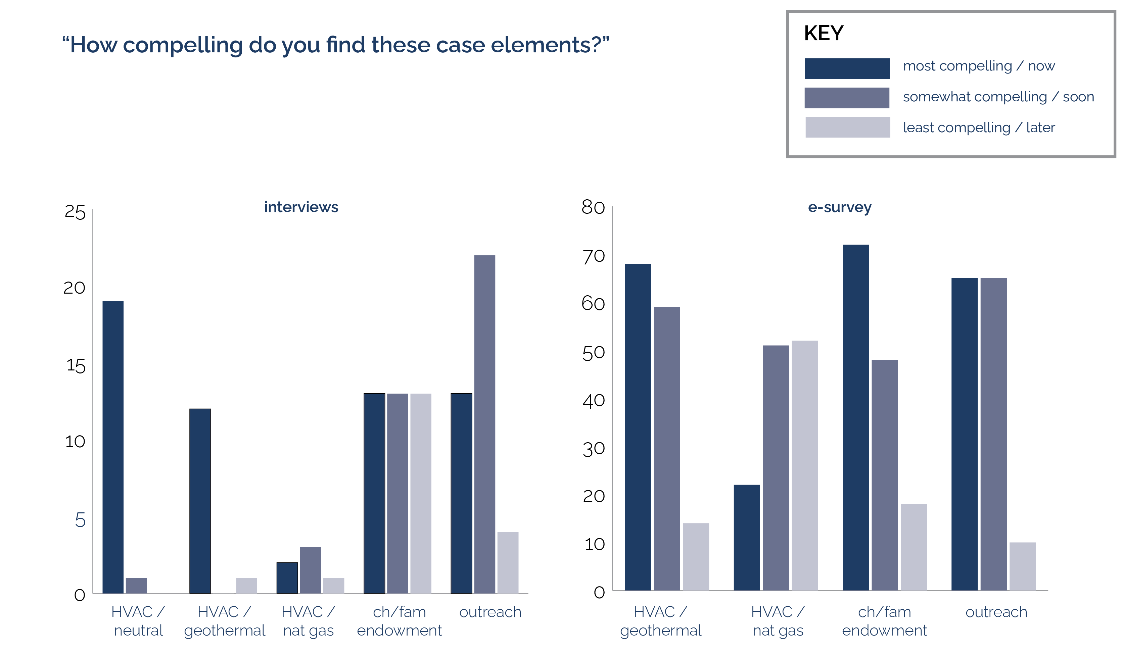

REFLECTIONS FROM THE CONGREGATION
Data from

Slide 17
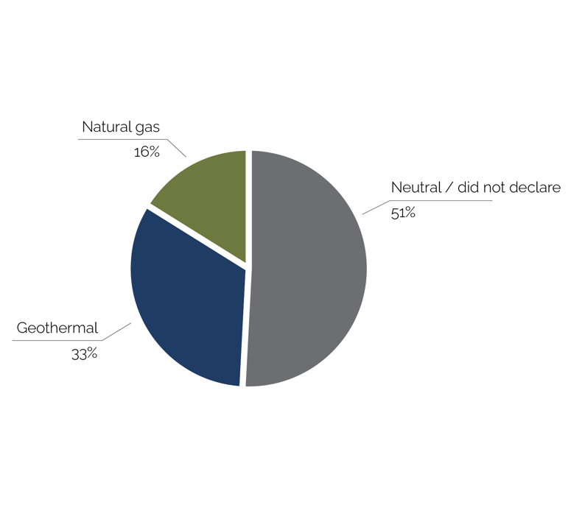
REFLECTIONS FROM THE CONGREGATION
Percentage of interviewees’ HVAC system preferences
Representative comments
“The HVAC is loud in the winter! It must be replaced: our restored organ needs a steady environment.”
“HVAC needs to be replaced. We should be remembered as good stewards of our church.”
“Frame HVAC better…A sustainable system would save us X amount in the long run.”
”Be transparent about upfront versus net costs. Any rebates must be used for something the congregation agrees upon.”
“HVAC seems like a lot but if it makes us better stewards of the environment and can help attract new members, we should do it if we can.”
“How essential is geothermal versus gas? Which makes more economic sense?”
“Capital upgrades can’t just be earth-friendly; they must make economic sense as well.”
“I know we need a new HVAC system, but are we going a little too far to make it green? Is that essential for our capital needs? It appears too expensive with not enough ROI.”
Data from

Slide 18
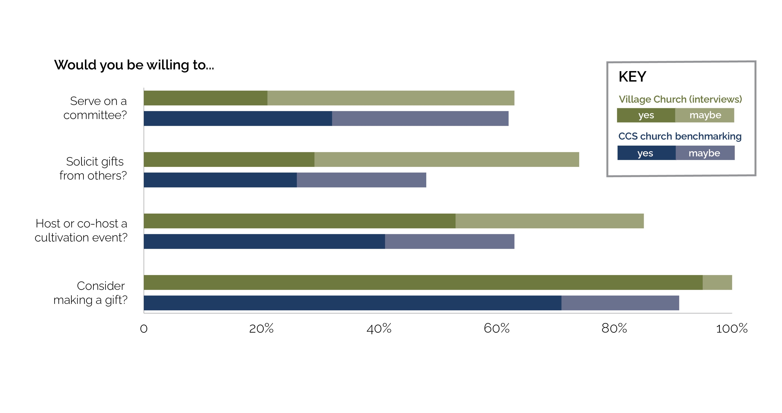
IS THE CONGREGATION READY TO ENGAGE?
Data from

Slide 19
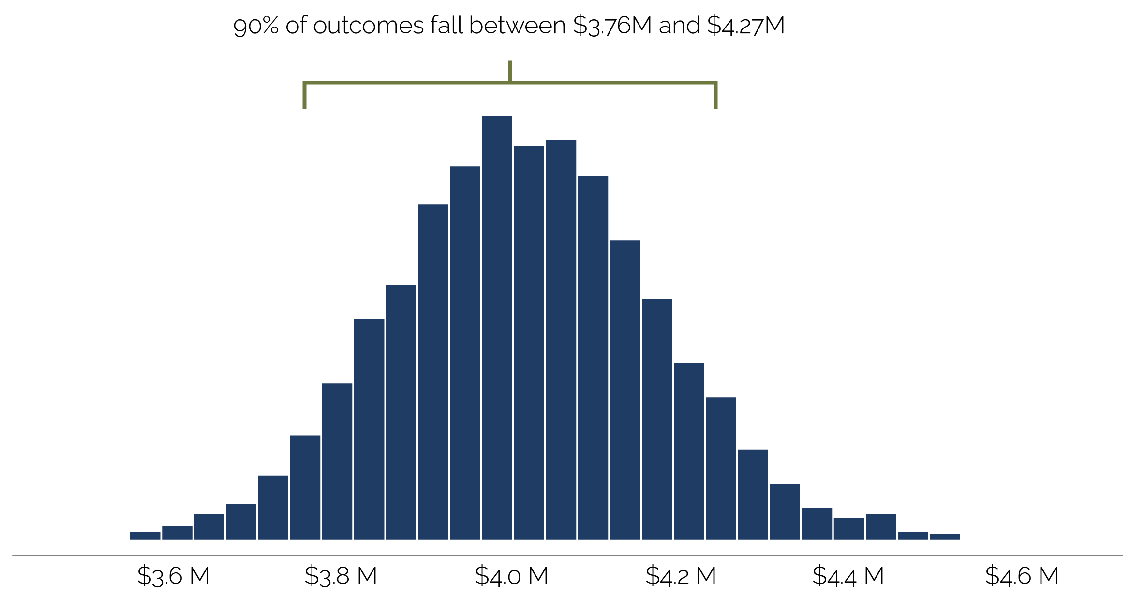

RECOMMENDED CAPITAL PROGRAM: $4M
Simulation results
Lowest | $3.5 million
Highest | $4.6 million
Average | $4.02 million
Median | 4.01 million
90% range | $3.76 million – $4.27 million
Data from

Slide 20
DRAFT CAMPAIGN DRIVERS
 | Heat pump / natural gas | Geothermal
HVAC system | $2,206,000 | $2,493,000
Children/youth prog/endowment | $750,000 | $472,000
Outreach (including Village Table and Weston) | $300,000 | $300,000
Property reserve | $400,000 | $400,000
Other lighting | $170,000 | $170,000
Campaign consultant | $190,000 | $190,000
Subtotal | $4,025,000 | $4,025,000
primary uses
secondary uses
Specific funding allocations will be a congregational decision

Slide 21
STREAM THREE
FINANCING THE FUTURE

Slide 22

TWO FINANCING PATHWAYS
Borrowing against endowments
(self-financing)
Waiting for capital campaign to fund

Slide 23
PROS AND CONS: SELF-FINANCING
PROS:
Able to start all efforts immediately
Protects against price increases for both technologies
We are primarily borrowing from ourselves
CONS:
Saddling the church with a loan and interest payments
We bear the risk if the capital campaign does not meet targets
We bear the risk if the federal and/or state rebates are not received
Are there better ways to spend our money than making interest payments?
Borrowing against endowments
(financing)

Slide 24
PROS AND CONS: FUNDRAISING
PROS:
No interest payments to be paid
Protects us against missed expectations on capital campaign
CONS:
Vulnerable to price changes with both technologies
Our current system may need major repairs with unplanned and emergency expenditures
More years of heating with oil
We will need to largely finance the outreach and endowments before rebates are received
Waiting for capital campaign to fund

Slide 25
CASE
STUDY

Slide 26
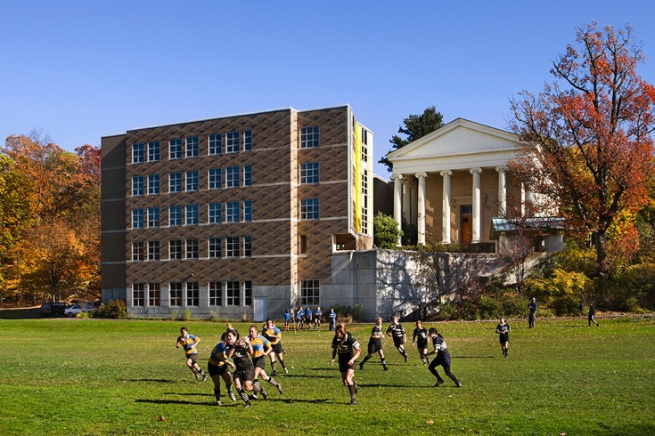
CASE STUDY: BARD COLLEGE
QUICK FACTS
Bard is in Annandale-on-Hudson, New York.
Bard is in the process of performing a geothermal conversion of three buildings that make up the Charles P. Stevenson, Jr., Library with parts dating back to 1893.
Approximately 40% of Bard College’s campus uses geothermal.
The library geothermal system will add $1 million to the construction costs and save $60,000 annually in oil costs.
The Charles P. Stevenson, Jr., Library at Bard College

Slide 27
DISCERNMENTS
FROM THE
CONGREGATION

Slide 28
DISCERNMENTS
Do we agree to support a $4 million capital campaign focused on HVAC, children and youth ministry, outreach, and property reserve?
What technology option should we select for addressing the church heating and cooling needs and enhancing energy efficiency?
Should we finance the Empowering the Future program or seek a cash-neutral (wait for capital campaign funds) position?

Slide 29
Blessing upon us all as we consider these important decisions

Slide 30
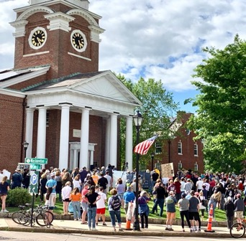

ACKNOWLEDGMENTS: LEADERSHIP
Mitch Coddington (Treasurer)
Julien Grant (Finance)
Tim Kelly (Finance)
Mark Lenci (Properties)
Emily Lordi (Finance)
Joe Morray (Moderator Team)
Kevin Nielsen (Finance)
Kathy Schleyer (Moderator Team and Chairperson)
Cynthia Sibold (Development)
Athene Sirivollop (Properties)
John Snyder (Finance)
Candace Sutcliff (Moderator Team)
Carolyn Wood (Development)
with support from

Slide 31
OUR MISSION STATEMENT
With open hearts and minds, Village Church
welcomes the curious, the seeker, and the sure at every stage of life.
Guided by the love of Jesus, our growing congregation shares in
inspiring worship, inclusive community, and intentional service.
We are continually transformed by following Jesus’ example that
in giving we receive, in feeding we are fed, and in loving, we are loved.
Our intergenerational ministries deepen our faith and compel our service.
We are called to pursue justice and joy for all people, and
we care passionately about God’s creation and the shared health of our world.
Energized by the Holy Spirit, we joyfully live into our future together.

Slide 32
Follow On Topics

Slide 33
Inflation Reduction Act (IRA) Vulnerability
Discussion with Capin Crouse, our tax advisors
Are we exempt from the prevailing wage and apprenticeship requirements for the 30% credit? He is 99% sure we would be exempt, given the (smaller) size of our project. GreenerU is in the best position to confirm (which they have) that our project is under 1MW (or BTU equivalent).
Risk of the federal credits being rescinded in a Republican White House? He said “it’s not zero”, but a low risk given the approvals that would be needed from both Congress and Senate. If it was a very high priority for the Trump administration, it could be possible.
There is still very little experience thus far with non-profits building geothermal, filing a tax return and then receiving the 30% or 10% ”credits”. However, the ability for individuals or corporations to apply for and receive ITC or PTC credits has been tax law for some time. Importantly, they are expecting additional guidance on the IRA from the IRS in October or November.
To avoid a delay of up to 12-18 months to receive the payments from the IRS (in the event the project is not in service until 2026), he suggested we may want to add language in our contract with GreenerU as to the importance of the system being “placed in service” prior to 12/31/25.

Slide 34
New England Geothermal Projects
Type | Owner | Location
House of Worship | Faith Community Bible Church | Louden, NH
House of Worship | First Parish | Concord, MA
House of Worship | St. Michael's Lutheran Church | Akron, NY
House of Worship | St. Patrick's Cathedral | New York, NY
Municipal | Cambridge Fire Department Headquarters | Cambridge, MA
Municipal | Bedford Public Library | Bedford, NH
Networked Geo | National Grid | Framingham, MA
Networked Geo | National Grid | Lowell, MA
Networked Geo | Boston Housing Authority | Boston, MA
Private Higher Education | Smith College | Northampton, MA
Private Higher Education | Mount Holyoke College | South Hadley, MA
Private Higher Education | Amherst College | Amherst, MA
Private Higher Education | Boston University, Computing and Data Science building (Jenga building) | Boston, MA
Private K12 | Middlesex School | Concord, MA
Private K12 | Philips Academy, Exeter | Exeter, NH
Private K12 | Fessenden School | West Newton, MA
Public K12 | Belmont Middle/High School | Belmont, MA
Public K12 | New Driscoll School | Brookline, MA
Public K12 | Wellington ES | Belmont, MA
Public K12 | Auburn MA | Auburn, MA
Public K12 | Winthrop HS | Winthrop, MA
Public K12 | Plymouth South HS | Plymouth, MA

Slide 35
New England Geothermal Projects
Public K12 | Nelson Place ES | Worcester, MA
Public K12 | Memorial HS | Billerica, MA
Public K12 | Hastings ES | Lexington, MA
Public K12 | Balmer ES | Northbridge, MA
Public K12 | Bristol County Agricultural HS
Public K12 | Fales ES | Westborough, MA
Public K12 | Douglas ES | Acton, MA
Public K12 | Mindess ES | Ashland, MA
Public K12 | Hanlon ES | Westwood, MA
Public K12 | Crocker ES | Fitchburg, MA
Public K12 | Hadley ES | Swampscott, MA
Public K12 | Stonehame HS | Stoneham, MA
Public K12 | Foster ES | Hingham, MA

Slide 36
GEOTHERMAL BORING PROCESS
How to Drill for Geothermal Energy | This Old House (youtube.com)

Slide 37
REFLECTIONS FROM THE CONGREGATION
Data from

Slide 38
Further Discussions

